Slide 1

Substance Use Prevention:
Progress and Key Opportunities Moving Forward
Christopher M. Jones, PharmD, DrPH, MPH
CAPT, US Public Health Service
Director, Center for Substance Abuse Prevention
Substance Abuse and Mental Health Services Administration
U.S. Department of Health and Human Services
Notes:
1

Slide 2
Data, Data, Data

Slide 3
Historically High Overdose Deaths in the U.S., 1968-2023P
Estimated more than 105,000 overdose deaths in 2023
Source: CDC

Slide 4
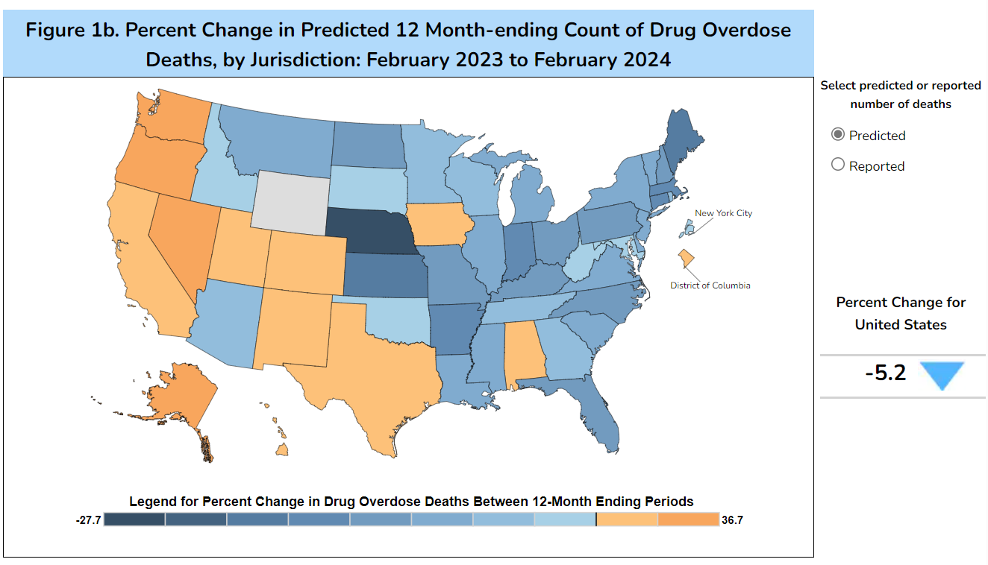
Latest Provisional Data
Products - Vital Statistics Rapid Release - Provisional Drug Overdose Data (cdc.gov)

Slide 5
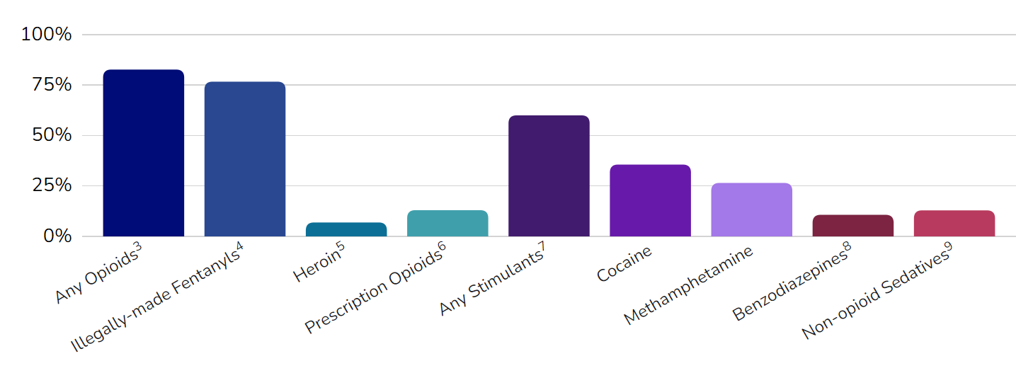
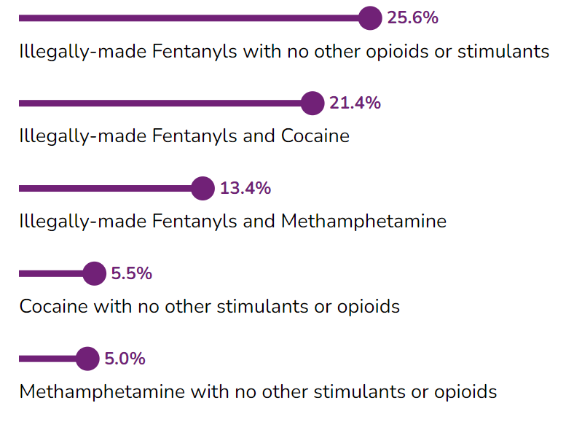
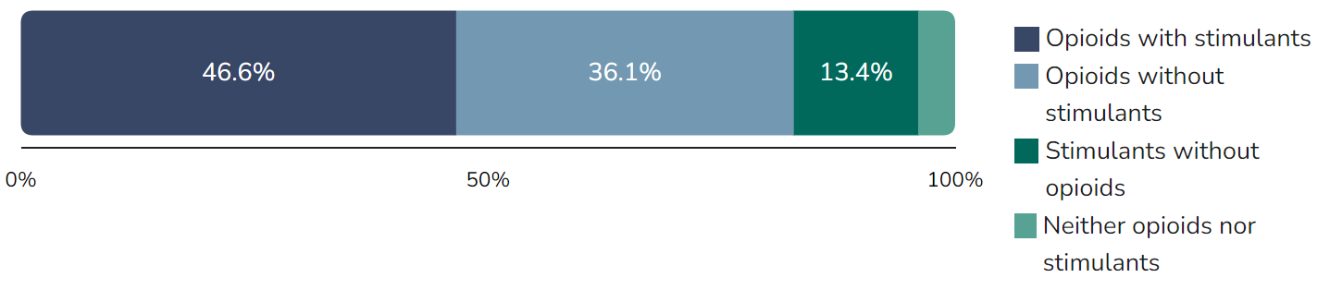
Deaths Driven by Illicit Synthetic Opioids and Stimulants
SUDORS Dashboard: Fatal Overdose Data | Drug Overdose | CDC Injury Center

Slide 6

Changing Epidemiology of Overdose
Source: CDC NCHS. NVSS/WONDER, 2024.

Slide 7
Disparities in Overdose Deaths Among Youth and Young Adults by Race/Ethnicity, 12-24 Year Olds, U.S.

Slide 8
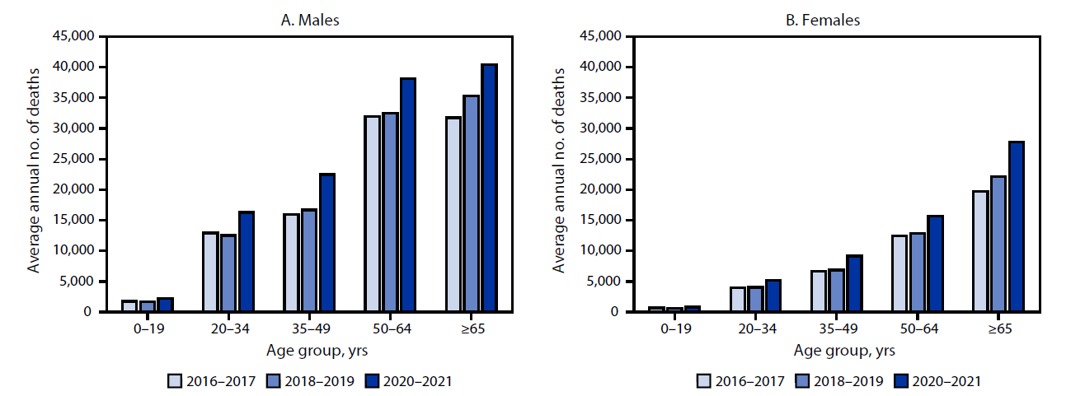
Approximately 29% Increase in Deaths From Excessive Alcohol Use from 2016–2017 to 2020–2021
  Increased 5% from 138,000 deaths per year during 2016–2017 to 145,000 during 2018–2019 and then increased 23% more to 178,000 deaths during 2020–2021
Esser et al. (2024) MMWR

Slide 9
Alcohol-Related Deaths Among People Younger than 21
  More than 4,000 people younger than 21 die from excessive alcohol use each year,* including from:
    Underage drinking
    Drinking by adults of legal drinking age (e.g., passenger in an alcohol-involved motor vehicle crash)
  Leading causes of these alcohol-attributable deaths among young people:
    Motor vehicle traffic crashes
    Homicide
    Suicide
    Other poisonings involving alcohol (e.g., drug overdoses)
    *During 2020–2021
www.cdc.gov/ardi

Slide 10
Alcohol, Nicotine, and Cannabis Remain Most Commonly Used Substances by Youth & Young Adults
Data Source: Substance Abuse and Mental Health Services Administration. (2023). Key substance use and mental health indicators in the United States: Results from the 2022 National Survey on Drug Use and Health (HHS Publication No. PEP23-07-01-006, NSDUH Series H-58). Center for Behavioral Health Statistics and Quality, Substance Abuse and Mental Health Services Administration. https://www.samhsa.gov/data/report/2022-nsduh-annual-national-report

Slide 11
Youth Substance Use Doesn’t Happen in a Vacuum
Source: SAMHSA NSDUH, 2023 and CDC YRBS, 2023

Slide 12
As With Overdose, Disparities in Youth Substance Use Also Exist
CDC YRBS, 2023

Slide 13
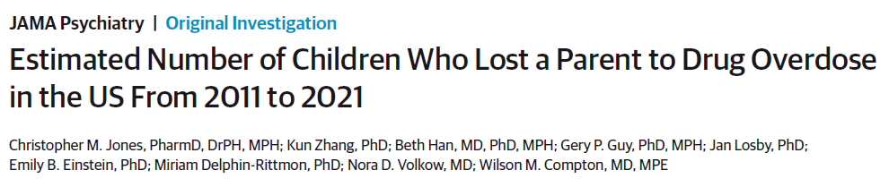
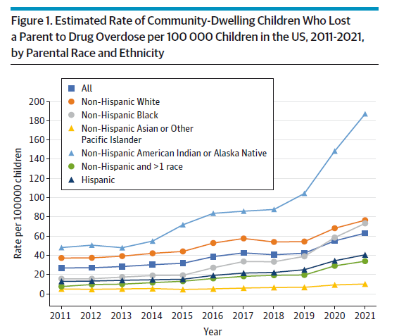
Prevention Has Never Been More Important
Multi-generational impacts of the overdose crisis
Connected to economic and other stressors in homes and communities
If not addressed, we will continuously be playing catch up rather than getting ahead of the crisis
More than 320,000 kids lost a parent to a drug overdose between 2011 -2021

Slide 14
Comprehensive Prevention Approach for Substance Use & Overdose

Slide 15


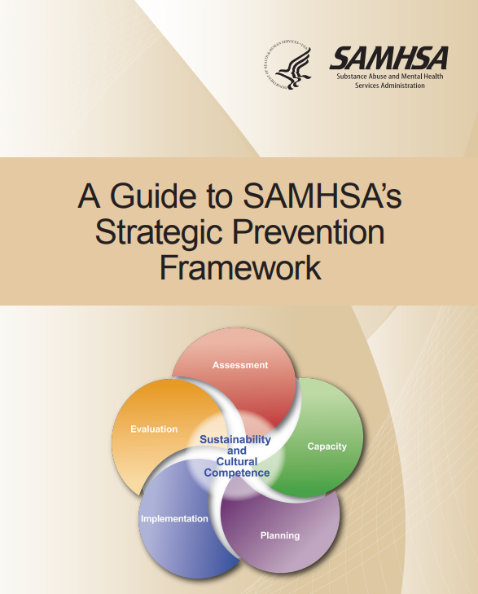
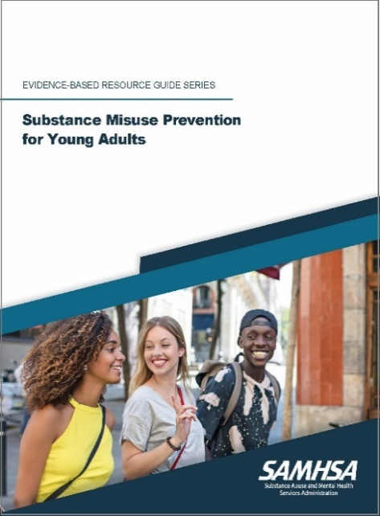
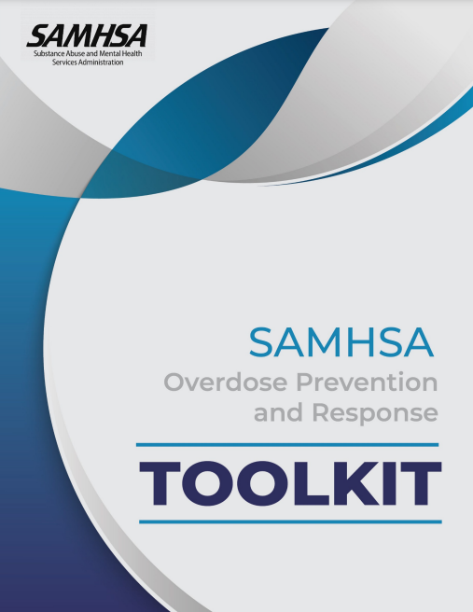
The Future We Envision
CSAP’s Vision
  A future where individuals, families, and communities are healthy and thriving
CSAP’s Mission
  Provides leadership and collaborates across sectors to advance prevention across the lifespan.
  We aim to:
    Prevent substance use initiation
    Prevent progression of substance use
    Prevent and reduce harms associated with substance use
Strategic Priorities
  Analyzing and Disseminating Information on the Latest Data, Trends, and What Works in Prevention
  Building Prevention Capacity at the National, State, Tribal, Territorial, and Local Levels
  Advancing Prevention through Strategic Collaborations and Partnerships
  Raising Awareness and Catalyzing Prevention Action
CSAP Guiding Principles
Data-Driven
Innovative
Community Informed
Grounded in Cultural Humility
Focused on Health Equity
Inclusive of Social Determinants of Health

Slide 16
Substance Use Among Youth – Setting the Stage
Youth substance use rates heading in right direction
Yet, overdose deaths among young people remain high – driven by proliferation of fake pills and toxic illicit drug market
  1 in 12 deaths, 12-17 year-olds
  1 in 5 deaths, 18-24 year-olds
Need a comprehensive approach to address range of risk and protective factors long-term while also addressing acute issues of increasing overdose risk and harms
Alcohol – down 44% since 2004; down 16% since 2019
Any illicit drug – down 26% since 2004; down 27% since 2019
Cannabis – down 24% since 2004; down 29% since 2019
Any illicit drug other than cannabis – down 59% since 2004; down 38% since 2019

Slide 17
Prevention Needs to Start Early
Nicotine = tobacco products or vaping nicotine products
SOURCES: 2023 NSDUH

Slide 18
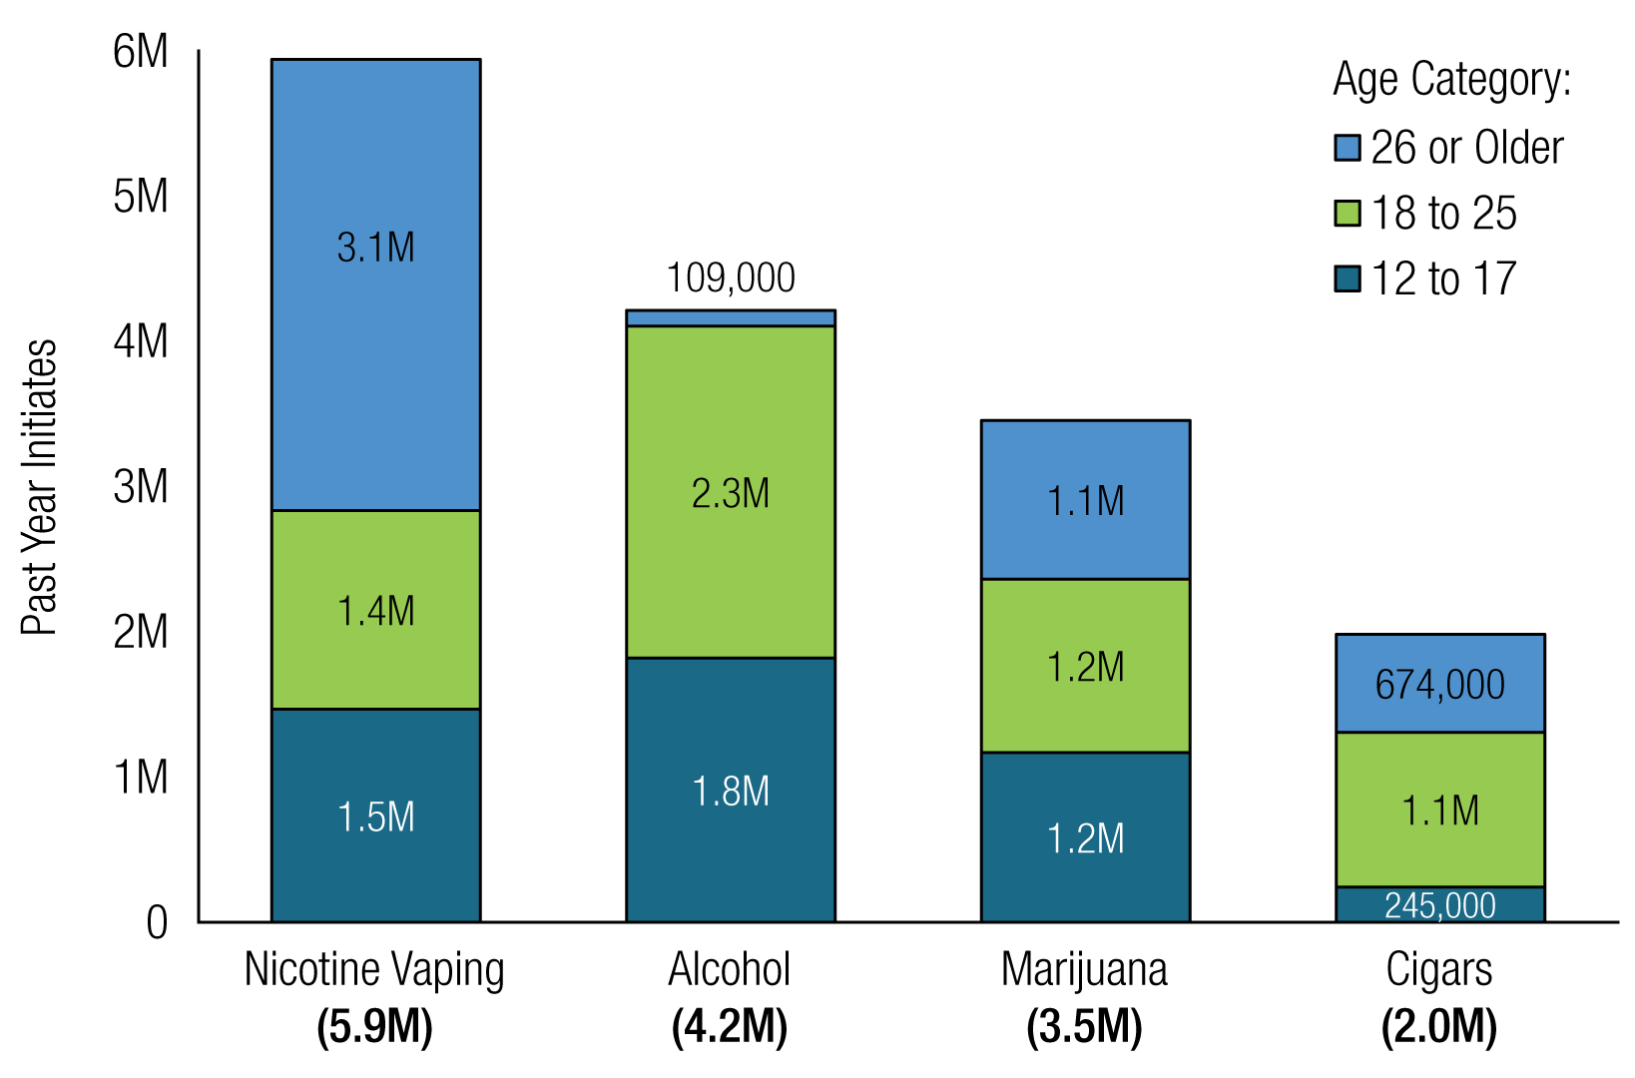
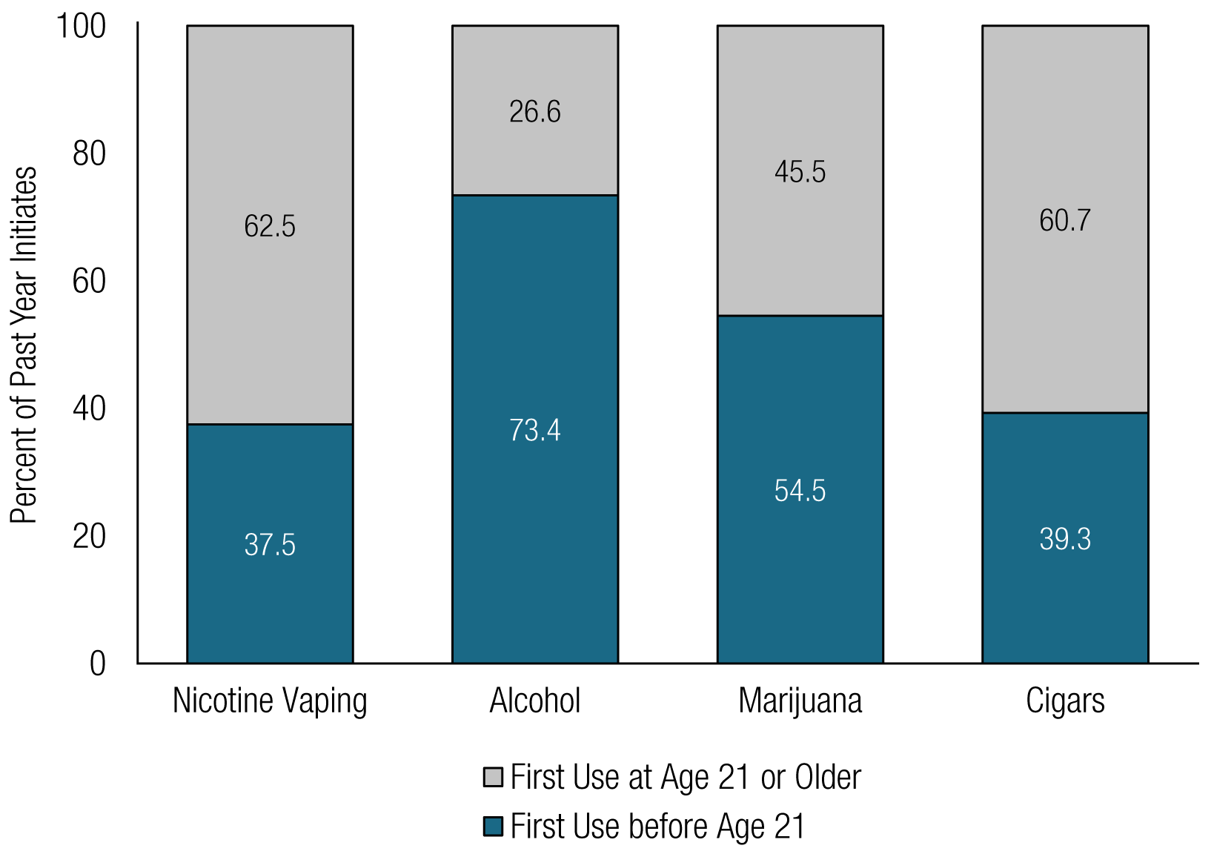
Prevention Opportunities Across the Lifespan
Initiation Age
Initiated Before 21 or 21 or Older
SOURCE: 2023 NSDUH

Slide 19
Many People Who Use Substances Do Not Have SUD But Still At Risk for Harms and Progression to SUD - Alcohol Use, 2023
Alcohol Use Patterns Among Those Reporting Past Year Alcohol Use in 2023
78%
35%
16%
9%
SOURCE: 2023 NSDUH
Note: Binge Alcohol Use is defined as drinking five or more drinks (for males) or four or more drinks (for females) on the same occasion on at least 1 day in the past 30 days. Heavy Alcohol Use is defined as binge drinking on the same occasion on 5 or more days in the past 30 days; all heavy alcohol users are also binge alcohol users.

Slide 20
Many People Who Use Substances Do Not Have SUD But Still At Risk for Harms and Progression to SUD
Data from 2022 NSDUH Public Use File. Jones CM Analysis 8.3.24

Slide 21
Many People Who Use Substances Do Not Have SUD But Still At Risk for Harms – Past Year Injection Drug Use
Rx Benzodiazepines | 367,711
Rx Stimulants | 201,911
Rx Opioids | 393,326
Hallucinogens | 331,849
Cocaine | 419,883
Methamphetamine | 635,319
Illicit Opioids | 549,980
Data from 2022 NSDUH Public Use File. Jones CM Analysis 8.3.24

Slide 22
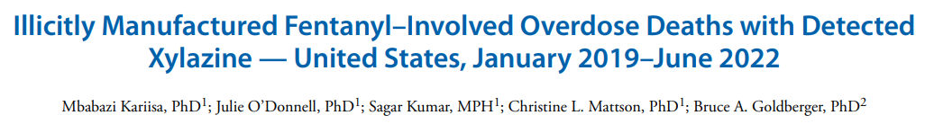
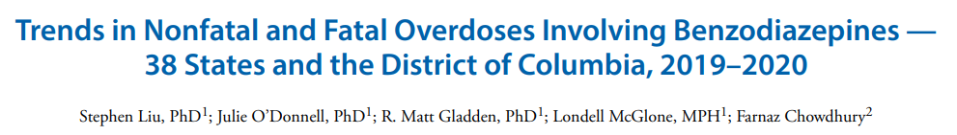
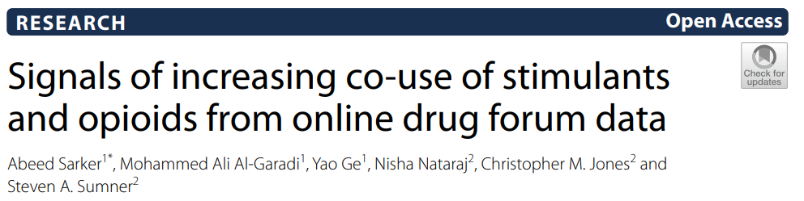
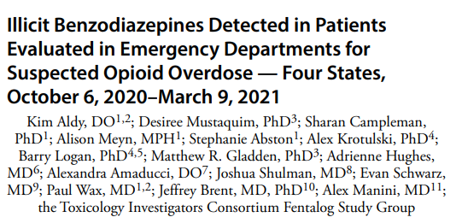
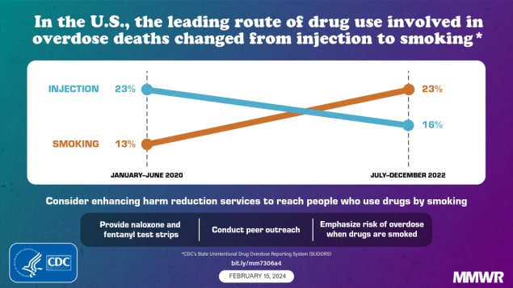
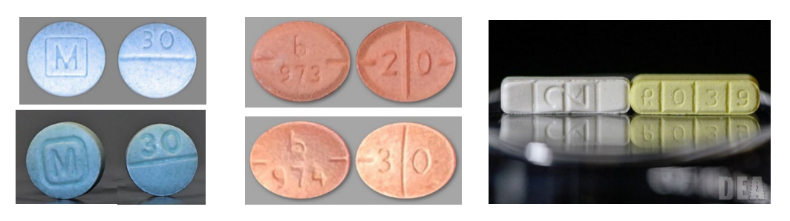
Illicit Drug Supply Has Never Been Riskier and Patterns of Use Are Changing
Notes:
Chris

Slide 23
Opportunities to Increase Youth Exposure to Prevention Programming, Messages and Select Protective Factors
*Statistically Significant Difference Between 2022 and 2023
SOURCES: 2023 NSDUH

Slide 24
Prevention Opportunities – Acute Overdose Response
SOURCES: CDC SUODRS

Slide 25
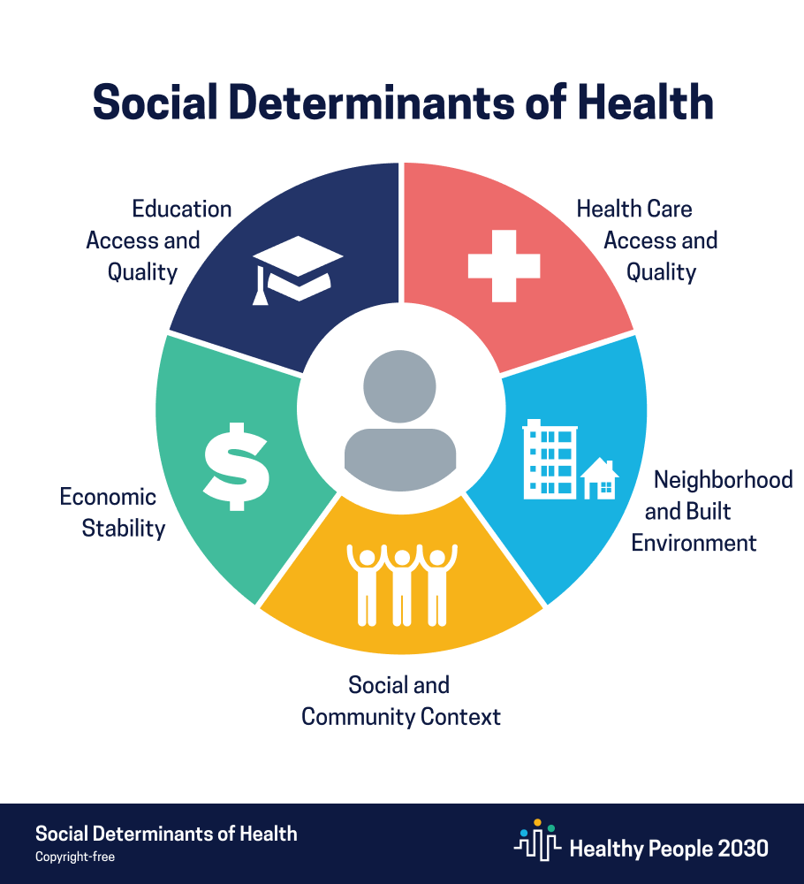
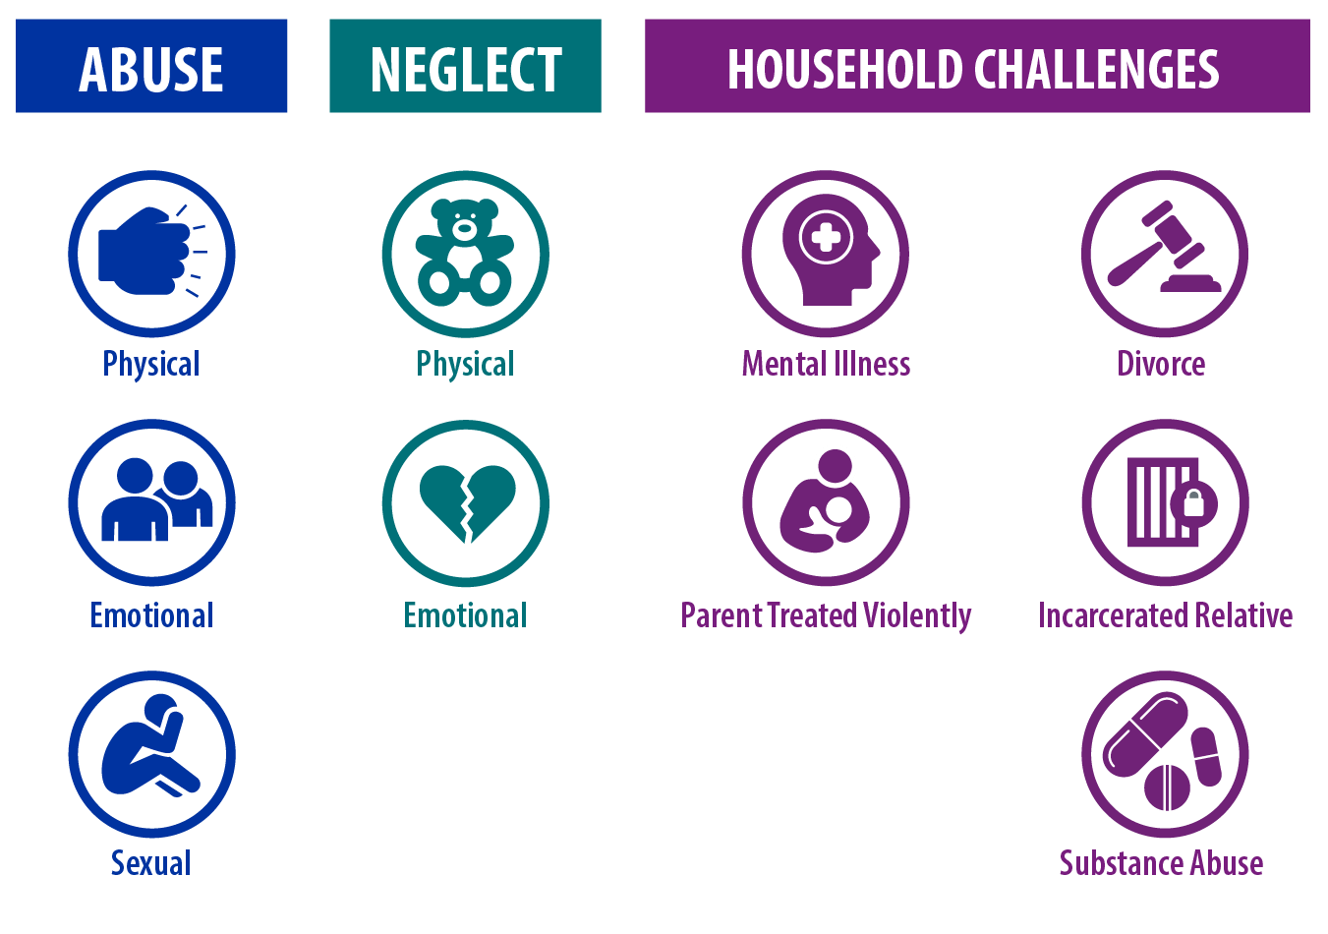


Moving Upstream to Get Ahead of Substance Use Challenges
Adverse Childhood Experiences
ACEs not included in the traditional measure:
Bullying
Teen dating violence
Peer to peer violence
61%
Violence in community or school
Experiencing homelessness
Death of a parent
adults report experiencing
at least 1 ACE
1 in 6 adults report experiencing 4+ ACEs
Notes:
Chris

Slide 26
ACEs and Risk for Substance Use
Number of Categories of ACEs
Research shows ACEs increase risk for:
        Rx opioid misuse, illicit opioid use, opioid use disorder, opioid injection
        Cocaine and amphetamine use and use disorder
        Earlier age of initiation of substances
Source: Felitti, Vincent J., et al. American journal of preventive medicine 14.4 (1998): 245-258.
Notes:
Chris

Slide 27
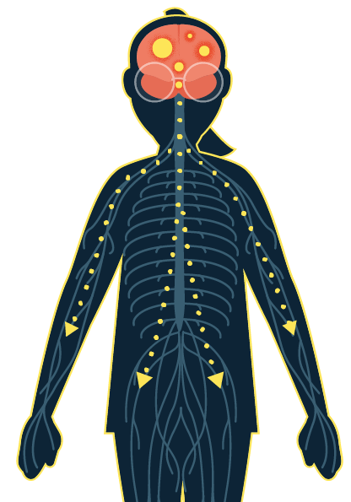
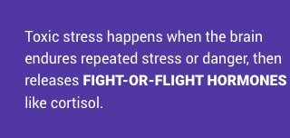
ACEs Manifest Their Effects Via Toxic Stress
The effects of ACEs can add up over time and affect a person throughout their life.
Children who repeatedly and chronically experience adversity can suffer from TOXIC STRESS.
Toxic Stress Has Impacts On:
Responses to stress
Reward circuits
Emotion processing
Coping strategies
Executive function
Decision making
Cognition
Organ function
Source: De Bellis & Zisk. The biological effects of childhood trauma. 2014

Slide 28
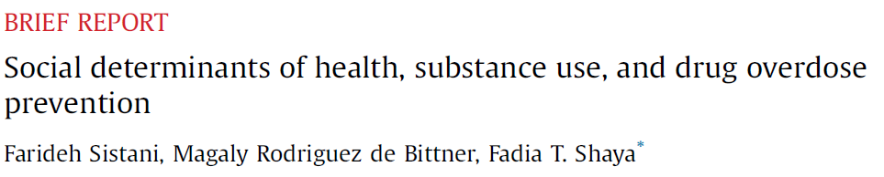
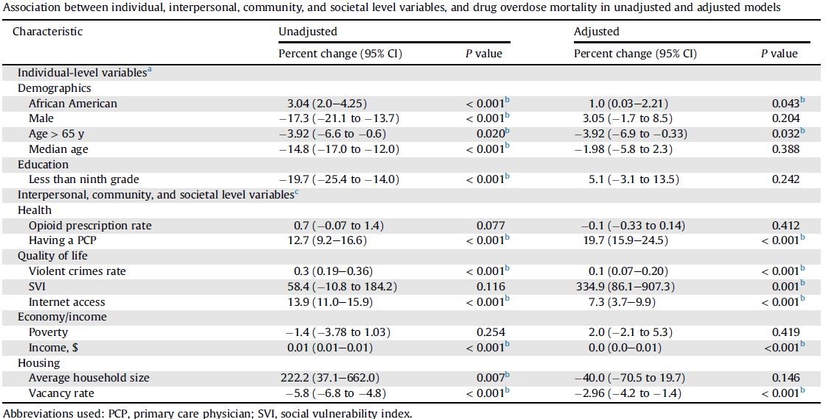
Social Determinants of Health and Substance Use
SDOHs have been directly associated with an increased risk of substance use and others are associated with increased rates of stress and anxiety, which can increase the likelihood of substance use
Greater community-level social vulnerability, violent crime, per capita income, access to health care, and access to the Internet were all associated with increased risk for drug overdose
Having a lower housing vacancy rate was associated with lower risk for drug overdose

Slide 29
Social Determinants of Health and Substance Use
Green et al. Predictors of substance use initiation by early adolescence. Am J Psychiatry, 2024
Analysis of nearly 7,000 substance-naive youth ages 9-10 years from the NIH ABCD Study, who were followed for 3 years. Among 420 different variables, including demographic characteristics, self and peer involvement with substance use, parenting behaviors, mental and general medical health, culture and environment, hormones, neurocognitive functioning, and structural neuroimaging, the strongest predictors of substance use initiation were sociodemographic, cultural, and environmental characteristics, including race and income.
Assari et al. The link between residential stability and youth substance use: role of stressful life events and behavioral problems. J Med Surg Public Health, 2024.
Analysis of NIH ABCD Study data. Found that residential stability was higher among families with higher incomes, married households, and people residing in high-income neighborhoods. However, residential stability was inversely associated with risk for substance use and behavioral problems among the study’s children, suggesting that residential stability may be a cornerstone of children’s healthy development.
Altekruse et al. Socioeconomic risk factors for fatal opioid overdoses in the United States: findings from the Mortality Disparities in American Communities Study (MDAC). PloS One, 2020.
Risk of dying from an opioid-involved overdose was higher among unemployed compared with employed individuals (HR=2.46), those with only a high school education compared with adults with graduate degrees (HR=2.48), those who rented their homes compared with those who owned homes with mortgages (HR=1.36), people without health insurance (HR=1.30), people who were incarcerated (HR=2.70), and people living in poverty compared with those living in households at least five times above the poverty line (HR=1.36).

Slide 30
Substance Use Risk Factors – Socio-ecological Model
Individual
Relationship
Community
Societal
Genetic factors
Initiating substance use early
Low risk perception of use
Peers who use substances
Perception of substance use among peers is high
Early emotional distress or aggressiveness
Mental health challenges
ACEs/Trauma
Substance use in the family and home
Parental mental health challenges
Family conflict, abuse, or neglect, other ACEs
Parents who favorably view or approve of substance use
Lack of family connectedness
Lack of community connectedness and supports
Community norms favorable toward alcohol and drugs
Violence in schools or community
Availability of, access to, and costs of drugs and alcohol
Lack of access to health and behavioral health services
Poverty
Lack of economic and educational opportunities
Inadequate housing
Disinvestment
Discrimination
Social norms
Laws and policy environment
BUILDING INDIVIDUAL AND COMMUNITY RESILIENCE
Focuses on promoting positive situational, social, and individual characteristics
1) Healthy development of social & emotional competencies; 2) Presence of positive relationships; 3) Safe, protective, & equitable environments

Slide 31
Example Prevention Strategies to Address Risk and Protective Factors Across the Social Ecology

Slide 32
Individual-Level Strategies
Risk Factors
Genetic factors
Initiating substance use early
Low risk perception of use
Peers who use substances
Perception that use of substances among peers is high
Early and persistent problem behavior
Mental health challenges
Prevention Strategies
Life-skills development
Problem solving skills
Conflict resolution
Strengthening resiliency
Empowerment opportunities
Exposing youth to positive adult role models
Raising awareness about risks associated with substance use and overdose prevention and response
Treatment for health and behavioral health conditions

Slide 33
Relationship-Level Strategies
Risk Factors
Substance use in family or home
Parental mental health challenges
Family conflict, abuse, or neglect
Parents who favorably view or approve of substance use
Lack of family connectedness
Prevention Strategies
Healthy relationship skills programs
Creating opportunities for positive social involvement with family
Positive parenting skills programs
Strengthening parent-child relationship and communication
Addressing household challenges that contribute to stress and other risk factors
Treatment for parental/caregiver substance use, mental health challenges

Slide 34
School and Community-Level Strategies
Risk Factors
Lack of school, community connectedness and supports
Community norms favorable towards alcohol and drugs
Violence in schools or community
Availability and costs of drugs and alcohol
Lack of commitment to school
Poverty
Prevention Strategies
Creating opportunities for positive social involvement with school and community
Positive and supportive school environments and policies
Student assistance programs
Raising awareness at the community level about substance use and impacts on communities
Drug checking and awareness about illicit drug supply
Promoting help-seeking
Combatting stigma
Built environment
Access to health and behavioral healthcare
Access to overdose reversal interventions

Slide 35
Society-Level Strategies
Risk Factors
Lack of economic and educational opportunities
Inadequate housing
Disinvestment
Discrimination
High rates of transition or instability
Prevention Strategies
Strengthening economic supports for individuals and families
Improving access to education, including early childcare to ensure a strong start for kids
Housing and food security policies and programs
Environmental strategies related to access and availability of substances
Societal norms around substance use

Slide 36
CSAP Prevention Programs, Technical Assistance, & Resources

Slide 37
SAMHSA’s Prevention Grant Programs
State formula funding for Prevention
Substance Use Prevention, Treatment, and Recovery Services (SUPTRS) Block Grant.
Synar Program (youth tobacco use prevention)
Opioid Prevention discretionary programs
Strategic Prevention Framework for Prescription Drugs (SPF-Rx)
Grants to Prevent Prescription Drug/Opioid Overdose Related Deaths
First Responders (FR-CARA)
Improving Access to Overdose Treatment (OD-Tx)
State & community discretionary primary prevention programs
Strategic Prevention Framework – Partnerships for Success (PFS)
STOP Act Program (Sober Truth on Preventing Underage Drinking)
Minority Aids Initiative (MIA) Programs
HIV Prevention Navigator Program
Braided MAI Prevention & Treatment program
Syndemic Approach to Preventing HIV & Substance Use
Tribal discretionary funding
Tribal Behavioral Health (Native Connections)
Harm Reduction Grant Program

Slide 38
SAMHSA’s Prevention Technical Assistance Capacity
Prevention Technology Transfer Centers: Provides accessible technical assistance to the prevention field; coordinates with the ATTCs
Strategic Prevention Technical Assistance Center: Provides direct technical assistance to CSAP grantees (SUPTRS BG, PFS, STOP Act, SPF Rx, FR CARA, PDO, ODTA)
Tribal Technical Assistance Center: Provides TA to tribal entities
Native Connections Technical Assistance Center: Provides TA to Native Connections Grantees

Slide 39
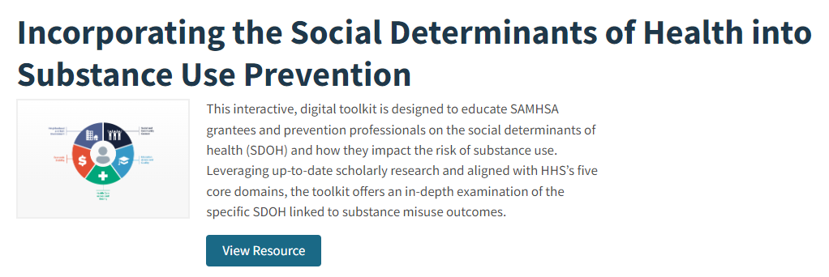
Incorporating SDOH into Substance Use Prevention Digital Toolkit
Digital Toolkit to help grantees and prevention professionals understand SDOH and how they impact substance use risk
In-depth information by type of SDOH and its impact on substance use and overdose

Slide 40

SAMHSA Overdose Prevention and Response Toolkit
Updated to reflect latest overdose trends
Practical tips for preventing, recognizing, and responding to an overdose
Information on available opioid overdose reversal medications (OORM)
Information for specific audiences
  People who use drugs
  People who take prescription opioids
  Practitioners and health systems
  First Responders
  Policy and systems considerations
Overdose Prevention and Response Toolkit (Spanish Version) | SAMHSA Publications and Digital Products

Slide 41
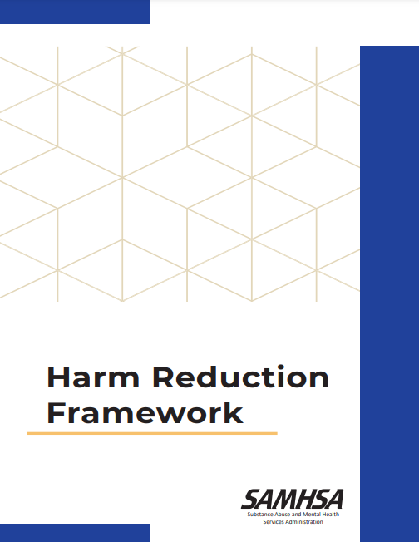
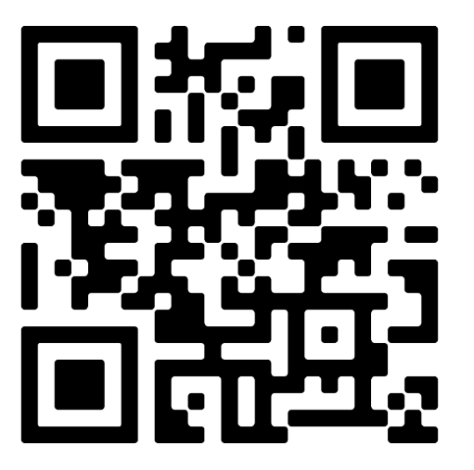
Harm Reduction Framework
First document to comprehensively outline harm reduction and its role within HHS
Provides a roadmap of best practices, principles, and pillars that anyone can apply to their work.
Will inform SAMHSA’s harm reduction activities moving forward, as well as related policies, programs, and practices

Slide 42




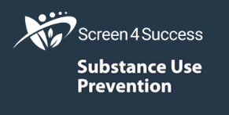
Empowerment and Engagement
Collaborations and Resources
Voices of Youth: FY2024 Strategic Partnerships
  Communities Talk to Prevent Alcohol and Other Drug Use
  Community Anti-Drug Coalitions of America (CADCA)
  HOSA – Future Health Professionals
  4-H – Positive Youth Development, Mentorship, and Education
  FentAlert Challenge
  SAMHSA’s Youth Summit, Fall 2024
  State Prevention Policy Academy
https://www.samhsa.gov/prevention-week/voices-of-youth

Slide 43
A Comprehensive Path Forward to Meet the Moment
PREVENTION…
  Supports healthy social & emotional development
  Strengthens problem solving, conflict, & relationship skills
  Supports parents, caregivers, & strengthens families
  Increases exposure to positive role models & youth empowerment opportunities
  Expands evidence-based strategies across settings and risk populations
  Prevents & addresses ACES & trauma
  Addresses structural & social determinants of health
  Meets individuals and communities where they are
  Embraces the lived & living experiences and voices of communities
  Improves the safety, stability, & livability of community environments
  …SO INDIVDIUALS, FAMILIES & COMMUNITIES ARE HEALTHY AND THRIVING

Slide 44



Thank You!
SAMHSA’s mission is to lead public health and service delivery efforts that promote mental health, prevent substance misuse, and provide treatments and supports to foster recovery while ensuring equitable access and better outcomes.
Grant Opportunities
www.samhsa.gov/grants
www.grants.gov/web/grants
988 Suicide and Crisis Lifeline Toolkit
www.samhsa.gov/find-help/988/partner-toolkit
@samhsagov @samhsa_leader
/samhsa
/samhsa

