Slide 1
Building a Supportive Environment: Strategies for Preventing Substance Misuse in Older Adults August 15, 2024 Chuck Klevgaard Prevention Manager Great Lakes PTTC
Patricia Zuber-Wilson
Associate Commissioner for Prevention
Division of Prevention at the New York State Office of Addiction Services and Supports (OASAS)
Notes:
There is growing concern among prevention specialists and public health officials regarding older adults and substance use, misuse, and increasing substance use disorders. Substance use in older adults is complicated and is often overlooked, especially when individuals are experiencing other ageing related health conditions. While the number of older adults experiencing substance misuse disorders dramatically increased in the last 20 years, prevention services have not been tailored to the needs of older adults. This webinar will highlight the growing problem, approaches to understanding the older adult population in your community, and available strategies. Additionally, we will hear directly from preventionists who are implementing programming with this population.
LEARNING OBJECTIVES:
Discuss way identify and assess the prevention needs of older adults in your community.
Identify strategies for prevention of substance misuse and promoting the health and well-being of seniors.
Understand approaches and barriers to engaging older adults in prevention efforts.
Develop new partnerships that can work across sectors to engage older adults.

Slide 2
Objectives
Participants in this webinar will be able to:
Identify strategies to prevent substance misuse and promote the health and well-being of older adults.
Understand approaches, facilitators, and barriers to engaging older adults in prevention efforts.
Develop new partnerships that can work across sectors to engage older adults.

Slide 3
Demographic Shifts
America is Growing Older
Americans 65 and Older
In Millions
58M
0
1
2
3
4
5
6
7
8
0
1
2
3
4
5
6
7
0M
2022
2050
Notes:
Fact Sheet: Aging in the United States | PRB https://www.prb.org/resources/fact-sheet-aging-in-the-united-states/
The current growth of the population ages 65 and older, driven by the large baby boom generation—those born between 1946 and 1964—is unprecedented in U.S. history.
This aging of the U.S. population has brought both challenges and opportunities to the economy, infrastructure, and institutions.
Today, there are 45 percent more children under age 18 than there are people 65 and older; well before 2050, adults 65 and over will outnumber children. And there will be two-and-a-half times as many people 85 or older as there are today.

Slide 4
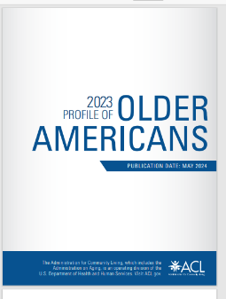
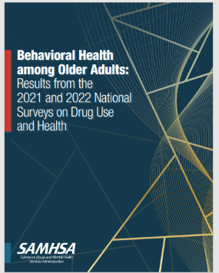
0
1
2
3
4
5
6
7
8
Demographic Shifts
America is Growing Older
0
1
2
3
4
5
6
7
0M
Americans 65 and Older
In Millions
58M
https://acl.gov/news-and-events/announcements
2022
2050
Store.samhsa.gov Search older adults
Substance use disorders (SUDs) among older persons are among the fastest-growing health problems in the United States.
Notes:
Fact Sheet: Aging in the United States | PRB https://www.prb.org/resources/fact-sheet-aging-in-the-united-states/
The current growth of the population ages 65 and older, driven by the large baby boom generation—those born between 1946 and 1964—is unprecedented in U.S. history.
This aging of the U.S. population has brought both challenges and opportunities to the economy, infrastructure, and institutions.
The number of Americans ages 65 and older is projected to increase from 58 million in 2022 to 82 million by 2050 (a 47% increase), and the 65-and-older age group’s share of the total population is projected to rise from 17% to 23%.¹
The U.S population is older today than it has ever been. Between 1980 and 2022, the median age of the population increased from 30.0 to 38.9, but one-third (17) of states in the country had a median age above 40 in 2022, with Maine (44.8) and New Hampshire (43.3) at the top of the list.²
The older population is becoming more racially and ethnically diverse. Between 2022 and 2050 the share of the older population that identifies as non-Hispanic white is projected to drop from 75% to 60%.³
The rising diversity among older Americans can’t match the rapidly changing racial/ethnic composition of those under age 18, creating a diversity gap between generations. In 2022, fewer than half of children ages 0 to 17 (49%) were non-Hispanic white.⁴ But research shows that there is fluidity in how people identify with racial/ethnic categories: Mixed-race Americans (particularly mixed Hispanic and white) increasingly see themselves as part of the white majority.⁵
More older adults are divorced compared with previous generations. The share of divorced women ages 65 and older increased from 3% in 1980 to 15% in 2023, and for men from 4% to 12% during the same period.¹⁵
More older women are living alone. Over one-fourth (27%) of women ages 65 to 74 lived alone in 2023. This share jumped to 39% among women ages 75 to 84, and to 50% among women ages 85 and older.¹⁶
Older Americans face a caregiving gap, especially those with lower incomes and dementia.¹⁷ Demand for elder care is expected to increase sharply with a rise in the number of Americans living with Alzheimer’s disease, which could more than double by 2050 to 13 million, from 6 million today.¹⁸
ACL Releases 2023 Profile of Older Americans | ACL Administration for Community Living ACL Releases 2023 Profile of Older Americans | ACL Administration for Community Living
Content slide with PTTC logo. Please include the logo on as many pages as possible.

Slide 5
Alcohol Use Percentage Using in the Last Month
Binge Alcohol Use
Heavy Alcohol Use
3.2%
12.8%
Total
3.2%
10.5%
Female
4.4%
15.5%
Male
SAMHSA (2024). Behavioral health among older adults: Results from the 2021 and 2022 National Surveys on Drug Use and Health (Publication No. PEP24-07-018). CBHSQ. https://www.samhsa.gov/data/report/older-adult-behavioral-health-report-2021-2022
Notes:
There were 10.0 million older adults (12.8%) who engaged in binge drinking in the past month, including 2.5 million (3.2%) who engaged in heavy drinking.
Older adult males were more likely than older adult females to have engaged in binge drinking in the past month
More than 1 in 7 older adult males engaged in binge drinking, compared with about 1 in 10 older adult females.
Older adult males were twice as likely as older adult females to have engaged in heavy drinking in the past month

Slide 6
Illicit Drug Use Percentage Using in the Last Year
10.0%
Females
12.1%
14.6%
Any Illicit
Males
Females
7.5%
9.9%
12.5%
Marijuana
Males
2.2%
Females
2.3%
Opioid Misuse
2.5%
Males
SAMHSA (2024). Behavioral health among older adults: Results from the 2021 and 2022 National Surveys on Drug Use and Health (Publication No. PEP24-07-018). CBHSQ. https://www.samhsa.gov/data/report/older-adult-behavioral-health-report-2021-2022
Notes:
There were 9.5 million older adults who used illicit drugs in the past year, including 7.7 million who used marijuana (9.9%) and 1.8 million who misused opioids (2.3%).
Older adult males were more likely than older adult females to have used illicit drugs in the past year
About 1 in 7 older adult males used illicit drugs, compared with about 1 in 10 older adult females.
Older adult males were more likely than older adult females to have used marijuana in the past year
About 1 in 8 older adult males used marijuana, compared with about 1 in 13 older adult females. About 1 in 45 older adults misused opioids in the past year. Similar percentages of older adult females and males misused opioids.

Slide 7
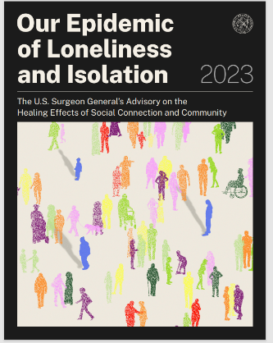
“Social connection— the structure, function, and quality of our relationships with others—is a critical and underappreciated contributor to individual and population health, community safety, resilience, and prosperity.
However, far too many Americans lack social connection in one or more ways, compromising these benefits and leading to poor health and other negative outcomes.”
Notes:
Extensive scientific findings from a variety of disciplines, including epidemiology, neuroscience, medicine, psychology, and sociology, converge on the same conclusion: social connection is a significant predictor of longevity and better physical, cognitive, and mental health, while social isolation and loneliness are significant predictors of premature death and poor health.10,20,32,124 In fact, the benefits of social connection extend beyond health-related outcomes. They influence an individual’s educational attainment, workplace satisfaction, economic prosperity, and overall feelings of well-being and life fulfillment. This chapter summarizes the rapidly growing body of evidence on the relationship between various indicators of social connection and these outcomes for individuals

Slide 8
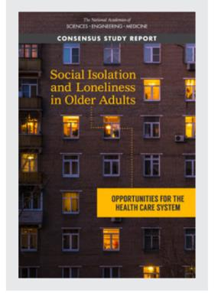
The risk of social disconnectedness on your health and wellbeing is comparable to other risk factors such as obesity, smoking, air pollution, and physical inactivity.
Loneliness is an important risk factor for substance use, and research shows that among those who use substances, feelings of loneliness are associated with both marijuana and alcohol use.
Holt-Lunstad, J. (2018). The potential public health relevance of social isolation and loneliness: Prevalence, epidemiology, and risk factors. Public Policy & Aging Report, 27(4), 127-130.
Notes:
What Is Loneliness?
Although most of us think of loneliness as an emotional state, it takes a physical toll on brains and bodies when lack of human contact becomes chronic. In fact, social isolation increases total risk of premature death by up to 50 percent.
Humans have an innate need to feel like they belong. Loneliness, then, is an emotional state typically defined by painful feelings associated with a sense of isolation and/or a lack of social contact or belonging.¹
Loneliness and social isolation, however, are two different things. The latter is simply a lack of human contact and interaction. Meanwhile, loneliness comprises feelings of pain or distress that are often associated with being isolated or alone. The point is that some people can be socially isolated and not feel lonely. Similarly, others can be surrounded by people and still feel utterly alone.²
Based on these definitions, a significant percentage of people in the U.S. are lonely. According to a recent paper in the International Journal of Environmental Research and Public Health, roughly 11 to 22% of adults are lonely, with those figures increasing to 35% for those aged 45 and older.²
So what does loneliness have to do with addiction? Not only is loneliness a significant stressor that’s associated with social, psychological, and physical health outcomes, but also it’s linked to depression and anxiety as well as substance misuse. In fact, according to the aforementioned paper, loneliness is an important risk factor for substance use.³
The Impact of Loneliness
A host of physical and mental health issues are related to loneliness as described below. And the impact loneliness can have on an individual is substantial. In fact, some scientists surmise that the risk of social disconnectedness on your health and wellbeing is comparable to other risk factors such as obesity, smoking, air pollution, and physical inactivity.⁴
Loneliness can increase the risk for the following physical health issues:^{1,4,5}
Stroke.
Heart disease and high blood pressure.
Death among people with heart failure.
Cerebrovascular, cardiovascular, and other chronic illnesses.
Obesity.
Weakened immune function.
Mental health issues associated with loneliness can include:
Suicidal ideations.
Generalized anxiety disorder.
Depression.
Cognitive decline, memory problems, dementia, and Alzheimer’s.
The Link Between Loneliness and Addiction
Many factors contribute to substance misuse, substance use disorders (SUDs), and relapse. Among them, genetic and environmental factors have been identified as vulnerability factors to substance use and addiction. What isn’t yet widely understood is the role loneliness plays in substance use. More research is needed to fully understand the relationship between loneliness and substance use; however, current evidence supports a correlation.⁶
Existing research shows that among those who use substances, feelings of loneliness are associated with both marijuana and alcohol use. Researchers theorize that substances can reduce feelings of loneliness by providing a brief reprieve from the mental and emotional distress that loneliness brings.⁶
When it comes to relapse, again, many factors can contribute to it. However, researchers have identified that loneliness can play a role for many people. More specifically, relationship conflicts and negative moods (e.g., loneliness, sadness, hopelessness, etc.) can be significant factors in whether someone relapses.⁷
What’s more, loneliness and substance misuse can mutually influence one another. For example, loneliness and other mental health disorders such as anxiety and depression can lead to substance misuse and the development of addiction. Equally, addiction can contribute to feelings of loneliness. Research has found that people who use alcohol and/or marijuana and reported feelings of loneliness within the past two weeks also reported significantly higher substance use than those who didn’t report feelings of loneliness.⁶
Loneliness and Alcoholism
Alcohol misuse in the United States is not uncommon. In fact, according to the 2021 National Survey on Drug Use and Health, 10.6% of those aged 12 and older (29.5 million people) had an alcohol use disorder in the past year.⁸
Research conducted across many populations has linked both loneliness and social isolation to the development and maintenance of problematic alcohol use. Additionally, recent research has further shed light on the role loneliness plays in alcohol use. In a nationwide survey conducted during the COVID-19 pandemic, researchers found that loneliness was correlated with an increased risk of alcohol misuse and that nondrinkers scored much lower loneliness scores than those who experienced alcohol dependence and high-risk drinkers.⁹

Slide 9
Building on What We Understand Starting with Risk and Protective Factors
Risk Factors
Protective Factors

Slide 10
Building on What We Understand Starting with Risk and Protective Factors
Risk Factors
Transitions
Hx of Misuse
Coexisting Medical Conditions
Isolation Loneliness
Depression
Pain
+ Affectivity
Connections
Having a Partner
Sense of Purpose
Life Satisfaction
Moderate Drinking
Health Literacy
Positive Coping
Protective Factors
Notes:
Retirement (when not voluntary)
• Loss of spouse, partner, or family member
• Environment (e.g., relocation to assisted living)
• Physical health (e.g., pain, high blood pressure, sleep and mobility issues)
• Previous traumatic events
• Mental disorders (e.g., disorders related to depression and anxiety)
• Cognitive decline (e.g., Alzheimer’s disease)
• Social changes (e.g., less active, socially disconnected from family and friends)
• Economic stressors (rising medication and healthcare costs, living on reduced income)
• Lifetime or family history of SUDs
• High availability of substances
• Social isolation
Resiliency
• Marriage or a committed relationship
• Supportive family relationships
• Retirement (when voluntary)
• Ability to live independently
• Access to basic resources such as safe housing
• Positive self-image
• Well-managed medical care and proper use of medications
• Sense of identity and purpose

Slide 11
Leveraging Psychosocial Factors
Psychosocial factors are characteristics or facets that influence an individual psychologically and/or socially.
Psychosocial resources in the social environment include social network and social support
Leveraging psychosocial factors can play an important role in health behavior change.
Thomas, K., Nilsson, E., Festin, K., Henriksson, P., Lowén, M., Löf, M., & Kristenson, M. (2020). Associations of psychosocial factors with multiple health behaviors: A population-based study of middle-aged men an women. International journal of environmental research and public health, 17(4), 1239.
Notes:
The role of health behaviors in the development of the major non-communicable diseases, i.e., cardiovascular disease, cancer, respiratory disease, and type II diabetes, is well described. Health behaviors in terms of “the big four” (tobacco use, alcohol intake, physical inactivity, and dietary habits) are substantial contributors to the global burden of disease [1,2] and account for more than 50% of preventable premature deaths globally [3]Psychological risk factors (cynicism, vital exhaustion, hopelessness and depressiveness), were analyzed.
Health behaviors were found to cluster within the same individual, and the majority of adults report two or more risk behaviors [4–6]. For example, smokers—compared to non- and ex-smokers—are more likely to report physical inactivity, poor diet, and risky alcohol consumption [7]. Clustering in terms of risky alcohol consumption and smoking, as well as clustering of all four risk behaviors, was also noted [8]. In addition, clustering of risk behaviors is more prevalent in low socioeconomic groups (income and education) [6,9]. Engaging in multiple risk behaviors was shown to constitute a risk of disease development that is greater than the summated risk for each of the behaviors, for both general populations [10] and clinical populations [11]. Individuals with four risk behaviors compared with those who report one risk behavior have a two-fold risk of stroke [12] and three times the risk of coronary vascular disease and cancer mortality [13]. In addition, individuals engaging in four risk behaviors have an all-cause mortality risk corresponding to being 12 years older than people with no risk behaviors [13].
Psychosocial factors are characteristics or facets that influence an individual psychologically and/or socially. Such factors can describe individuals in relation to their social environment and how these affect physical and mental health. Psychosocial factors include protective psychosocial resources and psychological risk factors. Psychosocial resources in the social environment include social network and social support. Central among psychological resources are coping ability or mastery, sense of coherence, and self-esteem. Psychological risk factors include vital exhaustion, depressiveness, hopelessness, and hostility.
Psychosocial factors, with both psychological and social resources
Questionnaire data on health behaviors (smoking, alcohol consumption, physical activity, and fruit/vegetable intake) and psychosocial factors, with both psychological and social resources (social integration, emotional support, perceived control, self-esteem, sense of coherence and trust) and ps

Slide 12
Leveraging Psychosocial Factors
Reductions in
Health Behaviors
Building Psychosocial Factors
Smoking
Alcohol Consumption
Cannabis
Non-medical use of Drugs
Illicit Drug Use
Low Physical Activity Poor Diet
Social Network
Emotional Support Coping Ability
There is
growing support for
the development of
interventions, which aim to
change psychosocial determinants
of lifestyle and to integrate these into methods for behavioral change.
Notes:
The role of health behaviors in the development of the major non-communicable diseases, i.e., cardiovascular disease, cancer, respiratory disease, and type II diabetes, is well described. Health behaviors in terms of “the big four” (tobacco use, alcohol intake, physical inactivity, and dietary habits) are substantial contributors to the global burden of disease [1,2] and account for more than 50% of preventable premature deaths globally [3]Psychological risk factors (cynicism, vital exhaustion, hopelessness and depressiveness), were analyzed.
Health behaviors were found to cluster within the same individual, and the majority of adults report two or more risk behaviors [4–6]. For example, smokers—compared to non- and ex-smokers—are more likely to report physical inactivity, poor diet, and risky alcohol consumption [7]. Clustering in terms of risky alcohol consumption and smoking, as well as clustering of all four risk behaviors, was also noted [8]. In addition, clustering of risk behaviors is more prevalent in low socioeconomic groups (income and education) [6,9]. Engaging in multiple risk behaviors was shown to constitute a risk of disease development that is greater than the summated risk for each of the behaviors, for both general populations [10] and clinical populations [11]. Individuals with four risk behaviors compared with those who report one risk behavior have a two-fold risk of stroke [12] and three times the risk of coronary vascular disease and cancer mortality [13]. In addition, individuals engaging in four risk behaviors have an all-cause mortality risk corresponding to being 12 years older than people with no risk behaviors [13].
Psychosocial factors are characteristics or facets that influence an individual psychologically and/or socially. Such factors can describe individuals in relation to their social environment and how these affect physical and mental health. Psychosocial factors include protective psychosocial resources and psychological risk factors. Psychosocial resources in the social environment include social network and social support. Central among psychological resources are coping ability or mastery, sense of coherence, and self-esteem. Psychological risk factors include vital exhaustion, depressiveness, hopelessness, and hostility.
Psychosocial factors, with both psychological and social resources
Questionnaire data on health behaviors (smoking, alcohol consumption, physical activity, and fruit/vegetable intake) and psychosocial factors, with both psychological and social resources (social integration, emotional support, perceived control, self-esteem, sense of coherence and trust) and ps

Slide 13
Engagement in Lifestyle Health and Cognitive Decline
Even a moderate level of engagement in the four lifestyle health behaviors (physical activity, cognitive activity, healthy diet, and social activity) over time could result in less cognitive decline, similar to the rates that older adults with high levels of engagement showed
Halloway, S., Wagner, M., Tangney, C., Lange‐Maia, B. S., Bennett, D. A., Arvanitakis, Z., & Schoeny, M. E. (2024). Profiles of lifestyle health behaviors and cognitive decline in older adults. Alzheimer's & Dementia, 20(1), 472-482.

Slide 14
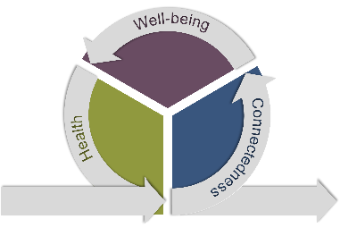
An Integrated Approach Interactions Between Risk, Protection, & Psychosocial Factors and Health Behaviors

Slide 15
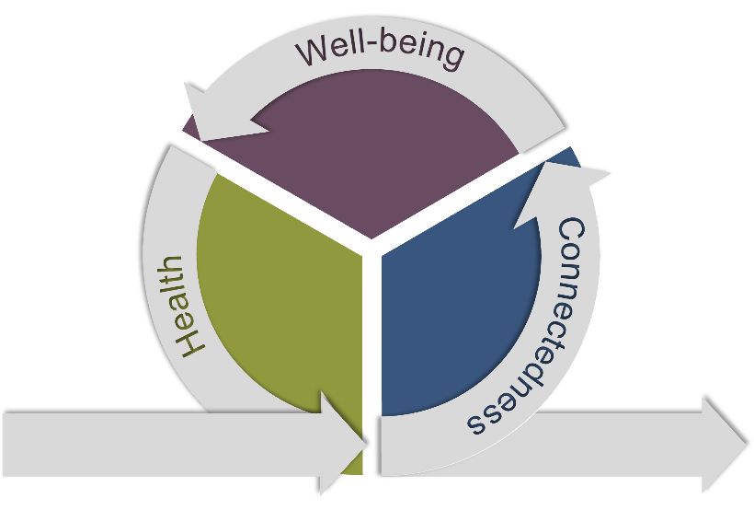
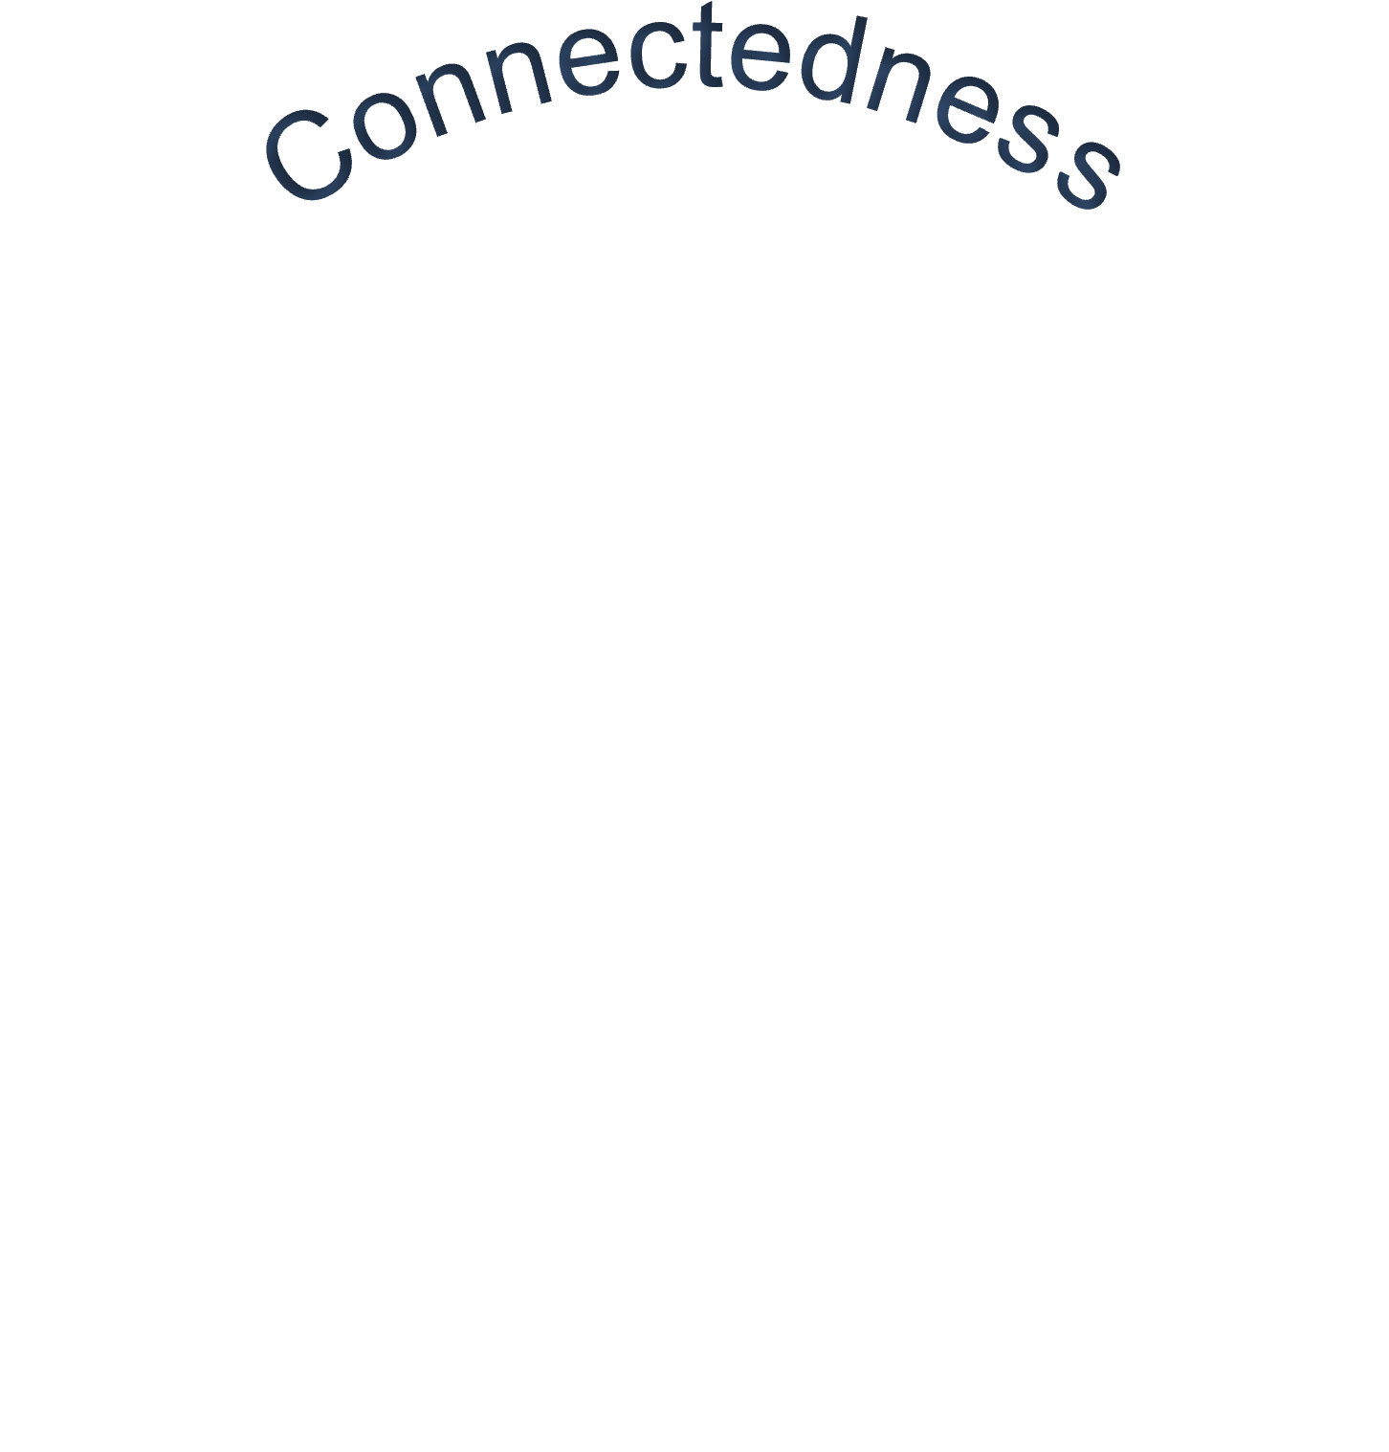
An Integrated Approach Through Psycho-social Factors
Health
Affect
Connectedness

Slide 16
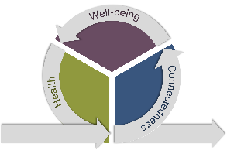
An Integrated Approach Through Psycho-social Factors
Connectedness
Health
Affect
Planned
Secure
Partner
Major Life Events
Unplanned
Transition
Single
Source

Slide 17
An Integrated Approach Through Psycho-social Factors
Health
Affect
Connectedness

Slide 18
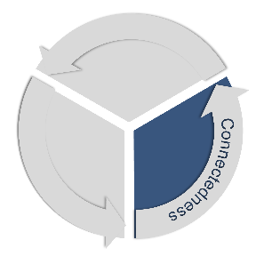
An Integrated Approach Through Psycho-social Factors
Connectedness
Network
Relationships
Involved
⬆ Protective Factors ⬆
⬇ Risk Factors ⬇
Isolation
Loneliness
Mobility
Source

Slide 19
An Integrated Approach Through Psycho-social Factors
Well-being
Affect
Purpose
Efficacy
⬆ Protective Factors ⬆
⬇ Risk Factors ⬇
Depression
Cynicism
Agism
Source
Notes:
The results showed that perceived age discrimination positively predicts loneliness and negatively and indirectly predicts well-being. Furthermore, positive affect, confidence in the future, and current physical health are protective factors, while loneliness, social isolation, and ageism are risk factors.

Slide 20
An Integrated Approach Through Psycho-social Factors
Health
Literacy
Adaptive Behaviors
Wellness
⬆ Protective Factors ⬆
⬇ Risk Factors ⬇
Physiology
Insomnia
Risky Behaviors
Source

Slide 21
An Integrated Approach Through Psycho-social Factors Outcomes
Health
Affect
⬆ Health
⬆ Wellness
⬇ Risky Behaviors
⬇ Morbidity
⬇ Mortality

Slide 22
Affect: Mutually Reinforcing Relationships
Health
Affect
Positive affectivity refers to the subjective experience of pleasant affective states, such as enthusiasm or joy. It affects the following aspects:
Physiological (better immune system: Behavioral (more adaptive health behaviors, such as physical activity and,
Social- better social relationships.
Positive affect is associated with greater longevity .
Donizzetti, A. R., & Capone, V. (2023). Ageism and the pandemic: risk and protective factors of well-being in older people. Geriatrics, 8(1), 14.
Notes:
Cognitive, Biological, Social, and Affective Changes
Donizzetti, A. R., & Capone, V. (2023). Ageism and the pandemic: risk and protective factors of well-being in older people. Geriatrics, 8(1), 14.
Positive affectivity refers to the subjective experience of pleasant affective states, such as enthusiasm or joy, for shorter or longer intervals of time. It affects the following aspects: physiological (better immune system: behavioral (more adaptive health behaviors, such as physical activity: , and social- better social relationships. Furthermore, in a study of older people, positive affect was found to be associated with
greater longevity .
Furthermore, positive affect is a positive antecedent of both future confidence and physical health. Positive affect affects not only physical health but also mental health; this relationship has been observed in numerous studies
Adaptive behaviors are learned behaviors that reflect an individual's social and practical competence to meet the demands of everyday living. To meet the demands of their environments, each person must learn a set of skills.
Thus, it can be argued that the tendency to find positive meaning in general or adverse life situations helps to cope with them proactively, resulting in an increase in the initial level of positive affect
loss of coping in terms of vital exhaustion and depressiveness, especially
in the case of multiple health risk behaviors.

Slide 23
Connectivity: Mutually Reinforcing Relationships
Health
Affect
Social support is defined as the “degree to which individuals have access to receive support for his or her network. Supportive Relationships encourage optimism, leading to…
Better psychological health.
Patients receiving support from their network may feel a greater sense of self-worth, which can encourage optimism regarding treatment.
Medication adherence
Guo, A., Jin, H., Mao, J., Zhu, W., Zhou, Y., Ge, X., & Yu, D. (2023). Impact of health literacy and social support on medication adherence in patients with hypertension: a cross-sectional community-based study. BMC Cardiovascular Disorders, 23(1), 93.
Notes:
Guo, A., Jin, H., Mao, J., Zhu, W., Zhou, Y., Ge, X., & Yu, D. (2023). Impact of health literacy and social support on medication adherence in patients with hypertension: a cross-sectional community-based study. BMC Cardiovascular Disorders, 23(1), 93.
Social support is defined as the "degree to which individuals have the potential access to receive actual or perceived support from his or her social network, such as familial relations, friends, neighbors, colleagues, fellow patients to reduce psychological stress response, relieve mental stress, and improve social adaptability".
Low social support has been shown to be associated with uncontrolled blood measures [8]. Previous studies [9,10,11] have clearly supported that social support is associated with medication adherence and is a critical target for the improvement of medication adherence among patients with hypertension.
Patients receiving support from family members and/or friends may feel a greater sense of self-worth [35], which can encourage optimism regarding treatment. Higher social support is associated with better psychological health, meaning that the improvement of medication adherence may be induced by good emotion [36].

Slide 24
Barriers and Facilitators Considerations for Engaging Older Adults
For today we defining barriers as factors that hinder, limit, or prevent people from engaging in a certain behavior, whereas facilitators are factors that favor, facilitate, or help people to engage in a certain behavior.
Notes:
We defined barriers as factors that hinder, limit, or prevent people from engaging in a certain behaviour, whereas facilitators are factors that favour, facilitate, or help people to engage in a certain behaviour.

Slide 25
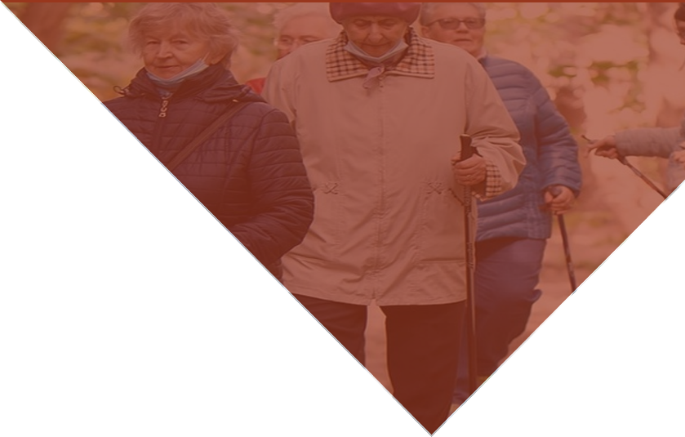
Preparing for Implementation Considering Facilitators and Barriers
Barriers
Physical health conditions or physical
limitations
Language barriers, lack of motivation, time, and interest.
Life
Satisfaction
Health Literacy
Positive Coping
Transportation
Technology
Knowledge, positive attitudes, interest, sense of achievement, Support form friends/ family.
Facilitators
Notes:
Retirement (when not voluntary)
• Loss of spouse, partner, or family member
• Environment (e.g., relocation to assisted living)
• Physical health (e.g., pain, high blood pressure, sleep and mobility issues)
• Previous traumatic events
• Mental disorders (e.g., disorders related to depression and anxiety)
• Cognitive decline (e.g., Alzheimer’s disease)
• Social changes (e.g., less active, socially disconnected from family and friends)
• Economic stressors (rising medication and healthcare costs, living on reduced income)
• Lifetime or family history of SUDs
• High availability of substances
• Social isolation
Resiliency
• Marriage or a committed relationship
• Supportive family relationships
• Retirement (when voluntary)
• Ability to live independently
• Access to basic resources such as safe housing
• Positive self-image
• Well-managed medical care and proper use of medications
• Sense of identity and purpose

Slide 26
New York

Slide 27
NYS Prevention Strategies for Older Adults
Patricia Zuber-Wilson
Associate Commissioner
Division of Prevention Services, OASAS

Slide 28
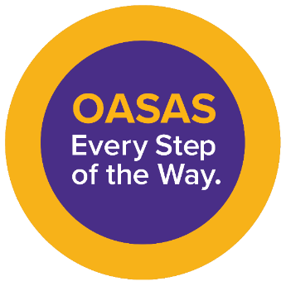
NYS Office of Addiction Services and Supports (OASAS)
Mission Statement
To provide, support, and oversee a data-driven continuum of addiction services delivered with equity, dignity, compassion, and respect.
OASAS Continuum of Services
Prevention
Treatment
Harm Reduction
Recovery
Notes:
Reduce the prevalence of substance use/problem gambling in NY population
Delay initiation of substance use and gambling behaviors among youth
Decrease negative health, social and economic consequences and costs associated with substance use and problem gambling
Prevent escalation of substance use through early identification, brief intervention and referral
Prevent escalation of substance use and gambling behaviors to levels requiring treatment

Slide 29
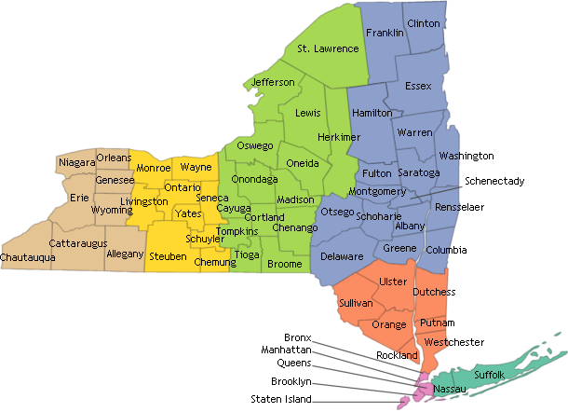
New York State Prevention System
145 OASAS-funded Prevention Providers
Community Based Prevention Programs
Schools (public/non-public)
Local Government
9 Regional Addiction Resource Centers
6 Prevention Resource Centers
Community Coalitions
150 local coalitions (funded/unfunded)
OASAS Funded
14 Special Populations
6 Partnership for Success Coalitions
5 High opioid burden counties

Slide 30
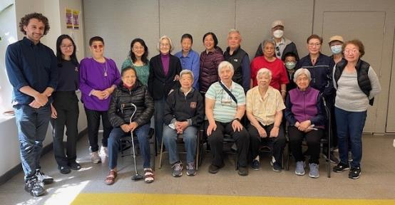
Older Adults In New York State
New York State
4.6M individuals aged 60+
Fourth in nation for number of older adults, behind California, Florida, and Texas
Counties with older adult populations of 30% or more are expected to increase:
9 counties (2020)
33 counties (2030)
Notes:
New York 4.6 million individuals aged 60 and fourth in the nation in the number of older adults behind California, Florida, and Texas.​
30% or more of the county’s total population of older adults will increase:
9 counties in 2020 ​
33 counties in 2030.​

Slide 31
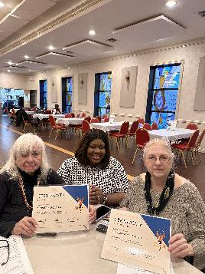
Older Adults and Alcohol Use
Increase of those age 65+ with higher levels of alcohol use and Alcohol Use Disorder (AUD) overburdens healthcare system
Excessive alcohol consumption by older adults increases risks of:
AUD
adverse medication interactions
sleep disturbance
cardiovascular disease
cancer
injuries/death due to falls
White AM, Orosz A, Powell PA, Koob GF. Alcohol and aging - An area of increasing concern. Alcohol. 2023 Mar;107:19-27. Available from: https://doi.org/10.1016/j.alcohol.2022.07.005
Notes:
Rapid expansion of population aged 65 and older higher levels of alcohol use and alcohol Use Disorder (AUD) in the Baby Boomer cohort could significantly increase the burden healthcare system.
Excessive Alcohol consumption by older adults increases the risk of:
AUD
adverse medication interactions
sleep disturbance
cardiovascular disease
Cancer
injuries/death due to falls.

Slide 32
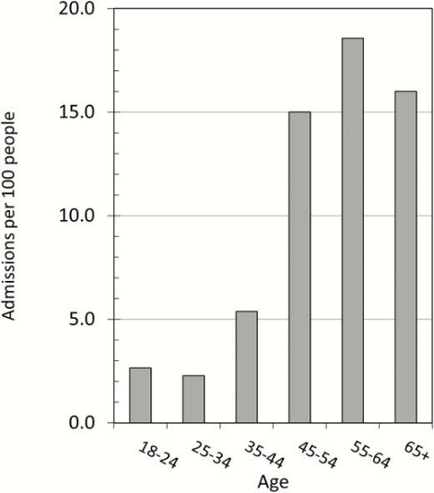
Emergency Department Alcohol Related Injuries
High-risk drinkers age 45+:
Up to 7.5x more likely to be admitted to EDs* for alcohol-related injury compared with those age 18–34
Older adults face additional risks from alcohol use
More likely to take medications (which may negatively interact with alcohol)
*Emergency Departments (EDs)
Richard A Grucza, Jennifer K Bello-Kottenstette, Carrie M Mintz, Jacob T Borodovsky, The changing landscape of alcohol use disorder and problem drinking in the USA: implications for primary care, Family Practice, Volume 37, Issue 6, December 2020, Pages 870–872, https://doi.org/10.1093/fampra/cmaa066
Notes:
High-risk drinkers in the 45 and over age categories are 6–7.5 times more likely to be admitted to the Emergency Department for alcohol-related injury than those aged 18–34.
Older adults have additional risks for drinking alcohol at any level because older adults are more likely than other age groups to take medications, many of which have the potential to interact negatively with alcohol.

Slide 33
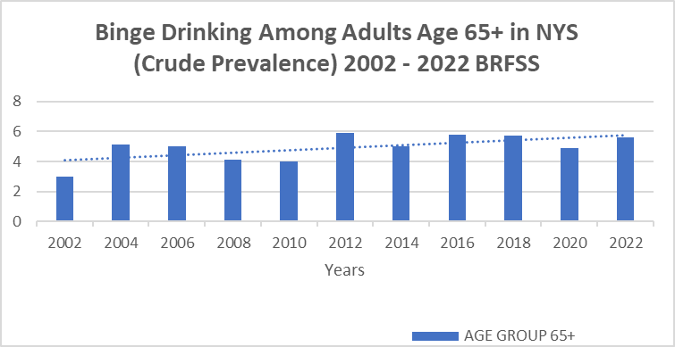
New York State Data: Older Adults
Binge drinking increase over time among people aged 65+
10% of adults aged 65+ drank five or more drinks (men) or four or more drinks (women) on at least one occasion in the past month
Balu RK, O’Sullivan G, Haile K, Battles H. Binge and Heavy Drinking. New York State Behavioral Risk Factor Surveillance System Brief, No. 2024-08
[Internet]. Albany, NY: New York State Department of Health, Division of Chronic Disease Prevention, Bureau of Chronic Disease Evaluation and Research;
2023; Available from: https://www.health.ny.gov/statistics/brfss/reports/docs/2024-08_brfss_binge_heavy_drinking.pdf

Slide 34
Partnerships Is Key
Buy-in by other agencies is important
County aging/veteran serving agencies:
Home/in-home/community-based programs and supportive services
Webinar with county aging/veteran serving agencies

Slide 35
The WISE/SBIRT Model

Slide 36
Wellness Initiative for Senior Education (WISE)
6-session (WISE)
Screening, Brief Intervention, and Referral to Treatment (SBIRT) program
Curriculum topics:
healthy aging
cultural and generational diversity
medication use/misuse, substance abuse & addiction
The WISE/SBIRT Model:
More accurate reporting of substance use in SBIRT
Quality health and wellness information
Safe space for sensitive or private concerns about substance use
Brief individualized interventions and referrals to additional supports

Slide 37
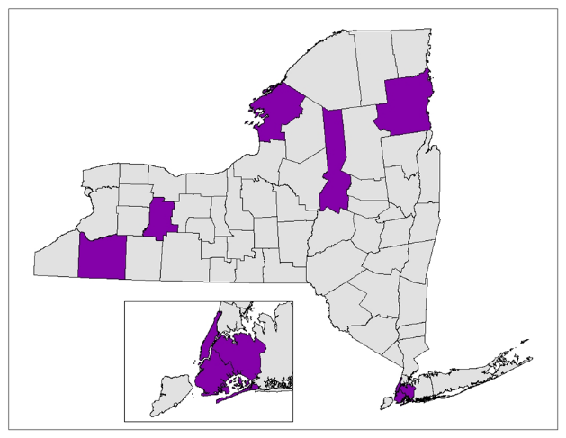
WISE/SBIRT Counties
WISE/SBIRT conducted in 29 locations across 9 counties, including at:
Office of Aging Nutrition Sites
Community Centers
Senior Centers and Senior Clubs
Senior Housing Facilities
Independent Livings Communities
Firehouses and Town Halls

Slide 38
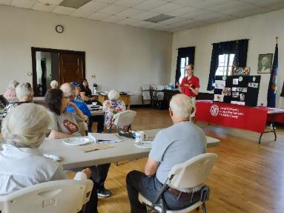
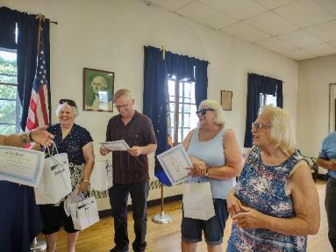
WISE in New York State
9 Prevention Agencies. 3 downstate, 5 upstate
108 facilitators trained to deliver the WISE curriculum
Over 1000 older adults participated in one year of implementation

Slide 39
WISE – SBIRT Pre/Post Outcomes
Healthier lifestyle choices and behaviors
Better management of medications and substances like alcohol
Improved understanding about alcohol, medications, aging, and depression
Enhanced medication management

Slide 40
WISE/SBIRT Data

Slide 41
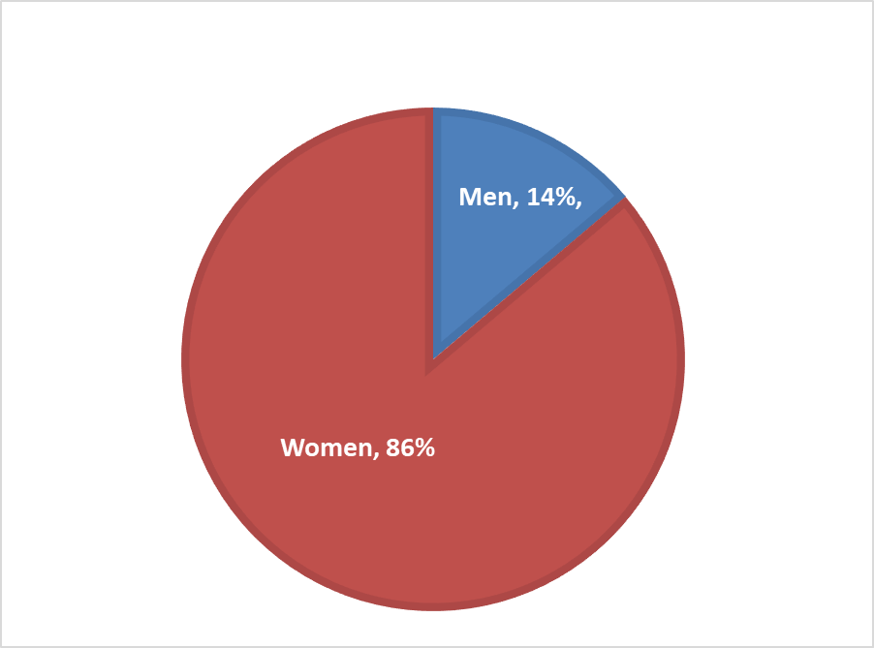
WISE Demographics: Participant Age and Gender
Age Range = 49 years (46 – 95 years)
Median Age = 74 years
Mean Age = 74 years

Slide 42
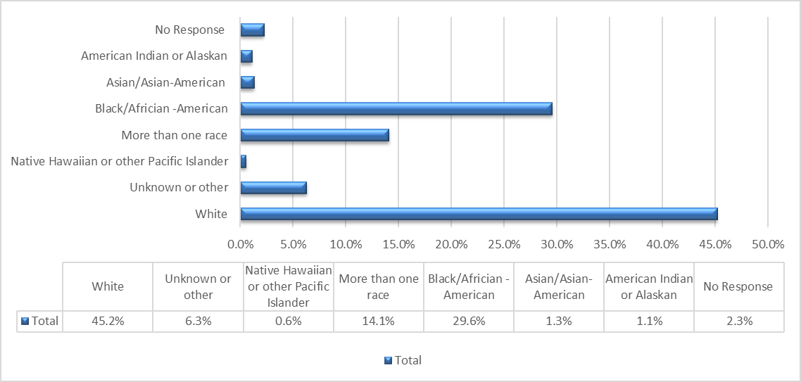
WISE Demographics: Participant Race

Slide 43
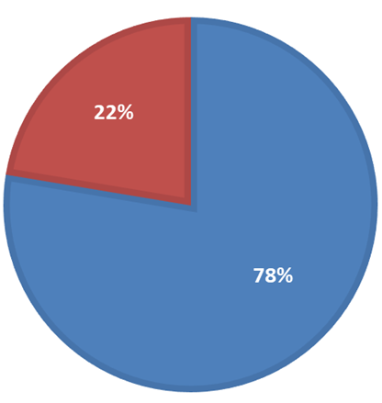
WISE Demographics: Participant Behavior
n = 726
No
“Have you changed any behavior to promote a healthier lifestyle in the past six weeks?”
Yes

Slide 44
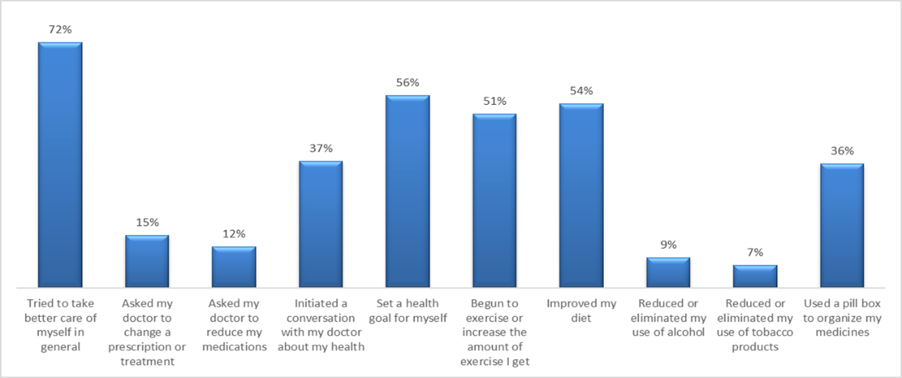
Self-Reported Health Behavior Changes Made

Slide 45
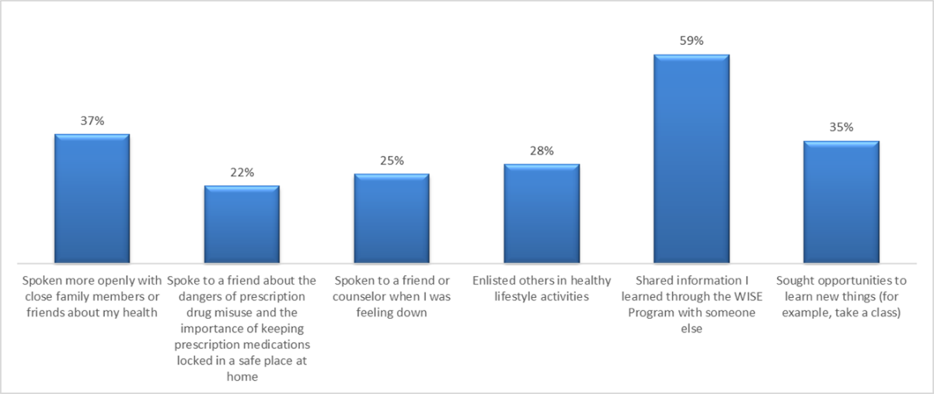
Self-Reported Social Connectedness Changes Made

Slide 46
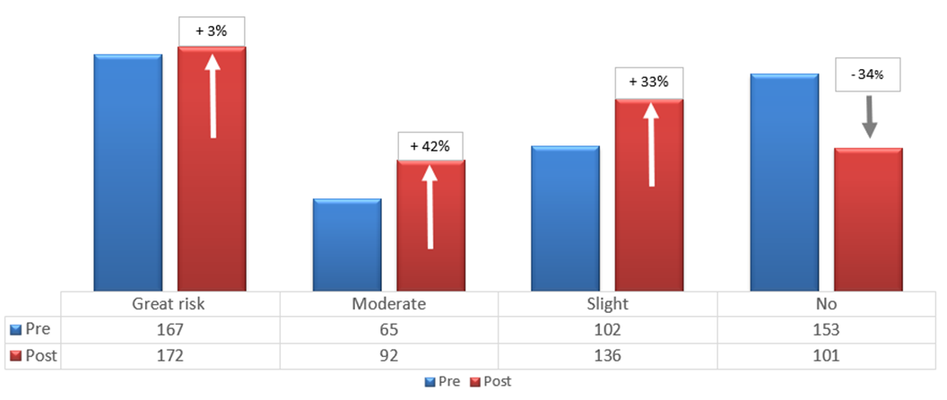
Perceived Risk of Harm
Drinking one or two alcoholic beverages regularly*
*drinking alcohol at least once or twice a week
Notes:
Chart indicates the percentage change of perceived risk of harm “of drinking one or two alcoholic beverages regularly (at least once or twice a week)”

Slide 47
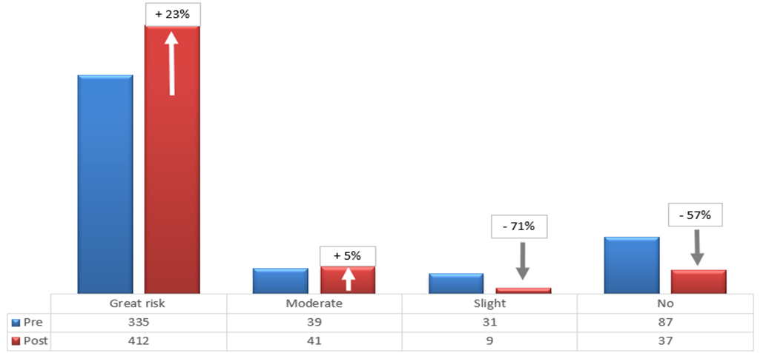
Perceived Risk of Harm
Use of prescription medications not prescribed or other than prescribed
Notes:
Chart indicates the percentage change of perceived risk of harm from “use of prescription medications not prescribed or other than prescribed”

Slide 48
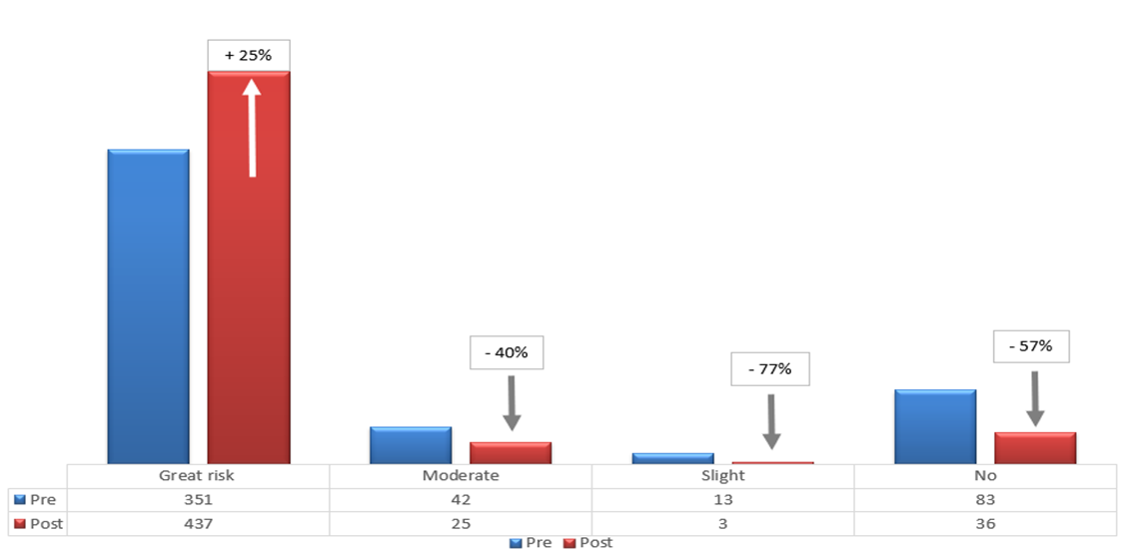
Perceived Risk of Harm
Use of prescription and/or OTC medications while drinking alcohol
Abbreviation: (OTC) over-the-counter
Notes:
Chart indicates the percentage change of perceived risk of harm “of use of prescription and/or over-the-counter medications while drinking alcohol”

Slide 49
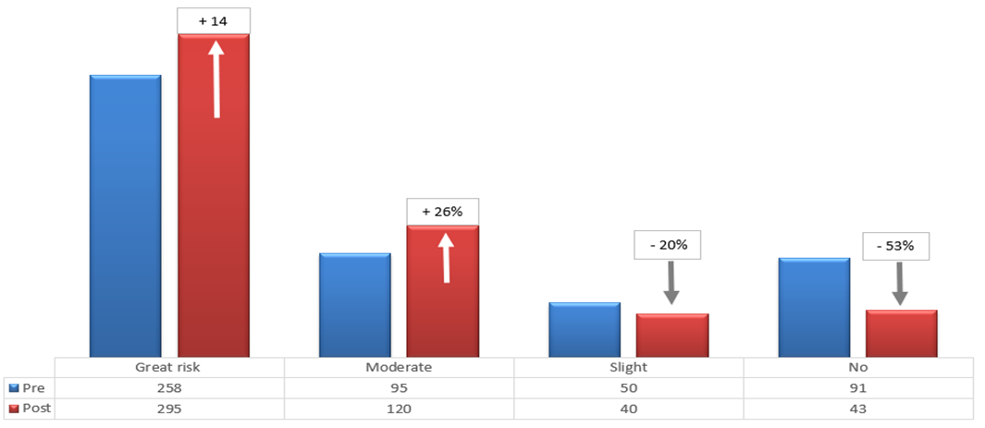
Perceived Risk of Harm
Drinking 5+ alcoholic beverages once or twice a week*
*three or more drinks if over age 65
Notes:
Chart indicates percentage change of perceived risk of harm from having five or more drinks of an alcoholic beverage once or twice a week (three or mor drinks if over age 65 years)

Slide 50
WISE/SBIRT Feedback & Lessons Learned

Slide 51
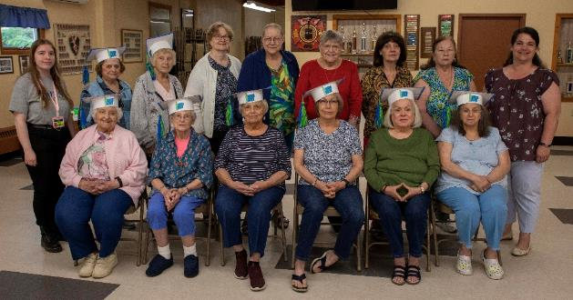
Participant Feedback
“It’s so relatable to what I am going through mentally and physically. It reminds me that I am not alone. When we age, we have questions like ‘what do I do’ and now we have those answers from WISE.”

Slide 52
Participant Feedback
“I would recommend the program for all seniors. The WISE program is for everyone.”

Slide 53
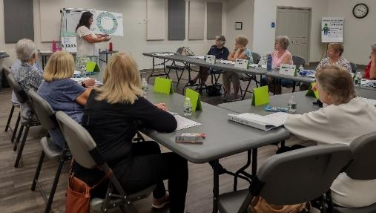
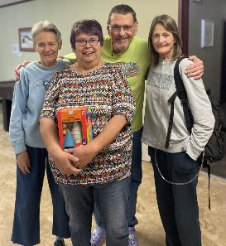
Participant Feedback
“I’ve enjoyed all the classes. I’ve saved all the lesson materials, they’re helpful. The information about substance use is helpful in my understanding of our community.”

Slide 54
New York: Lessons
Barriers
Privacy and data collection a challenge
Developing collaborative infrastructure with partners takes time/effort
Lessons Learned
Partnerships between OASAS Prevention/other state agencies allowed effective delivery of substance use education to diverse population of older adults
Notes:
Barriers
Privacy and data collection can be a challenge.
Developing new collaborative infrastructure for program delivery with partner sites takes time and effort to maintain relationship and commitment.
Lessons Learned
Partnerships between OASAS prevention division and other state agencies have allowed for effective delivery of substance abuse and misuse education to a diverse population of older adults throughout New York.

Slide 55
New York: Lessons
Well received by participants/facilitators/partner sites
Requests for more or extended programming
Serves older adults in place
Improves access to prevention/wellness programming
Frames interventions on substance use/misuse in broad “healthy aging” context
Builds rapport and engagement
Notes:
Well received by participants, facilitators, and partner sites.
Requests for more or extended programming.
Serving older adults in place, improving access to prevention and wellness programming.
Framing interventions about substance use and misuse in a broader “healthy aging” context builds rapport and engagement.

Slide 56
Questions?
Patricia Zuber-Wilson
Associate Commissioner
Division of Prevention Services
Patricia.Zuber-Wilson@oasas.ny.gov
51-485-6022

Slide 57
@NYSOASAS
nys_oasas
NewYorkStateOASAS
nysoasas

Slide 58
Potential Partners
State and City Departments on Aging
Health Centers
Senior Services or Centers
Primary Care
Specialized Workers (i.e. geriatric psychiatrists, gerontological nurses, Gero psychologists, and gerontological social workers)
Associations (i.e. American Geriatric Society)

Slide 59
Identifying Evidence-based or Evidence-Informed Programs
Research, Registries, and Catalogues
State and Federal Websites
Organizations Focus on Older Adults
National Council on Aging: https://www.ncoa.org/evidence-basedprograms
Administration for Community Living: https://acl.gov/programs/strengthening-aging-anddisability-networks/aging-and-disability-evidencebased-programs
Wellness Initiative for Senior Education (WISE). Wellness Initiative for Senior Education (acl.gov) Registry guide, explore and filter for older adults:
https://pttcnetwork.org/products_and_resources/gui de-to-online-registries-for-substance-misuseprevention-evidence-based-programs-and-practices/
Shaping a Social Isolation Strategy for Older Adults Key Takeaways From a Multidisciplinary Convening jahf_sil_report_apr24_v8.pdf (nyam.org

Slide 60
An Integrated Prevention Framework Building a Supportive Environment for Wellness
Create or Enhance Partnerships
Assess the Needs of Older Adults
Address Risk and Protective Factors
Enhance Psychosocial Resources
Address Barriers and Facilitators

Slide 61
Questions

Slide 62
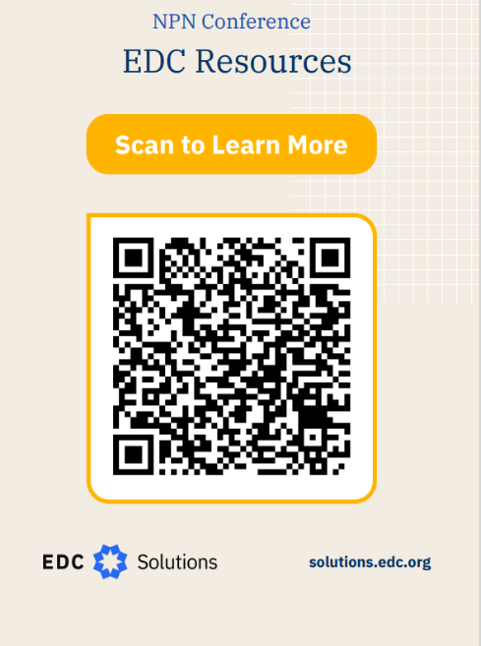
END

Slide 63
POLL: Fact or Falsehood Issues Impacting Older Adults
Depression and Loneliness are normal in older adults.
The older I get, the less sleep I need.
Older Adults can’t learn new things.
It is inevitable that older people get dementia.
Older adults should take it easy and avoid exercise, so they don’t get injured .
Notes:
https://www.nia.nih.gov/health/healthy-aging/10-myths-about-aging
1. Depression and loneliness are normal in older adults.
As people age, some may find themselves feeling isolated and alone. This can lead to feelings of depression, anxiety, and sadness. However, these feelings are not a normal part of aging as growing older can have many emotional benefits, such as long-lasting relationships with friends and family and a lifetime of memories to share with loved ones. In fact, studies show that older adults are less likely to experience depression than young adults. So, when should you be concerned? It’s important to remember that older adults with depression may have less obvious symptoms or be less likely to discuss their feelings. Depression is a common and potentially serious mood disorder, but there are treatments that are effective for most people.
2. The older I get, the less sleep I need.
As people age, they may find themselves having a harder time falling and staying asleep. A common misconception is that a person’s sleep needs decline with age. Older adults need the same amount of sleep as all adults — 7 to 9 hours each night. Getting enough sleep keeps you healthy and alert. Adequate sleep can also help reduce your risk of falls, improve your overall mental well-being, and have many other benefits.
Learn more about the importance of getting a good night’s sleep.
3. Older adults can’t learn new things.
Not true! Older adults still have the ability to learn new things, create new memories, and improve their performance in a variety of skills. While aging does often come with changes in thinking, many cognitive changes are positive, such as having more knowledge and insight from a lifetime of experiences. Trying and learning new skills may even improve cognitive abilities. For example, one study found that older adults who learned quilting or digital photography had improved memory. Seeking out new social connections with others and engaging in social activities, such as a dance class or book club, can keep your brain active and may also boost your cognitive health.
Learn more about cognitive health and older adults.
4. It is inevitable that older people will get dementia.
Dementia is not a normal part of aging. Although the risk of dementia grows as people get older, it is not inevitable, and many people live into their 90s and beyond without the significant declines in thinking and behavior that characterize dementia. Occasionally forgetting an appointment or losing your keys are typical signs of mild forgetfulness, which is very common in normal aging. Nevertheless, you should talk with a doctor if you have serious concerns about your memory and thinking, or notice changes in your behavior and personality. These problems can have a range of different causes, some of which are treatable or reversible. Finding the cause is important for determining best next steps.
5. Older adults should take it easy and avoid exercise so they don’t get injured.
As you age, you may think exercise could do more harm than good, especially if you have a chronic condition. However, studies show that you have a lot more to gain by being active — and a lot to lose by sitting too much. Often, inactivity is more to blame than age when older people lose the ability to do things on their own. Almost anyone, at any age and with most health conditions, can participate in some type of physical activity. In fact, physical activity may help manage some chronic conditions. Exercise and physical activity are not only great for your mental and physical health, but can help keep you independent as you age. Tai Chi and similar mind and body movement practices have been shown to improve balance and stability in older adults and this can help maintain independence and prevent future falls.

