Slide 1
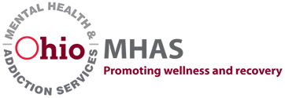
Building the Prevention BIPOC Workforce … ”This is how we do it.”
Albert Gay, Costella Green, Tracy Johnson, Raylette Johnson, Dr. Marketa Robinson, and Dr. Holly Raffle

Slide 2
By attending this session participants will be able to:
Recognize the research supporting affinity groups, and how they can support Ohio’s workforce development projects.
Describe how the Substance Abuse Prevention Skills Training (SAPST) was adapted so that it is more relevant for people who identify as Black/African American, Hispanic/Latinx, Asian, Native American/Indigenous, or People of Color without compromising or deleting its core components.
Name the unique supports and learning opportunities provided by Ohio’s BIPOC Affinity Group Prevention Skills Training (PST) Initiative to achieve career advancement within the field of Prevention.

Slide 3
Welcome and Background
The Ohio Center of Excellence for Behavioral Health Prevention and Promotion is committed to health equity
The Center is required by SAMHSA and OhioMHAS to have a Disparities Impact Statement
A call to action was formed

Slide 4
What is an affinity group?
Affinity Groups are communities of people who come together based on shared identity, interests, or experiences.
Whether it's race, ethnicity, gender, religion, or sexuality, Affinity Groups offer a space for people to connect with others who share their experiences and create a sense of belonging and solidarity.

Slide 5
What is the purpose of an affinity group?
The purpose of Affinity Groups is to create a safe space for individuals to connect with others who share similar experiences and offer support, encouragement, and empowerment.
They can also offer a platform for people to advocate for causes and create change in their communities.

Slide 6
What types of affinity groups Exist?
Type of Affinity Group | Description
Cultural Affinity Group | Groups based on shared heritage or cultural identity
Identity Based Affinity Group | Groups based on shared experiences such as gender, race, or sexuality.
Professional Affinity Group | Groups based on shared professions or career ambitions.

Slide 7
Affinity Group Best Practices
Determine primary function and overarching goals
Define membership practices
Identify and collaborate with supportive leadership, or other organizations/groups
Develop sustainability plan

Slide 8
Background
The goal of the BIPOC PST is to develop the essential knowledge and skills needed by entry-level substance misuse prevention practitioners to plan, implement, and evaluate effective, data-driven programs and practices that reduce behavioral health disparities and improve wellness among BIPOC populations.
The BIPOC PST is essential to building workforce capacity. The BIPOC PST training series incorporates new content related to BIPOC populations with concentrated themes of health disparities, health equity, and cultural aspects.

Slide 9
Slide 1: Connecting 2 points
SAPST
BIPOC Supplemental Sessions
A
B
Bridgework
Concepts
Cultural Experiences
Research
Discovery
Case Studies
Experiences

Slide 10
Overview of the BIPOC PST

Slide 11
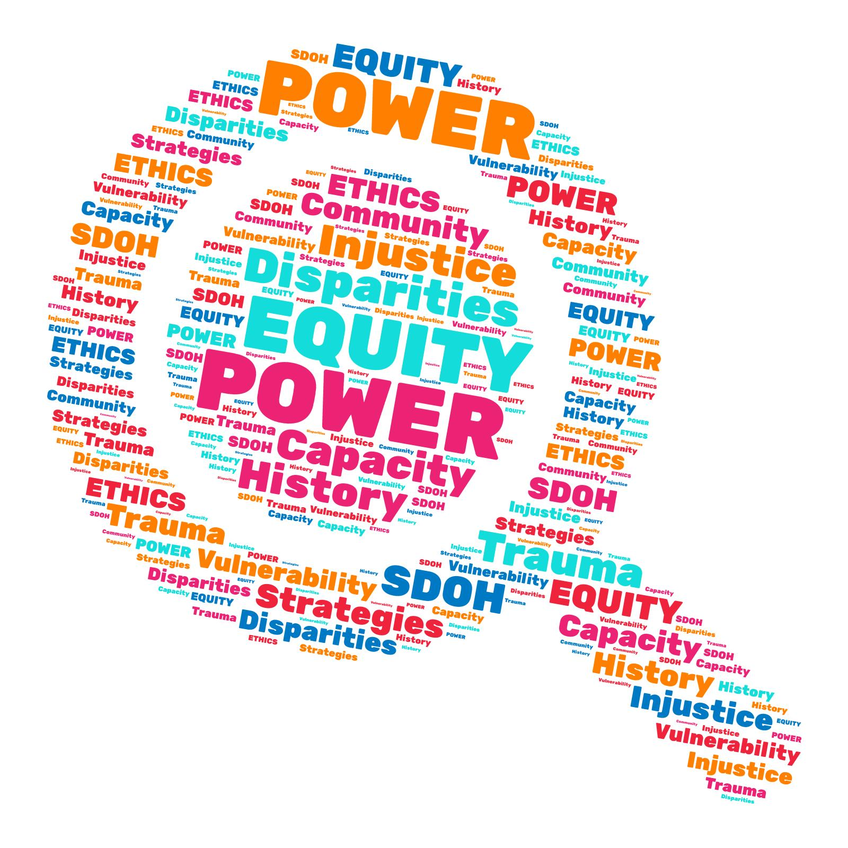
Anchors of Focus
Notes:
As we embark on this journey here are some anchors that we will focus on throughout our discussions. These words are of particular importance because of how they impact BIPOC populations.

Slide 12
The Background
Notes:
The Who, What, When, Where, Why, and the How?

Slide 13
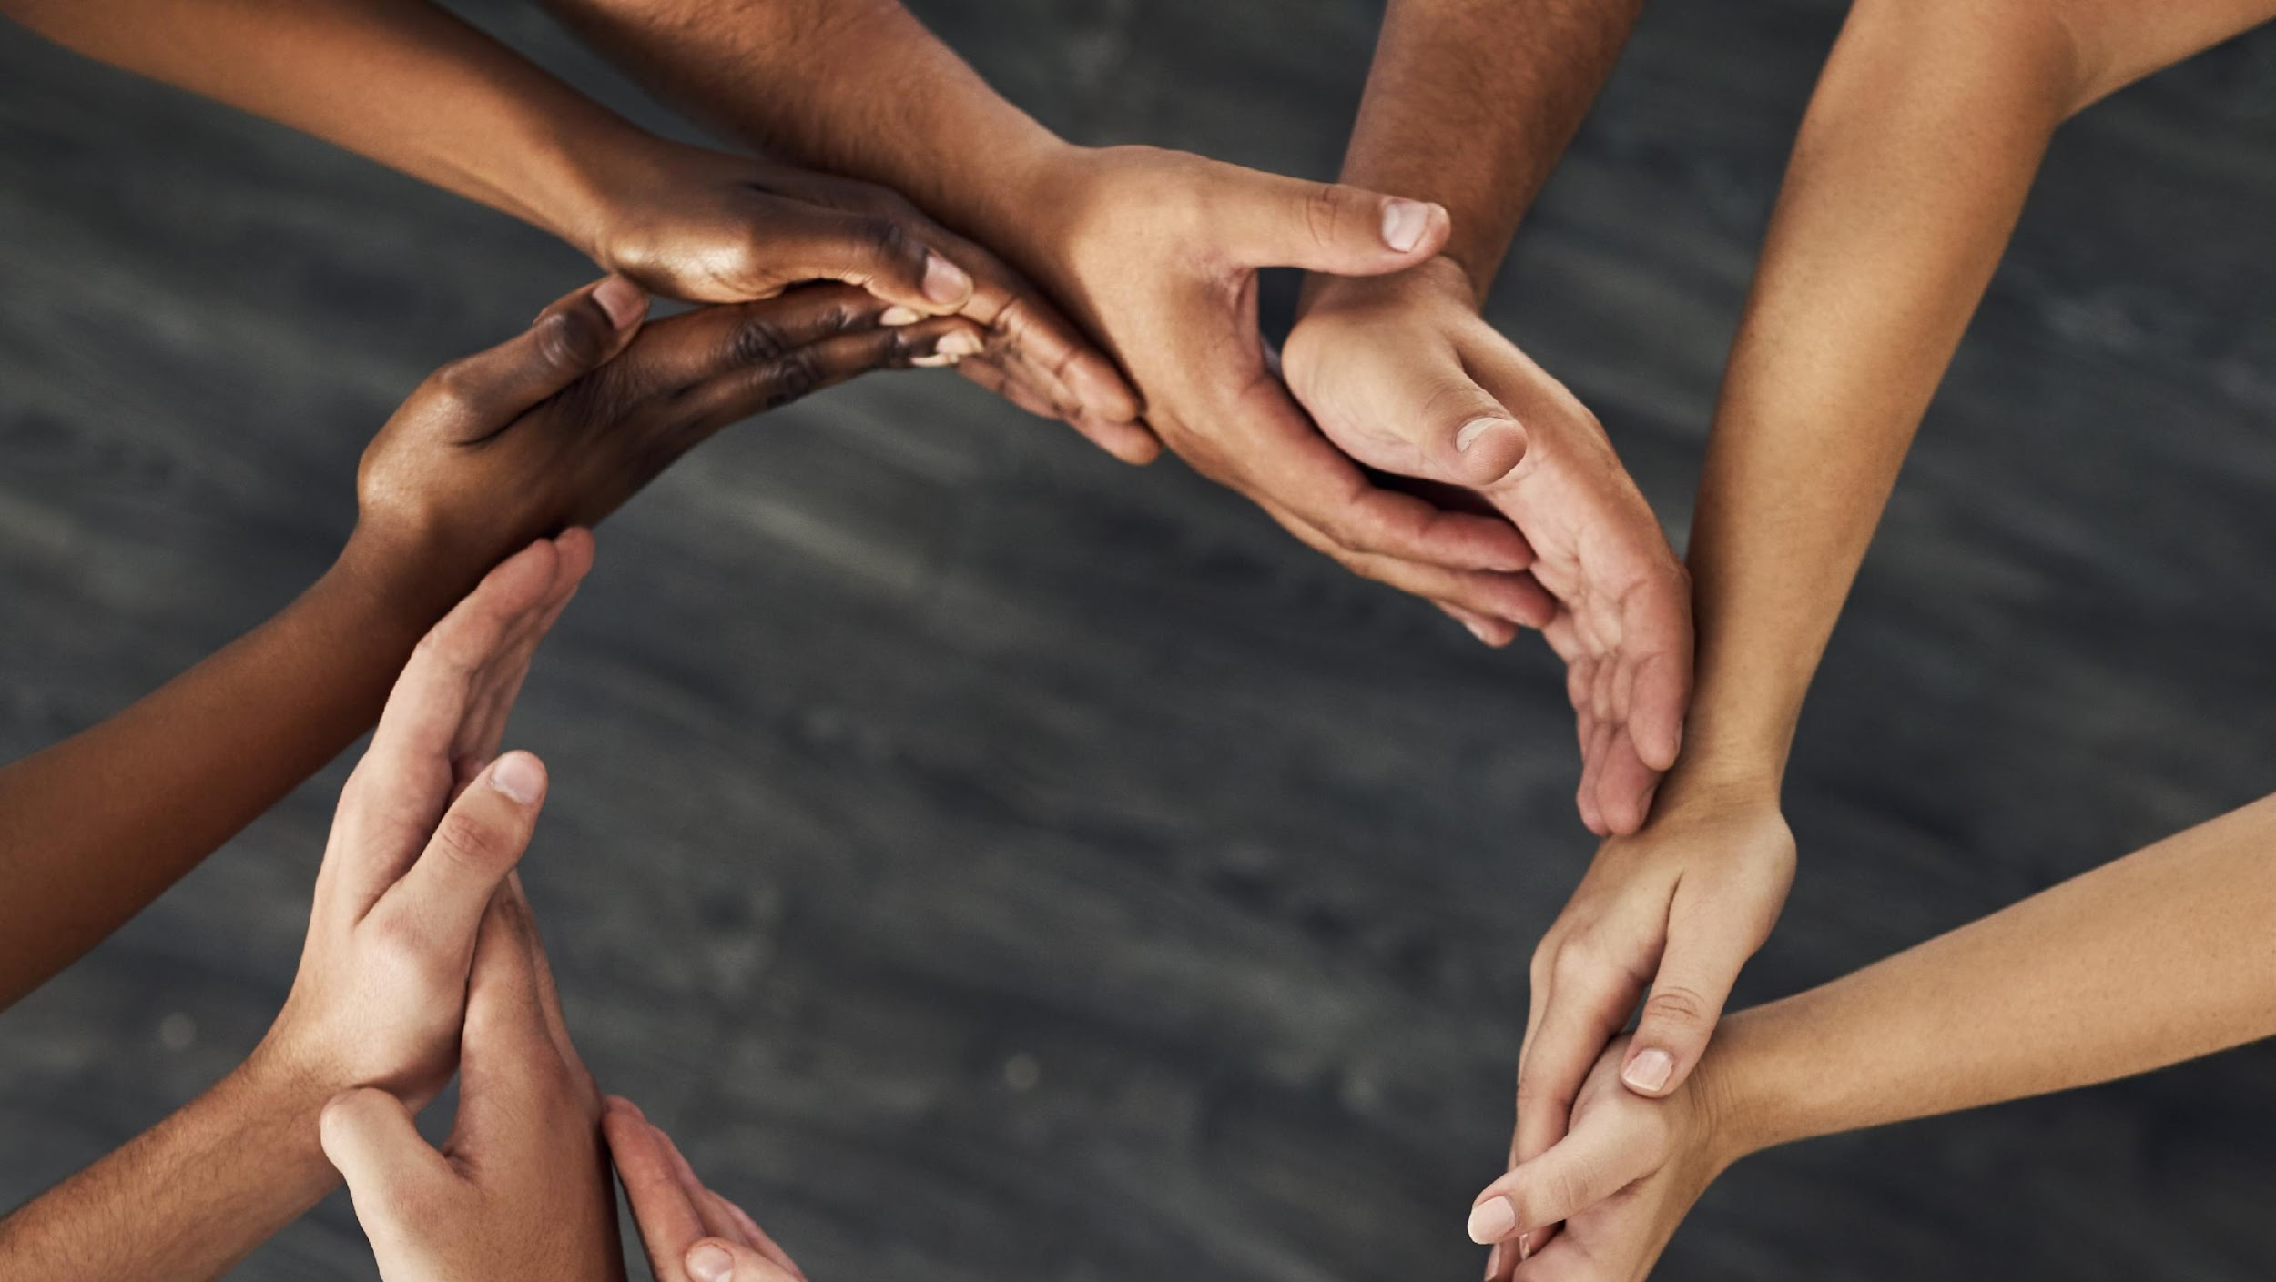
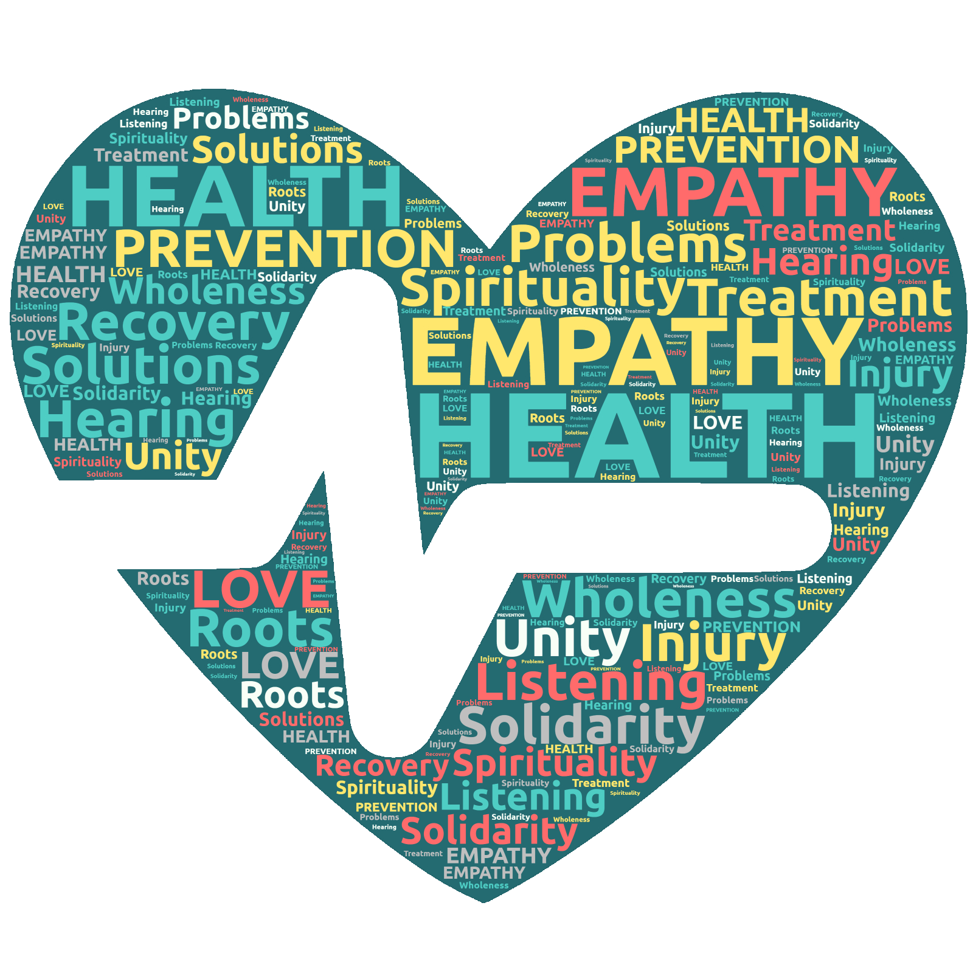
Healing Circles
Notes:
Healing circles are a traditional indigenous ritual in which people get together to help one another in dealing with personal and community challenges. An elder or facilitator often leads the circles, guiding the group through a variety of activities such as storytelling, sharing, and debate. Healing circles aim to offer a safe and supportive environment in which people may express their feelings, acquire understanding, and discover answers to issues.
Healing circles are important for substance use prevention because they take a comprehensive and culturally relevant approach to treating the underlying causes of addiction. Healing circles consider the social, historical, and cultural environment in which substance use happens rather than merely the individual's conduct. They allow people to connect with their community, culture, and traditions, which can assist to improve their feeling of identity and purpose.
Furthermore, healing circles provide a non-judgmental and stigma-free environment for individuals to relate their substance-use experiences and get support from their peers. This can aid in the reduction of feelings of shame and loneliness that are frequently connected with addiction. Furthermore, healing circles can serve as a forum for community members to come together and discuss bigger socioeconomic concerns that lead to substance use, such as poverty, trauma, and discrimination.
Overall, healing circles are an important tool for substance use prevention because they provide a holistic and culturally relevant approach to addressing the root causes of addiction and assisting individuals in developing resilience, finding purpose, and strengthening their connection to their communities.
Depending on the custom or culture, a healing circle's steps might differ, however the following could serve as a broad outline:
Setting the intention: After setting the intention for the meeting, the facilitator or leader of the healing circle will ask everyone to express their personal intentions for the session.
Marking the beginning of the healing circle with a ritual or ceremony, such as lighting a candle or smudging with sage, is done by the facilitator or leader.
Sharing: Participants are encouraged to talk about their ideas, emotions, and experiences. The talk might be steered by the facilitator or leader, or it can just happen naturally. On occasion, the participant may share only when they are holding an object that is designated for speaking. This helps eliminate multiple people talking at the same time. Instead, the person with the talking object will be the only person talking and then once finished, the participant will either pass that same object to the next participant that is cued to speak.
Listening: Participants are urged to actively and impartially hear what others have to say.
Healing rituals: The healing circle may incorporate rituals like meditation, prayer, chanting, or visualization, depending on the tradition or culture. The circle will be closed by the facilitator or leader using a ritual or ceremony, such as extinguishing the candle or smudging with sage.
Aftercare: It's crucial for the facilitator or leader to offer the participants aftercare, including check-ins and referrals to other resources if necessary.
Processing Questions:
Do you see the benefits of participating in a healing circle?
Have you participated in healing circles in the past?
Would you consider bringing healing circles to your community coalition or other group meetings?

Slide 14
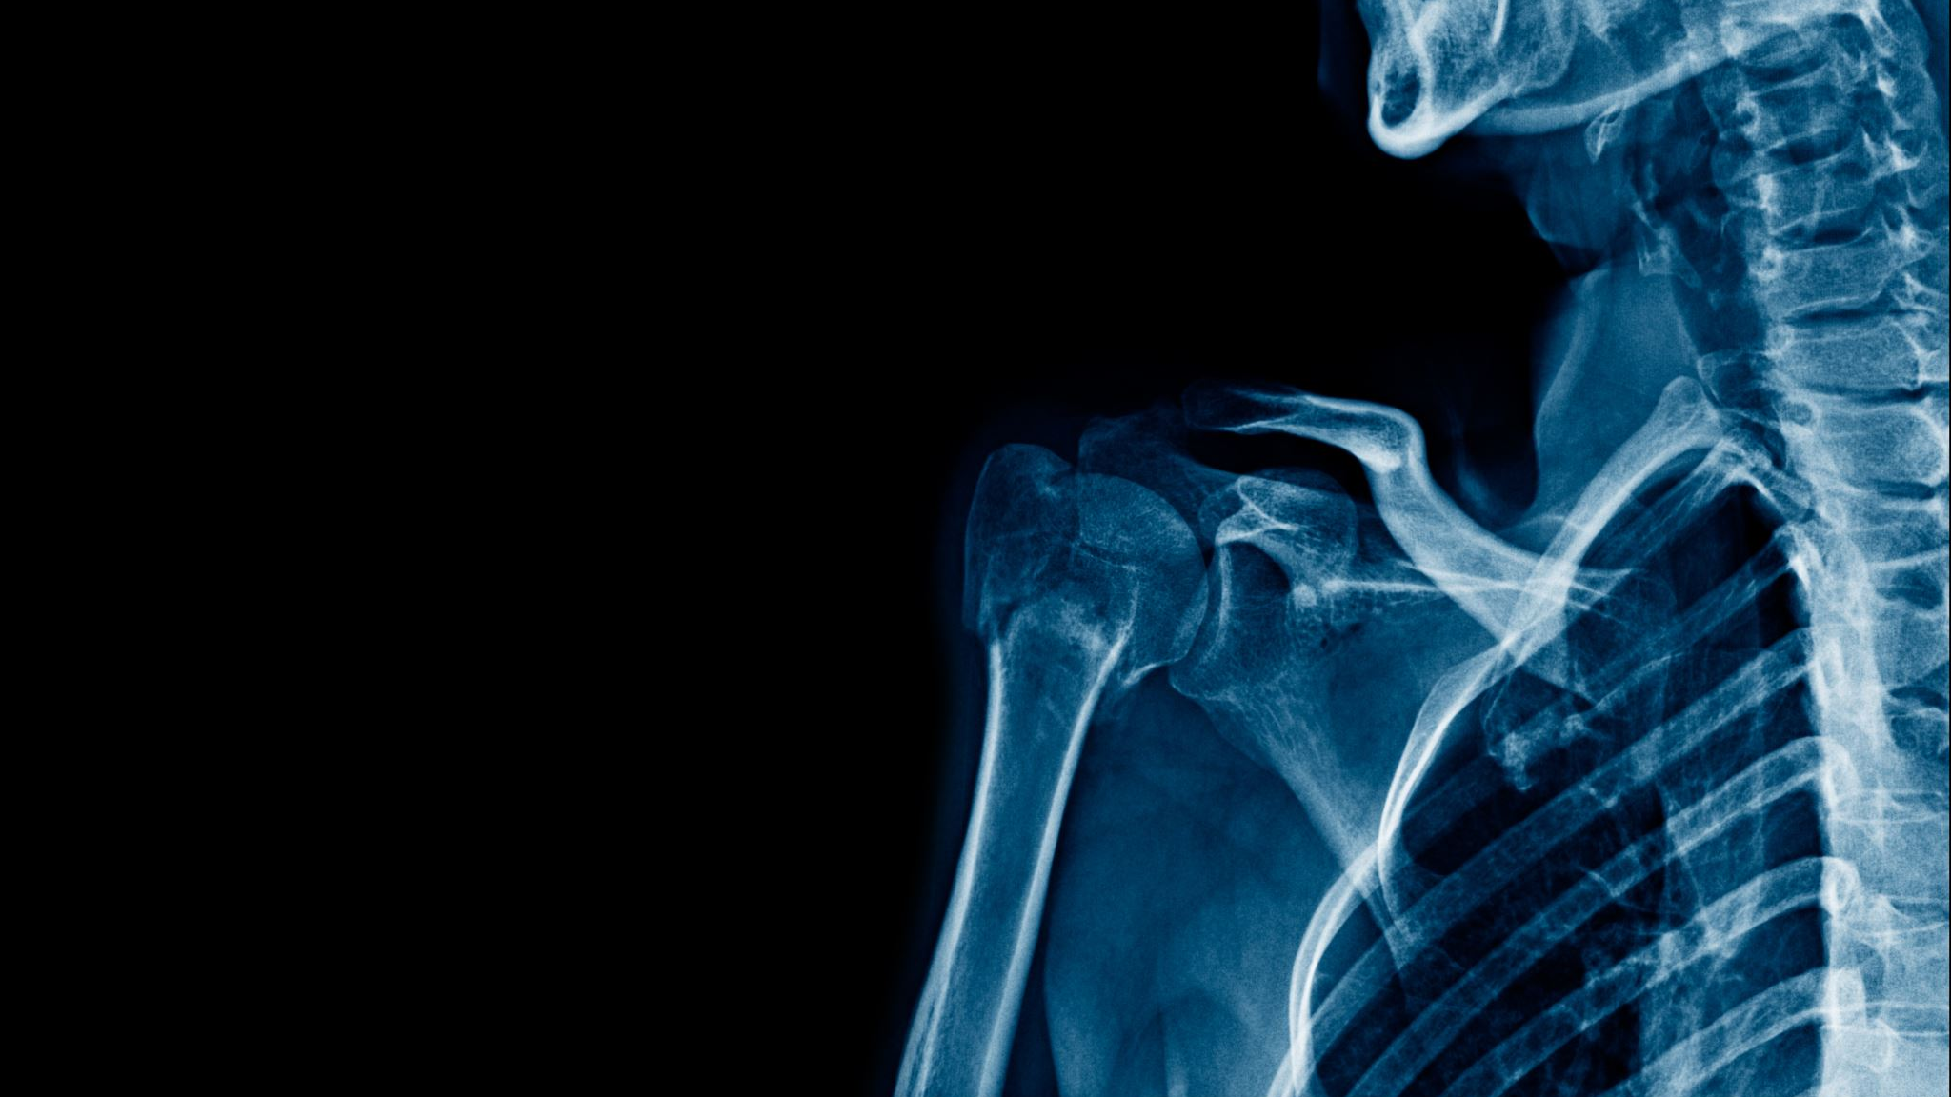
Harm
Notes:
Substance use and injustices disproportionately damage BIPOC (Black, Indigenous, and People of Color) communities. These damages are caused by a number of linked issues, such as systemic racism, poverty, and a lack of access to competent healthcare and drug use treatment.
Racism and prejudice in healthcare systems can result in BIPOC people obtaining subpar care or being denied care entirely. This can lead to an increase in the prevalence of drug use disorders and fewer options for treatment. Furthermore, BIPOC groups are more likely to be poor, which might increase the chance of drug use as a coping mechanism for financial and social pressures.
Furthermore, BIPOC communities are frequently overpoliced and disproportionately targeted by the criminal justice system, which can contribute to greater imprisonment rates and the criminalization of drug use. This can make it more difficult for people in these areas to get treatment and assistance, as well as contribute to increased stigma and marginalization.
It is critical to recognize that the harm caused by substance use in BIPOC communities is a society issue, not just an individual one. To address these harms, structural injustices and inequities, such as racism and poverty, must be addressed, as well as investments in culturally relevant and community-driven drug use treatment and harm reduction initiatives.
Finally, drug use and disparities in BIPOC communities are inextricably linked and based in systemic racism and poverty. Addressing these difficulties necessitates a holistic strategy that targets the underlying causes while also investing in culturally relevant and community-driven treatment and harm reduction initiatives.
Processing Questions:
In what ways have your BIPOC population experienced harm from substance use / misuse?

Slide 15
Substance Use/Misuse

Slide 16
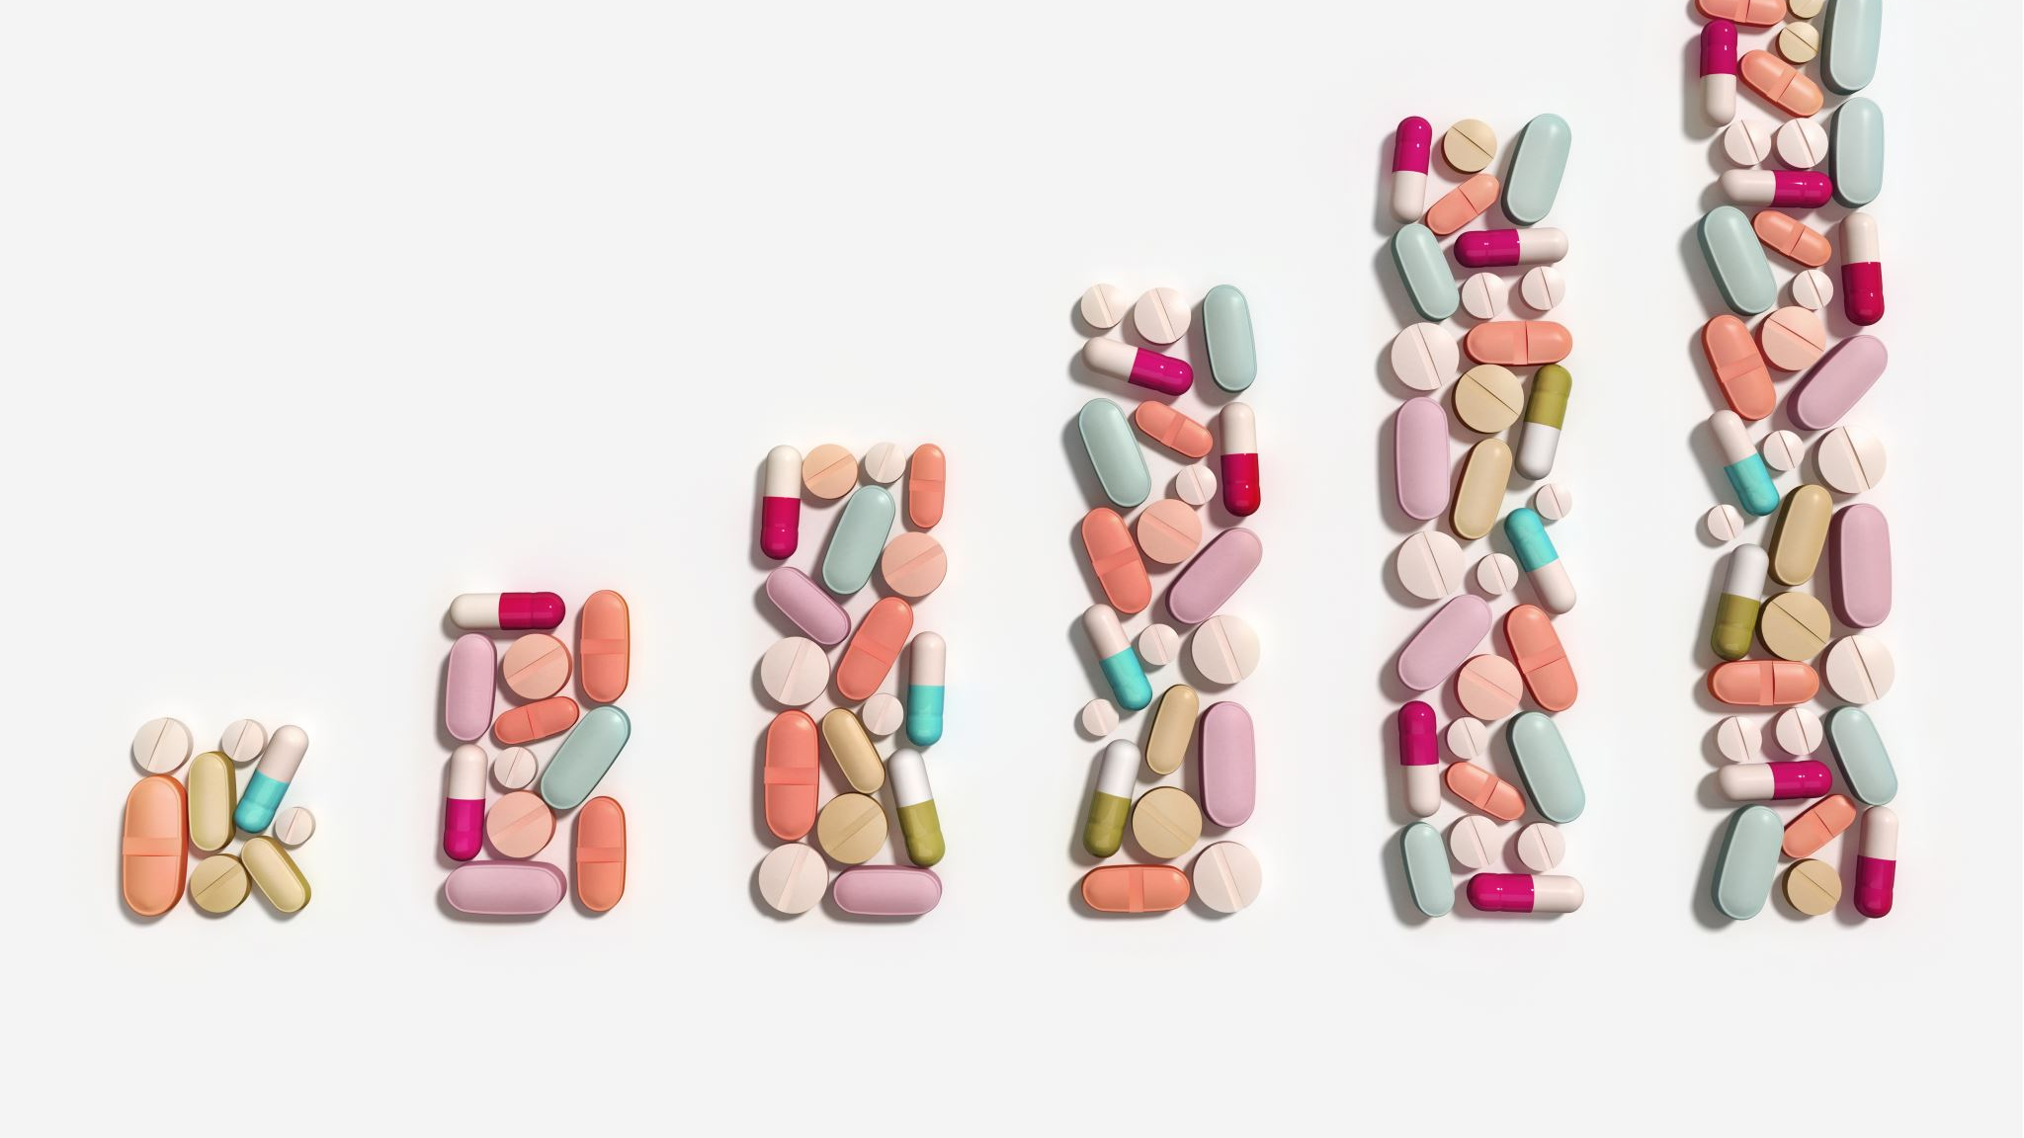
Health & Behavioral Health Disparities

Slide 17
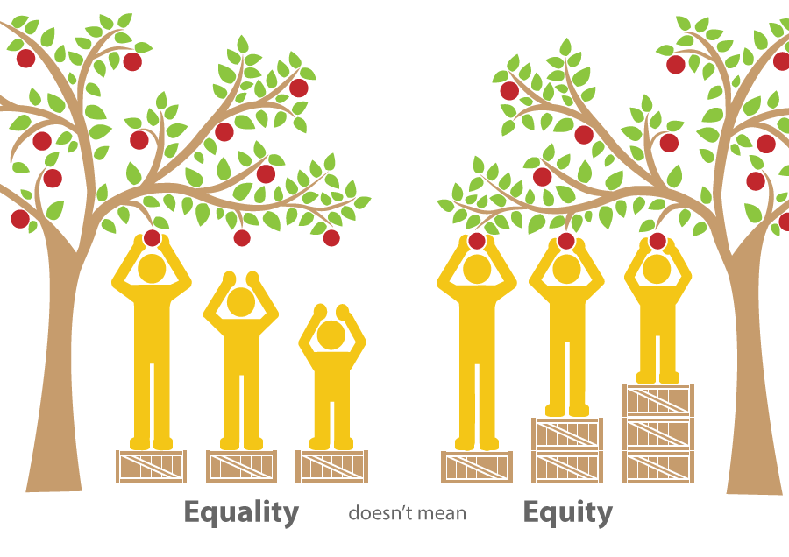
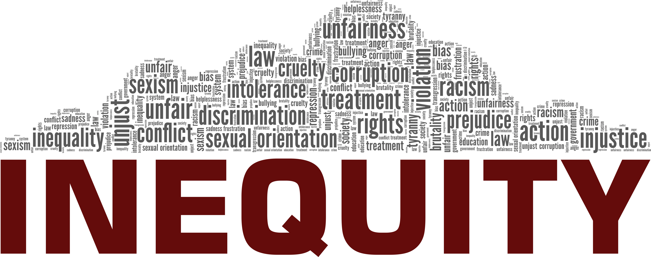
Equity

Slide 18
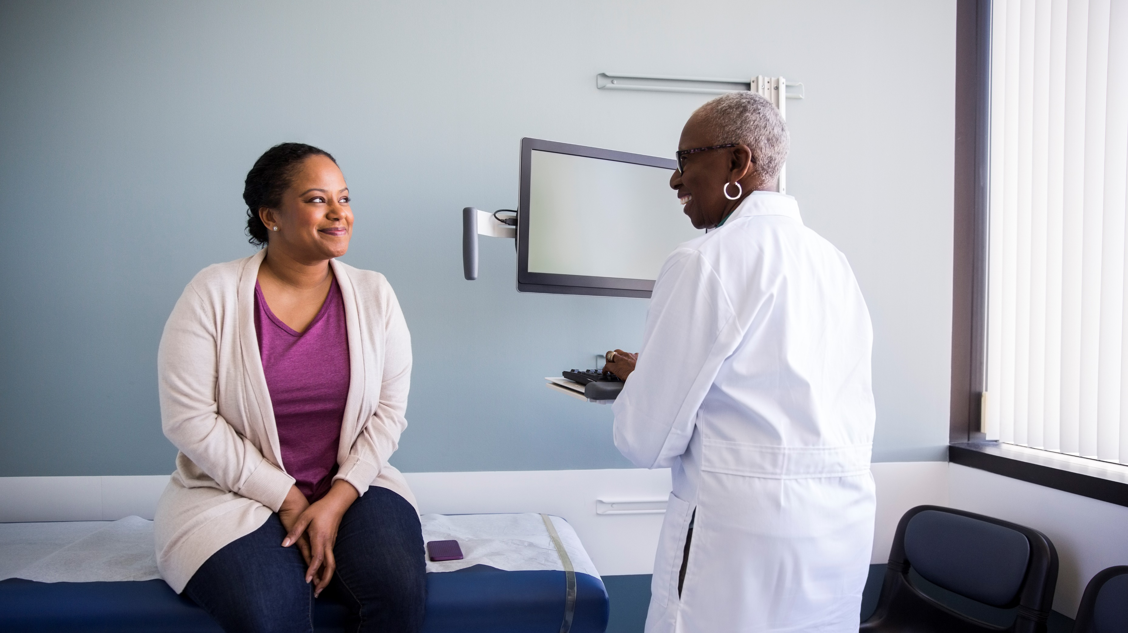
Health Equity
https://youtu.be/PTaLFmnS_jo
Notes:
The discussion around equity, is one that we will revisit repeatedly as this one is the ultimate goal for our communities. If we are ultimately wanting this fair treatment, then will need time for Imagineering this complex goal into our realities for BIPOC populations.
https://youtu.be/PTaLFmnS_jo

Slide 19
Justice

Slide 20
Root Causes
Notes:
Root or Social Inequalities
Historical Trauma

Slide 21
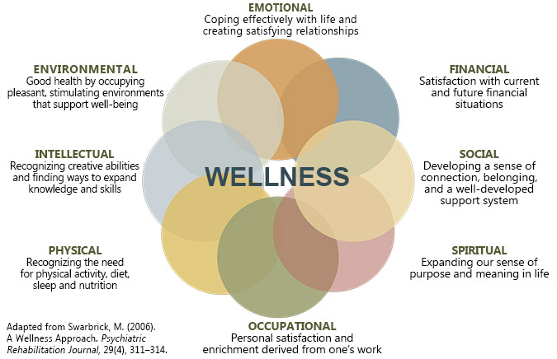
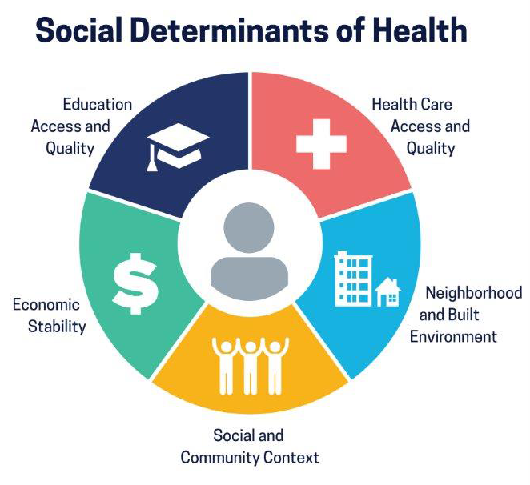
Decoding

Slide 22
Defining Wellness

Slide 23
Determining Health
Notes:
The Social Determinants of Health (SDOH) is an anchor that we will repeatedly link our discussions to. There is so much packed within the SDOH, that we will need those several conversations to truly understand the context in which our BIPOC populations have been existing.

Slide 24
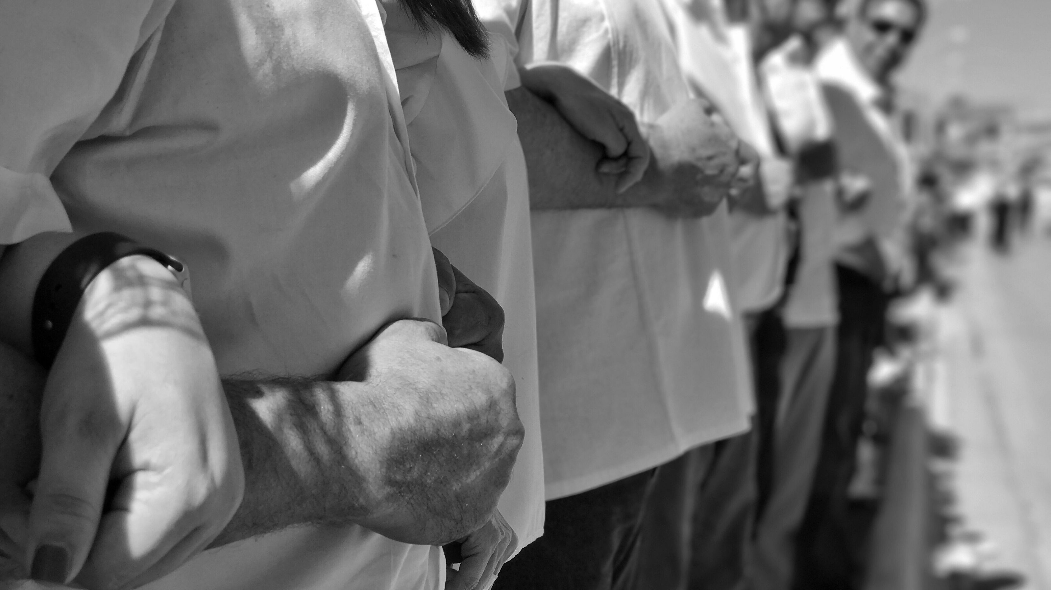
Power
Notes:
https://youtu.be/ezJU30Zr6FM

Slide 25
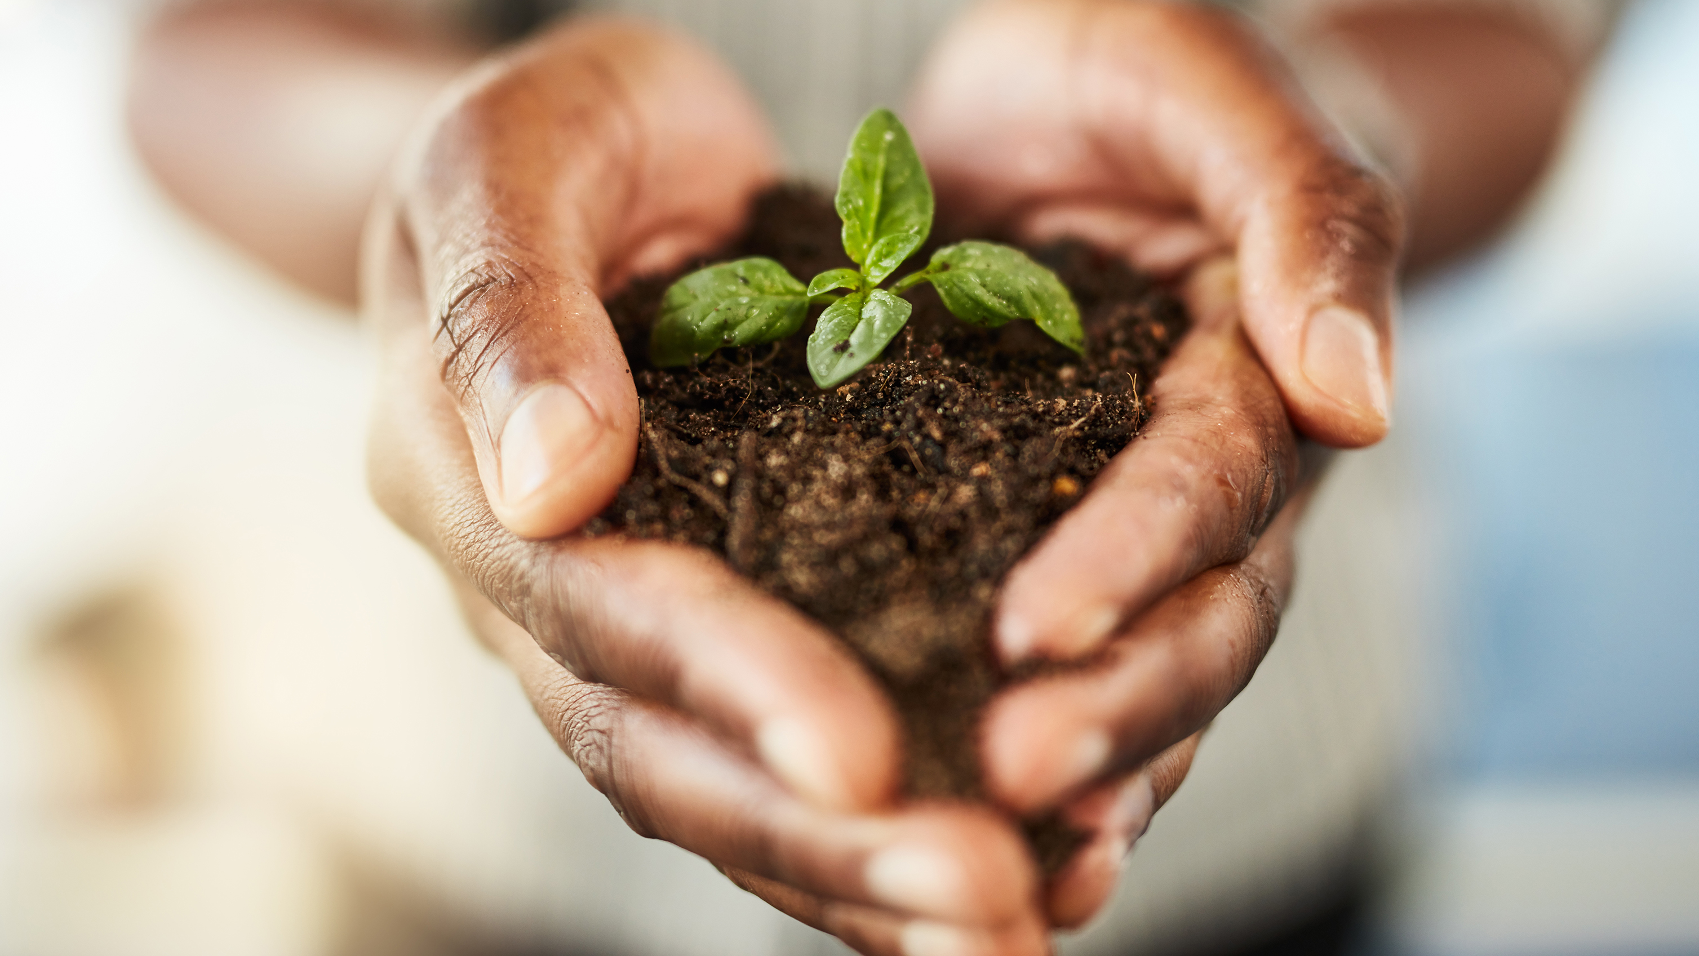
Restoration

Slide 26
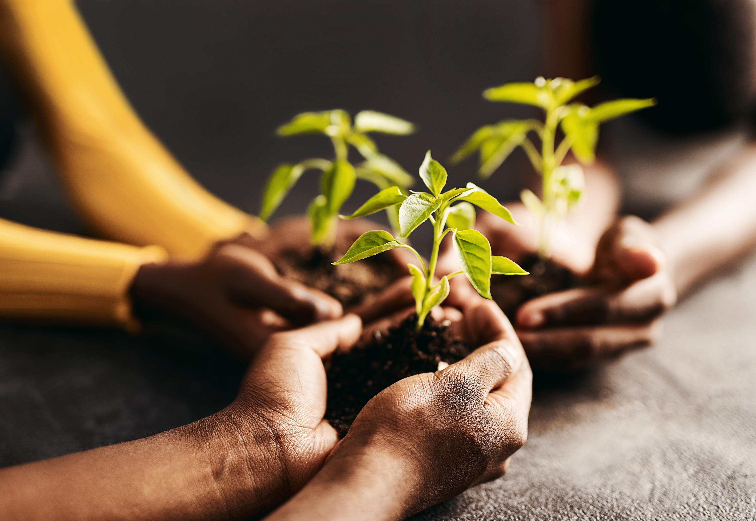
Public Health Response
https://youtu.be/z7pVGxnTQO4

Slide 27
Cultural Humility Principles
Organizational
Advocate and maintain institutional accountability
Create anti-discrimination policies
Interpersonal
Lifelong commitment to learning from others
Challenge and redress the power imbalances
Mutually beneficial partnerships with communities on behalf of individuals and defined populations
Intrapersonal
A lifelong process of critical self-reflection, self-critique, and learning
Self-awareness of biases, limitations, and humility

Slide 28
Adaptation and Feedback Process
The training series is done through an innovative training format, 5 day training sessions, learning communities, journaling, and mentorship) to build and sustain capacity to deliver comprehensive and culturally diverse community-level prevention services.
The training will equip participants with the necessary tools customized specifically for complex communities of color with high risk factors, (i.e., trauma, violence, substance use etc.) so often identified in these communities. This training was developed by BIPOC preventionists of color to train individuals who are interested in becoming an Ohio certified prevention specialist in serving BIPOC communities.

Slide 29
Training: Virtual Resources
Participants will participate in the Connectivity Space Learning Management System and meet virtually with an Ohio Coaching & Mentoring Network (OCAM) coach.

Slide 30
Success Stories and Highlights from Ohio’s BIPOC PST Affinity Group
Cohort 1 (Dayton) -10 participants trained 32.5 CEU’s
Cohort 1 (Dayton)- All training participants completed first step in process to obtain R.A certification
Cohort 2 (Mansfield)- 10 participants trained received 32.5 CEU’s
Cohort 2 (Mansfield)- 10 participants completed Prevention Basics 101 perquisite training
Cohort 2 (Mansfield)- 2 new participants completed RA application and 8 previously had RA and are now progressing to obtain OCPSA Certification

Slide 31
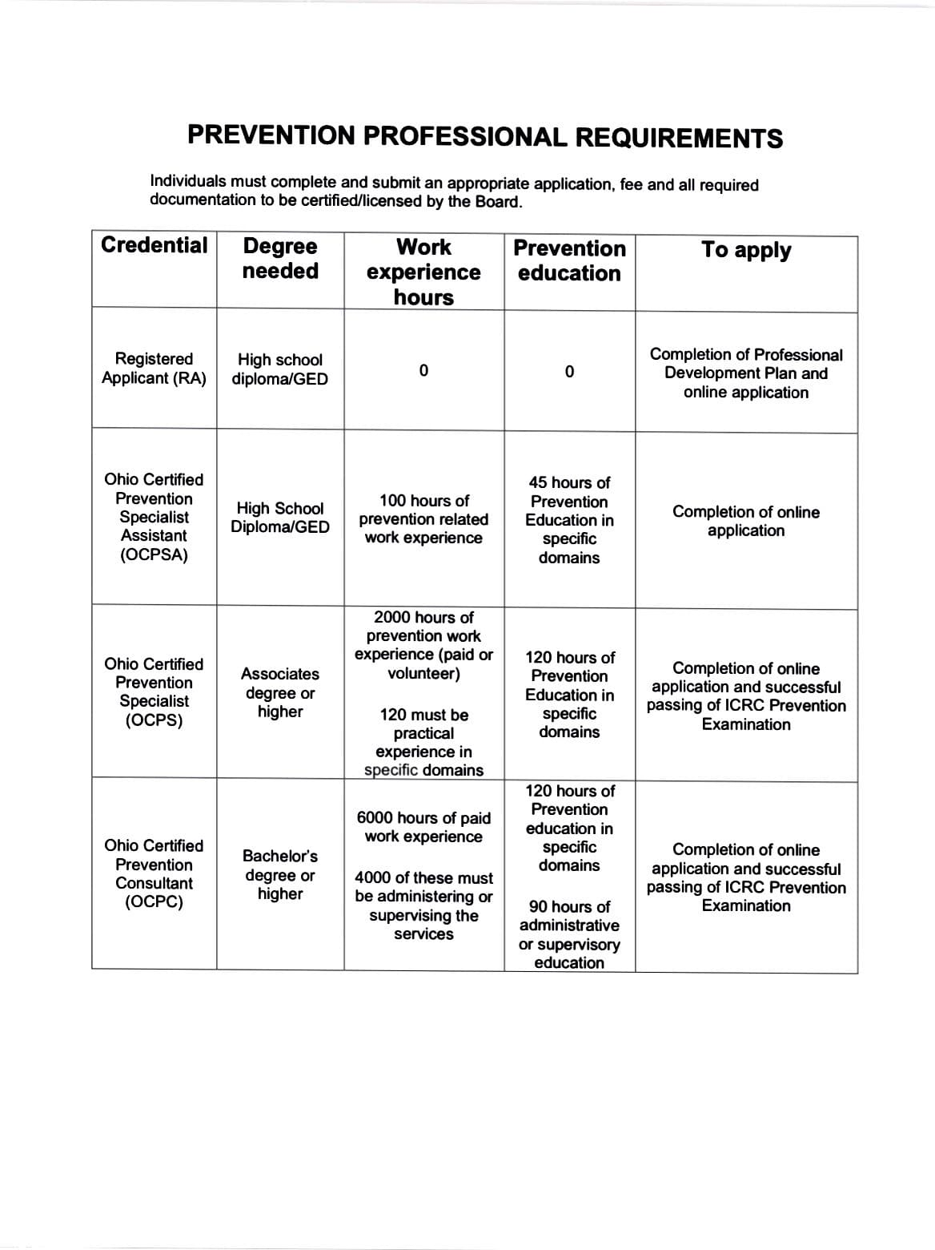
Prevention Credentialing in Ohio

Slide 32
Program Evaluation - Reach

Slide 33
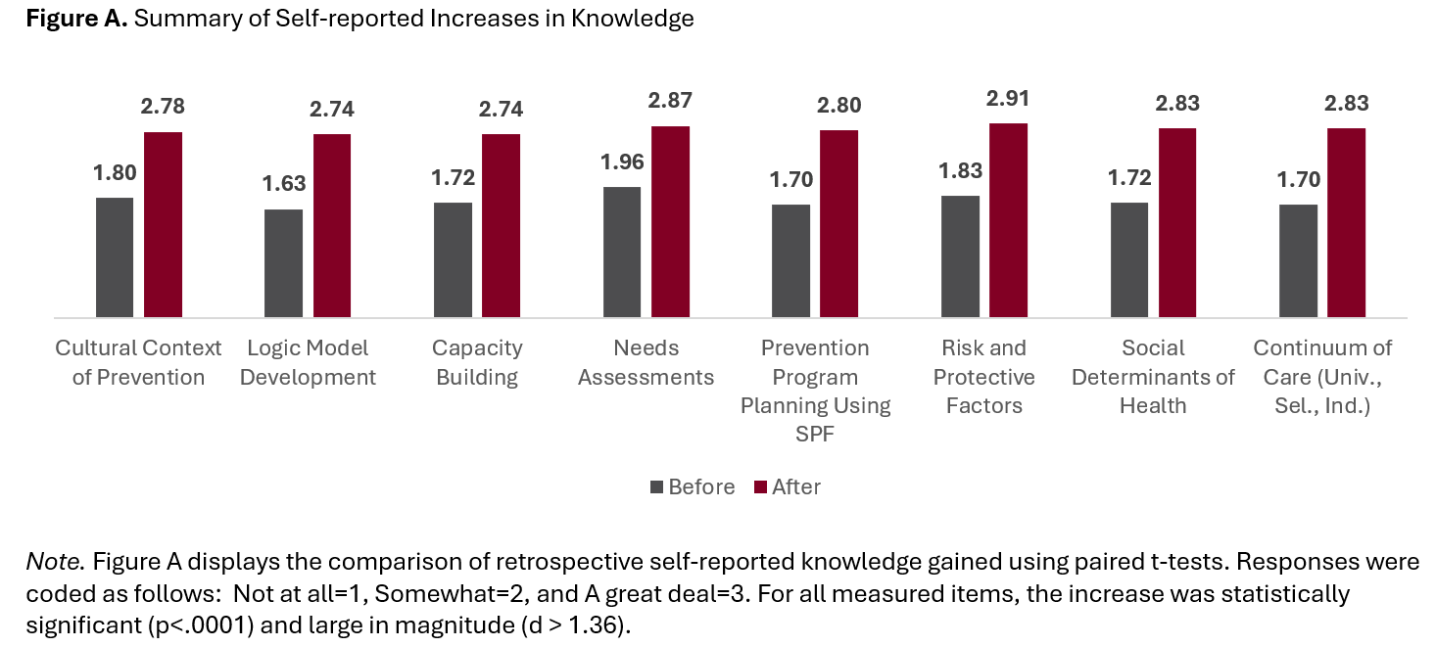
Program Evaluation - Knowledge

Slide 34
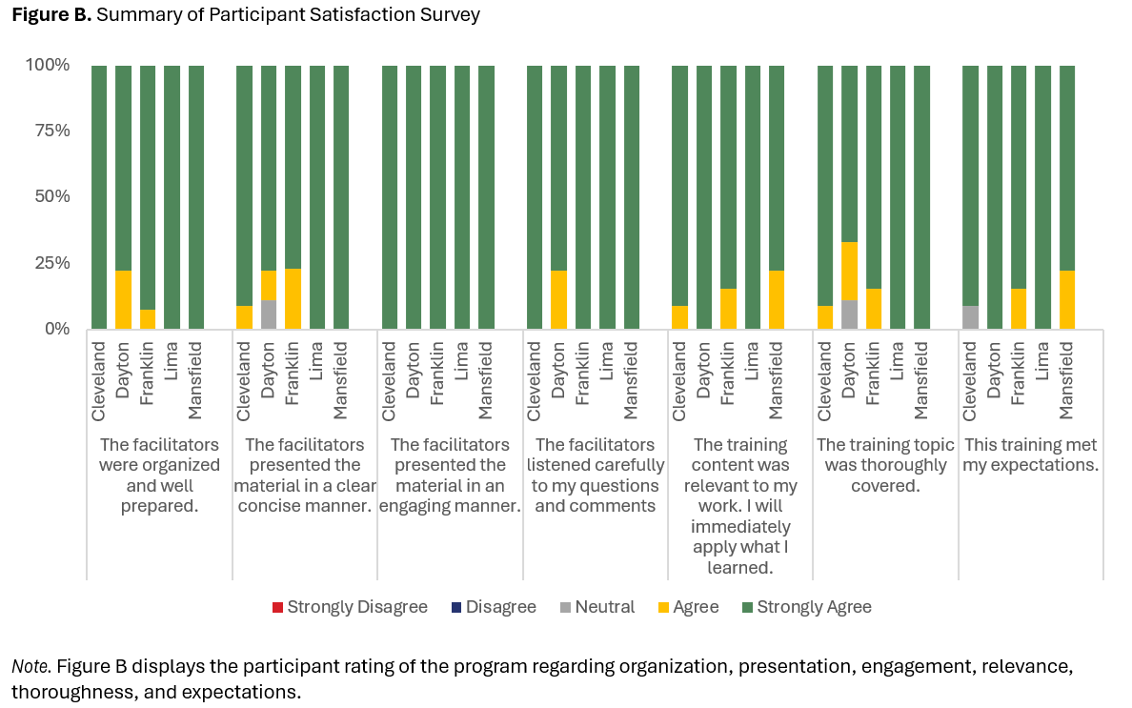
Program Evaluation - Satisfaction

Slide 35
Program Evaluation – Lessons Learned
Feedback is essential.
Culture matters.
Effective facilitation is essential.
Evaluation is ongoing, and it grows with the training.
Celebrate success.

Slide 36
Project Partners
Curriculum Development, Facilitation, and Wrap-around Support: Latysha “Happy” Askew, Albert Gay, Costella Green, Raylette Pickett Johnson, Tracy Johnson, Dr. Marketa Robinson, and Tasha Wilkerson
Credentialing Coaching and Mentoring: Takiyah Anderson and Christi Valentini-Lackner
Project Management and Evaluation: Shemane Marsh, Dr. Tessa Miracle, Dr. Holly Raffle, and Dr. Dawn Thomas
Hosting, Promotion, and UMADAOP Representation: Mr. Dennis Baker

Slide 37
Thank you!

