Slide 1

Equitable and innovative opioid overdose prevention and response in Chicago
National Prevention Network Conference
Phoenix, Arizona
Presented by:
Sarah Gabriella Hernandez, PhD
Chuck Klevgaard, CSPS
August 15, 2024

Slide 2


Equitable and Innovative Opioid Overdose Prevention and Response in Chicago
Learning Objectives
Learn about Chicago’s tapestry of innovative opioid overdose prevention programs and services
Understand how culturally responsive evaluation capacity building can support improved outcome measurement and program efficacy
Examine specific emergent community-centered strategies and promising practices to advancing opioid overdose prevention and response.

Slide 3

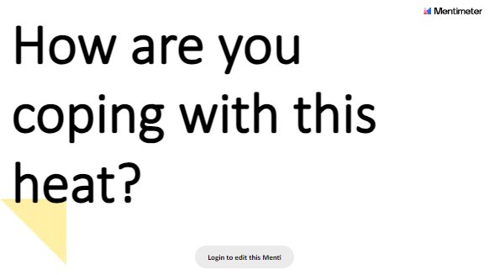

Slide 4






Opioid Overdose Prevention and Response in Chicago
At-A-Glance
75,000
6,900
50
79%
Chicago residents receive services per year.
Narcan kits distributed between 1-22 and 3-23.
Partner organizations are funded by CDPH
Of those diverted start treatment.
Over 300
Between 2019 and 2022
Chicago converted data from their opioid overdose alert system into an actionable response plan, which has advanced outreach efforts in persistent overdose hotspots.
Connected to same or next-day medications to treat opioid use disorder since program launch in May 2022.
Notes:
75,000 receive services, 80 Million Dollar Budget
50 Organizations, 18 outreach, serving 25 communities, CDPH convenes monthly meetings with over 50 partner organizations to review data and maps of opioid-related overdose EMS responses in 5 West Side communities and coordinate efforts.
Every community area in the city is impacted by opioid overdose, but the West Side of Chicago is most disproportionately impacted: East and West Garfield Parks, Humboldt Park, Austin, and North Lawndale account for 35% of all opioid overdoses in the City. The majority of opioid-related overdose deaths in Chicago involve fentanyl, a highly potent opioid.
900 diverted , 79 % participate in treatment, 50 % still in treatment 30 days later
MAR Now an innovative treatment hotline called Medication Assisted Recovery Now (MAR NOW) that connects callers looking for opioid use disorder treatment directly to a provider for immediate care. CALL 833-234-6343, 24/7 to be connected to immediate treatment. This includes being able to start on the medication buprenorphine at home that same day - a safe and effective treatment for opioid use disorder that does not require daily clinic appointments
CDPH operates 5 Public Health Vending Machines that offer harm reduction supplies at no cost to anyone in Chicago. The machines launched as a pilot program in Fall 2023 and aim to help prevent overdose and support the health and wellbeing of people in Chicago.
Narcan, the FDA-approved nasal spray form of naloxone, is a crucial tool in the public health response to the opioid crisis. Narcan is available for free in all 81 Chicago Public Library locations, as well as many Aldermanic offices and other community locations
In 2022, there were more opioid-related overdose deaths in Chicago (1,397) than homicides and traffic crash fatalities combined. Sixty-five percent of those fatalities were among Non-Latinx Black individuals and 78 percent were men.
opioid-related overdose deaths are one of the primary drivers in the life-expectancy gap between Black and non-Black Chicagoans, along with deaths from chronic diseases (e.g. heart disease, diabetes, etc.) and gun-related homicide. That gap in life expectancy, which in 2017 was 8.8 years, widened to 10 years pre-pandemic and then, due largely to disparities in COVID-19 outcomes, to 12.7 years in 2021. Data from 2022 show it at 11.4 years.
For example, during one recent 24-hour period there were 50 suspected opioid-related overdoses in the city. While every Chicago community area has had an opioid-related overdose EMS response (fatal or non-fatal) in the last three years, in 2023, 34% of such responses occurred in five West Side community areas: Austin, Humboldt Park, North Lawndale, East Garfield Park and West Garfield Park. It is typical to see a surge in cases during summer months.
In Chicago, opioid overdose responses and deaths primarily affects…
African American Men
Ages 50-59
West and South side neighborhoods
Recent spike in the summer in 2024 – Chicago like many parts of the country are seeing spikes
This highlights racial inequities at the community level. These neighborhoods have experienced historical disinvestment that limits access to social determinants of health that support health and wellness.

Slide 5

Equitable and Innovative Opioid Overdose Prevention and Response in Chicago
Overdose Data to Action (OD2A)
OD2A in States and OD2A:Local
CDC launched the first multiyear OD2A cooperative agreement in 2019 with 66 recipients (referred to as jurisdictions) from state, territorial, county, and city health departments.
In August 2023, CDC awarded new five-year cooperative agreements to 90 jurisdictions under two distinct OD2A programs, one designed for states, and one designed specifically for localities and territories.
Notes:
CDC launched the first multiyear OD2A cooperative agreement in 2019 with 66 recipients (referred to as jurisdictions) from state, territorial, county, and city health departments. In August 2023, CDC awarded new five-year cooperative agreements to 90 jurisdictions under two distinct OD2A programs, one designed for states, and one designed specifically for localities and territories.
CDC created OD2A in States and OD2A: LOCAL to:
Address the evolving epidemiology of the drug overdose crisis.
Close identified gaps in prevention activities.
Apply lessons learned from the previous OD2A funding opportunity.
Leverage the differing roles and spheres of influence state and local health departments and their partners have.
OD2A: LOCAL
Required: Overdose surveillance infrastructure
Optional and competitive: Toxicologic testing of drug products and/or paraphernalia
Optional and competitive: Surveillance of linkage to and retention in care
Required in community, public safety, and healthcare settings: Linkage to and retention in care
Required in community, public safety, and healthcare settings: Harm reduction
Required in healthcare settings: Clinician and health systems best practices
Optional: Stigma reduction
Optional: Health IT enhancements
Chicago converted data from their opioid overdose alert system into an actionable response plan, which has advanced outreach efforts in persistent overdose hotspots. As a result, there are now teams and processes in place to respond to overdose spikes with naloxone, education, and linkages to additional resources via outreach events.

Slide 6
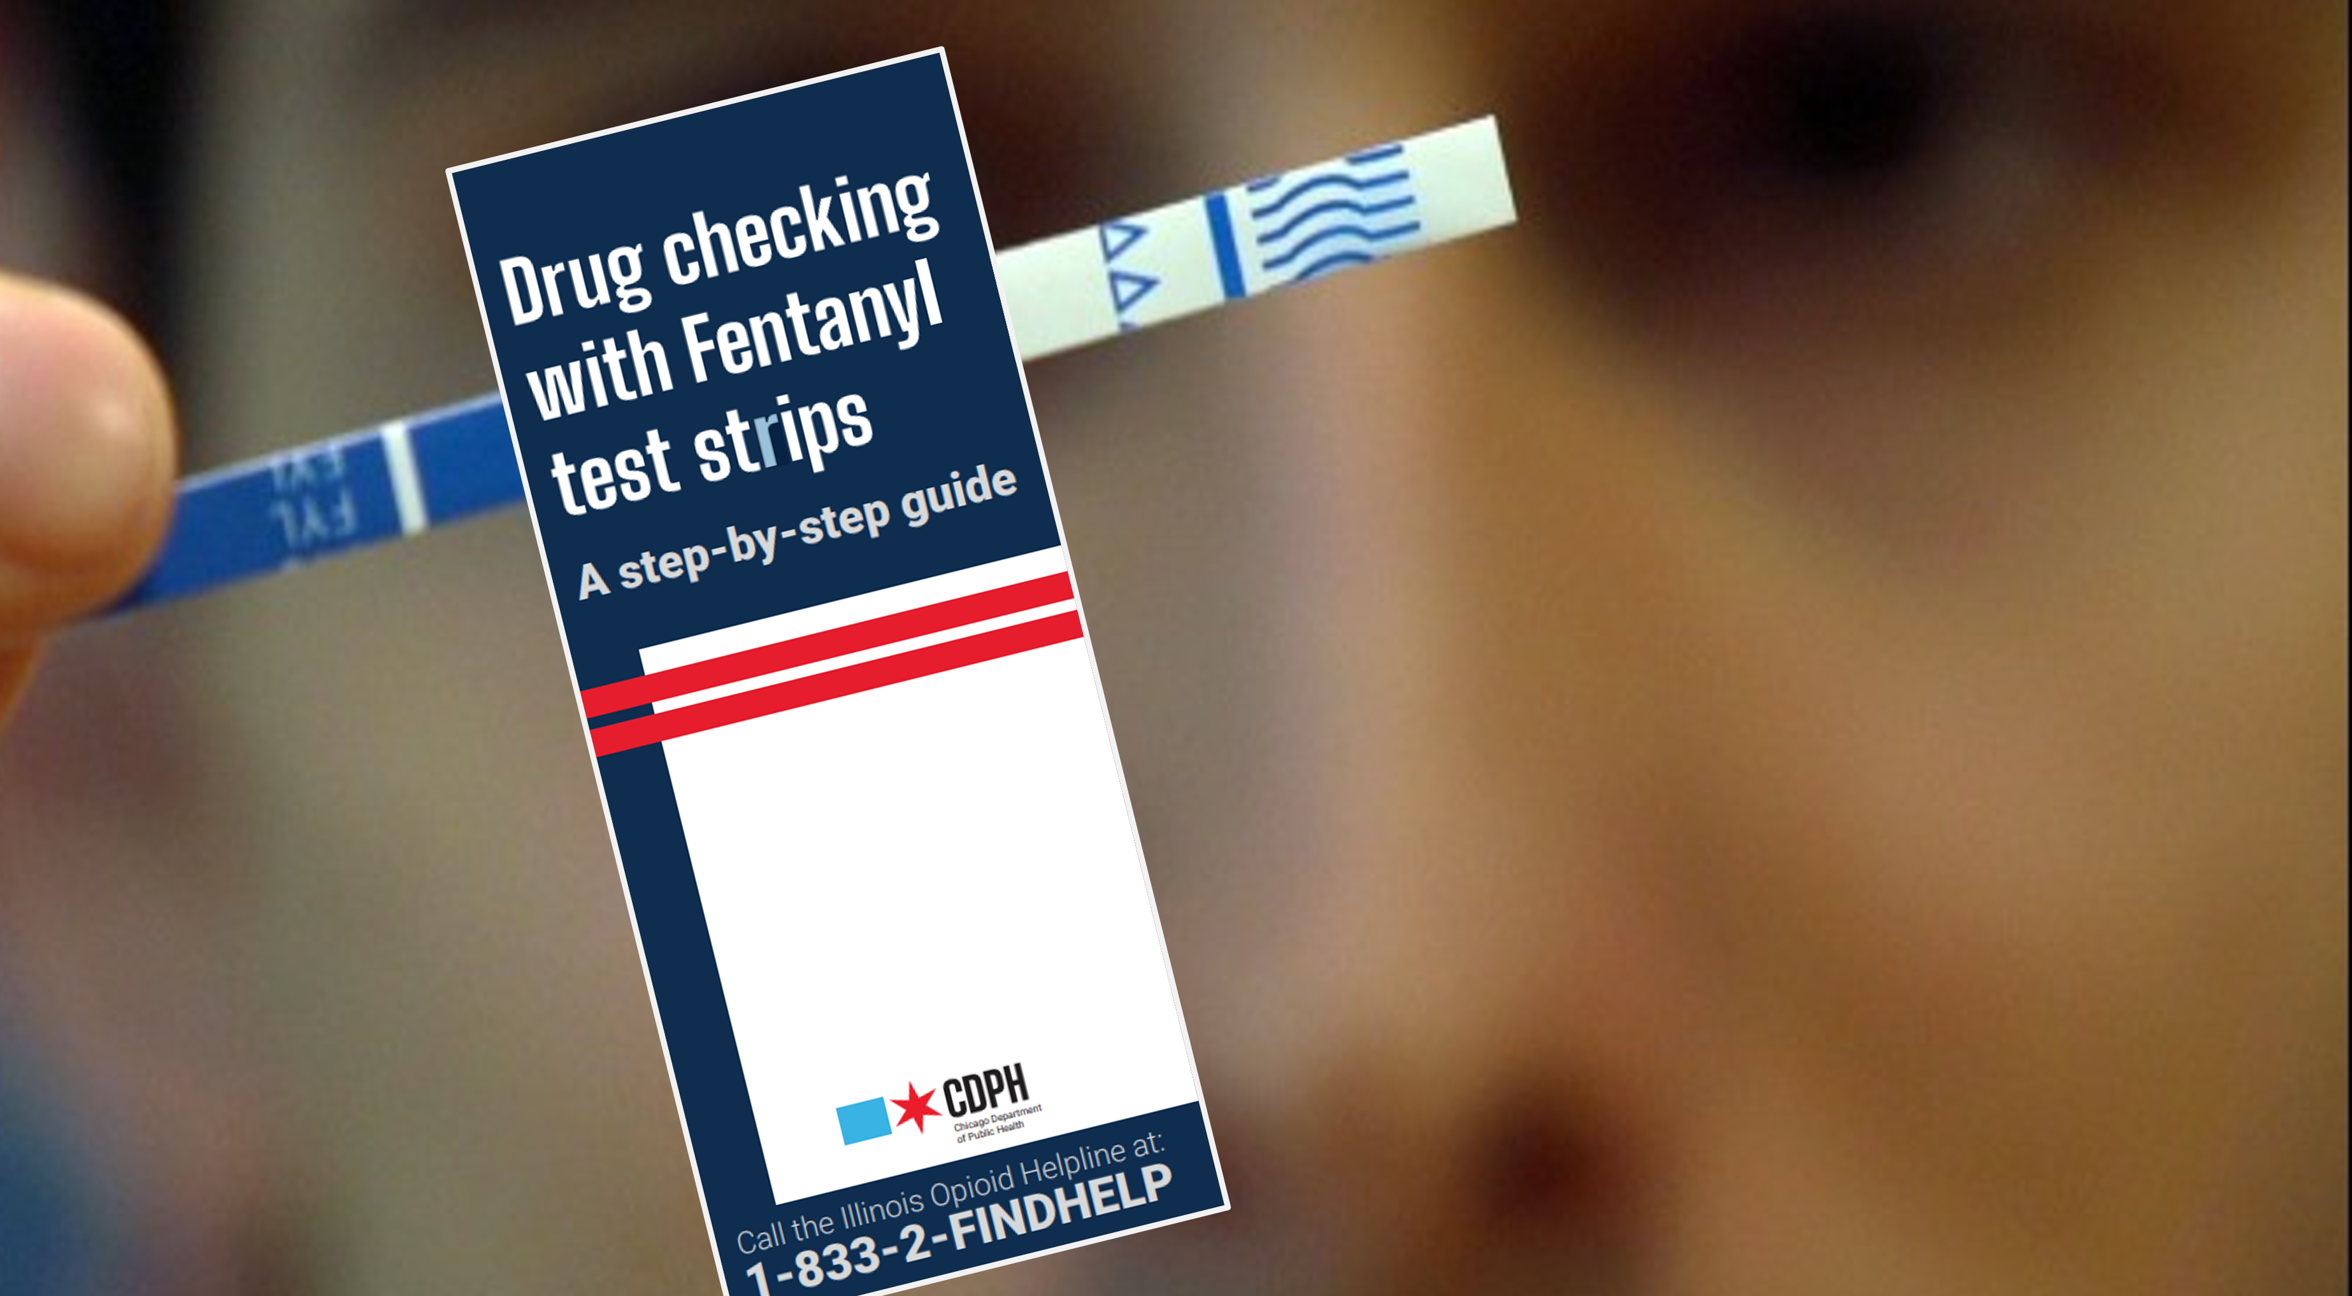

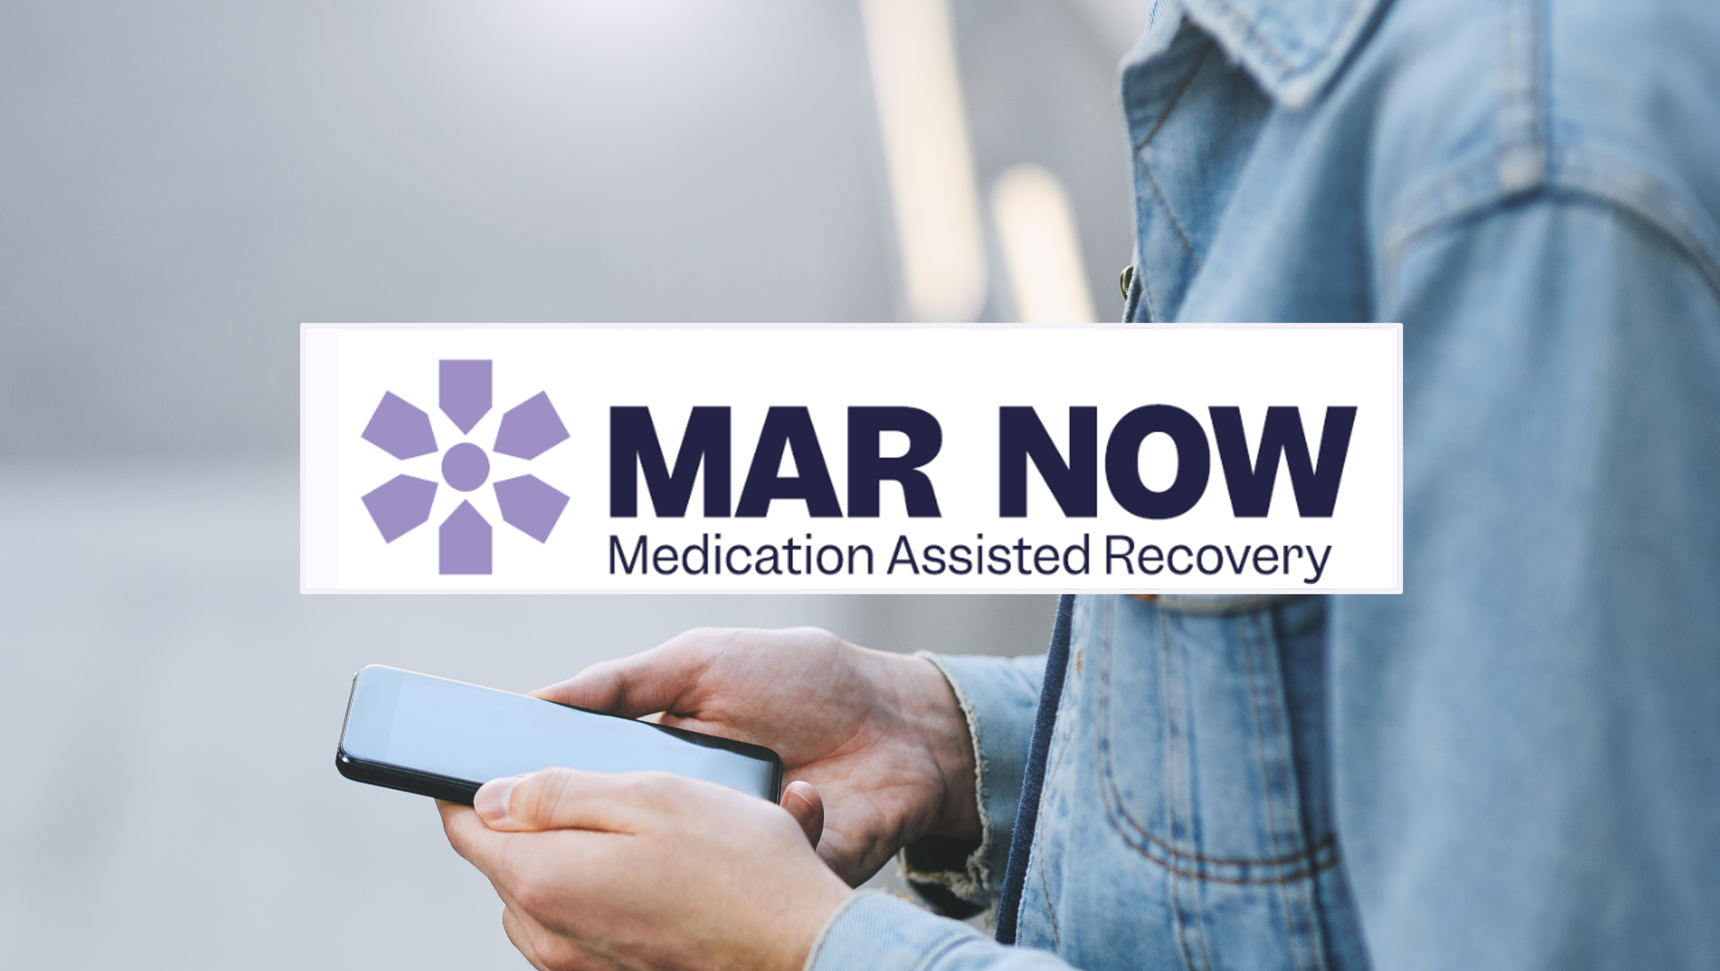
Equitable and Innovative Opioid Overdose Prevention and Response in Chicago
Chicago’s Strategies
Harm reduction resources and programs to Chicago’s most impacted communities
Hyperlocal Outreach
to distribute harm-reduction supplies including overdose reversal medication Narcan, and test strips to check for the presence of the powerful synthetic form of opioids, fentanyl. Visit bit.ly/find narcan for a list of locations with free harm reduction tools.
Community Education
on overdose prevention, including hyperlocal heat-mapping that reviews data and maps of opioid-related overdose EMS responses, and provider education.
Connection to Treatment
for opioid use disorder (OUD) including same-day access to medication treatment. Medication Assisted Recovery (MAR) consists of FDA-approved medications that reduce the risk of drug overdose and death, reduces withdrawal symptoms, and supports care engagement over time.
Notes:
CDPH’s response to the opioid overdose crisis includes a three-pronged strategy that is flooding resources to areas seeing overdose surges:
Hyperlocal outreach to distribute harm-reduction supplies including overdose reversal medication Narcan, and test strips to check for the presence of the powerful synthetic form of opioids, fentanyl. Visit bit.ly/findnarcan for a list of locations with free harm reduction tools.
Community education on overdose prevention, including hyperlocal heat-mapping that reviews data and maps of opioid-related overdose EMS responses, and provider education.
Connection to treatment for opioid use disorder (OUD) including same-day access to medication treatment— the Medication Assisted Recovery (MAR) NOW program which is a partnership with the Illinois Department of Human Services Division of Substance Use Prevention and Recovery (IDHS/SUPR) and Family Guidance Centers. MAR consists of FDA-approved medications that reduce the risk of drug overdose and death, reduces withdrawal symptoms, and supports care engagement over time.

Slide 7
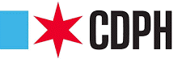
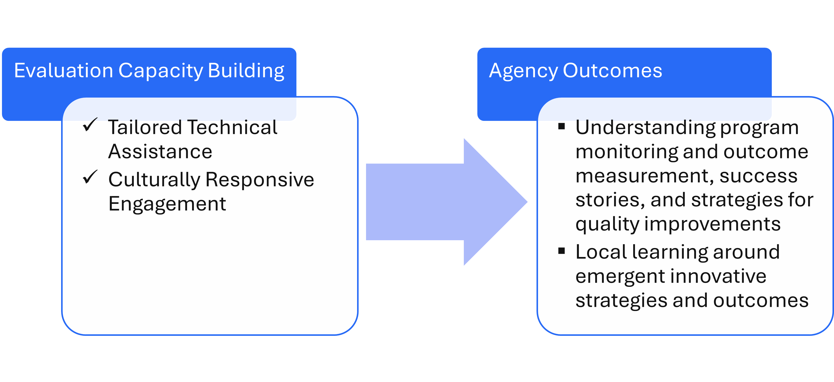





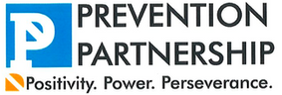
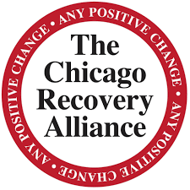
Equitable and Innovative Opioid Overdose Prevention and Response in Chicago
Evaluation Capacity Building Project
Tailored Technical Assistance
Agency Outcomes
Culturally Responsive Engagement
Evaluation Capacity Building
Understand program monitoring and outcome measurement, success stories, and strategies for quality improvements
Promote local learning around emergent innovative strategies and outcomes
Evaluation activities

Slide 8
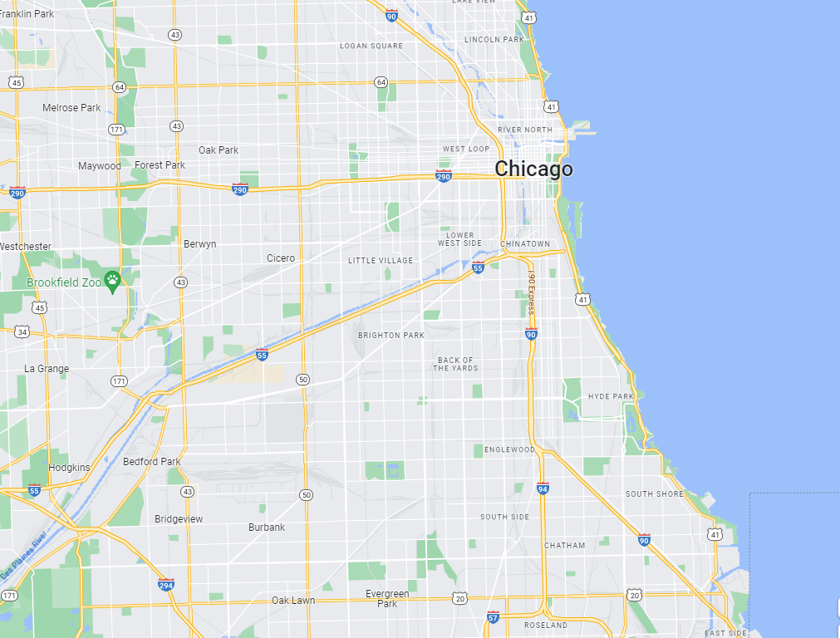



Prevention Partnership
Education Development Center
Illinois Public Health Institute
University of Chicago Crime Lab
UIC COIP
Chicago Department of Public Health
Chicago Recovery Alliance
The Thresholds
Family Guidance Centers
OD2A
Delegate Agencies
Cook County Sheriffs Office
Cook County Department of Public Health
Equitable and Innovative Opioid Overdose Prevention and Response in Chicago
Notes:
Range of programs, including MAT/MAR service provision, data monitoring, drug checking program, sobering tent, warm handoff and linkage to care programs, and narcotics arrest diversion program
UIC COIP
Cook County Department of Public Health
Illinois Public Health Institute
Family Guidance Centers
Thresholds
University of Chicago Crime Lab
Cook County Sheriff's Office
Chicago Recovery Alliance
Prevention Partnership

Slide 9


Chicago Overdose Data to Action (OD2A)
Building meaningful, data-informed, and community-centered solutions
Wednesday, June 21st, 2023
10:00am – 2:00pm CST
Loretto Hospital, Chicago
Notes:
As part of our evaluation capacity building, we convened agencies for an evaluation roundtable session in which agencies first learned of CDPH’s efforts in opioid overdose prevention and response since 2020, and then engaged in structured peer sessions to co-develop ideas, innovations, and community centered solutions to opioid overdose response and prevention in Chicago.

Slide 10
Equitable and Innovative Opioid Overdose Prevention and Response in Chicago
Evaluation Roundtable
Goals and Objectives
Reflect on CDPH OD2A
Learn about progress, innovations, and lessons learned
Celebrate Delegate Work
Hear agency innovations and successes
Peer Engagement and Discussion
Identify strategies to advance this work in Chicago
Networking
Participate in Gallery Walk to build strategic connections

Slide 11
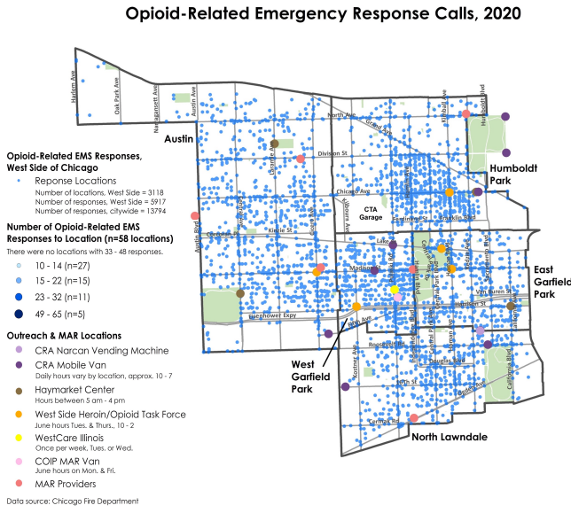
Equitable and Innovative Opioid Overdose Prevention and Response in Chicago
Progress We’ve Made
Mapping Trends
In 2021, CDPH began hyperlocal mapping at the request of delegates and partners, in addition to publishing annual Opioid Surveillance Reports and Mid-Year Briefs.

Slide 12
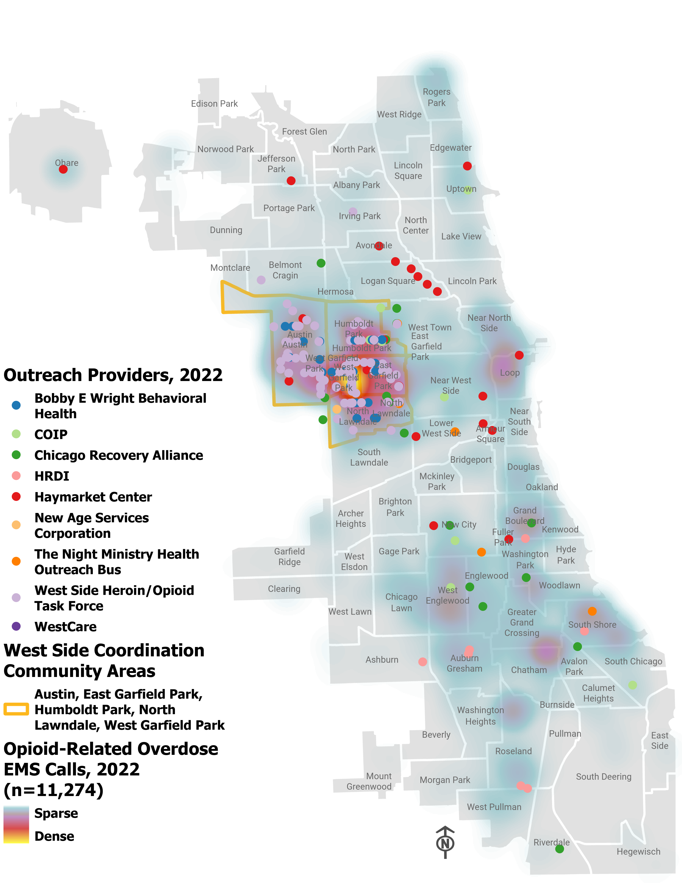
Equitable and Innovative Opioid Overdose Prevention and Response in Chicago
Progress We’ve Made
Mapping Trends
CDPH holds monthly West Side meetings to cover EMS data and outreach and to provide a space for coordination.
Focus on 5 West Side community areas:
Austin, East Garfield Park, Humboldt park, North Lawndale, West Garfield Park
Usually account for about 35% of Chicago's opioid-related overdose EMS responses

Slide 13
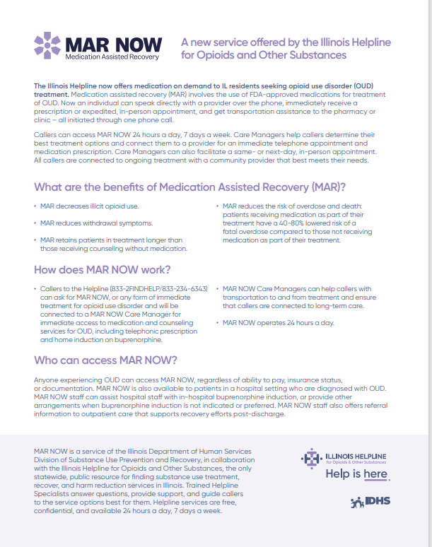
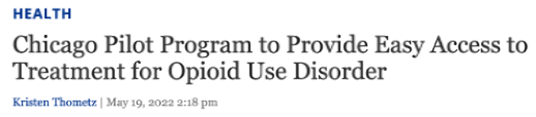
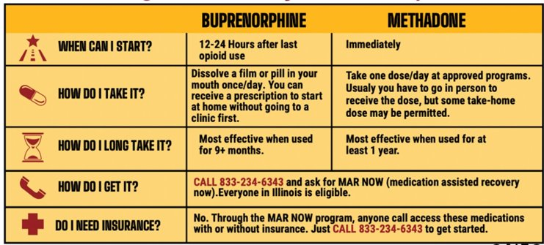
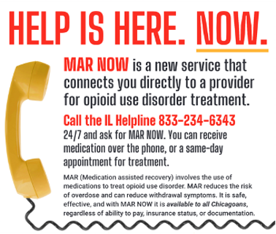
Equitable and Innovative Opioid Overdose Prevention and Response in Chicago
CDPH Innovations & Successes
MAR NOW
OSU funds agencies to provide treatment and recovery services for people with substance use disorders and has worked closely with Family Guidance Center and Illinois Department of Human Services Division of Substance Use Prevention and Recovery (IDHS/SUPR) to launch a successful opioid treatment program that connects anyone across the entire state to immediate opioid treatment.
MAR NOW:
Medication Assisted Recovery NOW opioid treatment hotline launched May 2022.
Anyone can call the IL helpline regardless of insurance, documentation or ability to pay

Slide 14
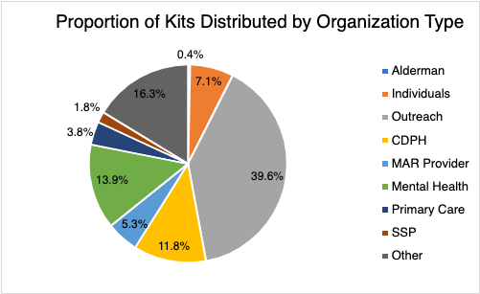
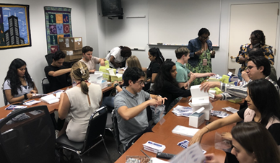
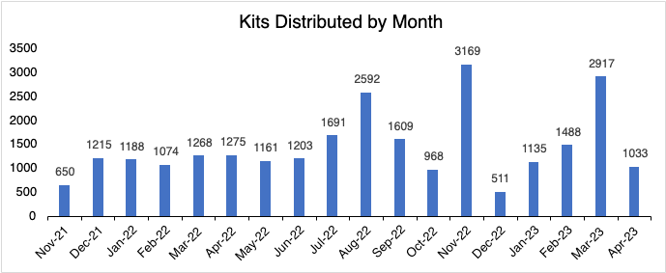
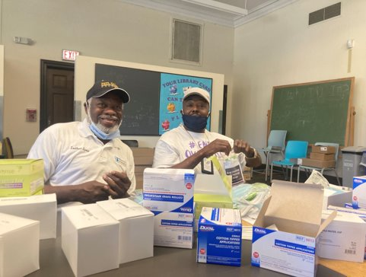
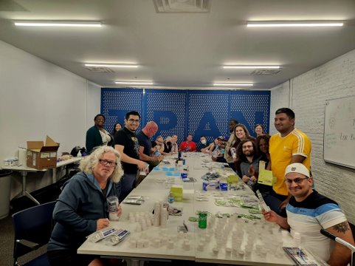
CDPH Innovations & Successes
Fentanyl Test Kit Distribution
This project started October 2021
Average output: 1,447.5 Kits distributed per month
We have distributed over 28,000 Fentanyl test kits which is 115,000 test strips to various communities
Drug testing empowers individuals to make informed decisions
Equitable and Innovative Opioid Overdose Prevention and Response in Chicago

Slide 15
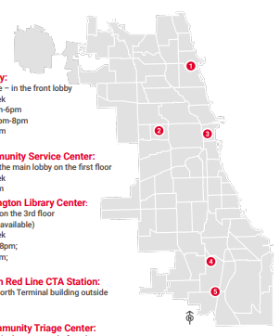
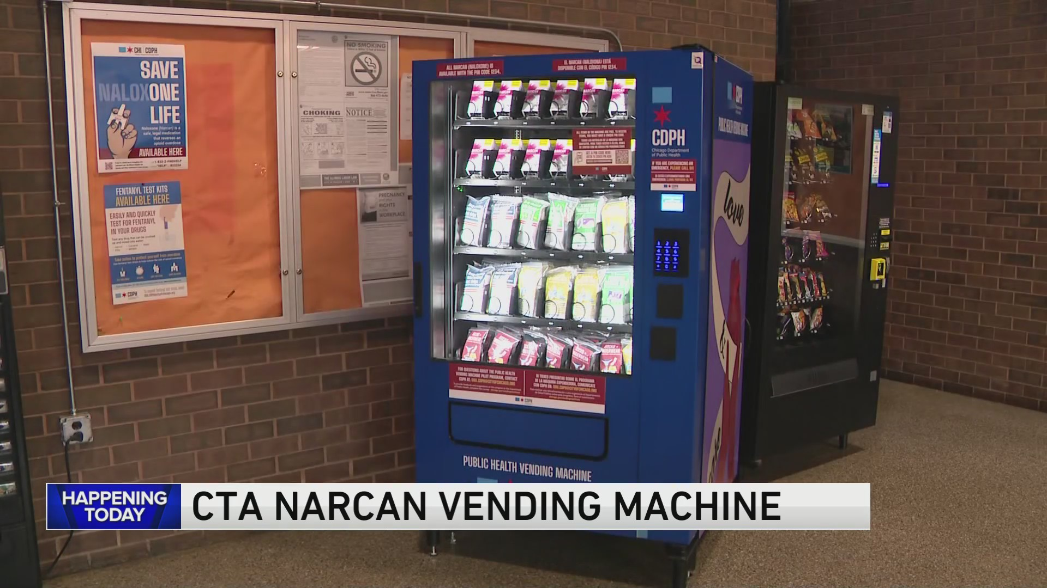
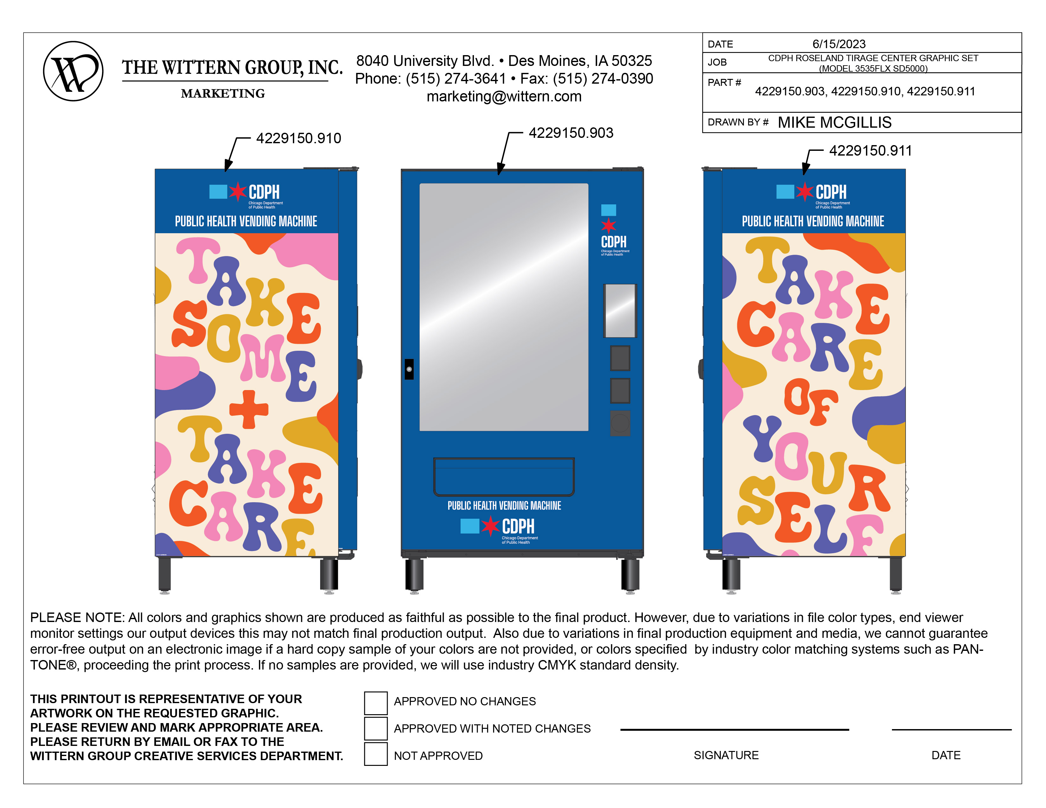
Equitable and Innovative Opioid Overdose Prevention and Response in Chicago
CDPH Innovations & Successes
Vending Machines
Vending Machines are coming soon to a community area near you!
5 confirmed locations

Slide 16



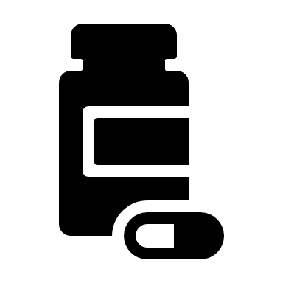







04 Medication Assisted Treatment
Expanding and Improving Services
Equitable and Innovative Opioid Overdose Prevention and Response in Chicago
05 Human Centered Services
Building trust and reducing stigma.
01 Immediate Resources ​Provision of safe housing and basic needs.
02 Systemic issues
Issues preventing individuals from accessing services.
06 Comprehensive Resource Hub
Coordination of data and services
RoundTable Event
Community centered solutions to opioid overdose response and prevention in Chicago
07 Hot Spot Corridors
Persistent Overdose in geographic areas of the city
03 Sector-wide Staffing
Retention and burnout challenges.

Slide 17

Equitable and Innovative Opioid Overdose Prevention and Response in Chicago
RoundTable Discussions
Chicago’s needs
Leveraging partnerships
Advancing our goals
Notes:
agencies engaged in structured peer sessions to co-develop ideas, innovations, and community centered solutions to opioid overdose response and prevention in Chicago.
What do we need in Chicago to advance opioid overdose prevention and response? What could be meaningful, data informed, and community centered solutions?
How can we leverage this network of people and organizations to accomplish our goals?
How can the city of Chicago and CDPH help to advance these goals and support agencies?
After discussing data insights, innovations and successes, and lessons learned, we engaged agencies in roundtable small group discussions to learn about…

Slide 18

Equitable and Innovative Opioid Overdose Prevention and Response in Chicago
RoundTable Event
Community centered solutions to opioid overdose response and prevention in Chicago
04 Medication Assisted Treatment
Expanding and Improving Services
01 Immediate Resources ​Provision of safe housing and basic needs.
05 Human Centered Services
Building trust and reducing stigma.
02 Systemic issues
Issues preventing individuals from accessing services.
06 Comprehensive Resource Hub
Coordination of data and services
03 Sector-wide Staffing
Retention and burnout challenges.
07 Hot Spot Corridors
Persistent Overdose in geographic areas of the city

Slide 19





Equitable and Innovative Opioid Overdose Prevention and Response in Chicago
1. Safe Housing and Basic Needs Provision
Homelessness and unstable housing are associated with higher incidence of alcohol and drug use, sexual risk behaviors and HIV acquisition, and poorer health outcomes. ¹
Overdose survivors experiencing unsheltered homelessness describe a chaotic public drug scene and resort to residing in nearby encampments because the existing shelter, housing, and addiction treatment systems were unwelcoming, difficult to navigate, or unaffordable. ²
Pan, Y., Metsch, L. R., Wang, W., Philbin, M., Kyle, T. L., Gooden, L. K., & Feaster, D. J. (2020). The Relationship Between Housing Status and Substance Use and Sexual Risk Behaviors Among People Currently Seeking or Receiving Services in Substance Use Disorder Treatment Programs. The journal of primary prevention, 41, 363-382.
Paradise, R. K., Desmarais, J., O'Malley, S. E., Hoyos-Cespedes, A., Nurani, A., Walley, A. Y., ... & Kimmel, S. D. (2023). Perspectives and recommendations of opioid overdose survivors experiencing unsheltered homelessness on housing, overdose, and substance use treatment in Boston, MA. International Journal of Drug Policy, 119, 104127.
Increase awareness of readily accessible resources for organizations and their clients
Use 311 as a resource rather than barrier to treatment
Propose for closed hospitals and hotels to serve as safe housing or temporary shelters
Expand support for people experiencing homelessness in Chicago, including prioritizing research, program development, service provision, and additional funding
Notes:
Immediate resources include access to food, clothing, safe shelter, treatment, and additional services relevant to the individual’s complex needs like crisis support services, overdose prevention resources, and safe injection sites
311 operators can report an individual’s needs for services to appropriate organizations/agencies and check the status of previous service requests. Although the system is designed to address non-emergency situations, individuals in distress in addition to mental health professionals and healthcare workers dial 311 to obtain information regarding City pro
Approval from the government and federal funding is needed to use hotels as a safe shelter for vulnerable populations experiencing homelessness, which offers a strategy to increase housing resources. grams.
Create work groups to conduct research/collect and analyze data on complex needs of homeless populations including variables/factors impeding access to comprehensive treatment services. Qualitative data is needed/essential.
Recent studies have consistently shown that homelessness and unstable housing are
associated with higher incidence of alcohol and drug use, sexual risk behaviors and HIV
acquisition, and poorer health outcomes such as mental illness, psychiatric disorders,
tuberculosis, asthma, and bronchitis.¹
Overdose survivors experiencing unsheltered homelessness described a chaotic public drug scene but resorted to residing in nearby encampments because the existing shelter, housing, and addiction treatment systems were unwelcoming, difficult to navigate, or unaffordable. Despite efforts to provide low-threshold housing in Boston, additional low-barrier housing services (i.e., including harm reduction resources and without "sobriety" requirements) could promote the health and safety of people who use drugs and are experiencing homelessness.²
References for Recommendations for Housing
Pan, Y., Metsch, L. R., Wang, W., Philbin, M., Kyle, T. L., Gooden, L. K., & Feaster, D. J. (2020). The Relationship Between Housing Status and Substance Use and Sexual Risk Behaviors Among People Currently Seeking or Receiving Services in Substance Use Disorder Treatment Programs. The journal of primary prevention, 41, 363-382.
Paradise, R. K., Desmarais, J., O'Malley, S. E., Hoyos-Cespedes, A., Nurani, A., Walley, A. Y., ... & Kimmel, S. D. (2023). Perspectives and recommendations of opioid overdose survivors experiencing unsheltered homelessness on housing, overdose, and substance use treatment in Boston, MA. International Journal of Drug Policy, 119, 104127.

Slide 20
Equitable and Innovative Opioid Overdose Prevention and Response in Chicago
2. Systemic Issues Preventing Individuals, Particularly from Marginalized/underserved groups, from Accessing Services
Disparities in overdose mortality rates are not fully explained by substance use patterns and result from unequal access to substance use treatment services, socioeconomic inequities, and social determinants of health ³
A multisectoral approach that includes structural and policy-level changes and clinician- and health-system–based approaches, with an intentional focus on disparities and the long-standing inequities is essential to respond to this crisis.⁴
Kariisa, M., Davis, N. L., Kumar, S., Seth, P., Mattson, C. L., Chowdhury, F., & Jones, C. M. (2022). Vital signs: drug overdose deaths, by selected sociodemographic and social determinants of health characteristics—25 states and the District of Columbia, 2019–2020. Morbidity and Mortality Weekly Report, 71(29), 940.
Beals M. Drug overdose deaths reach record high. The Hill. February 16, 2022. Available at: https://thehill.com/policy/healthcare/594630-drugoverdose- deaths-reach-record-high. Accessed February 25, 2022.
Develop an efficient system to track referrals and care coordination across agencies
Collaborate with peer agencies to engage in mutual mental health services (i.e., warm handoffs, follow-up during and after referral process)
Identify a champion within ER Departments to ensure delivery of quality healthcare to patients, with a focus on warm handoffs
Notes:
Social determinants of health (SDOH) have been underutilized in addressing drug overdose crisis, and they are more important than ever now, given the 16% rise in drug overdose deaths with the emergence of the coronavirus disease 2019 pandemic.⁴
A multisectoral approach that includes structural and policy-level changes and clinician- and health-system–based approaches, with an intentional focus on racial and ethnic disparities and the long-standing inequities that contribute to increased risk for overdose, is essential to respond to this urgent public health crisis.” ⁵
Warm Handoffs, Sometimes referred to as warm handoffs, these interventions represent a collaborative effort among law enforcement, medical providers, social workers, and prevention professionals to engage individuals who have experienced a non-fatal overdose and their family members in the period immediately following the overdose event. ⁶
OD survivors engaged in emergency departments or other health care “touchpoints” are excellent candidates for OEND and other OD prevention interventions. For these initiatives to be effective, however, some health-care providers may require training interventions of their own, designed to reduce negative and stigmatizing views of PWUO, OD survivors, and substance use disorders in general.. To address attitudinal barriers among providers, programs are emerging to help reduce stigma toward PWUO among medical students and nurses in training, and a promising program delivering OEND curricula for medical students and grounded in harm reduction has recently been developed. ⁸
Establishing community and local partnerships, particularly in resource-limited areas, is crucial for the continuity of addiction care and rehabilitation outcomes. ⁹
Stigma has been called out by scholars as a major barrier to the success of mental health reform; this demonstrates the intersections between media narratives and institutional inequities, specifically law and regulation. (National Academies of Sciences, 2016) This is to say that stigma exists, not just as an interpersonal issue, but as a systemic structural issue that permeates through media narratives, institutions, laws and regulations. ⁹

Slide 21
Equitable and Innovative Opioid Overdose Prevention and Response in Chicago
3. Sector-wide Staffing Retention and Burnout Challenges
Explore strategies and solutions to addressing barriers to treatment that are commonly observed among many organizations. Agencies have reported staffing shortages, retention/burnout, language barriers and lack of DEI resources which have impacted client retention/satisfaction.
Recruitment and retention struggles that continue to challenge the SUD treatment and recovery services workforce. ⁵
This challenge of staffing acts as a barrier for health departments, not only in the administration of regular projects and programming, but also in obtaining new foundational programming that can address health inequity or insights that could improve upon current programming using some of the health equity actions previously mentioned.
Ryan, O., Murphy, D., Krom, L. (2012). Vital Signs: Taking the Pulse of the Addiction Treatment Workforce, A National Report, Version 1. Kansas City, MO: Addiction Technology Transfer Center National Office in residence at the University of Miss
Notes:
Recruitment and retention struggles that continue to challenge the SUD treatment and recovery services workforce. States are applying a variety of strategies to address the SUD treatment and recovery services workforce shortage, including offering free or low-cost training and education tools to help SUD professionals enhance their skills, often in collaboration with the ATTC Network. States are expanding their SUD workforce through telehealth and technology tools, such as video conferencing and mobile apps for recovery support. Training and certifying peer counselors and recovery coaches is also helping to build the workforce. ¹¹
The SU Corporate training series, Mark sanders event
Lack of staff & associated skills: The inability of some departments to acquire or retain trained staff was shared as a challenge in addition to the fact that some health departments are understaffed (e.g. some were reported as having as little as four people) and, thus, have limitations on the types and numbers of programs they can implement in their jurisdiction. This challenge of staffing acts as a barrier for health departments, not only in the administration of regular projects and programming, but also in obtaining new foundational programming that can address health inequity or insights that could improve upon current programming using some of the health equity actions previously mentioned.¹¹
Ryan, O., Murphy, D., Krom, L. (2012). Vital Signs: Taking the Pulse of the Addiction Treatment Workforce, A National Report, Version 1. Kansas City, MO: Addiction Technology Transfer Center National Office in residence at the University of Miss

Slide 22
Equitable and Innovative Opioid Overdose Prevention and Response in Chicago
4. Expanding and Improving Medication Assisted Recovery Programs
Despite the protective effect of MAT on mortality, barriers still exist in the access to and utilization of MAT. Better retention in MAT is associated with a decreased likelihood of overdose. ⁶
People seeking treatment with MOUD often experience long travel-times, insurance barriers, prohibitive out-of-pocket expenses, provider stigma and long waitlists; some of these problems worsened during COVID-19. Many people die waiting to receive treatment. ⁷
Au, V. Y., Rosic, T., Sanger, N., Hillmer, A., Chawar, C., Worster, A., ... & Samaan, Z. (2021). Factors associated with opioid overdose during medication-assisted treatment: How can we identify individuals at risk?. Harm Reduction Journal, 18(1), 1-10.
NACo Opioid solutions Strategy Brief, Medication-Assisted Treatment (“MAT”) For Opioid Use Disorder,
Publicize service area map and information
Increase awareness and education
Provide ongoing coordination of care and make multiple follow-up calls as intentional effort to ensure patient access to immediate life-saving treatment.
Notes:
Our findings indicate that a considerable proportion of patients enrolled in MAT are affected by past or recent overdose. Additionally, there are significant differences in sociodemographic, treatment, substance use, and mental/physical health characteristics among patients stratified by their overdose status. Our study’s findings also concur with previous literature that suggests better retention in MAT is associated with a decreased likelihood of overdose ¹²
Despite the protective effect of MAT on mortality, barriers still exist in the access to and utilization of MAT . Facing the situation of limited coverage of OST and other harm reduction
interventions in worldwide, increased coverage and expanding access to MAT are crucial components of the effort to reduce opioids-related deaths and alleviate disease burden. ¹⁴
People seeking treatment with MOUD often experience long travel-times, insurance barriers, prohibitive out-of-pocket expenses, provider stigma and long waitlists; some of these problems worsened during COVID-19. Many people die waiting to receive treatment^{.15}
Stigmatization and aspects of the healthcare systems as facilitators and related barriers 16
References
Au, V. Y., Rosic, T., Sanger, N., Hillmer, A., Chawar, C., Worster, A., ... & Samaan, Z. (2021). Factors associated with opioid overdose during medication-assisted treatment: How can we identify individuals at risk?. Harm Reduction Journal, 18(1), 1-10.
Ma, J., Bao, Y. P., Wang, R. J., Su, M. F., Liu, M. X., Li, J. Q., ... & Lu, L. (2019). Effects of medication-assisted treatment on mortality among opioids users: a systematic review and meta-analysis. Molecular psychiatry, 24(12), 1868-1883
NACo Opioid solutions Strategy Brief, Medication-Assisted Treatment (“MAT”) For Opioid Use Disorder, https://www.naco.org/sites/default/files/documents/OSC_MOUD_Brief_June2023.pdf
Cernasev A, Hohmeier KC, Frederick K, Jasmin H, Gatwood J. A systematic literature review of patient perspectives of barriers and facilitators to access, adherence, stigma, and persistence to treatment for substance use disorder. Explor Res Clin Soc Pharm. 2021;2:100029. Available here.

Slide 23

Equitable and Innovative Opioid Overdose Prevention and Response in Chicago
5. Supporting a Comprehensive Resource Hub for Service Provision and Data
Collaboration between public health, EMS, and academic partners, can inform targeted response efforts, guiding decision-makers to allocate the most needed public health and clinical resources to the neighbor-hoods that need them most. ⁷
Stopka, T. J., Jacque, E., Kelley, J., Emond, L., Vigroux, K., & Palacios, W. R. (2021). Examining the spatial risk environment tied to the opioid crisis through a unique public health, EMS, and academic research collaborative: Lowell, Massachusetts, 2008–2018. Preventive Medicine Reports, 24, 101591.
Support an organization to establish an online resource hub, and to coordinate across service providers to maintain and disseminate up to date information on services, current availability, resources, and data
Integrate online data dashboards and data archives of EMS opioid overdose responses
Notes:
Through an innovative collaboration between public health, EMS, and academic partners, we employed GIS, spatial and trend analyses of opioid-related outcome data enabling assessment of the risk landscape, identification of overlapping patterns, and provision of findings to inform local public health intervention efforts. Results produced through these analyses can inform targeted response efforts, guiding decision-makers to allocate the most needed public health and clinical resources to the neighborhoods that need them most.
Stopka, T. J., Jacque, E., Kelley, J., Emond, L., Vigroux, K., & Palacios, W. R. (2021). Examining the spatial risk environment tied to the opioid crisis through a unique public health, EMS, and academic research collaborative: Lowell, Massachusetts, 2008–2018. Preventive Medicine Reports, 24, 101591.

Slide 24

Equitable and Innovative Opioid Overdose Prevention and Response in Chicago
6. Supporting Human-centered Service Provision
Stigmatization and aspects of the healthcare systems as facilitators and related barriers ⁷
Cernasev A, Hohmeier KC, Frederick K, Jasmin H, Gatwood J. A systematic literature review of patient perspectives of barriers and facilitators to access, adherence, stigma, and persistence to treatment for substance use disorder. Explor Res Clin Soc Pharm. 2021;2:100029.
Continually build trust while seeking to reduce stigma of services
Provide comprehensive treatment services with love, empathy, and compassion

Slide 25
Equitable and Innovative Opioid Overdose Prevention and Response in Chicago
7. Persistence of “Hot Spots” of Fatal and Nonfatal Overdoses in Specific Geographic Corridors
Further explore why and how specific “hot spots” of fatal and nonfatal overdoses in specific geographic corridors remain consistent over time, and learn more about how social and structural determinants of health are contributing to this problem
Continue supporting west side coordination group to support the ongoing dissemination of realtime geospatial data on opioid overdoses and service provision
Consecutive hot spots often overlap with the most disadvantaged inner-city neighborhoods ⁹
The spatial discrepancy between the overdose hot spots and lack of medical facilities or hospitals in the disadvantaged neighborhoods points to the critical issue of health inequity.⁹
Hess, G. S., & Zhang, C. H. (2022). Clustering Patterns and Hot Spots of Opioid Overdoses in Louisville, Kentucky: A Spatial Analysis of the Opioid Epidemic. International Journal of Applied Geospatial Research (IJAGR), 13(1), 1-15.

Slide 26
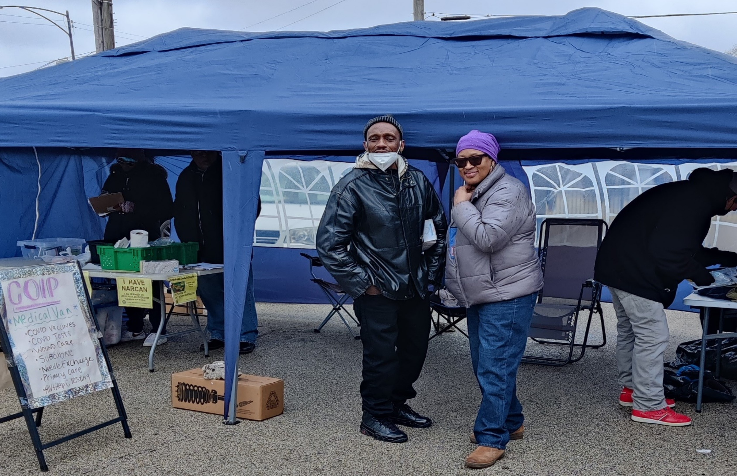
Equitable and Innovative Opioid Overdose Prevention and Response in Chicago
Practice Informed Evidence & Evidence-based Practice
Evidence-Based Practices: Evidence-based practice is a decision-making process that integrates the best available research evidence.
Practice-Based Evidence: Evidence provides experiential information (i.e., evidence that a practice is supported by real world conditions and community context.
Evidence-based Practices
Practice-based Evidence
Notes:
Evidence-based practice is among the most influential and compelling reforms in contemporary education. Despite their potential to improve the outcomes of students with disabilities, adoption and implementation of evidence-based reforms have been disappointing, with the gap between research and practice remaining wide. Practice-based evidence provides an alternative perspective on evidence grounded in the realities of classroom teaching in authentic settings, which practitioners find compelling when making instructional decisions. We propose that practitioners and other special education stakeholders (e.g., researchers) can form partnerships around practice-based evidence to leverage the implementation of evidence-based practice, and provide examples of such partnerships.
It is important to recognize that practice-based evidence is not simply a less rigorous version of efficacy research. Rather, efficacy research and practice-based evidence serve two different purposes.
Whereas efficacy research establishes whether a practice can work for a population (under ideal conditions), practice-based evidence is concerned with examining whether and how a practice works in specific, authentic settings. As such, practice-based evidence is situationally bounded, examining “what is credible for these pupils in this classroom in this school in this city” (Simons et al., 2003, p. 356; see also Horn & Gassaway, 2007). Indeed, Kratochwill et al. (2012) suggested that the roles of efficacy research and practice-based evidence are independent of one another
In practice-based evidence, contextual and social validity are prioritized (which is not a goal in efficacy studies), with internal validity (the primary aim of efficacy studies) playing a subordinate role.
The facility is a partnership between the University of Illinois-Chicago’s Community Outreach Intervention Projects program and the West Side Heroin and Opioid Task Force. Their goal is curbing overdose deaths.

Slide 27

Equitable and Innovative Opioid Overdose Prevention and Response in Chicago
Questions and Discussion
How can we utilize what we're learning from practice-based evidence?
What strategies can we advance now?

Slide 28
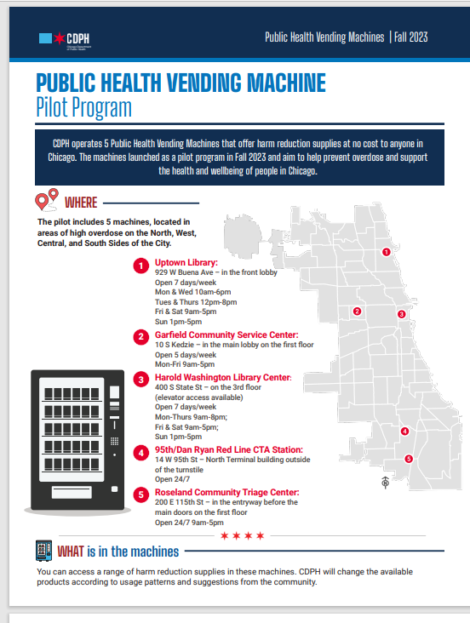
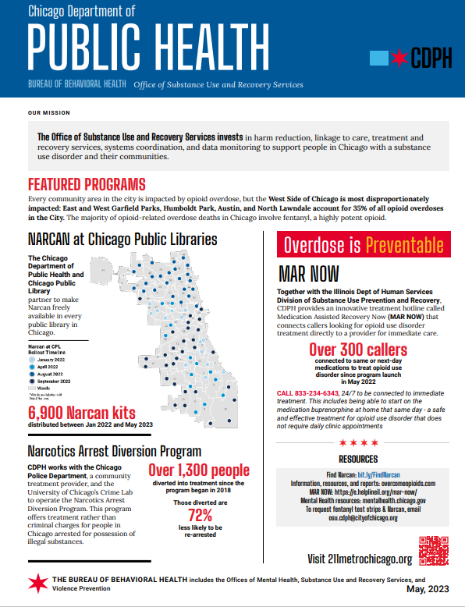
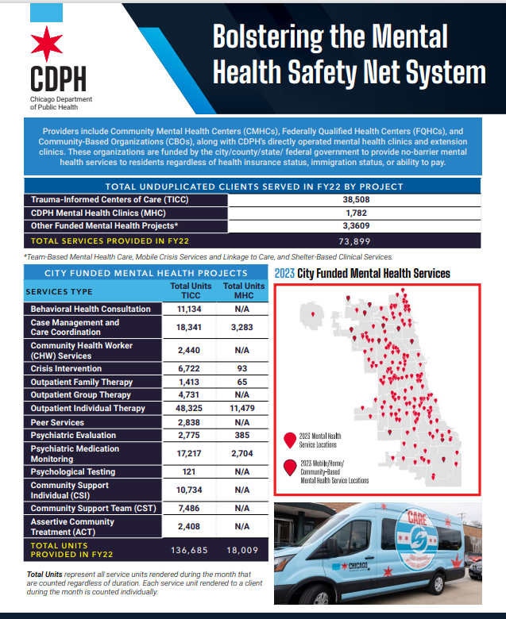
Equitable and Innovative Opioid Overdose Prevention and Response in Chicago
CDPH Flyers

Slide 29
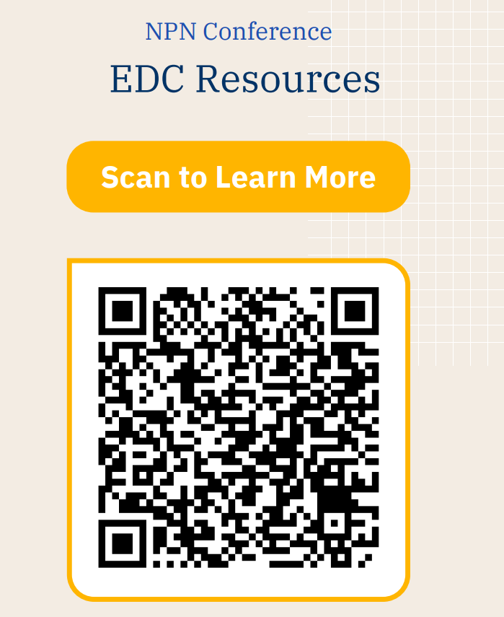

Questions
Sarah Gabriella Hernandez, PhD
sghernandez@edc.org
Chuck Klevgaard, CSPS
cklevgaard@edc.org
August 15, 2024

