Slide 1
Preventing Drug Misuse Among College Students:
The Importance of Strategic Planning and Addressing Culture
Rich Lucey – Drug Enforcement Administration
Allison Smith, Ph.D. – Louisiana Board of Regents
National Prevention Network Conference
August 14, 2024

Slide 2
Agenda
Welcome and Introductions
Drug Use Rates Among College Students
Prevention with Purpose Strategic Planning Guide
Considering Culture in Strategic Planning
DEA’s Prevention Resources
Q&A/Discussion
Notes:
8:00am – 8:05am: Welcome and Introductions (Rich, Allison)
8:05am – 8:10am: Disclaimers, Agenda, and Learning Objective (Allison)
8:10am – 8:15am: DEA in the Prevention Space (Rich)
8:15am – 8:30am: Drug Use Rates Among College Students (Rich)
8:30am – 8:45am: Prevention with Purpose Strategic Planning Guide (Rich)
8:45am – 9:00am: Highlighting Culture Across the SPF (Allison)
9:00am – 9:10am: Prevention Success During Times of Disruption (Rich)
9:10am – 9:15am: DEA’s Prevention Resources (Rich)
9:15am – 9:30am: Q&A/Discussion (Rich, Allison)

Slide 3
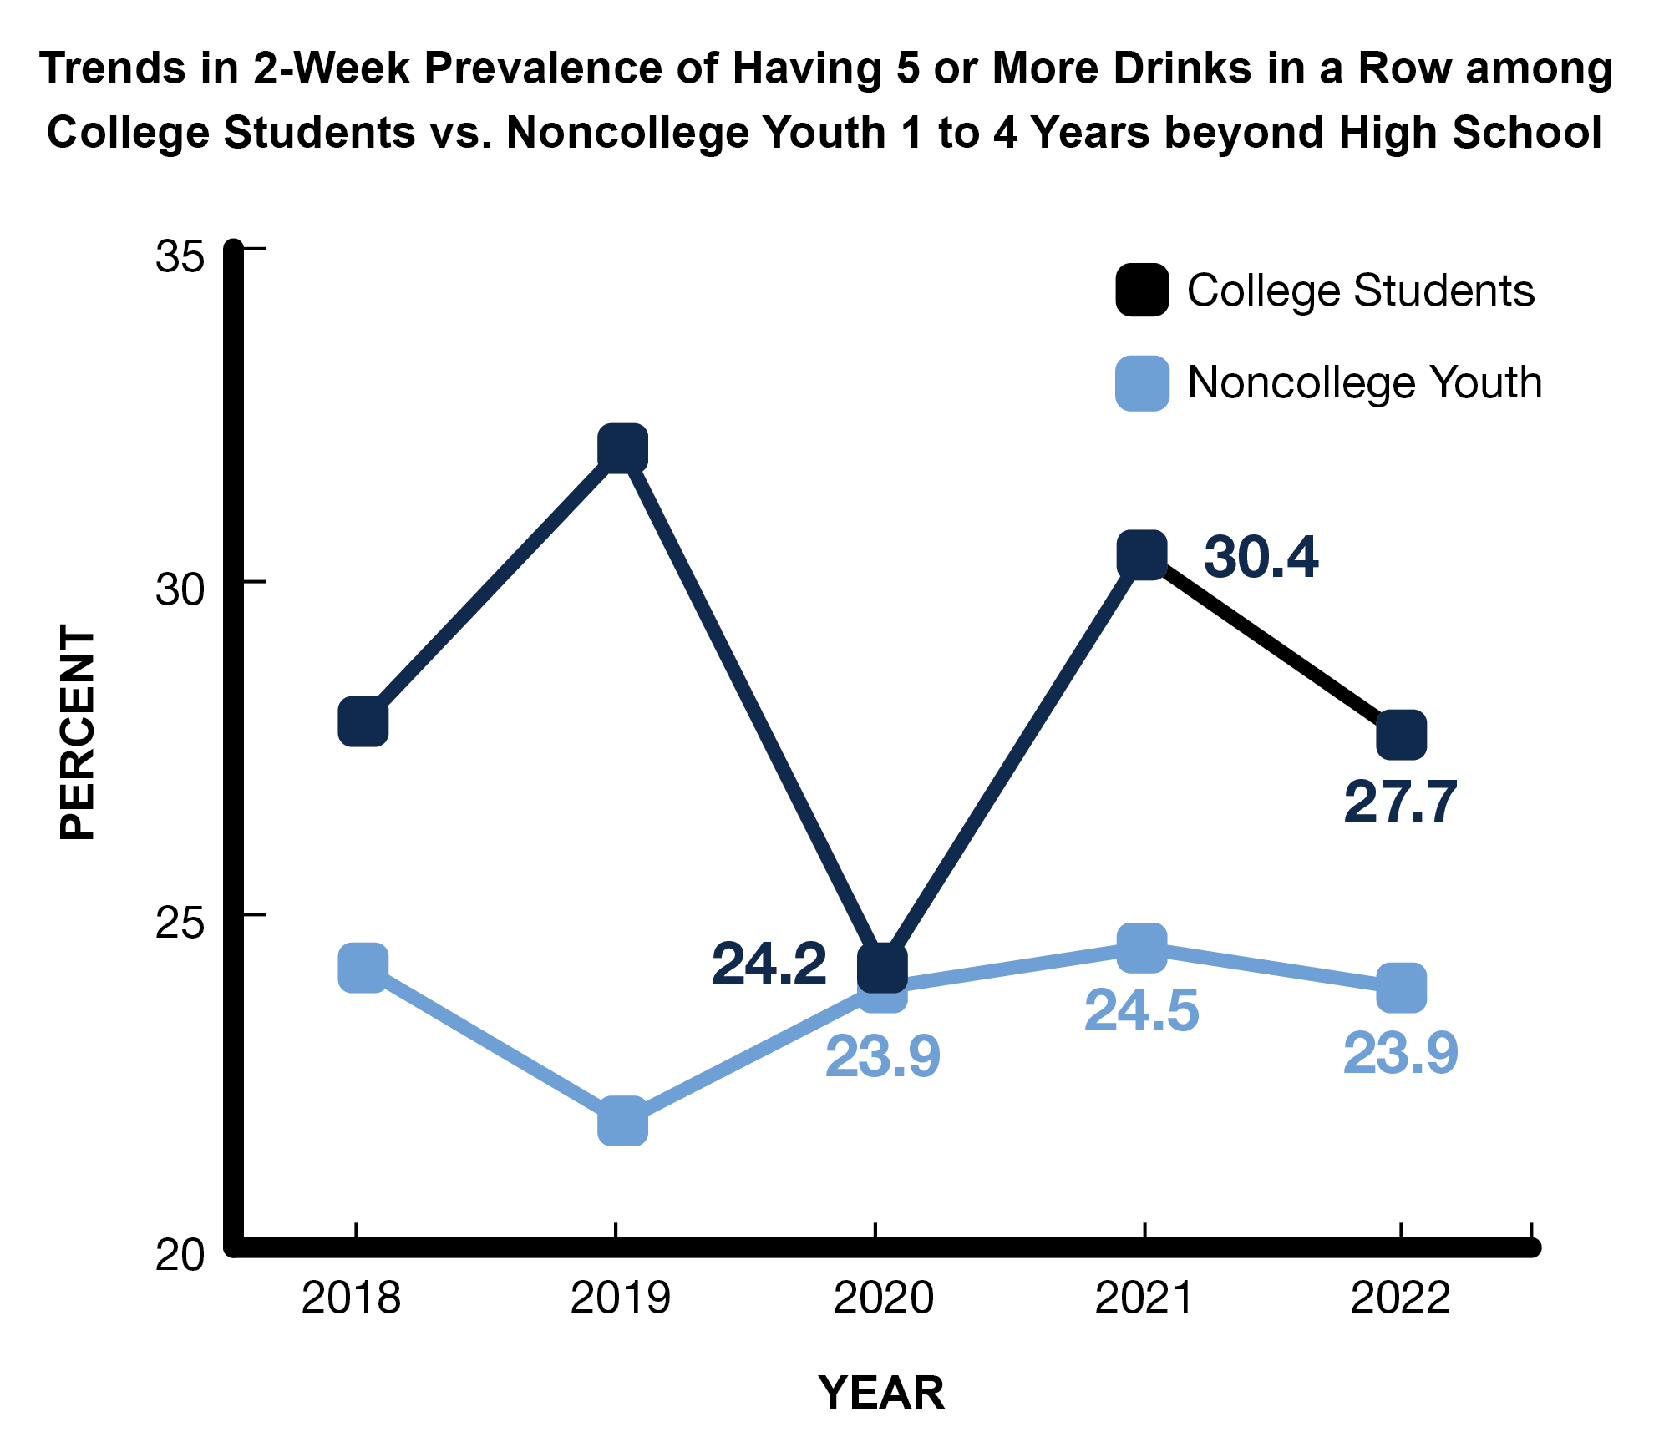
Late-breaking news: In 2023, new lows in binge drinking among males and females.
Source: 2024 MTF Study
Notes:
For college men, the prevalence of binge drinking is a new all time study low of 24.4% in 2023.
For college women, there was a significant decrease from 26.8% in 2022 to 19.9% in 2023, but the prevalence remains above the all time low of 18.2% during the pandemic in 2020.
Source
Patrick, M. E., Miech, R. A., Johnston, L. D., & O’Malley, P. M. (2024). Monitoring the Future Panel Study annual report: National data on substance use among adults ages 19 to 65, 1976-2023.
Monitoring the Future Monograph Series. Ann Arbor, MI: Institute for Social Research, University of Michigan. Available at: https://monitoringthefuture.org/results/annual-reports/

Slide 4
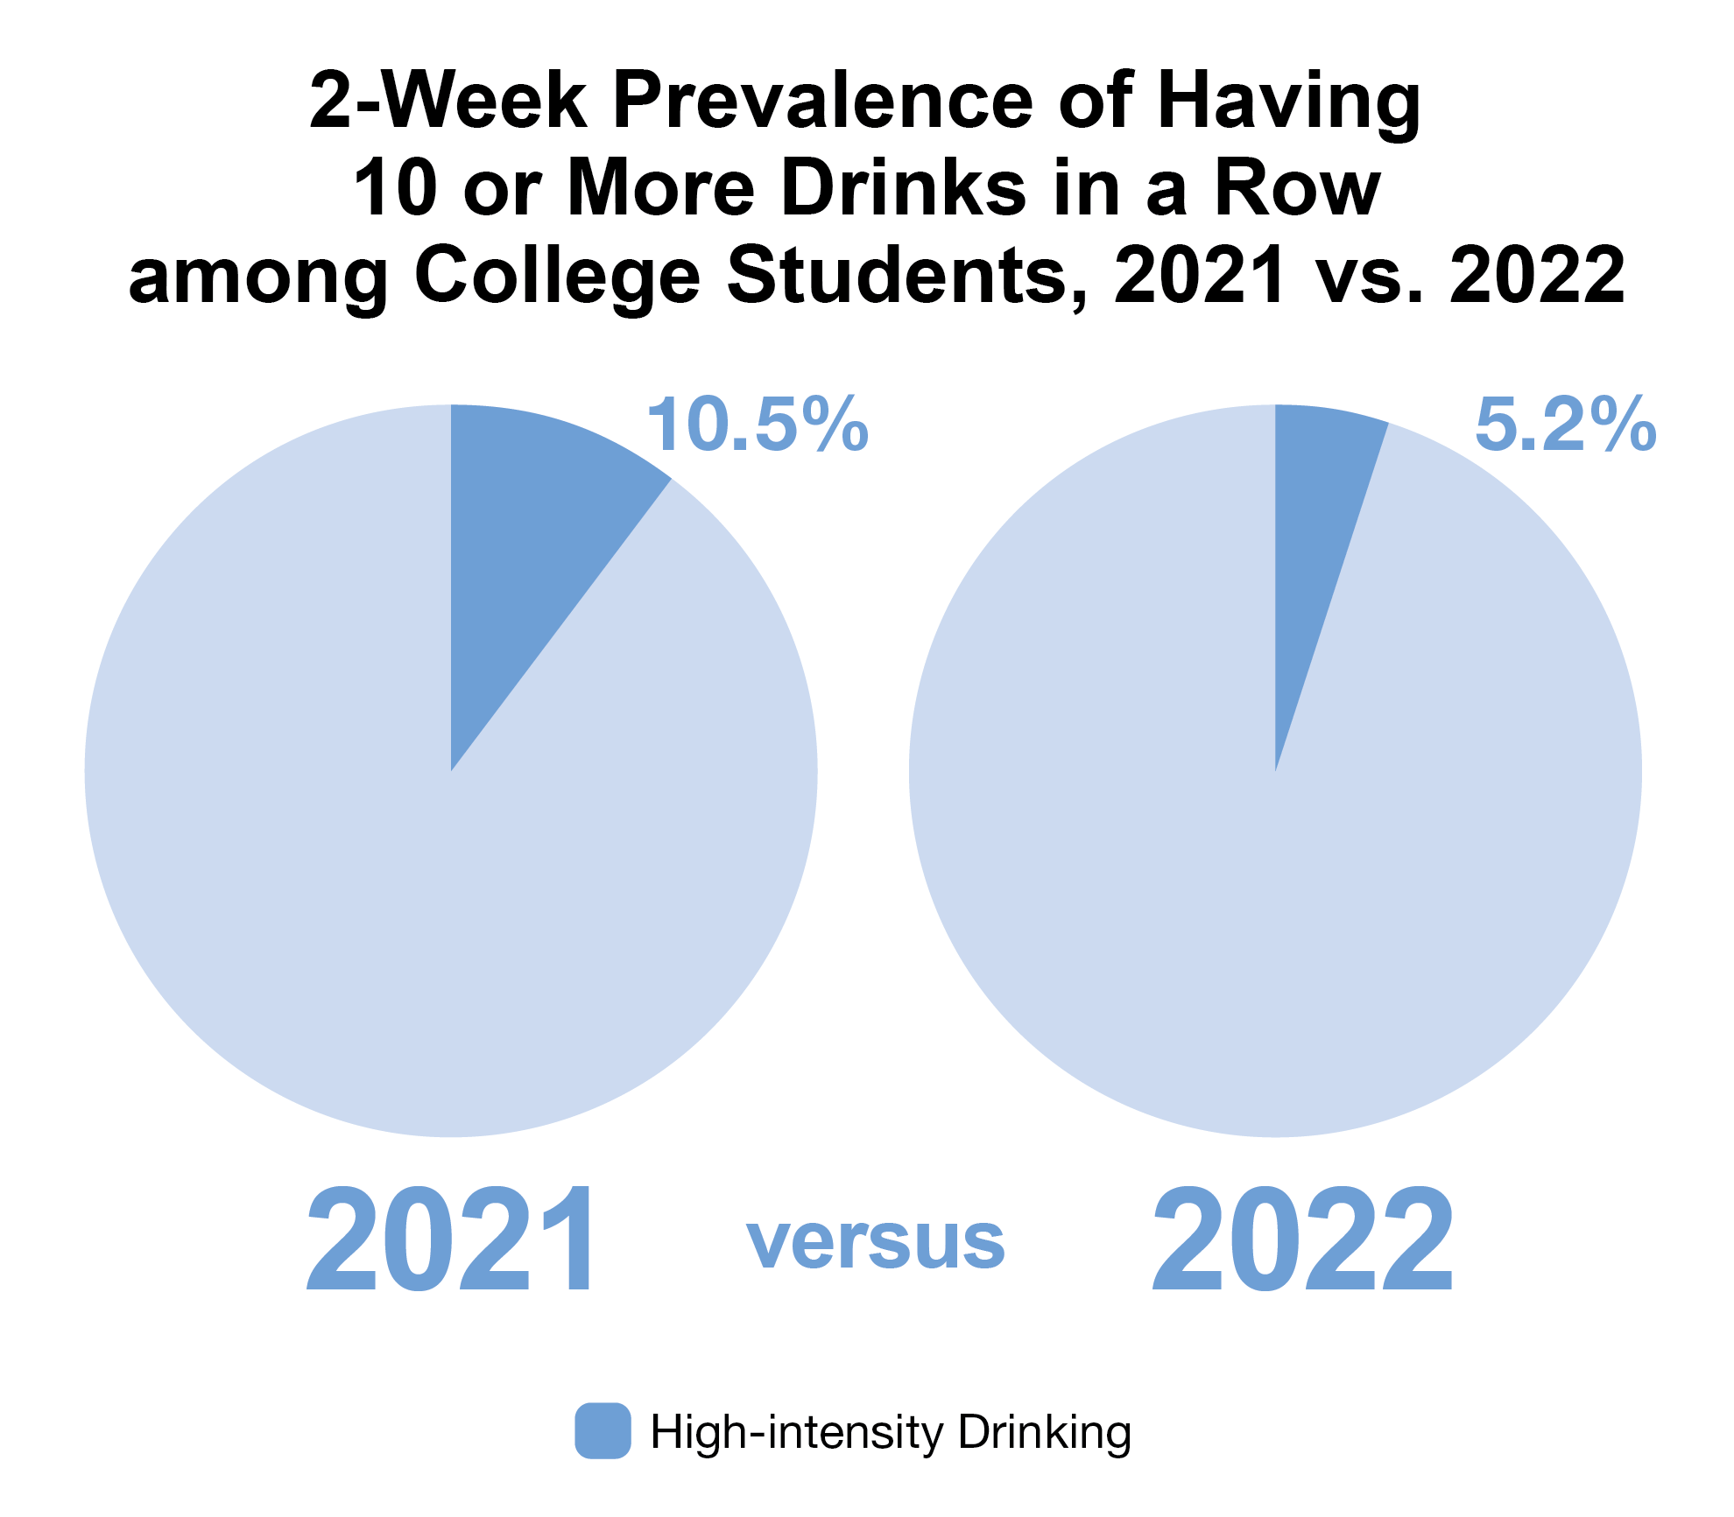
Late-breaking news: In 2023, high-intensity drinking was 5.1%.
Source: 2024 MTF Study
Notes:
In 2021, the prevalence of high-intensity drinking (i.e., 10+ drinks in a row) in the past 2 weeks among college students was 10.5%.
In 2022, 5.2% of college students engaged in high-intensity drinking in the past two weeks.
Source
Patrick, M. E., Miech, R. A., Johnston, L. D., & O’Malley, P. M. (2024). Monitoring the Future Panel Study annual report: National data on substance use among adults ages 19 to 65, 1976-2023.
Monitoring the Future Monograph Series. Ann Arbor, MI: Institute for Social Research, University of Michigan. Available at: https://monitoringthefuture.org/results/annual-reports/

Slide 5
Alcohol-related risk factors for suicide (Hufford, 2001)
Proximal risk factors
Suicidal behavior during alcohol intoxication
Looking at odds ratios, Borges & Rosovsky (1996) showed consumption of over 10 standard drinks increases risk for suicide attempts 90 times in comparison to abstinence
Slide courtesy of Jason Kilmer, University of Washington

Slide 6
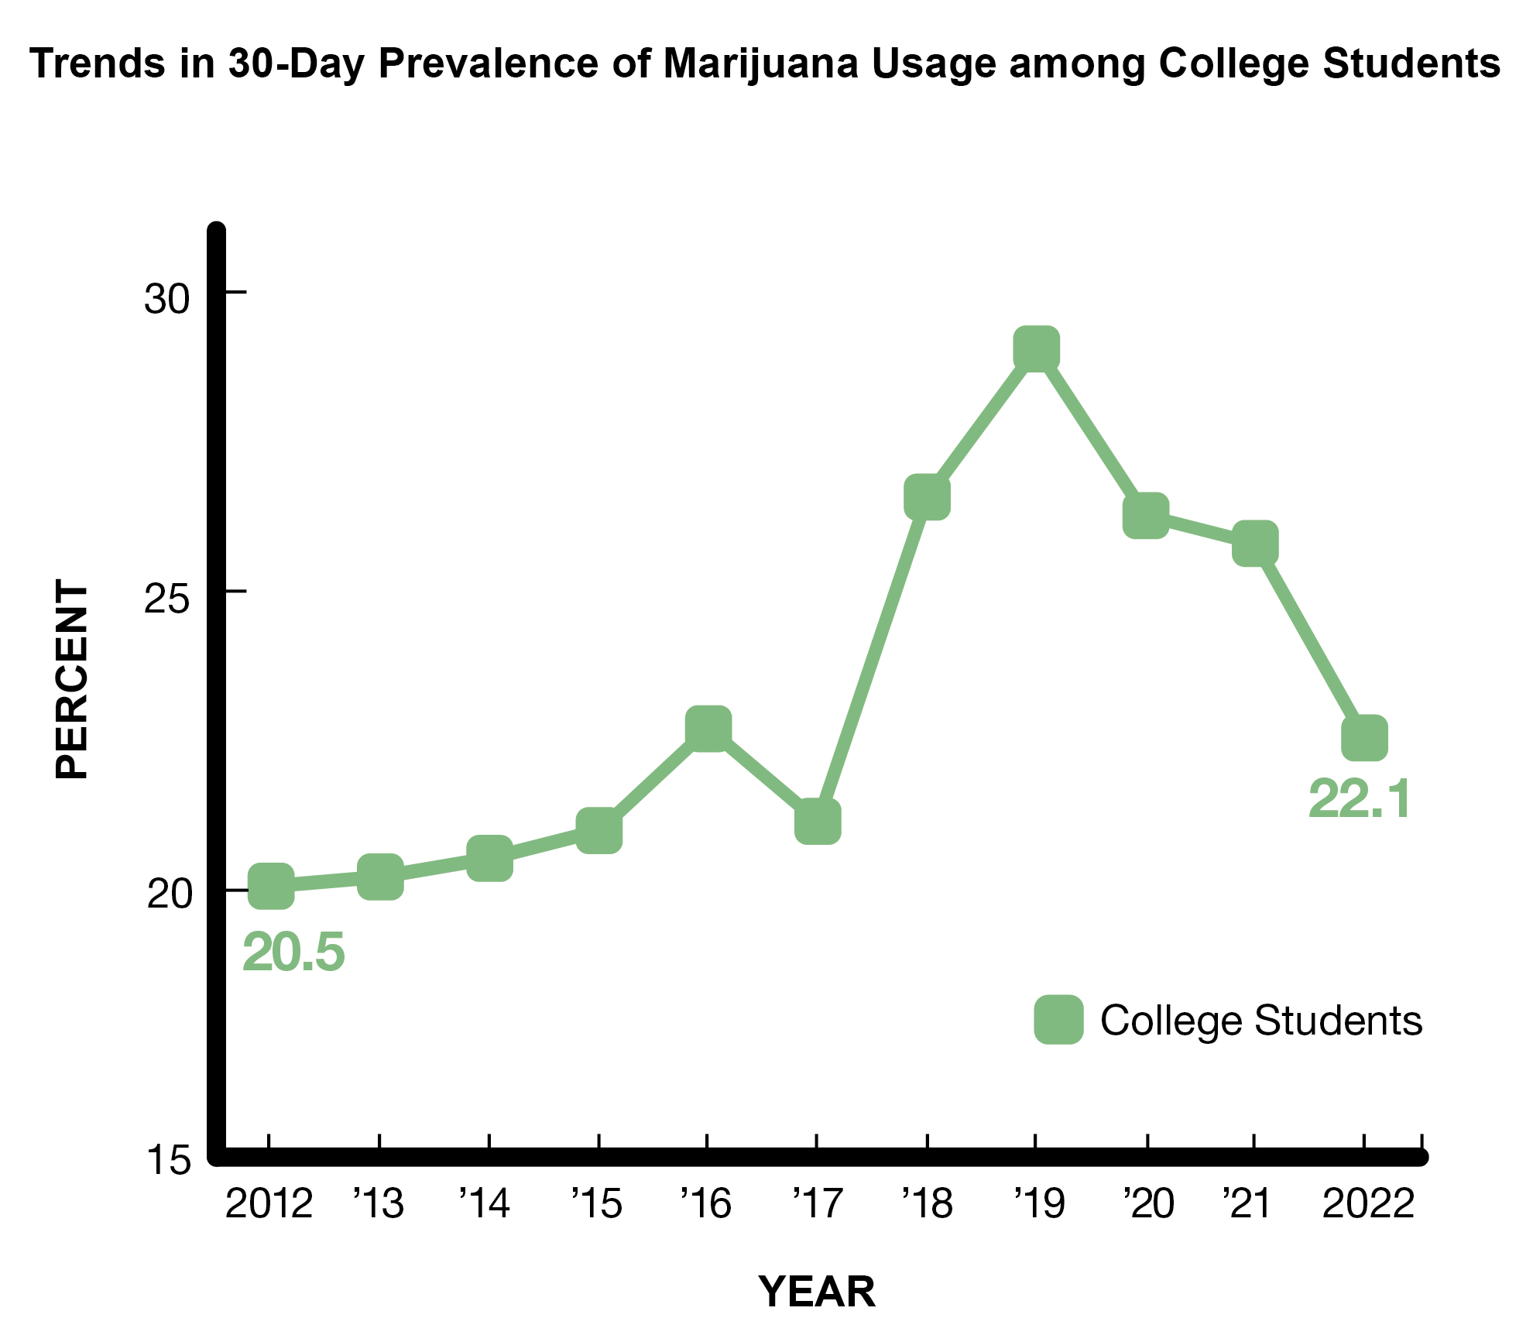
Late-breaking news: In 2023, current cannabis use was 26.1%.
Source: 2024 MTF Study
Notes:
Marijuana use trends showed there has been an increase over the past 10 years in use in the past 30 days (from 20.5% to 24.2% from 2012 to 2021) for college students.
In 2022, 22.1% of college students used marijuana in the past 30 days.
Source
Patrick, M. E., Miech, R. A., Johnston, L. D., & O’Malley, P. M. (2024). Monitoring the Future Panel Study annual report: National data on substance use among adults ages 19 to 65, 1976-2023.
Monitoring the Future Monograph Series. Ann Arbor, MI: Institute for Social Research, University of Michigan. Available at: https://monitoringthefuture.org/results/annual-reports/

Slide 7
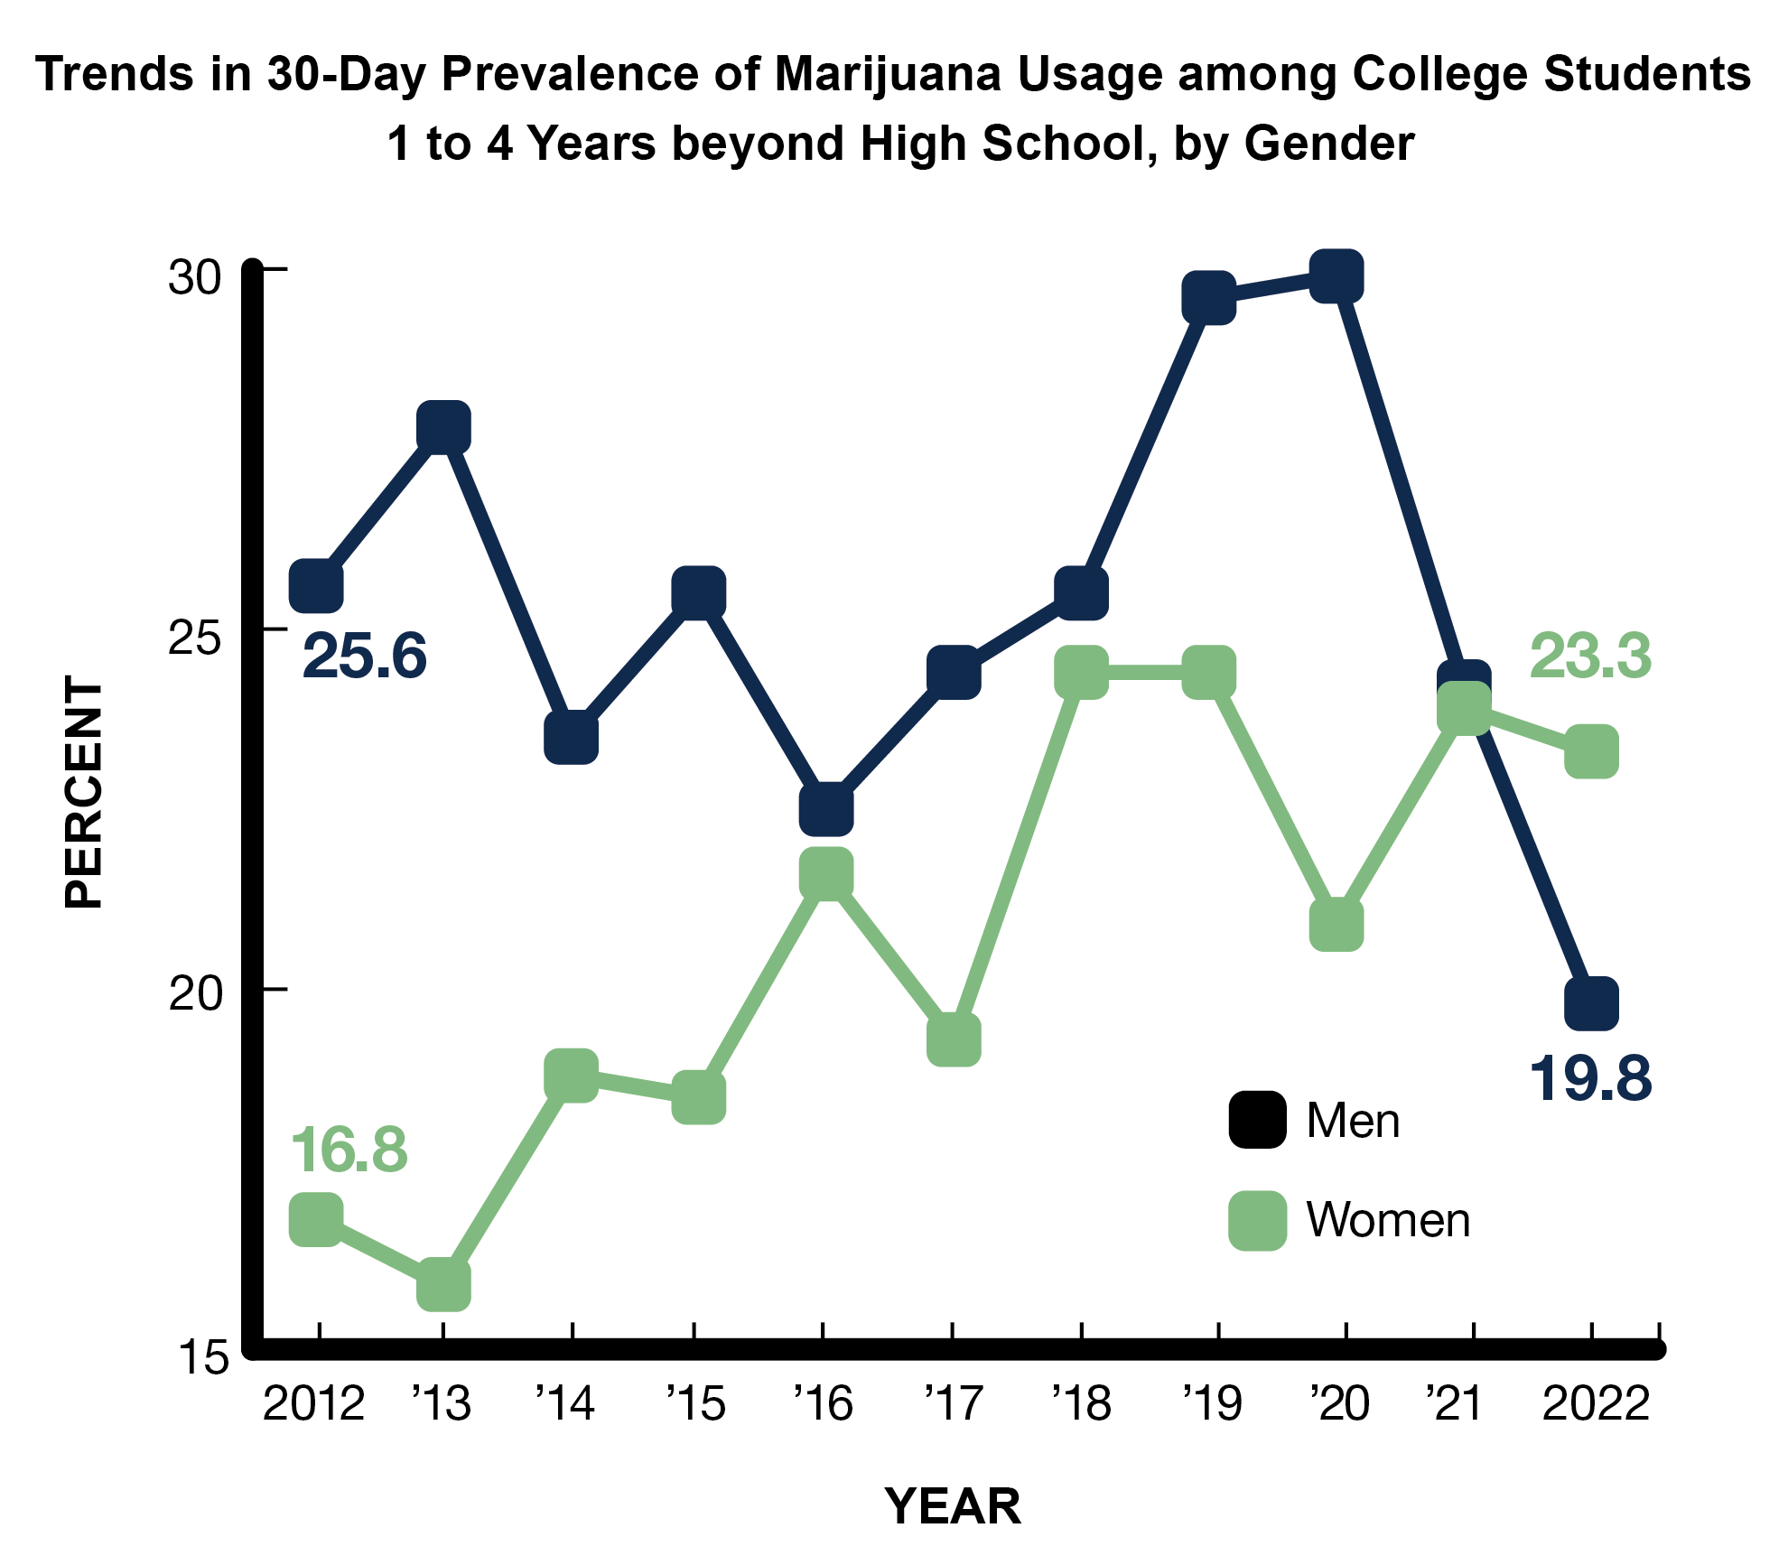
Late-breaking news: In 2023, current cannabis use among males was 26.7% and among females was 25.6%.
Source: 2024 MTF Study
Notes:
Before 2015, college men had consistently higher prevalence of cannabis use than college women. However, there has been a significant increase in cannabis use in the past 30 days among college women (from 16.2% in 2013 to 25.6% in 2023.
In 2021, marijuana use in the past 30 days was nearly the same for college men and women, due to somewhat stable levels of use among men and an increasing trend among women in college over the past 10 years (from 16.8% in 2012 to 24.2% in 2021).
In 2022, marijuana use in the past 30 days was higher among women in college (23.3%) compared to men in college (19.8%).
Source
Patrick, M. E., Miech, R. A., Johnston, L. D., & O’Malley, P. M. (2024). Monitoring the Future Panel Study annual report: National data on substance use among adults ages 19 to 65, 1976-2023.
Monitoring the Future Monograph Series. Ann Arbor, MI: Institute for Social Research, University of Michigan. Available at: https://monitoringthefuture.org/results/annual-reports/

Slide 8
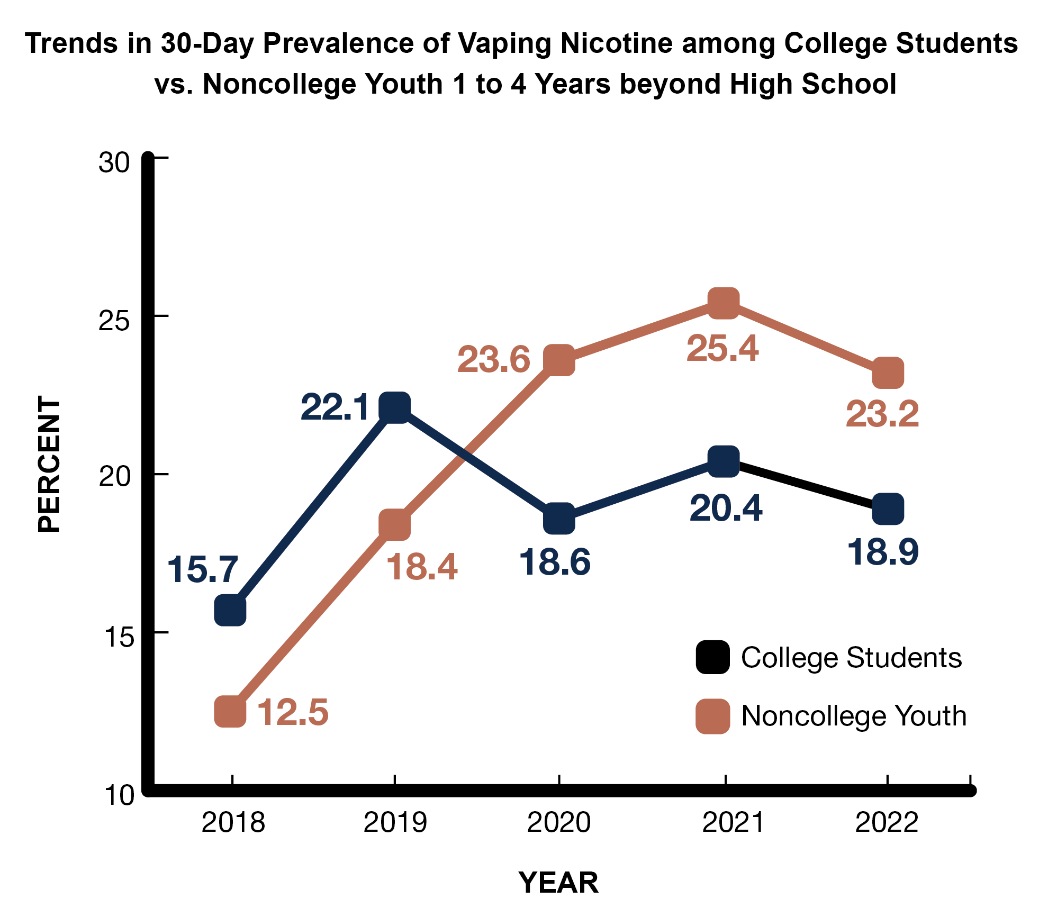
Late-breaking news: In 2023, current nicotine vaping was 18% (college) vs. 28.8% (noncollege).
Source: 2024 MTF Study
Notes:
In 2021, the prevalence of nicotine vaping was higher among noncollege than college students over the past 30 days (25.4% vs. 20.4%).
In 2022, prevalence of vaping nicotine continued to be higher for noncollege students (23.2%) versus college students (18.9%).
Source
Patrick, M. E., Miech, R. A., Johnston, L. D., & O’Malley, P. M. (2024). Monitoring the Future Panel Study annual report: National data on substance use among adults ages 19 to 65, 1976-2023.
Monitoring the Future Monograph Series. Ann Arbor, MI: Institute for Social Research, University of Michigan. Available at: https://monitoringthefuture.org/results/annual-reports/

Slide 9
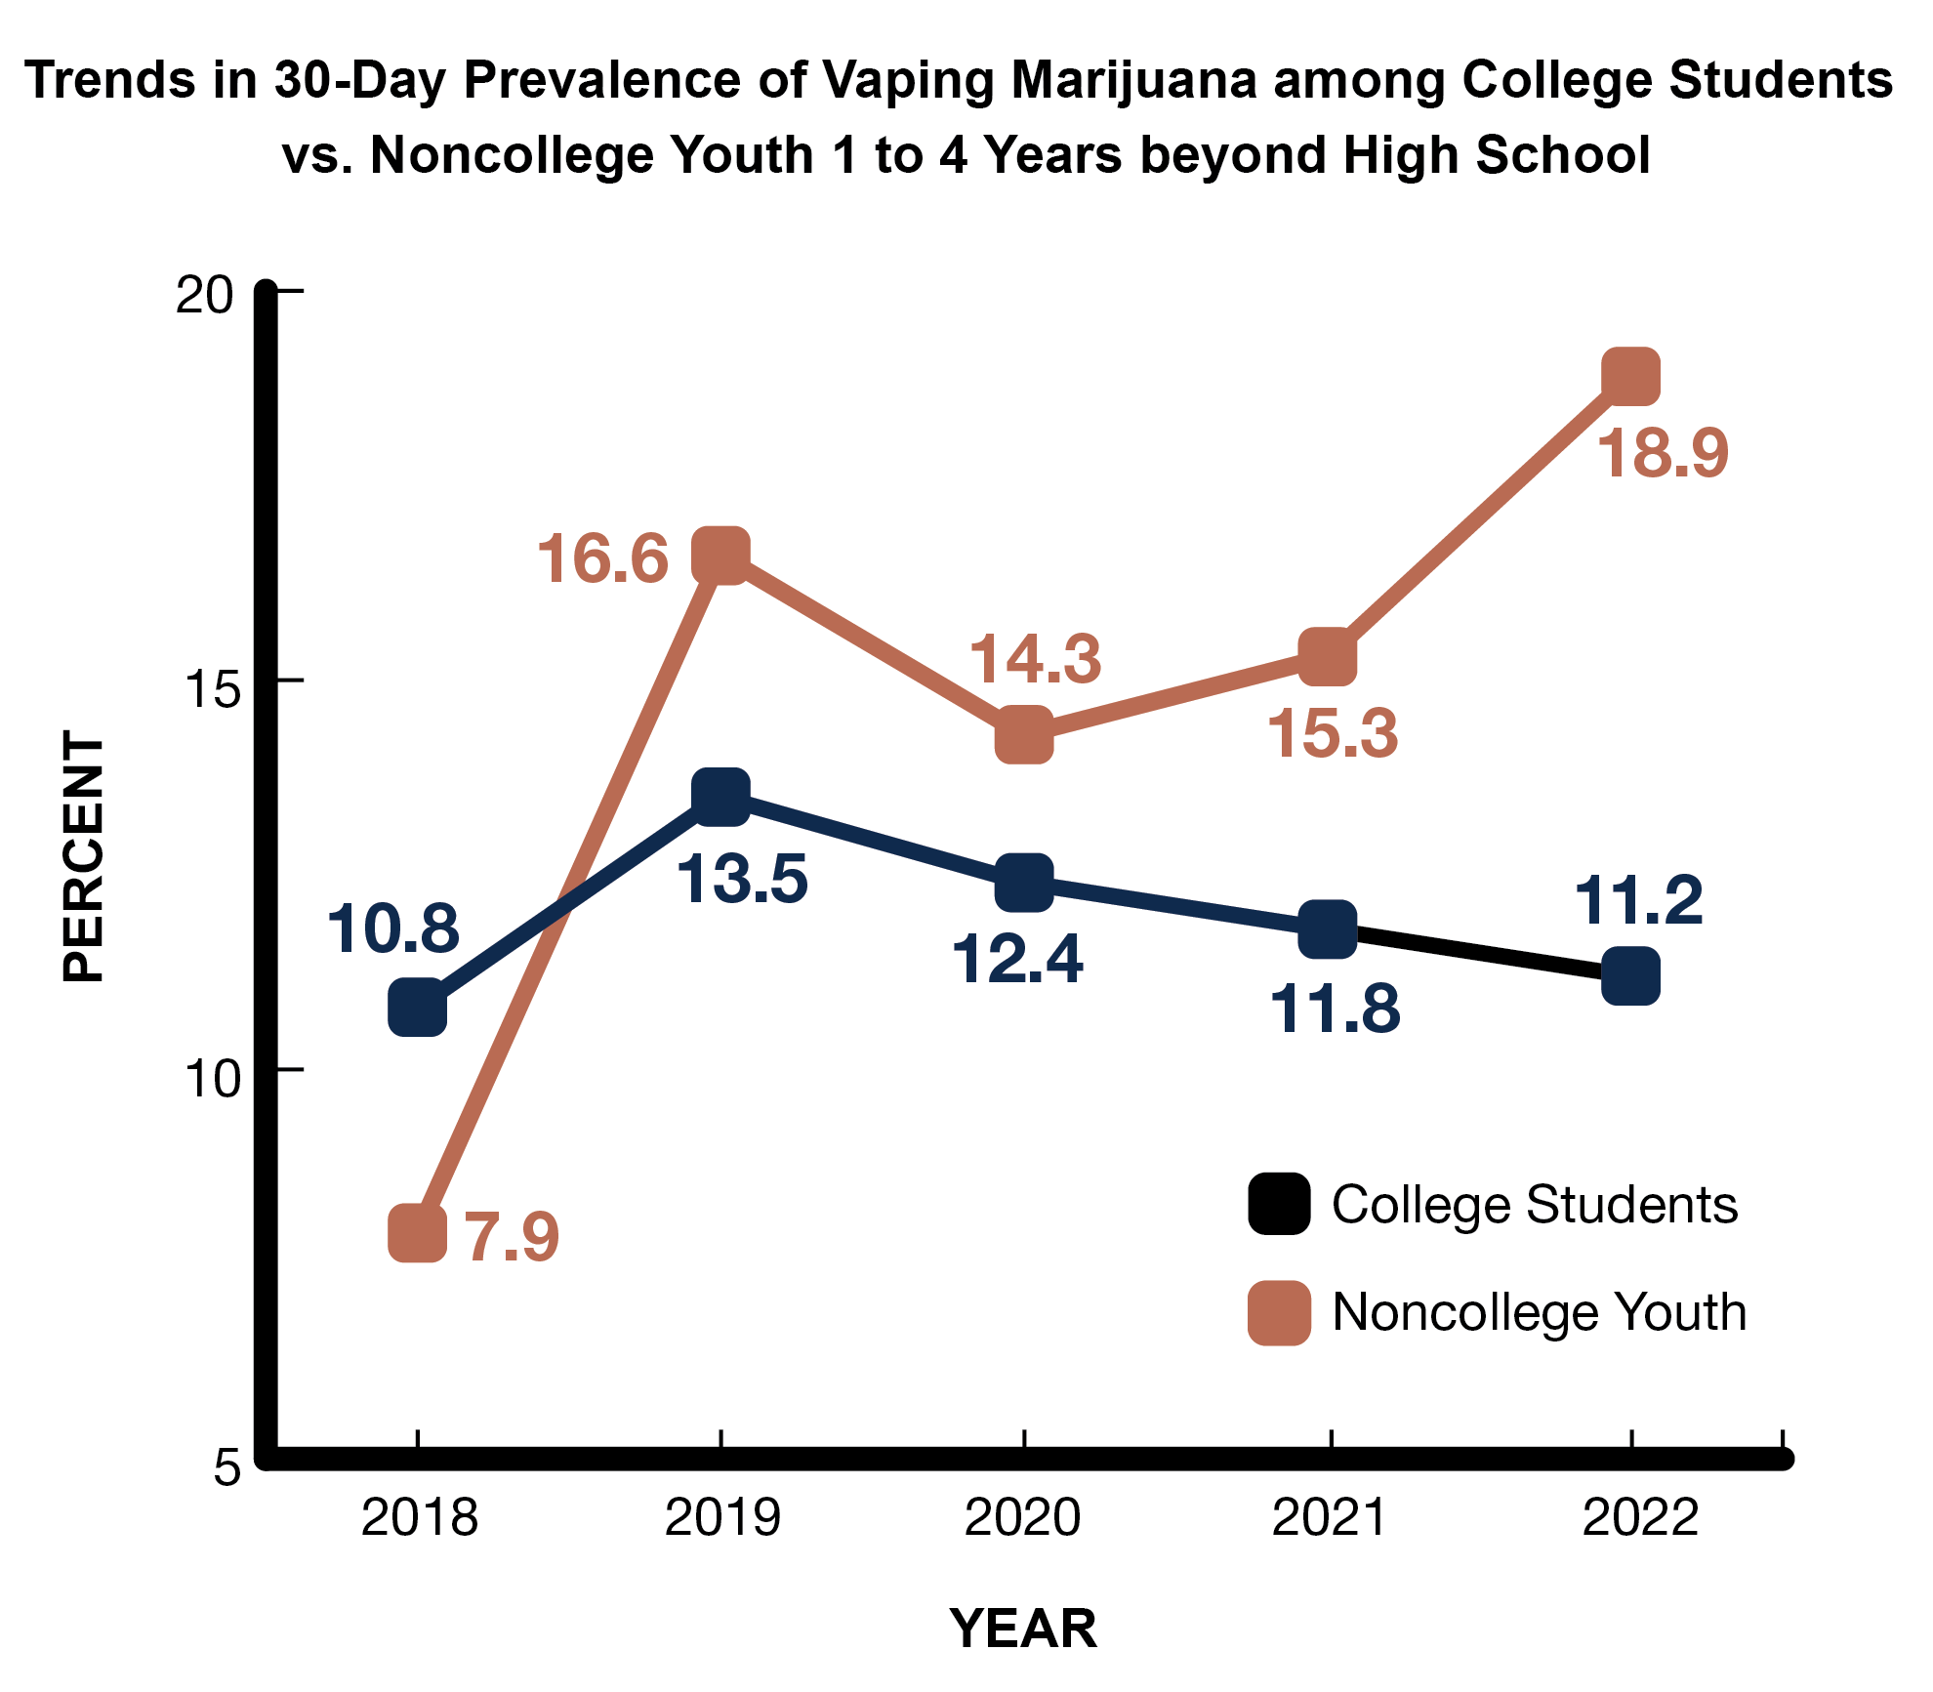
Late-breaking news: In 2023, current cannabis vaping was 14.2% (college) vs. 19.6% (noncollege).
Source: 2024 MTF Study
Notes:
Source
Patrick, M. E., Miech, R. A., Johnston, L. D., & O’Malley, P. M. (2024). Monitoring the Future Panel Study annual report: National data on substance use among adults ages 19 to 65, 1976-2023.
Monitoring the Future Monograph Series. Ann Arbor, MI: Institute for Social Research, University of Michigan. Available at: https://monitoringthefuture.org/results/annual-reports/

Slide 10
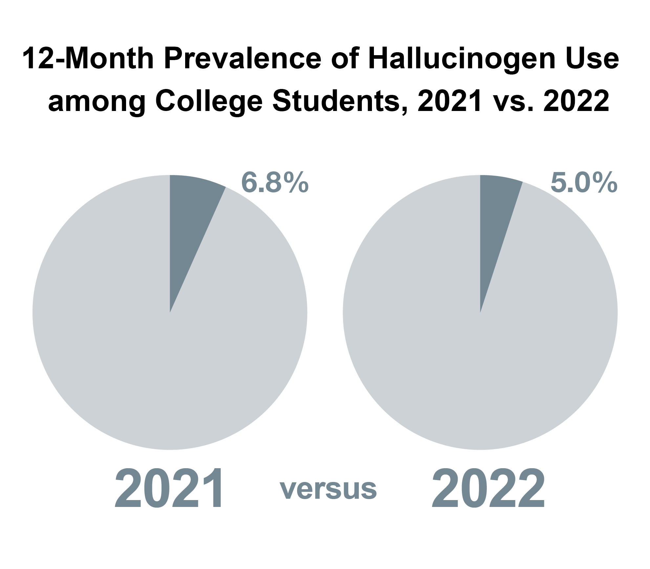
Late-breaking news: In 2023, past-year hallucinogen use was 7.5% (college) vs. 10.8% (noncollege).
Source: 2024 MTF Study
Notes:
In 2021, the use of hallucinogens in the past 12 months was 6.8% among college students, down from 8.6% in 2020.
In 2022, 5% of college students used an hallucinogen in the past year.
Source
Patrick, M. E., Miech, R. A., Johnston, L. D., & O’Malley, P. M. (2024). Monitoring the Future Panel Study annual report: National data on substance use among adults ages 19 to 65, 1976-2023.
Monitoring the Future Monograph Series. Ann Arbor, MI: Institute for Social Research, University of Michigan. Available at: https://monitoringthefuture.org/results/annual-reports/

Slide 11
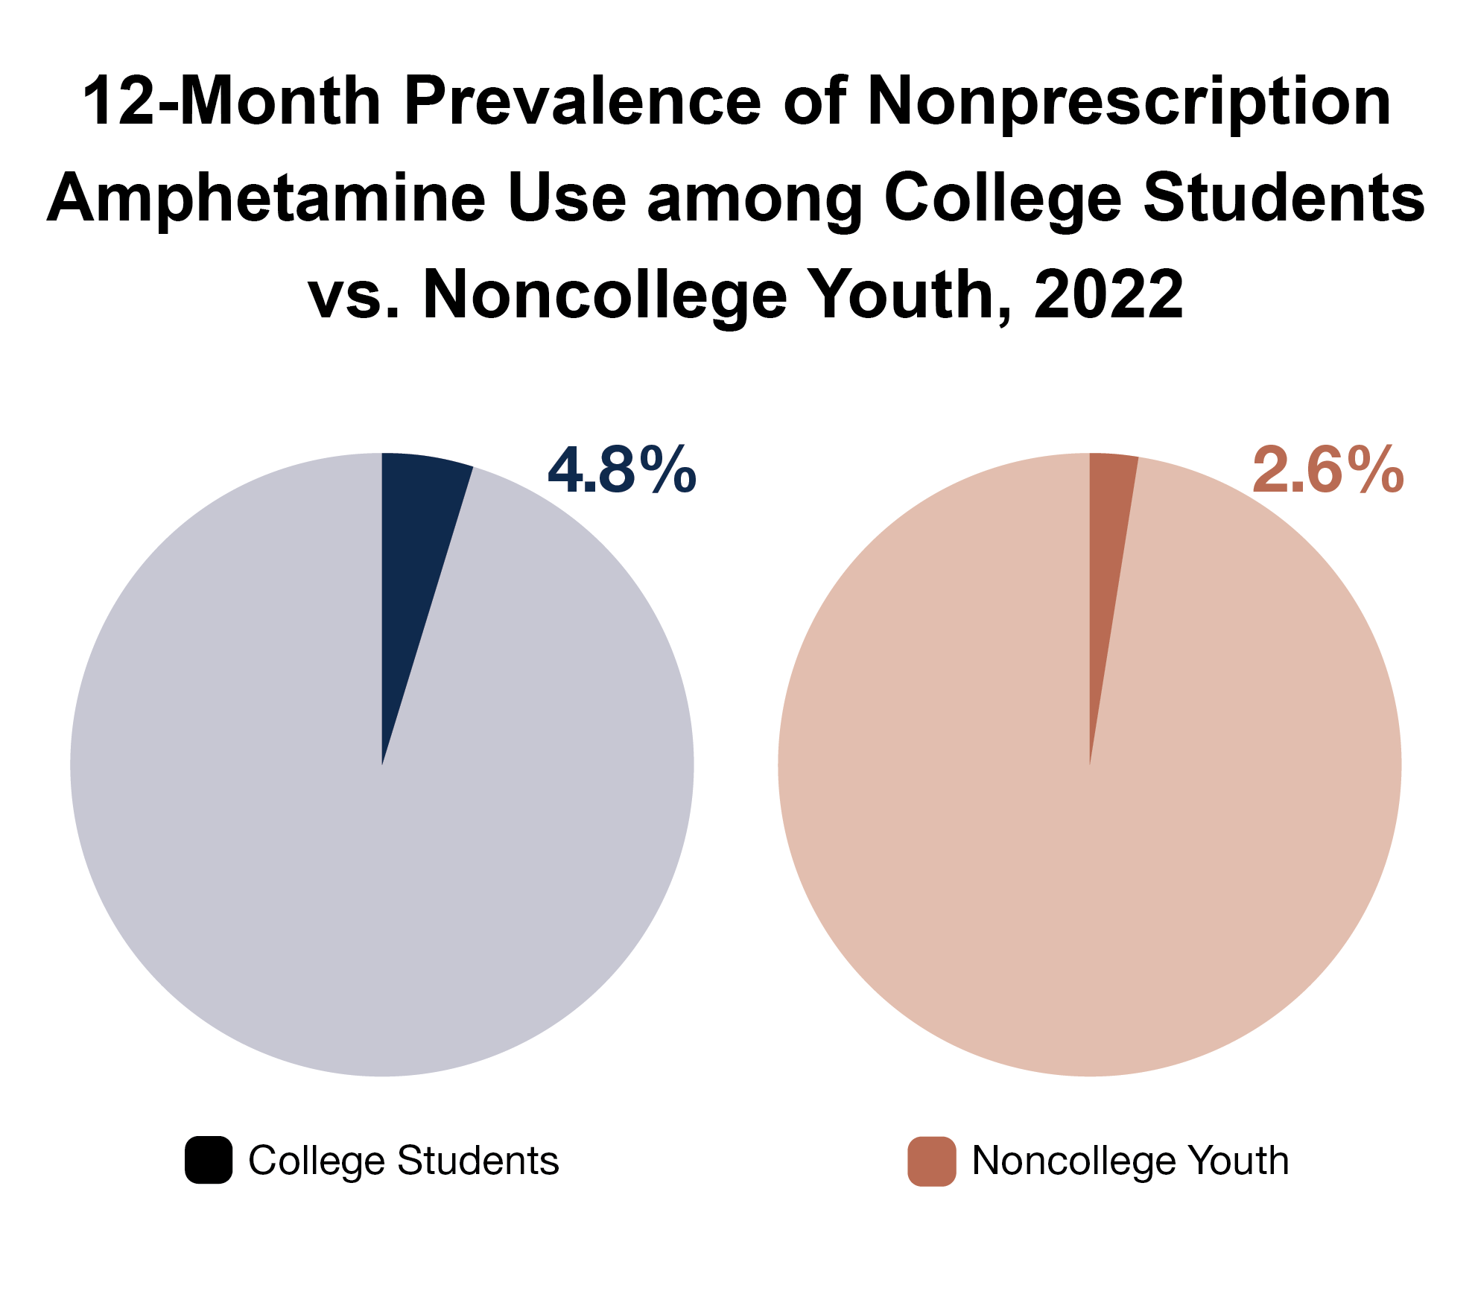
Late-breaking news: In 2023, past-year prescription stimulant misuse was 3.6% (college) vs. 2.6% (noncollege).
Source: 2024 MTF Study
Notes:
Amphetamine use without a doctor’s prescription in the past 12 months was slightly higher among college students compared to noncollege young adults (4.8% vs. 2.6%).
Misuse of Adderall was 3.6% (Ritalin was .2%).
Source
Patrick, M. E., Miech, R. A., Johnston, L. D., & O’Malley, P. M. (2024). Monitoring the Future Panel Study annual report: National data on substance use among adults ages 19 to 65, 1976-2023.
Monitoring the Future Monograph Series. Ann Arbor, MI: Institute for Social Research, University of Michigan. Available at: https://monitoringthefuture.org/results/annual-reports/

Slide 12
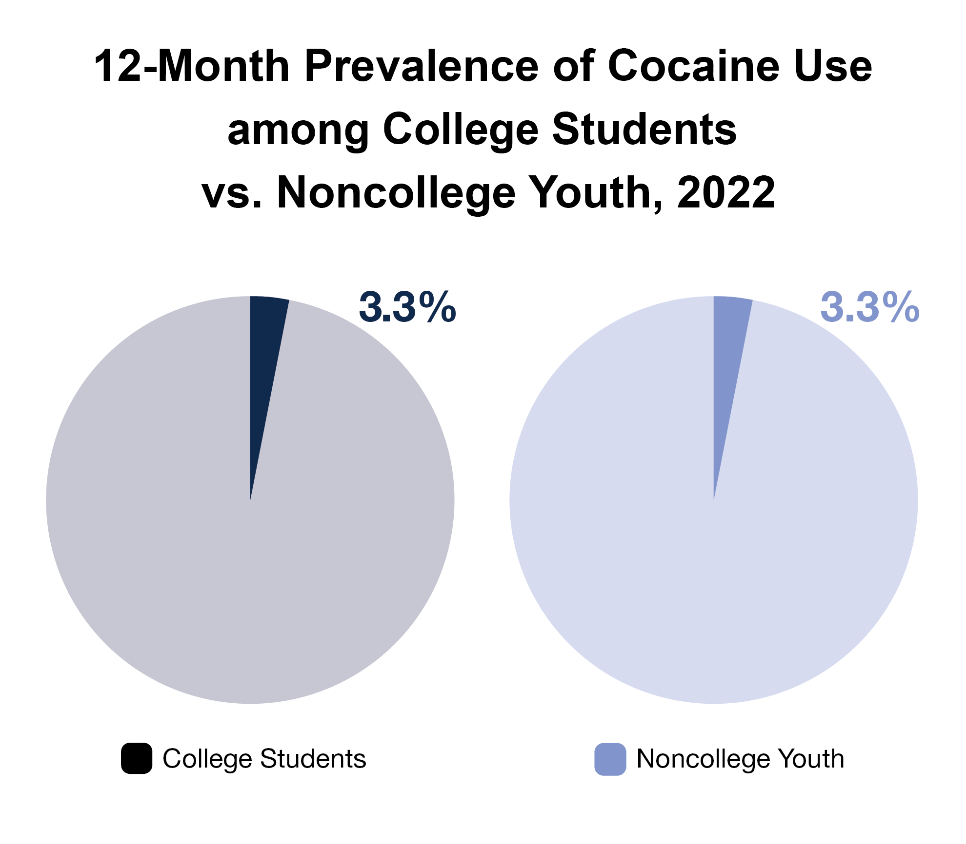
Late-breaking news: In 2023, past-year cocaine use was 2.2% (college) vs. 2.9% (noncollege).
Source: 2024 MTF Study
Notes:
Cocaine use in the past 12 months was the same among college students and noncollege young adults (3.3%).
Source
Patrick, M. E., Miech, R. A., Johnston, L. D., & O’Malley, P. M. (2024). Monitoring the Future Panel Study annual report: National data on substance use among adults ages 19 to 65, 1976-2023.
Monitoring the Future Monograph Series. Ann Arbor, MI: Institute for Social Research, University of Michigan. Available at: https://monitoringthefuture.org/results/annual-reports/

Slide 13
Mental Health of College Students
Anytime within the past 30 days:
36.4% felt things were hopeless*
27.9% felt so sad nothing could cheer them up*
25.5% felt worthless*
Within the past 12 months:
31.2% felt anxiety affected academic performance
Suicide:
2.3% likely to attempt suicide someday
2.2% attempted suicide within the last 12 months
* Some, Most, All of the Time
Source: American College Health Association-National College Health Assessment (Fall 2023)
Notes:
Based on approximately 24,473 students at 38 schools.
College students appear to be under a great deal of stress, as shown by these indications of mental health.
Young adults, including college students, have the highest behavioral health needs and the lowest rate of help-seeking behavior.
Rates of mental illness vary by race or ethnicity, but like substance abuse, these are universal problems that we need to address through culturally appropriate measures.
The mental health status of college students is one of the factors influencing—and being influenced by—alcohol and drug use. (Use alcohol or other drugs because they are depressed or have anxiety; yet, they are depressed and have anxiety when they use alcohol or other drugs.)
Source
American College Health Association. Reference Group Data Report—Fall 2023.

Slide 14
DEA’s Outreach to
Colleges and Universities
Notes:
18-25 age group has some of the highest rates of drug use and lowest rates of seeking help.
College students make up a significant percentage of this age group.
DEA filling a gap in the prevention landscape with its portfolio of resources that started in 2016.

Slide 15
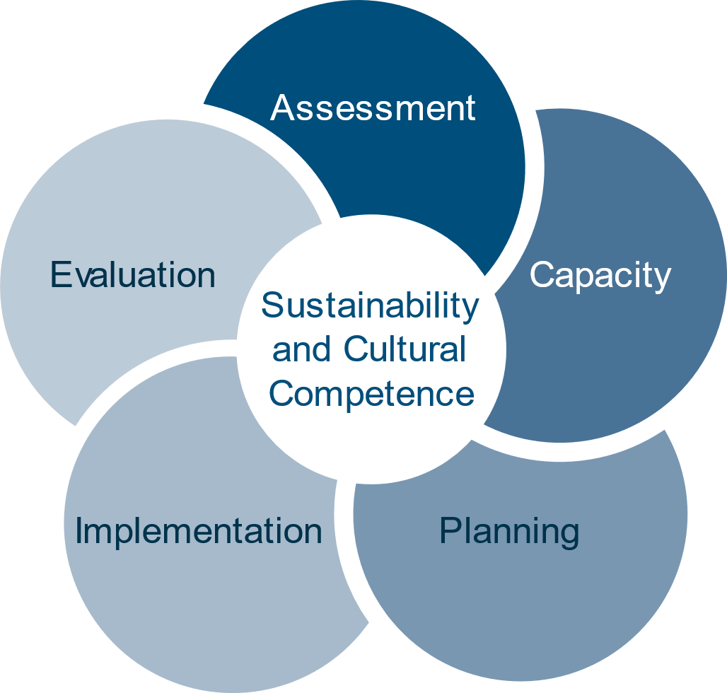
CHAPTER
Strategic Prevention Framework
Drug Enforcement Administration
Notes:
The strategic planning guide walks higher education prevention professionals through how to use the SPF to plan and implement their prevention efforts.
Explain that the SPF answers the question, “How will we do drug misuse prevention effectively on college campuses?” It provides us with the tools to be the “Grandmaster of Prevention” on your campus.
Share that practitioners often feel an urgent need to implement immediate solutions to the pressing substance misuse problems facing their communities. But research and experience have shown that prevention must begin with an understanding of these complex behavioral health problems within their complex environmental contexts; only then can communities establish and implement effective plans to address substance misuse.
To facilitate this understanding, SAMHSA developed the Strategic Prevention Framework (SPF). The five steps and two guiding principles of the SPF offer prevention practitioners a comprehensive approach to understanding and addressing the substance misuse and related behavioral health problems. The five steps include: assessment, capacity building, planning, implementation, and evaluation. All of the steps are guided by two central principles—cultural competence and sustainability—which should be integrated into each step of the SPF.
Cultural competence describes the ability of an individual or organization to interact effectively with members of diverse population groups. At a college or university, this means understanding that specific student communities on your campus may have very different ways of thinking about and understanding a substance misuse issue. This must be taken in account when working on each step of the SPF.
Equally important is the concept of sustainability, or the process of building an adaptive and effective system that achieves and maintains desired long-term results. To break the cycle of “one-off” programs and campaigns on your campus, working on sustainability is essential during each step of the SPF.
** Point out the “Chapter” banner at the top right. As we move through the steps of the SPF, this will indicate the corresponding chapter in the new planning guide!

Slide 16
CHAPTER 2
The SPF Process Answers…
Drug Enforcement Administration
Notes:
The publication guides readers through a process that answers the following questions:
What is the drug problem I am working to address?
What do I have to work with?
What should I do, and how should I do it?
How can I put my plan into action?
Is my plan succeeding?

Slide 17
Why Use the Strategic Prevention Framework? Because it…
Is data driven
Is dynamic and iterative
Relies on and encourages a team approach
Good decisions require data.
The SPF is a circular, rather than a linear, model.
Requires—and benefits from—participation from diverse community partners.
Notes:
Share that there are many advantages to using the SPF, including those listed on the slide.
It is data-driven. The SPF is designed to help practitioners gather and use data to guide all prevention decisions—from identifying which substance misuse problems to address in their communities, to choosing the most appropriate ways to address these problems, to determining whether communities are making progress.
It is dynamic and iterative. Assessment is the starting point of the SPF process, but practitioners will return to this step again and again as their community’s substance misuse problems and capacities evolve. Communities may also engage in activities related to multiple steps simultaneously. For example, practitioners may need to find and mobilize additional capacity to support implementation once a program or practice is underway. For these reasons, the SPF is a circular rather than a linear model.
It relies on and encourages a team approach: Each step of the SPF requires—and greatly benefits from—the participation of diverse community partners. The individuals and institutions involved in prevention efforts may change as the initiative evolves, but the need for prevention partners will remain constant.

Slide 18
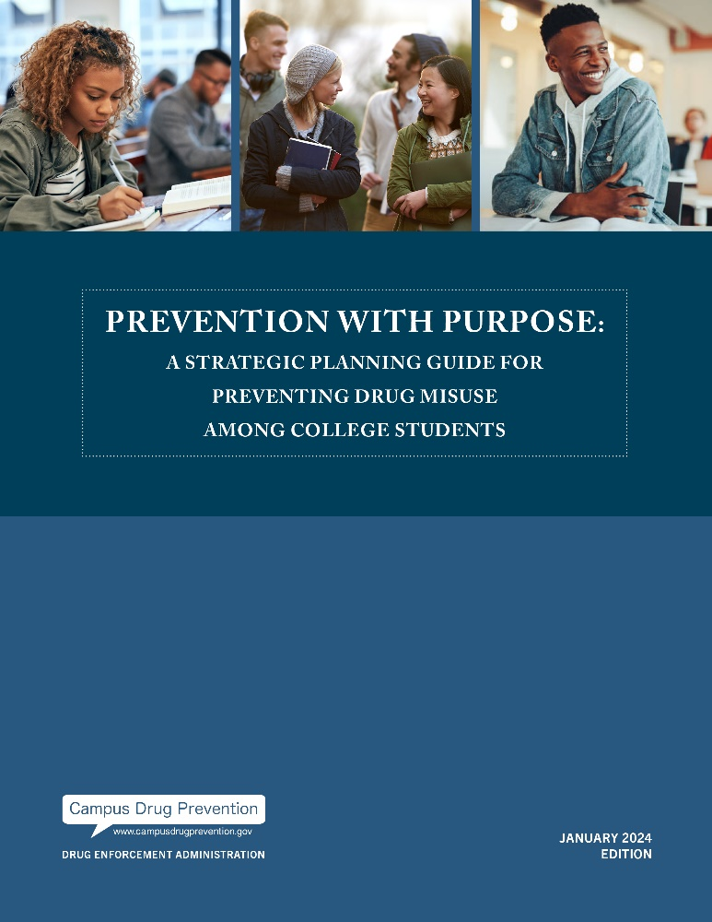
Prevention with Purpose
Provides a road map for prevention professionals to collaborate with a range of stakeholders to address campus-wide drug misuse issues
Overview of the guide
Eight easy-to-read chapters with helpful graphics
Print and online versions
Online resources associated with each chapter
What’s New in the 2024 Edition
Data update
SPF Profiles in Action
Integrating Culture Throughout the SPF
Prevention Success During Times of Disruption
Notes:
When we talked with campus-based professionals from around the country, they told us they needed current publications and guidance documents to support them in their work. As I started thinking about what DEA might be able to offer, I kept coming back to the Strategic Prevention Framework. Now the SPF has been around for about 25 years, but what didn’t exist was a publication that exclusively tied the SPF to prevention on college campuses and in their surrounding communities.

Slide 19
Updating Prevention with Purpose Data
Data Sources:
Over 85 references
Key word searches
Reviewed: research articles, archival data sources
Review Criteria:
2019 or later
Still relevant/ accurate
New information/ trends
Of All Data:
29% did not require any update
26% was updated
33% required reconsideration of context

Slide 20
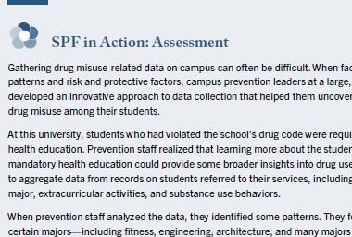
Development of Profiles
One profile per SPF Step
More than a dozen interviews with campus prevention professionals
Provides real world examples of the application of each SPF step
Unique approaches to challenges

Slide 21
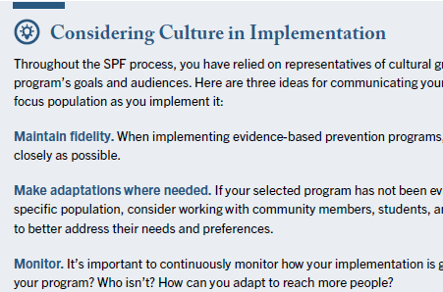
Highlighting Culture Across the SPF
New sections in Chapters 3-7
Highlight actions and considerations needed to ensure culturally responsive and inclusive prevention programming and processes.
Links directly to the Prevention with Purpose: Considering Culture Throughout the Strategic Prevention Framework

Slide 22
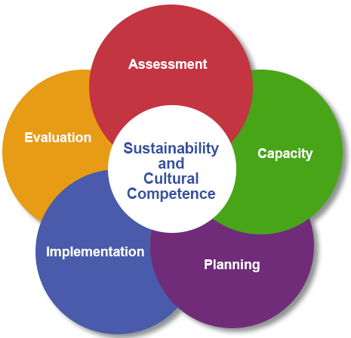
Considering Culture in Prevention Planning
Notes:
Will discuss the importance of sustainability and cultural competence across the lifespan of the SPF

Slide 23
Culture and the Prevention Workforce
Notes:
Will discuss staffing pipeline – making sure we’re intentionally recruiting diverse learners to create a diverse workforce

Slide 24
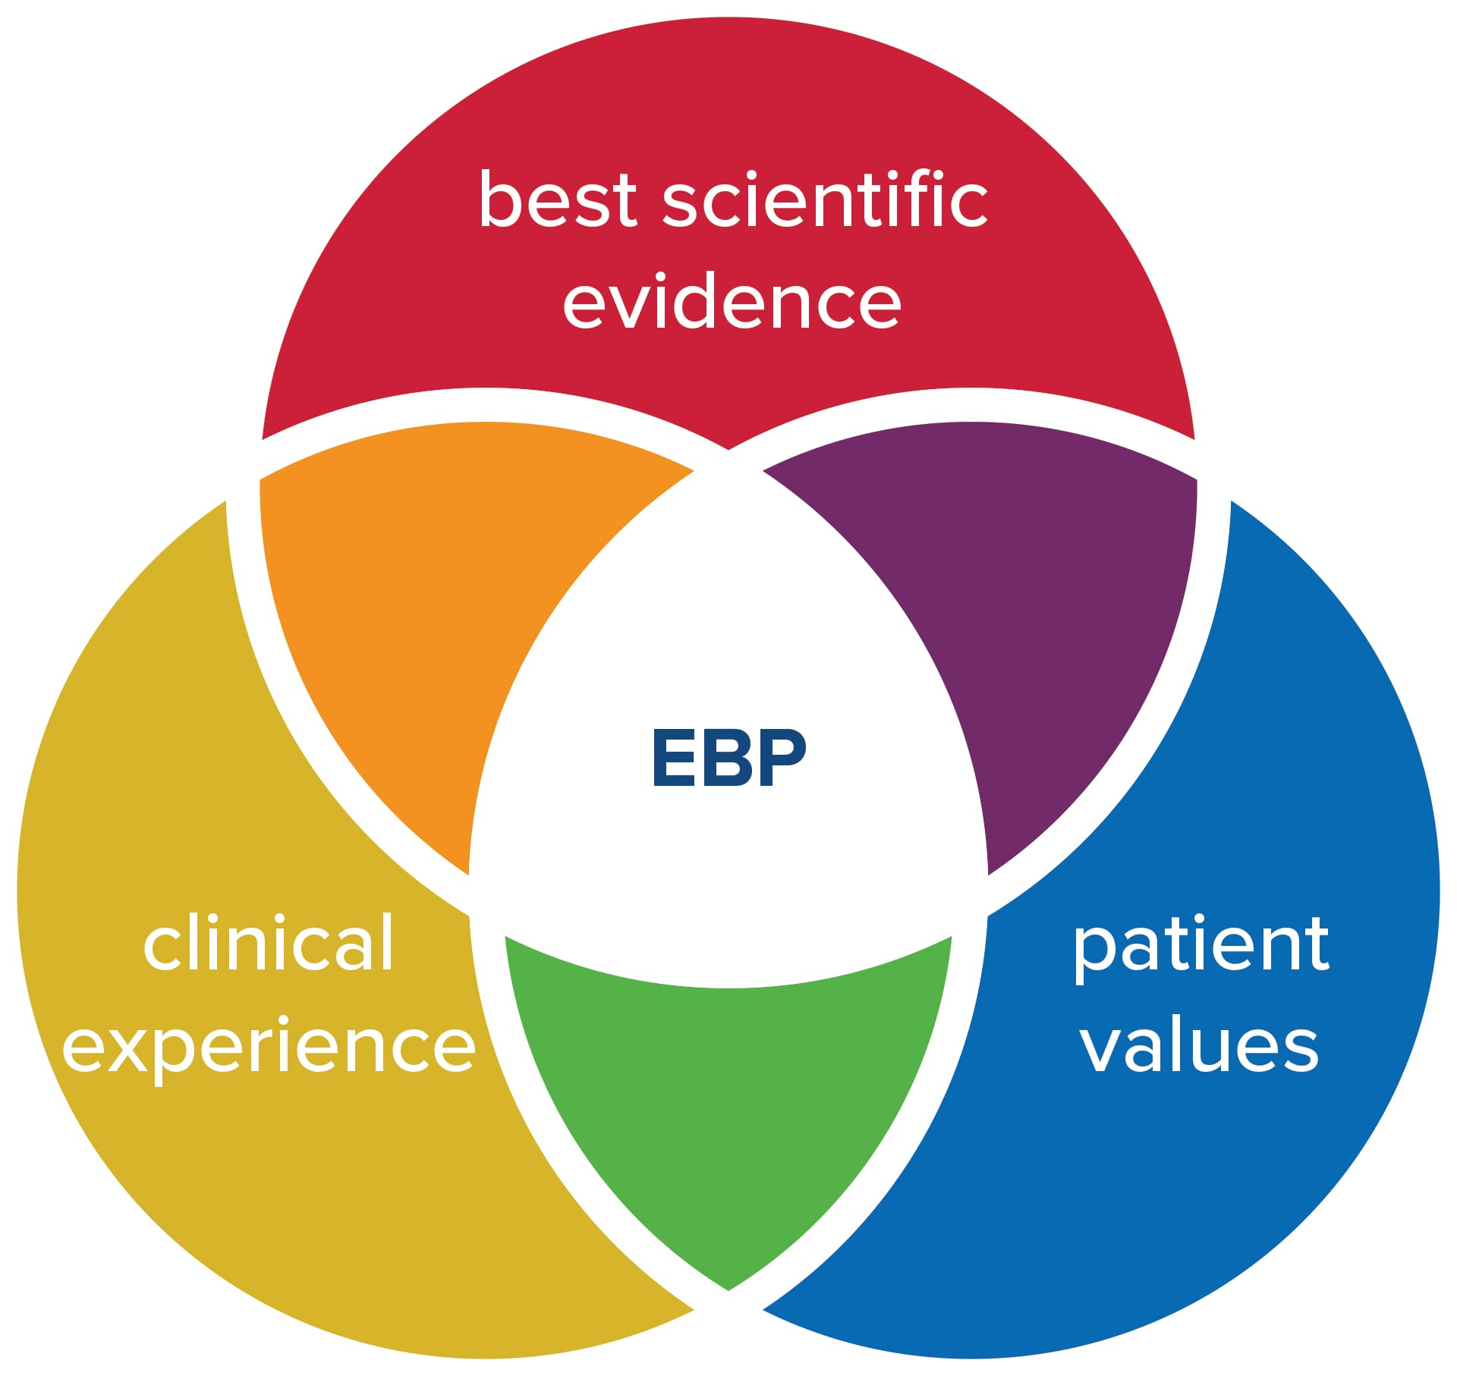
A Cultural Balancing Act
Notes:
Will discuss disparities in health care, such as access to treatment and experiences of patients/clients of color; experiences of student at Howard University doing collegiate recovery programming.

Slide 25
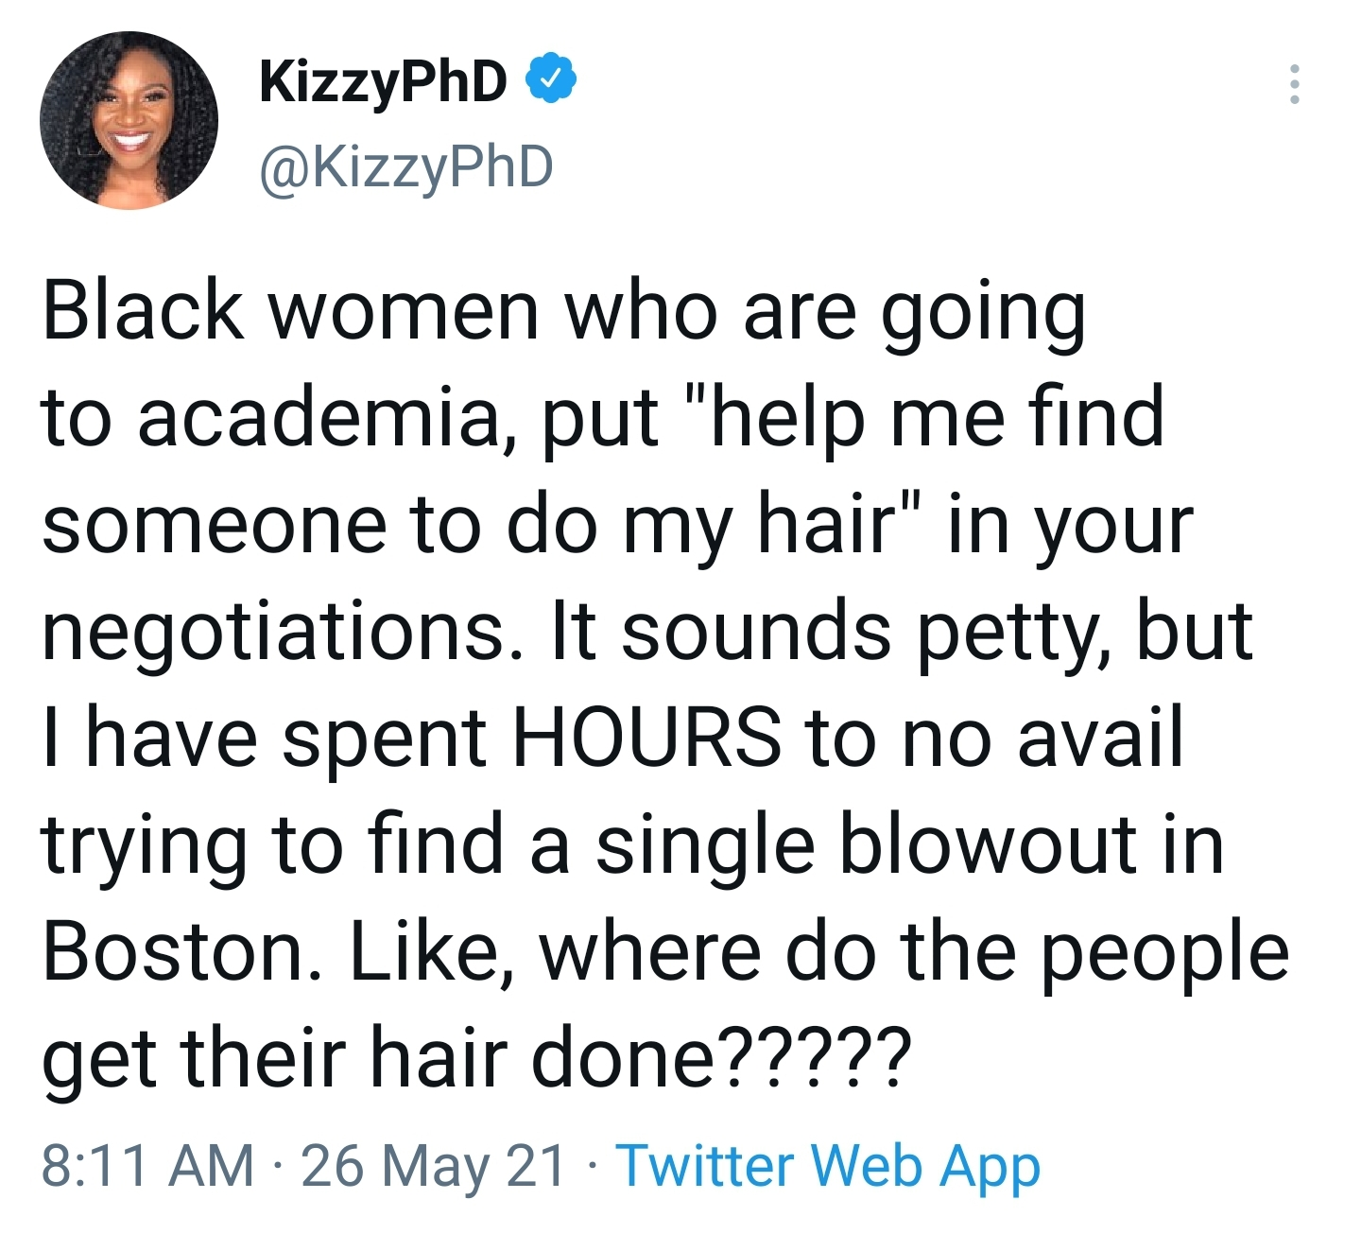
Cultural Needs Assessment
Notes:
Will share about the experience of Dr. Kizzmekia “Kizzy” Corbett (who helped to develop Moderna’s vaccine) and the role cultural competence plays at the intersection of higher ed and public health.

Slide 26
Expanding the Cultural Pipeline
“And the truth is, that it's bigger than me at this point. It's not necessarily about me but it is about providing a beacon of hope to younger generations of female and Black scientists…”
Notes:
Dr. Corbett: I've had girls dressing up like me for Halloween, and being me for their Black History Month projects at their schools.
And the truth is that it's bigger than me at this point. It's not necessarily about me but it is about providing a beacon of hope to younger generations of female and Black scientists, who are interested in science but have never really seen anyone like them be a scientist.
Dr. Lindsay: And we need more people who look like the communities that they serve … So that builds trust, people feel like my health care workers understand what I'm going through.
“The Story Behind the First COVID Vaccination with Dr. Kizzmekia Corbett and Dr. Sandra Lindsay” by the U.S. Department of Health and Human Services (HHS) -March 31, 2023 https://www.youtube.com/watch?v=BODPf582MBw

Slide 27
The Case for Culture in Prevention
Notes:
Dr. Corbett: I've had girls dressing up like me for Halloween, and being me for their Black History Month projects at their schools.
And the truth is that it's bigger than me at this point. It's not necessarily about me but it is about providing a beacon of hope to younger generations of female and Black scientists, who are interested in science but have never really seen anyone like them be a scientist.
Dr. Lindsay: And we need more people who look like the communities that they serve … So that builds trust, people feel like my health care workers understand what I'm going through.
“The Story Behind the First COVID Vaccination with Dr. Kizzmekia Corbett and Dr. Sandra Lindsay” by the U.S. Department of Health and Human Services (HHS) -March 31, 2023 https://www.youtube.com/watch?v=BODPf582MBw

Slide 28
Considering Culture in Prevention
Notes:
Will discuss “Views From the Field” three key points of Faith, Family & Cultural Competence in our evaluating & researching of EBPs

Slide 29
Defining Disruption
Any event that either poses to, or actively interrupts, the regular learning of students on campus – disruption can divert resources and attention from campus prevention efforts.
Outbreak of disease or virus
On-campus tragedies
Severe weather
Transitions in leadership
Cuts in services

Slide 30
Prevention in Times of Disruption
Strategies for preparing for and responding to disruptions
Based on interviews with campus prevention professionals
Builds on learning during the COVID-19 pandemic
Strategies are connected to the SPF process

Slide 31
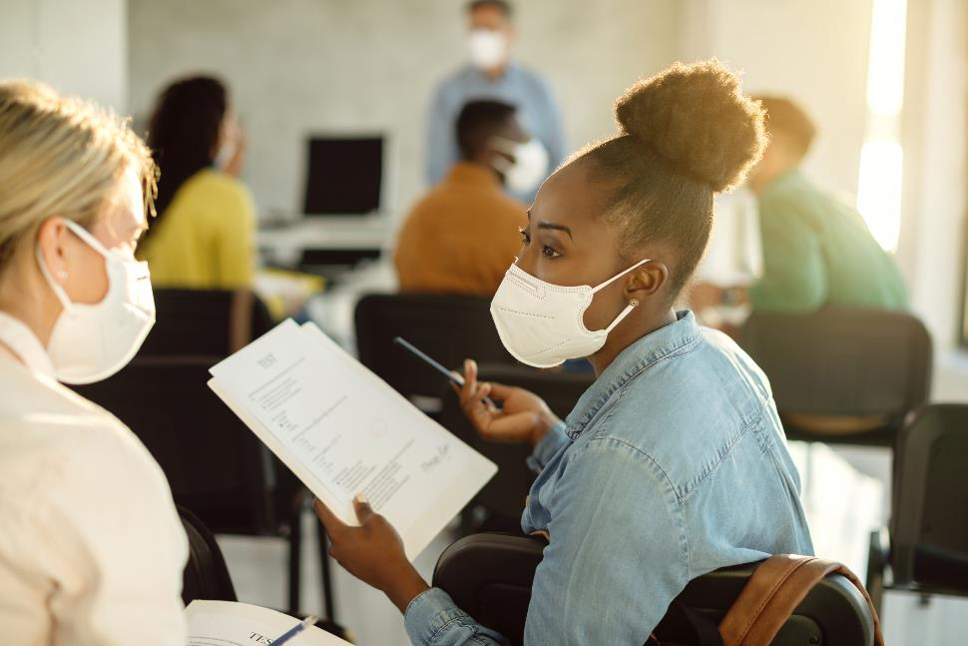
Strategies to Prepare for Disruption
Stay Strategic
Commit to Assessment
Leverage Existing Partnerships
Get Close to Leadership
Be Flexible and Creative
Strategic planning is the best preparation for the unknown.
Notes:
Stay Strategic
Think of your strategic plan as your “true north”90—it can provide clarity of action amid an evolving landscape.
Commit to Assessment
Having a culture of assessment helped them quickly adapt to changing state requirements. (James Lange, SDSU)
Leverage Existing Partnerships
Many administrators shared that having people who value and understand how prevention connects to the rest of the campus’s health and safety goals can generate continued support for prevention during times of disruption.
Get Close to Leadership
To help prevention stay at the forefront, campus prevention staff should try to foster partnerships and relationships with administrators who are in charge of the university’s crisis response.
Be Flexible and Creative
The ability to pivot is key to maintaining a focus on substance misuse in times of disruption.
“In the midst of a challenge, there are ways to reconceptualize your programming. You don’t have to keep doing things the same way you’ve been doing them for 20 years.” Dolores Cimini (University at Albany)

Slide 32
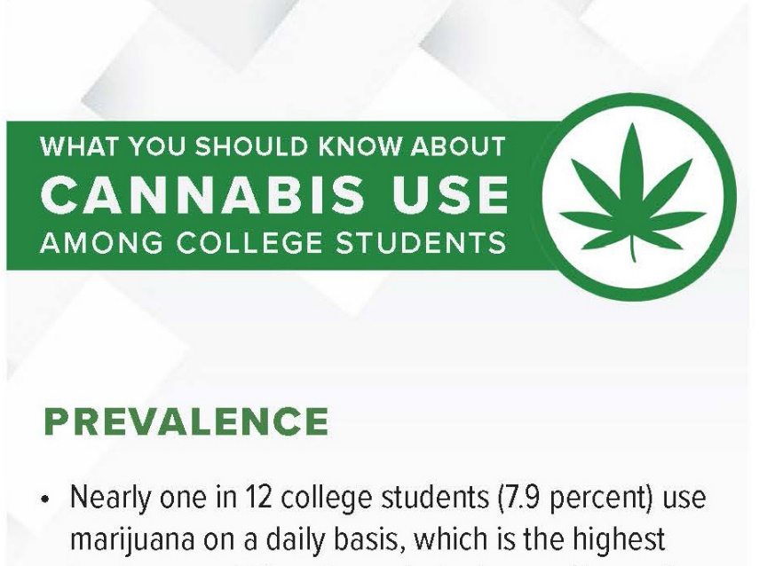
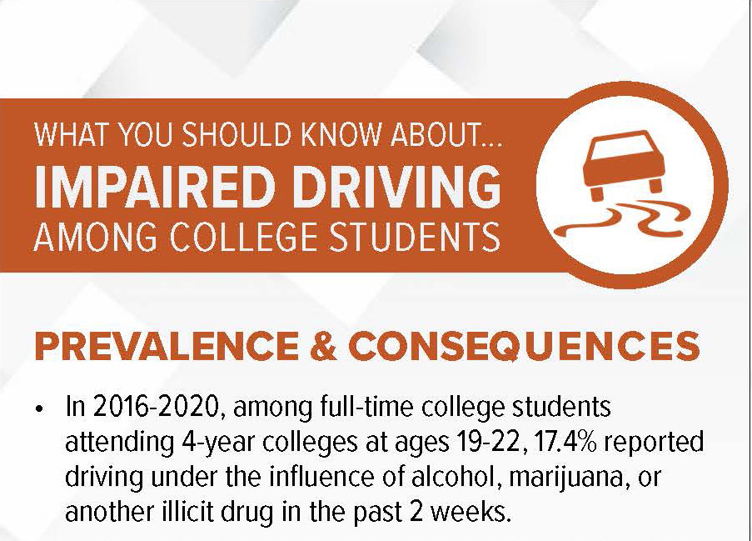
DEA’s Resources for Colleges and Universities Campus-Specific Fact Cards

Slide 33
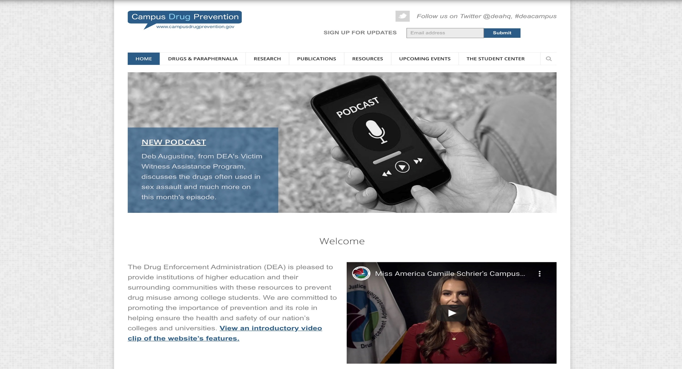
DEA’s Resources for Colleges and Universities www.campusdrugprevention.gov
Notes:
Debuted in July 2017 (73K+ subscribers)
Created as a one-stop resource for preventing drug use and misuse among college students
Highlights include:
Publications – federal, nonfederal, law enforcement
Resources – interactive map, Prevention Profiles: Take Five, Views from the Field
Events calendar
The Student Center
Sign up for e-mail updates

Slide 34
Prevention with Purpose
Provides a road map for prevention professionals to collaborate with a range of stakeholders to address campus-wide drug misuse issues
Overview of the guide
Eight easy-to-read chapters with helpful graphics
Print and online versions
Online resources associated with each chapter
What’s New in the 2024 Edition
Data update
SPF Profiles in Action
Integrating Culture Throughout the SPF
Prevention Success During Times of Disruption
Notes:
When we talked with campus-based professionals from around the country, they told us they needed current publications and guidance documents to support them in their work. As I started thinking about what DEA might be able to offer, I kept coming back to the Strategic Prevention Framework. Now the SPF has been around for about 25 years, but what didn’t exist was a publication that exclusively tied the SPF to prevention on college campuses and in their surrounding communities.

Slide 35
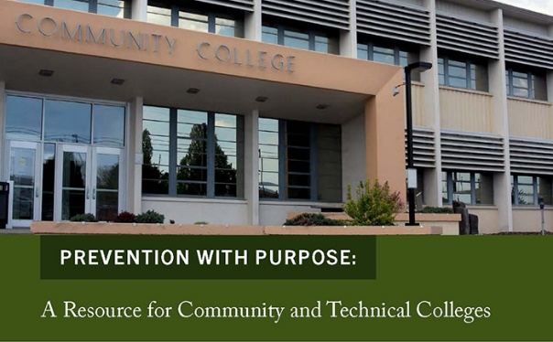
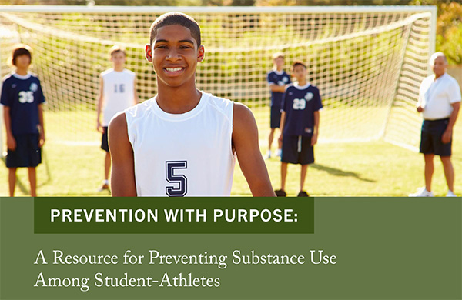
DEA’s Resources for Colleges and Universities Prevention with Purpose Supplemental Resources
Notes:
Designed as brief publications (4-12 pages each) that focus on a specific campus population, setting, or topic:
Community and Technical Colleges
Campus Police and Public Safety Personnel
Faculty Members
Presidents and Senior Administrators
Student Affairs Professionals
Health Centers/Counseling Centers
Community Coalitions
Student Leaders
Considering Culture
Shared Responsibility
Student-Athletes

Slide 36
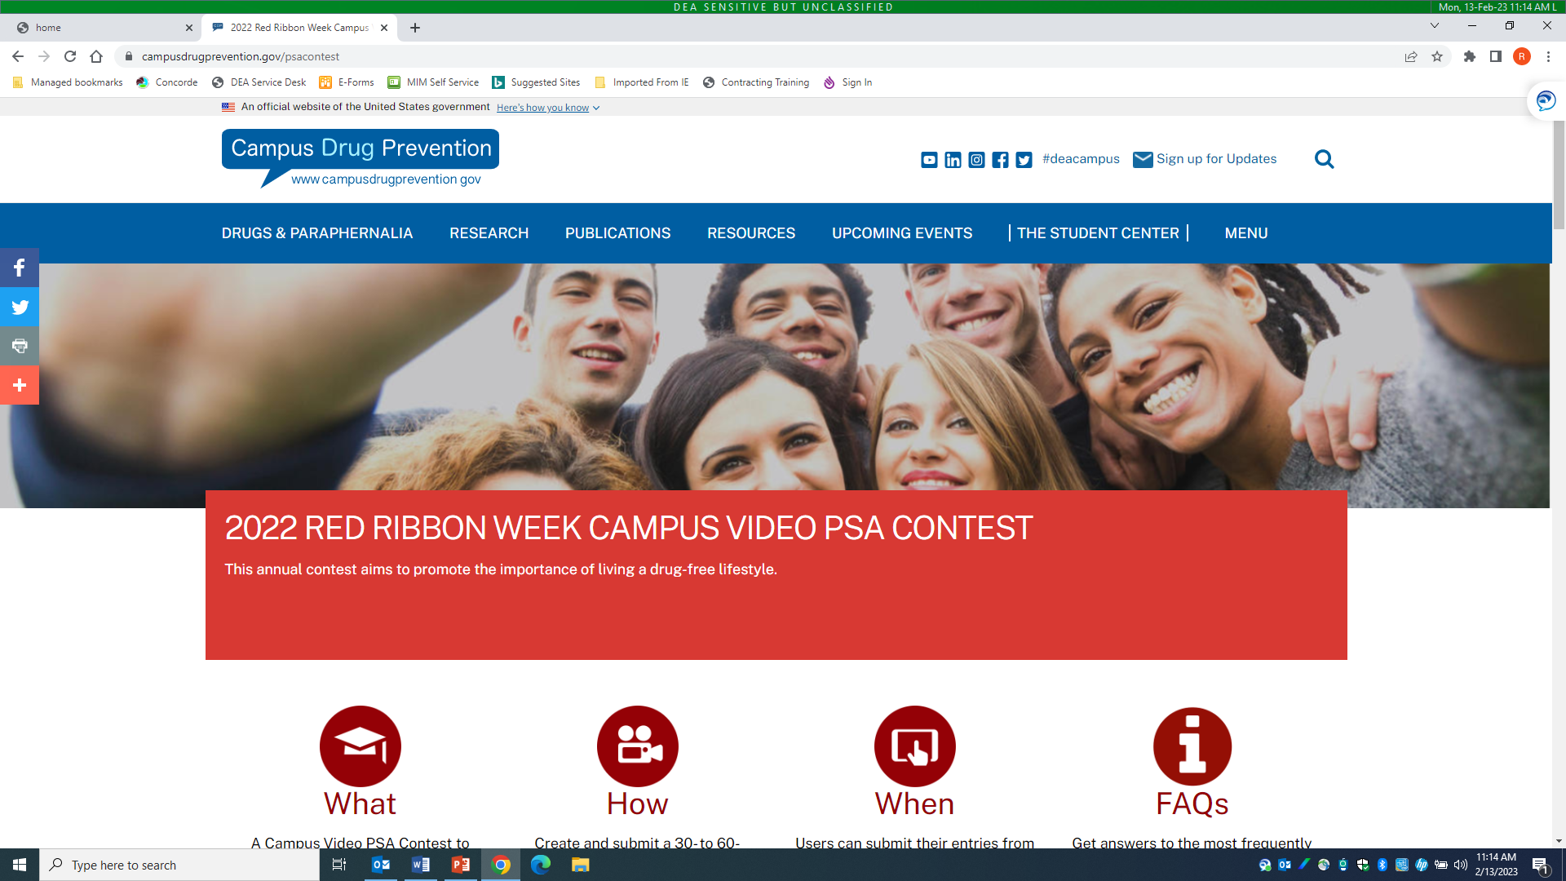
DEA’s Resources for Colleges and Universities Red Ribbon Week Campus Video PSA Contest
Notes:
In collaboration with SAMHSA’s Center for Substance Abuse Prevention
Recently announced the three winners of the 7th annual contest during NASPA’s Strategies Conference
Colleges and universities develop :30-:60 PSAs that focus on the importance of preventing alcohol and other drug misuse among college students
First place ($5,000), Second Place ($3,000), Third Place ($1,000)
Watch for information in mid-August about this year’s contest at www.campusdrugprevention.gov/psacontest

Slide 37
Strategic Planning Guide
Prevention is not random.
Prevention needs to be intentional.
It needs to be purposeful.
It needs to be strategic.
Notes:
The strategic planning guide walks higher education prevention professionals through how to use the SPF to be intentional, purposeful, and strategic with their prevention efforts.

Slide 38
Contact Information
Rich Lucey - richard.lucey@dea.gov
Allison Smith, Ph.D. - allison.smith@laregents.edu

