Slide 1

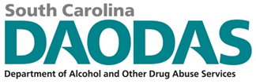


Navigating Underage Drinking Enforcement Before, During & After the Pandemic: The South Carolina Experience
Michelle M. Nienhius, MPH, NPN (SC), DAODAS
Wehme A. Hutto, MPA, CSPS, ICPS, Kennedy Center
Michael D. George, Ph.D., PIRE
NPN Conference; August 13-15, 2024: Phoenix, AZ
Notes:
Custom DAODAS color codes is : Red-0
Green-131
Blue-139

Slide 2
Presentation Objectives
Ascertain the process required to build a statewide underage drinking effort with emphasis at the local level.
Learn about environmental strategies that are meant to reduce underage consumption of alcohol.
Understand that consistent alcohol compliance checks are needed to reduce underage drinking traffic crashes.
Learn about developing and maintaining a long-term, productive relationship between local and state prevention and law enforcement agencies.
Notes:
Section Header Slide

Slide 3
History of Addressing Underage Drinking in South Carolina
(1993) Community Trials research effort led by Dr. Harold Holder, PIRE in Florence, South Carolina.
(1998-2002) Enforcing Underage Drinking Laws (EUDL) Block grant funds primarily allocated to colleges to implement campus education programs, alternative events and social norms campaigns. Very little attention paid to Enforcement strategies.
(2002-2005) EUDL Discretionary grant -3 SC counties were funded to implement a comprehensive approach to underage drinking prevention based on enforcement, education/awareness and community support (AET Model).
(2005-2006) EUDL Block Grant funds used to expand discretionary grant concepts. The sites funded under the discretionary grant became mentor sites to 4 new sites in SC.

Slide 4
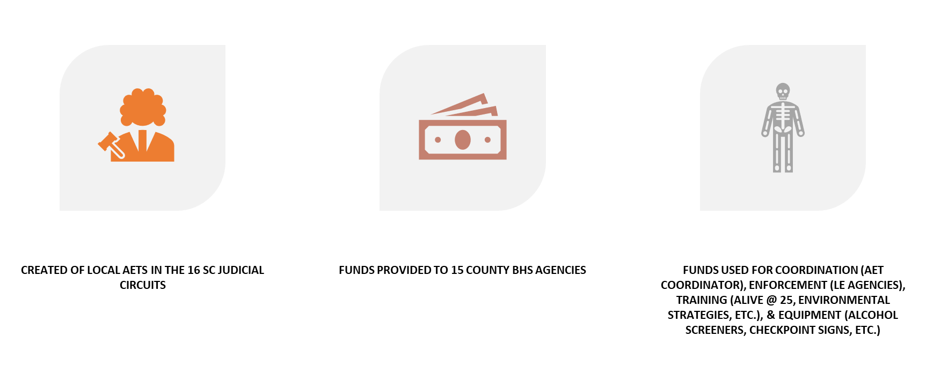
Passage of the Prevention of Underage Drinking and Access to Alcohol Act of 2007
Notes:
Section Header Slide

Slide 5
Alcohol Enforcement Teams (AETs)
The AET model, which includes community coalition maintenance and development, merchant education, and law enforcement partnership, specifies a multi- or single-jurisdictional alcohol law enforcement approach (depending on the needs and participation of law enforcement within the target area) in a community to:
  Reduce youth access to alcohol utilizing various strategies (social and retail access)
  Measure, track, and improve merchant compliance with alcohol laws
  Provide research-based merchant education
  Build community support for enforcement of underage drinking laws through media advocacy and community coalition maintenance and development
  Develop local law enforcement support for underage drinking prevention and enforcement efforts

Slide 6
Funding Resources for South Carolina Environmental Strategies
The Alcohol Enforcement Team efforts have been funded through a combination of federal (SUPTR BG/EUDL BG and EUDL Discretionary grants), state and local funds.
Funding levels = varied through the years (highest $98,000, stable $35,000 to $50,000 based on population)
Some counties awarded federal grants (NHTSA, Drug Free Communities, SAMHSA Discretionary grants

Slide 7
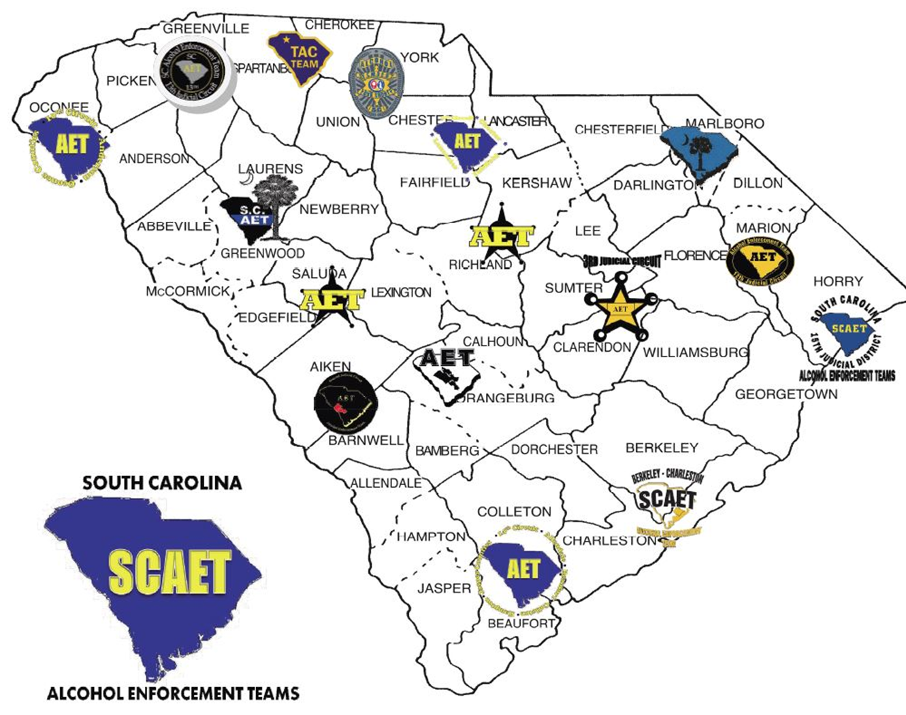
Each Circuit hired a Coordinator
Began extending community relationships and building new ones toward building the teams
All teams formed by October 2007
Notes:
Content Slide With No Bottom Border

Slide 8
South Carolina Initial Steps Toward Collaboration
State AET Liaison hired
State meeting involving coordinators
Regional AET Training for LEOs & partners
Lead Agency in Circuit Identified
Began Bi-monthly State Meetings
Statewide reporting system established
15 AET Coordinators hired for 16 circuits
Notes:
Section Header Slide

Slide 9
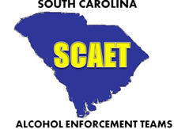



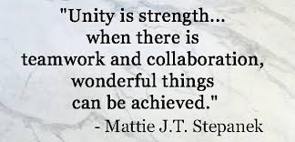
Essential Elements for Effective Strategies
Communication
Cooperation
Collaboration
Coordination
These are the essential elements to implement effective evidence-based strategies and achieve outcomes as we work together to improve the health and safety of communities across South Carolina.

Slide 10
Infusion of Cultural Competency in AET model….
What do we mean?
SAMHSA defines cultural competence as "the ability of an individual or organization to interact effectively with members of diverse population groups”
While awareness of cultural aspects of population groups is tantamount to ensure ALL population groups are reached….
Understanding organizational culture of coalition members is important to successful collaboration on community problems.
Schein (2010) defines organizational culture as “the basic tacit assumptions about how the world is and ought to be that a group of people share and that determines their perceptions, thoughts, feelings, and their overt behavior”.
An understanding begins by spending time with coalition members (i.e., social events, coalition meetings, training, community events)
Schein, E. H. (2010). Organizational culture and leadership (4th ed.). San Francisco: Jossey-Bass.
Notes:
Section Header Slide

Slide 11


What did DAODAS Provide?
Short training at Initial state meetings for Prevention staff in South Carolina to acclimate them to law enforcement profession & culture
Law Enforcement 101
Some agencies may embrace the underage drinking enforcement concept & and provide officers at no charge
Paying overtime may be possible; other methods of “payment” may work
Recognition, training, & equipment…other incentives or rewards
Notes:
Section Header Slide

Slide 12
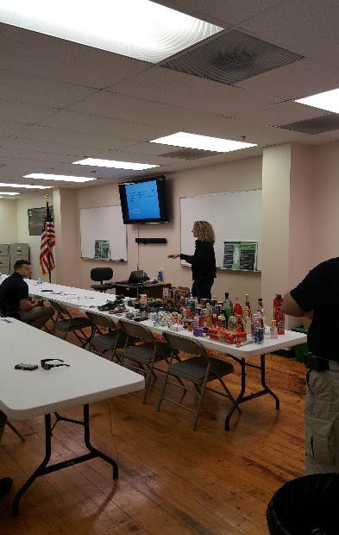
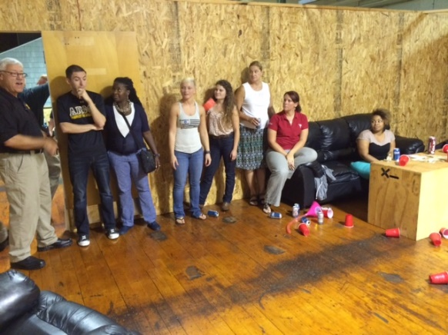
Free regional training for law enforcement, prevention specialists, and other community stakeholders-built CAPACITY for underage drinking enforcement and education in the community.
SCAET Class Title | SCCJA Hrs. awarded
Fake and Fraudulent ID Training | 5.0
AET: SC Underage Drinking Laws and Alcohol Products (AET 101) | 3.0
Alcohol Enforcement Team Activities Training | 4.0
Alcohol Enforcement Team Training – Mock Party Dispersal | 4.5
Special Alcohol Events Management Law Enforcement Training | 4.0
AET: Keys to Implementing Effective Environmental Strategies in Local Communities | 12.25, 6.25
Impaired Driving Public Safety Checkpoint Instruction (DVD) | 0.5
PAS Systems Training | 2.0
Source Investigation | 4.0
South Carolina Youth Tobacco Education & Enforcement Training | 2.5
Public Safety Checkpoints: A tool to combat impaired driving in local communities | 4.0
The training also helped develop and extend community relationships among stakeholders.
Notes:
Section Header Slide

Slide 13
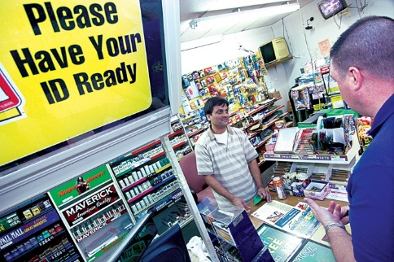

Initial Environmental Strategy
DAODAS funded several county-level AETs previously
Alcohol Compliance Checks
Circuit AETs had capacity
Many law enforcement agencies were experienced in compliance checks
County AOD Agency Prevention staff conducted merchant education (responsible beverage service) training
State-level enforcement reporting was in place

Slide 14
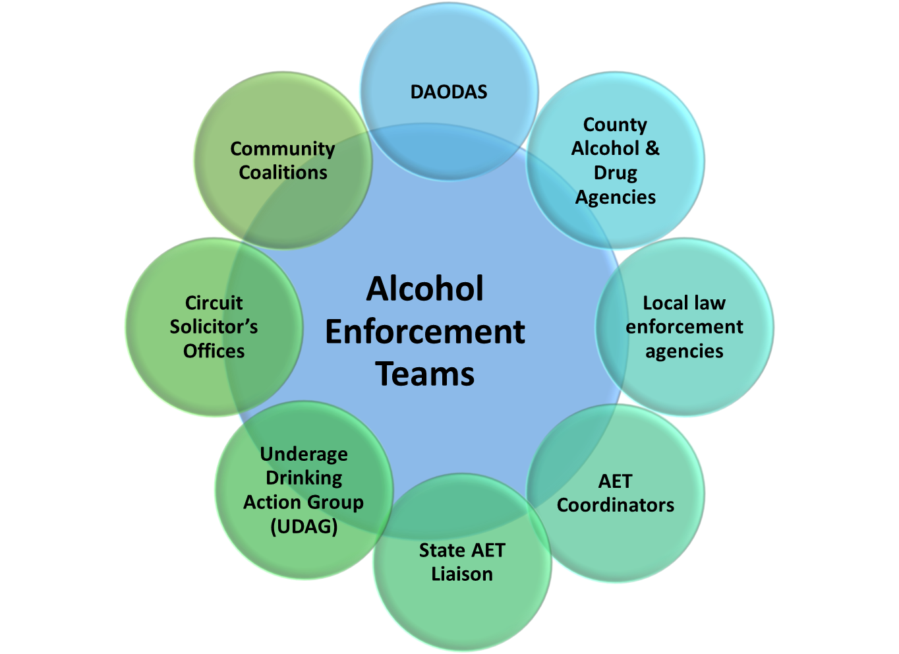
AET Partnerships and Structure

Slide 15
Evaluation of statewide AET conducted 2017-2018;
Article published Jan. 2021
MDG
George, M. D., Holder, R., Shamblen, S., Nienhius, M. M., & Holder, H. D. (2021). Alcohol Compliance Checks and Underage Alcohol-Involved Crashes: Evaluation of a Statewide Enforcement Program in South Carolina from 2006 to 2016. Alcoholism: Clinical and Experimental Research, n/a(n/a). https://doi.org/https://doi.org/10.1111/acer.14507

Slide 17
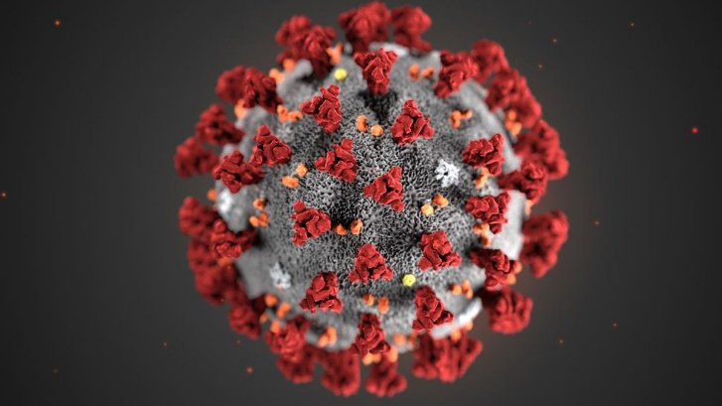
Impact of COVID-19 in South Carolina relating to Environmental Prevention
March 7, 2020: First COVID 19 cases reported in Charleston & Kershaw counties
March 15, 2020: South Carolina Governor Henry McMaster declared state of emergency and closed all but essential businesses. Most AETs discontinued alcohol enforcement operations.

Slide 18
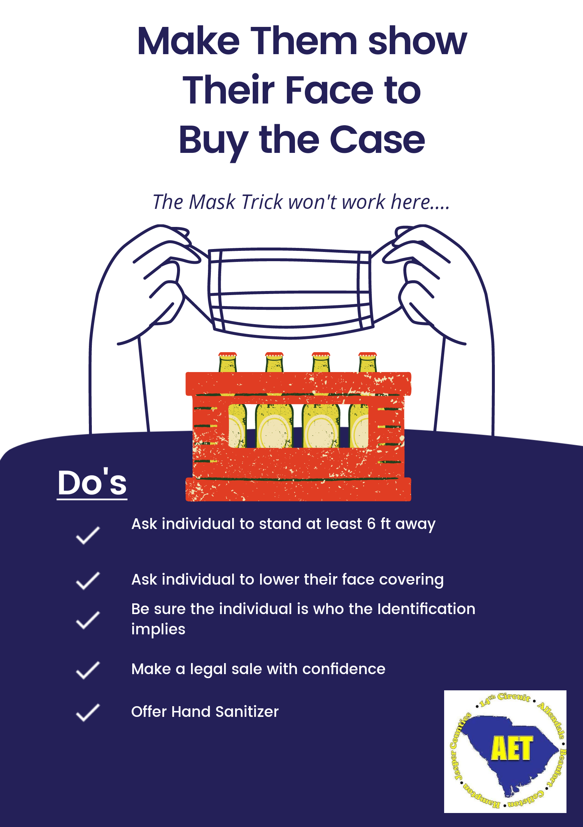
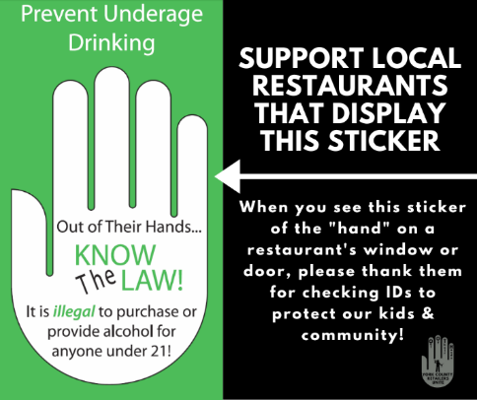
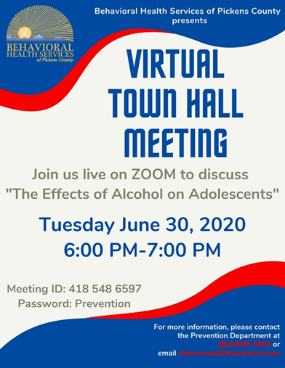
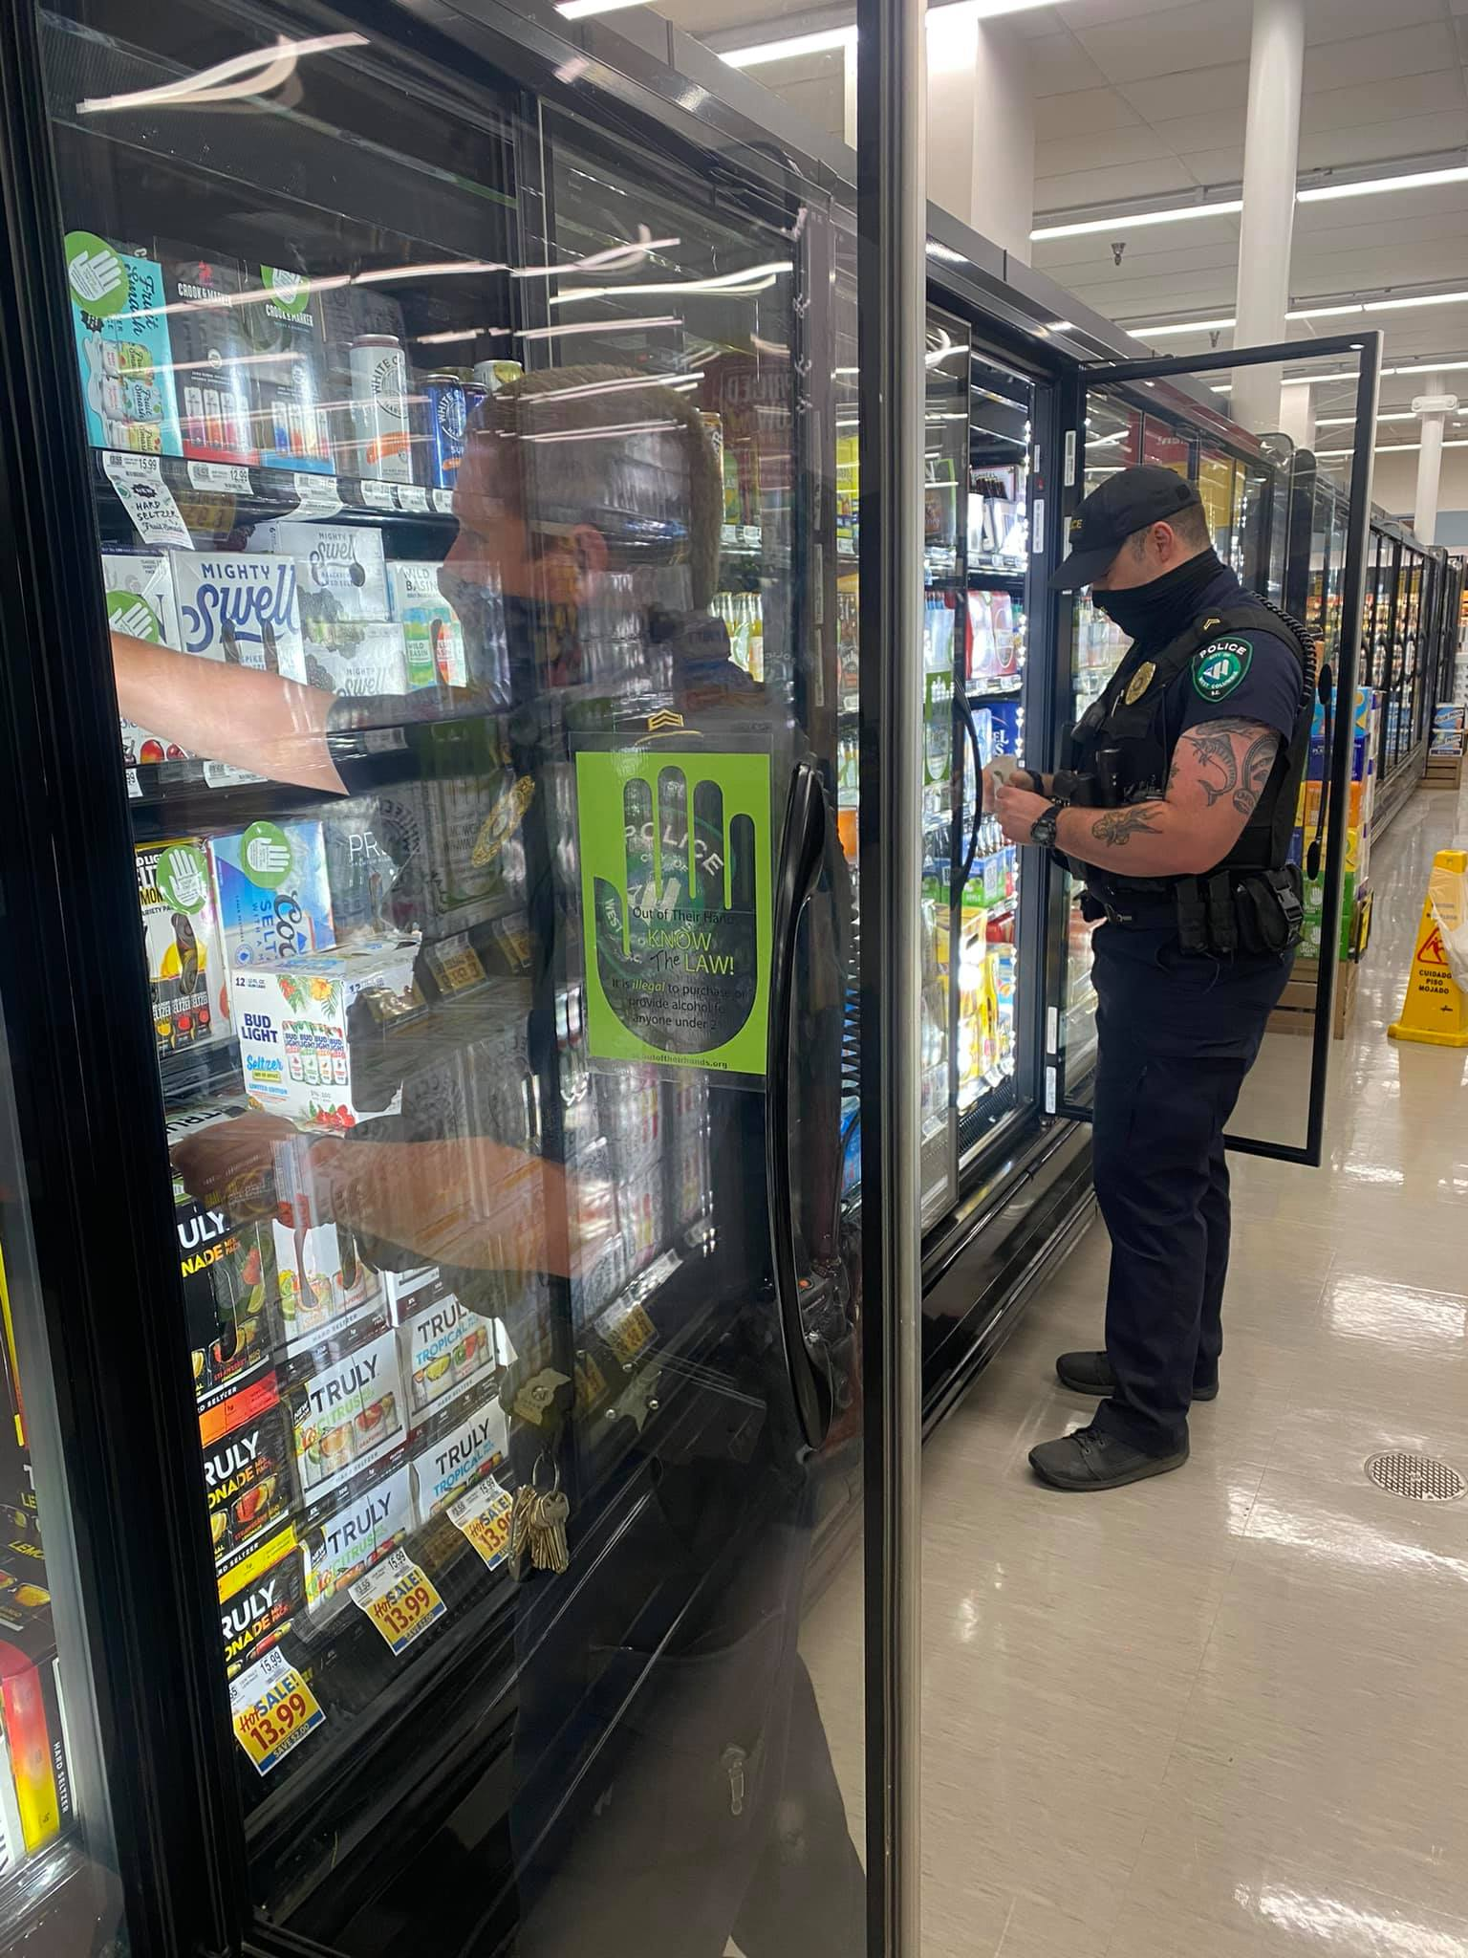
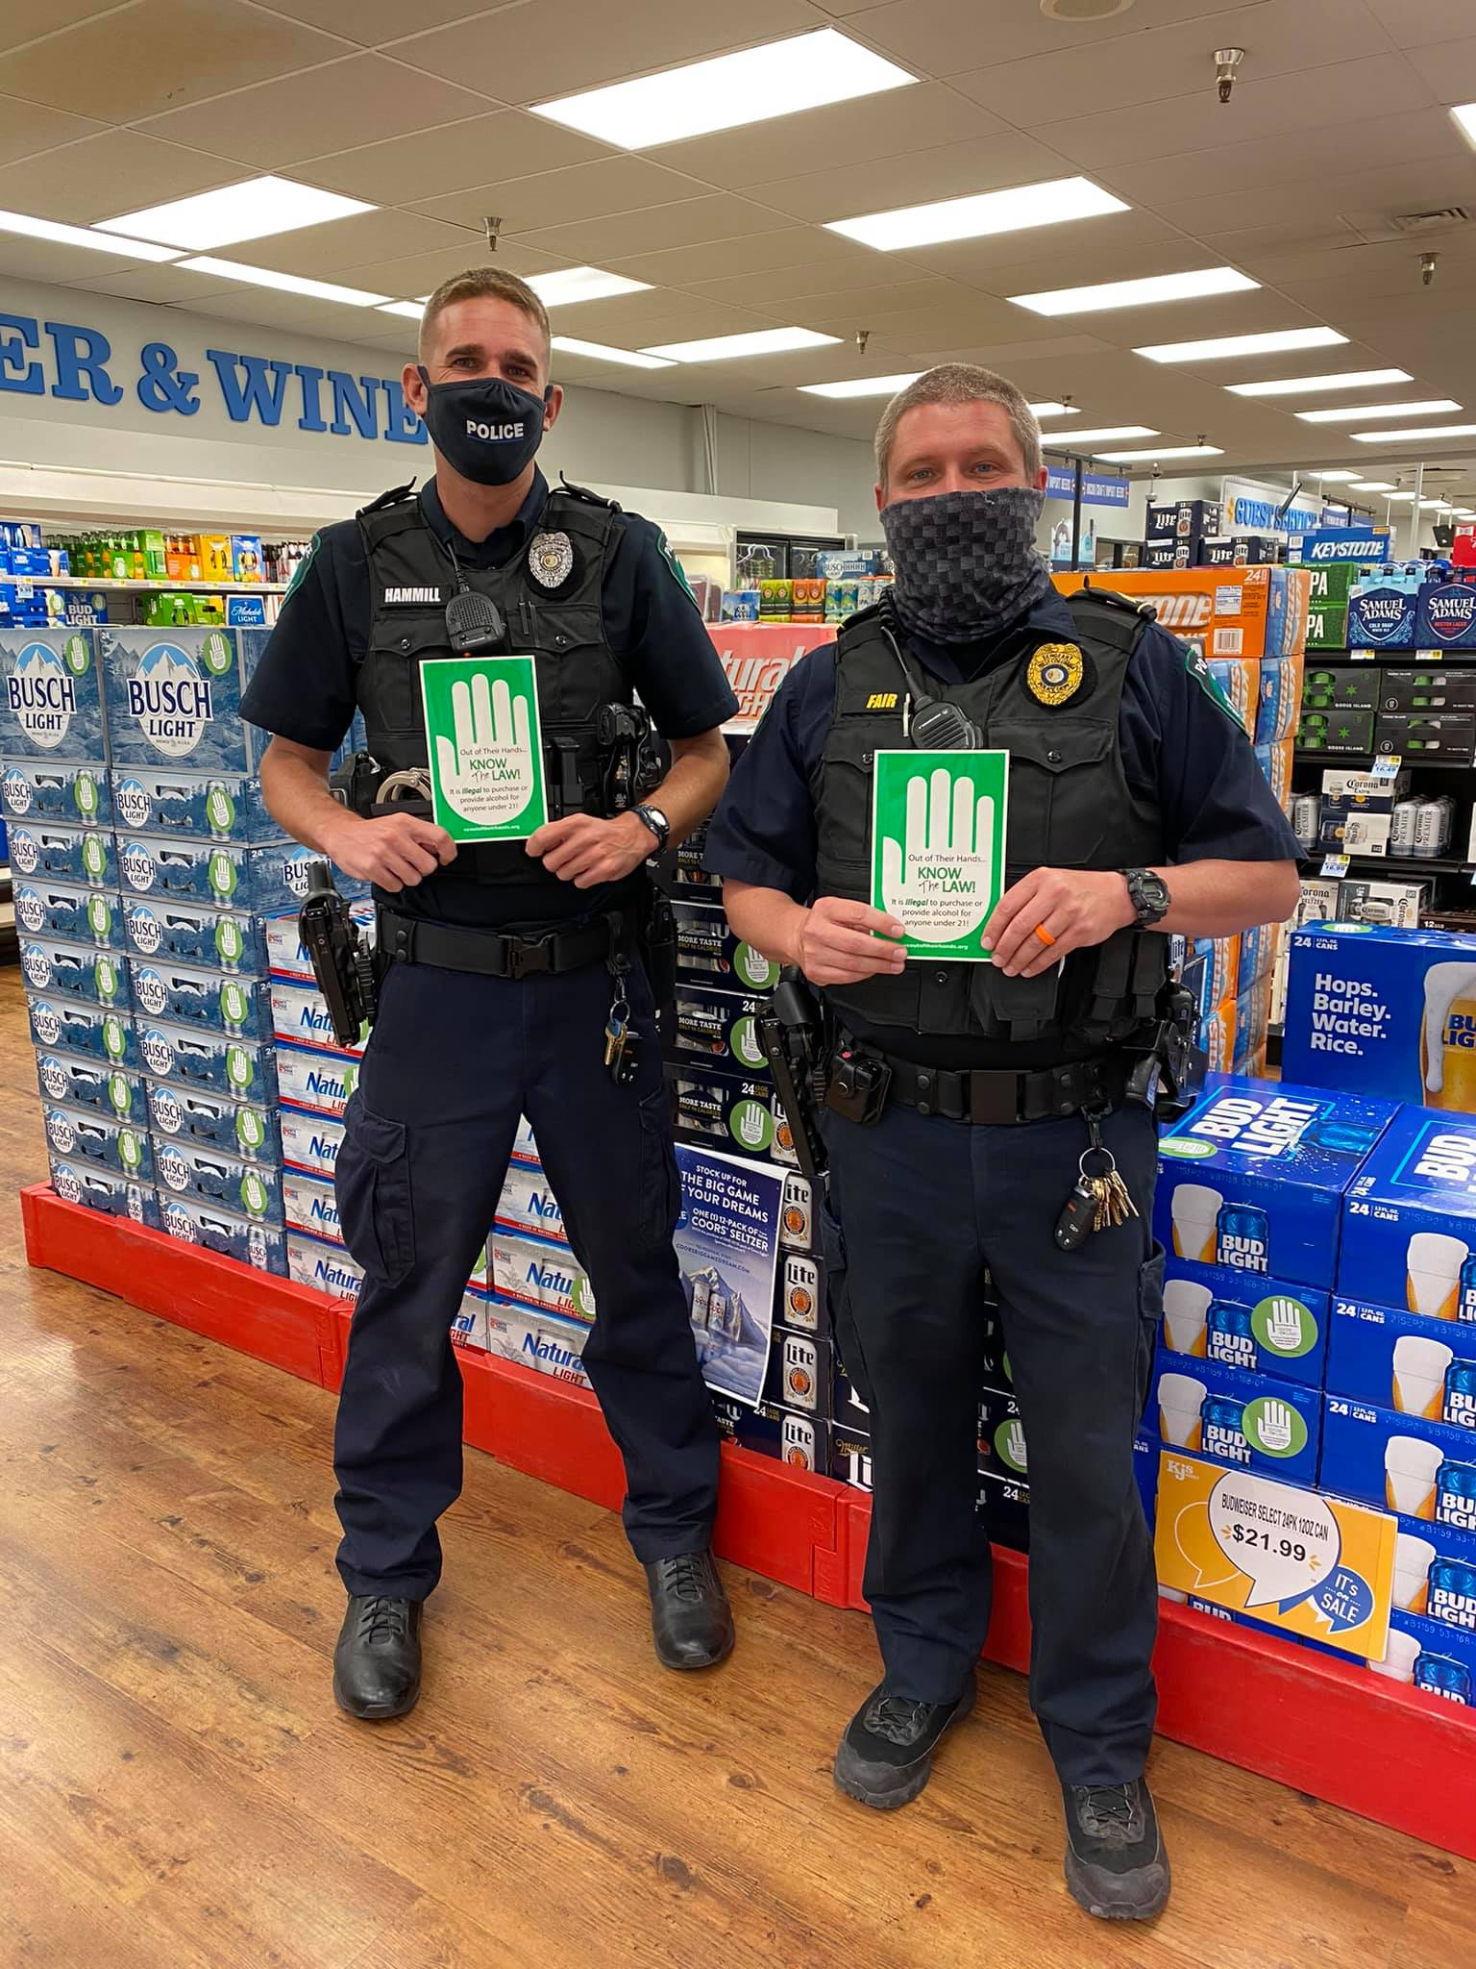
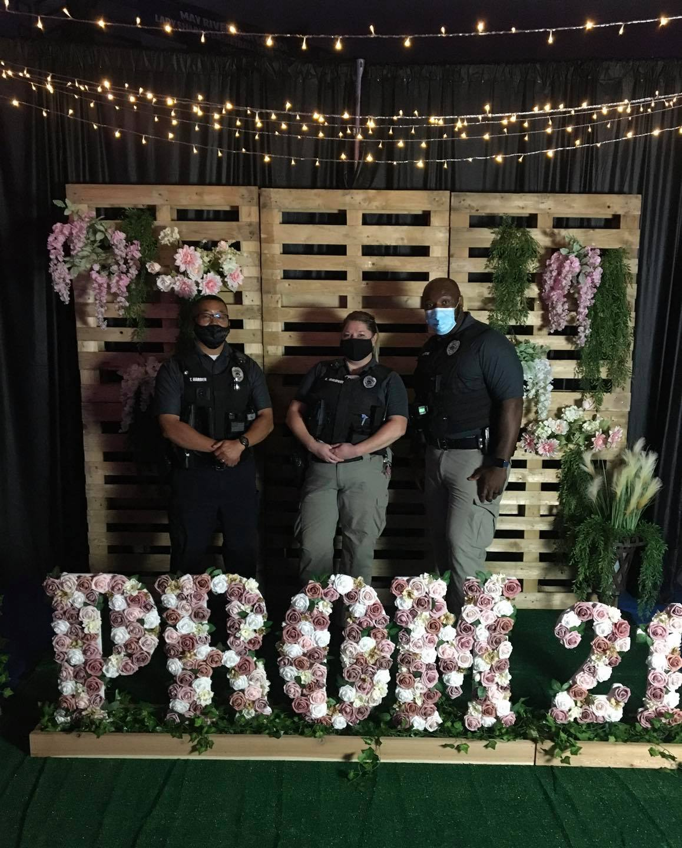
Adapting Primary Prevention Services During COVID-19
Notes:
Temporarily, prevention professionals were at loss to deliver prevention programs because public meetings were not allowed. Prevention professionals adapted to stay at home orders & implemented virtual meetings and virtual community events
Information indicate that the strong partner relationships built and maintained prior to pandemic sustained community efforts through the pandemic
For instance, in many counties, partner organizations expressed creative ideas to still implement AET activities during COVID-19 through social media and Facebook Live

Slide 19

Alcohol Enforcement Team
at the Local Level
Berkeley & Charleston County,
South Carolina

Slide 20
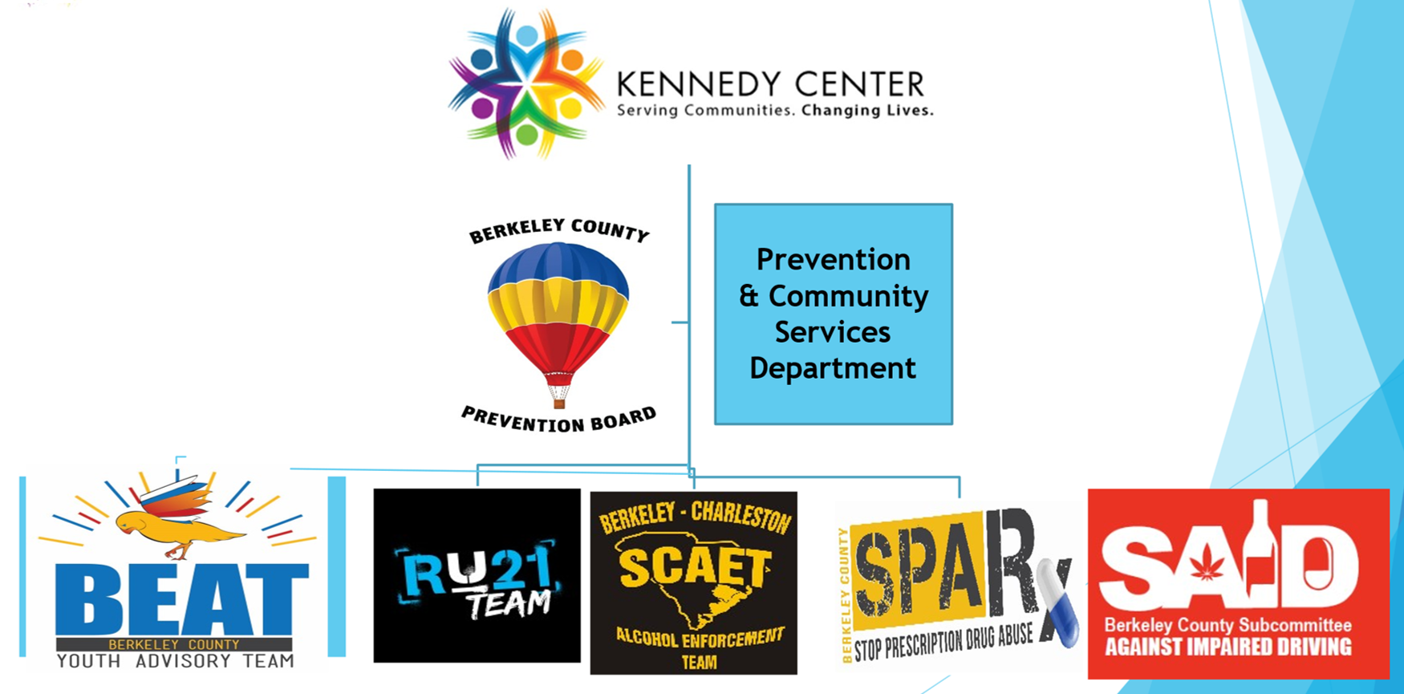
Prevention
& Community Services Department

Slide 21
9th Judicial Circuit
Alcohol Enforcement Team
  Casual Contacts
  Environmental Scans
  Compliance Checks
  Fake ID Checks/Bar Checks
  Public Safety Checkpoints
  Underage Party Dispersal/Patrols
  Shoulder Taps

Slide 22

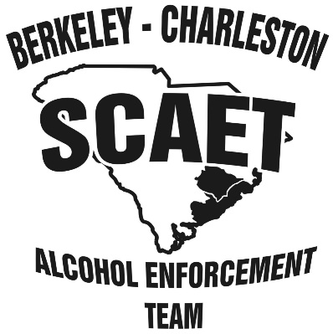


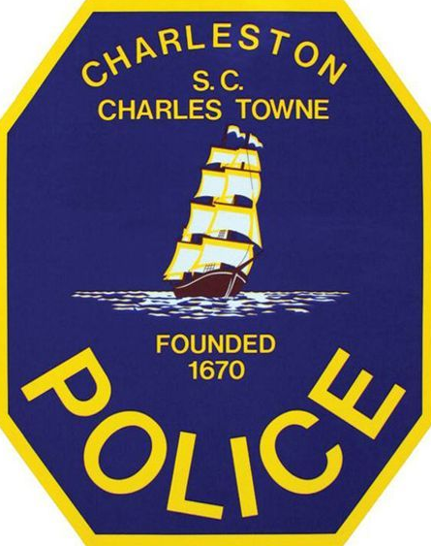
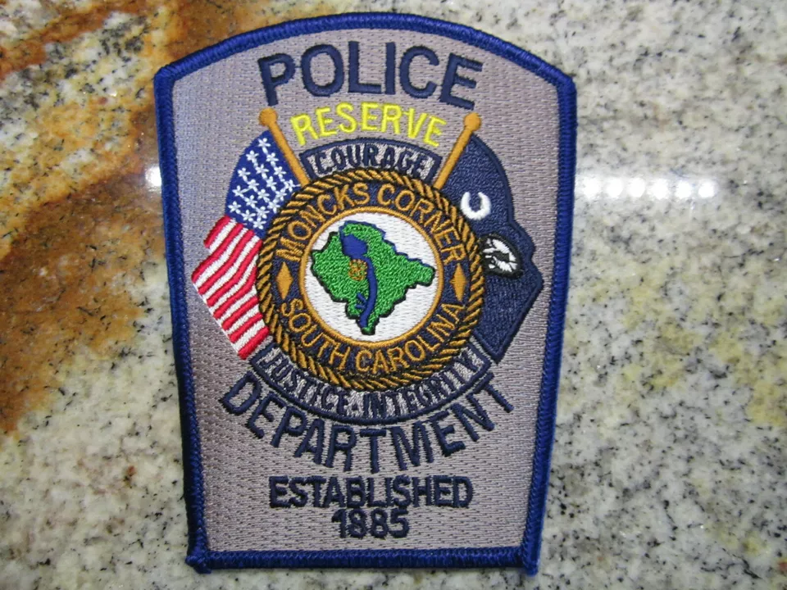
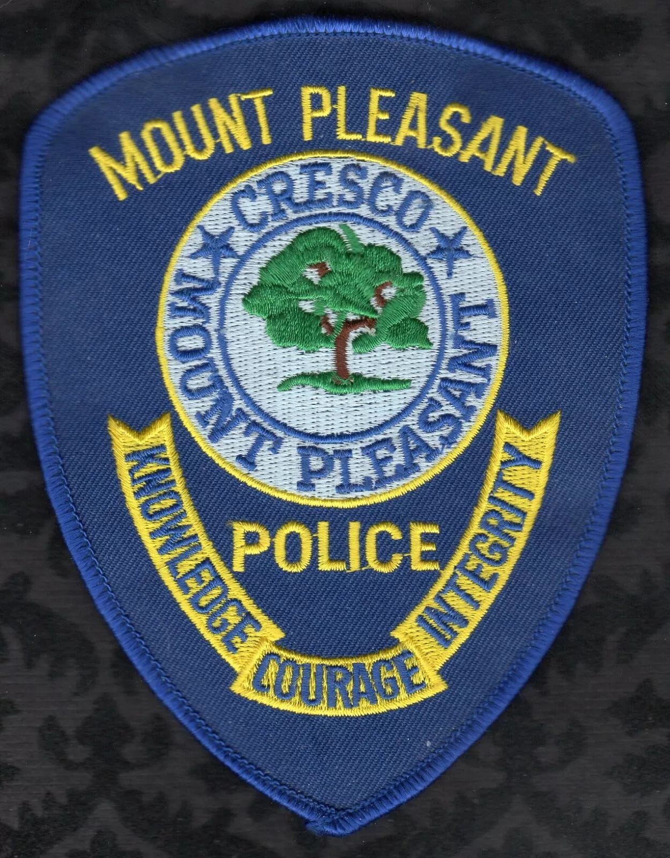




Slide 23
Collaboration is Key:
Memorandum of Understanding
Collaborative Enforcement
Merchant Education
Quarterly Meetings
Shared Information
Joint Media

Slide 24
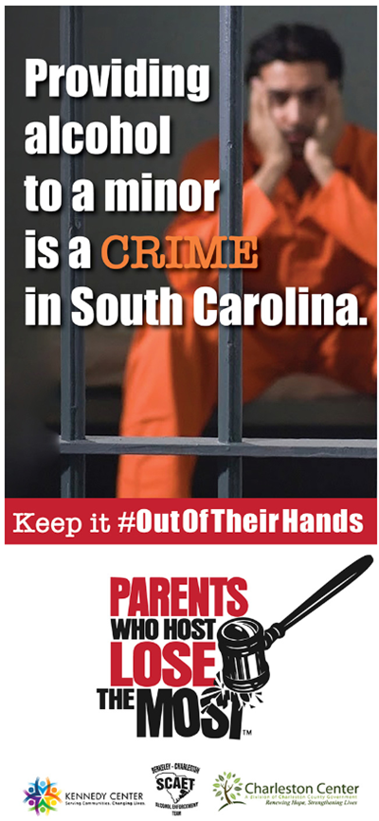

“Out of Their Hands” Campaign
  Billboards
  Online Social Media
  Front Page Takeover
  Eblast Email to Parents, Grandparents & Caregivers of Children
  Non-Profit Match Program

Slide 25

“Out of Their Hands” &
“Parents Who Host
Lose the Most”
Campaign
  Emails were sent to homes in the Berkeley & Charleston area that had children in the home who were school age.
  The Post & Courier sent this message via
  E-blast through a process of Geo-Mapping.
Targeted
E-Blast
Campaign

Slide 26
A Successful Collaborative Outcome to Build on

Slide 27
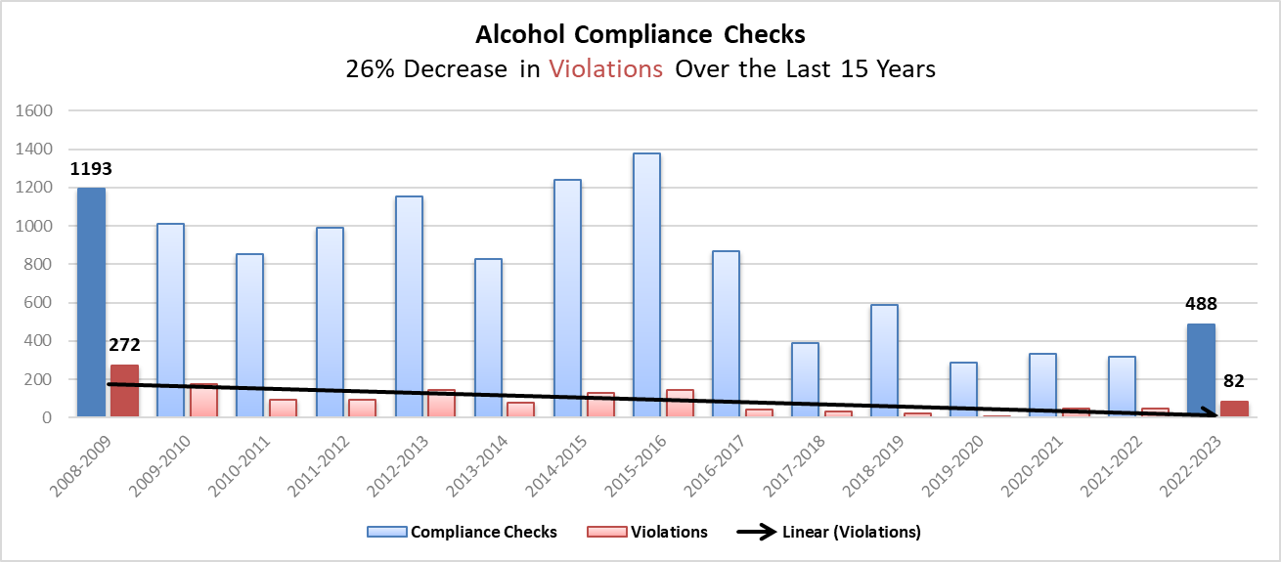
9th Judicial Circuit AET 2008-2024

Slide 28
In mid-year FY 2017, we began implementing Online Reporting, so it was July 2017 (FY ‘18) before it was fully implemented. Until Apr. ’20, average monthly checks = 508, Apr. & May ’20 (yellow) with compliance checks & other environmental strategies returning starting Jun.’20 (avg. 307). The buy rate remained steady until 2021. It increased in 2021 with drops in 2022 & 2023. New reporting online reporting system implemented Jul 2022.

Slide 29
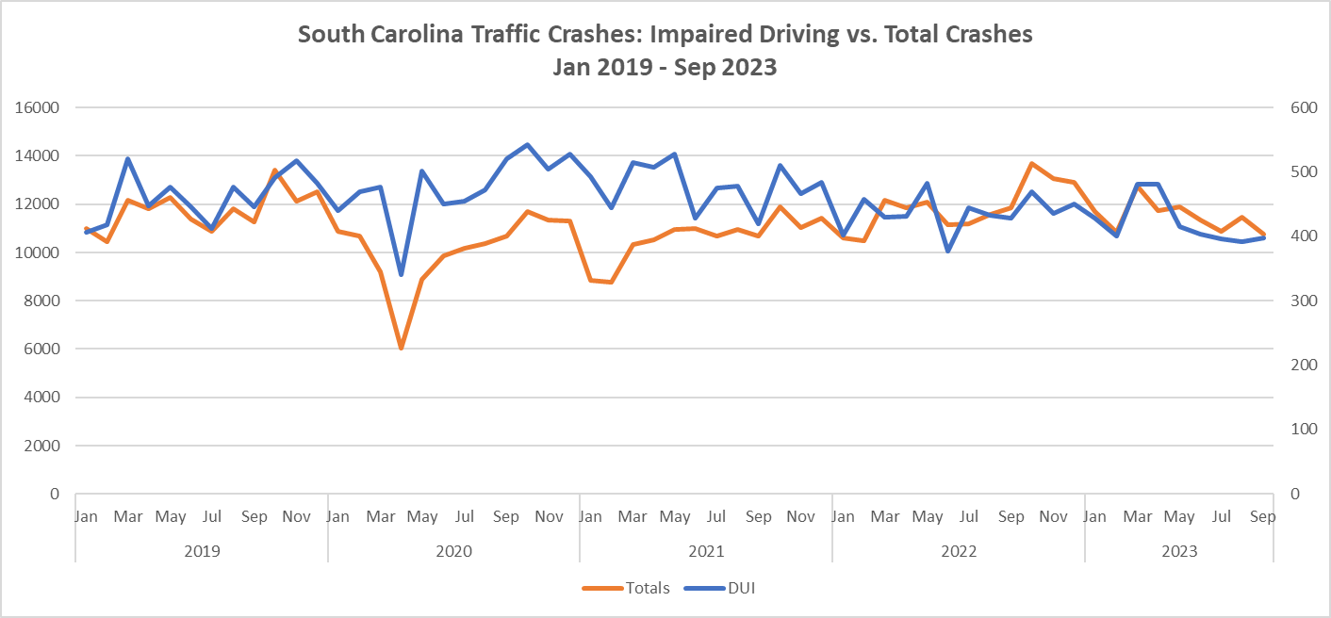




2019 to Mar. 2020 avg.
461 DUI crashes monthly
2019 to Mar. 2020 avg.
10,981 overall crashes monthly
May 2020 - Mar. 2021 avg.
476 DUI crashes monthly
May 2020 – Mar. 2021 avg.
9,479 overall crashes monthly
Apr. 2021 - Dec. 2023 avg.
444 DUI crashes monthly
Apr. 2021 – Dec. 2023 avg.
11,507 overall crashes monthly
Impaired Driving crashes followed Total crashes more closely and in Mar 2023, dropped below

Slide 30
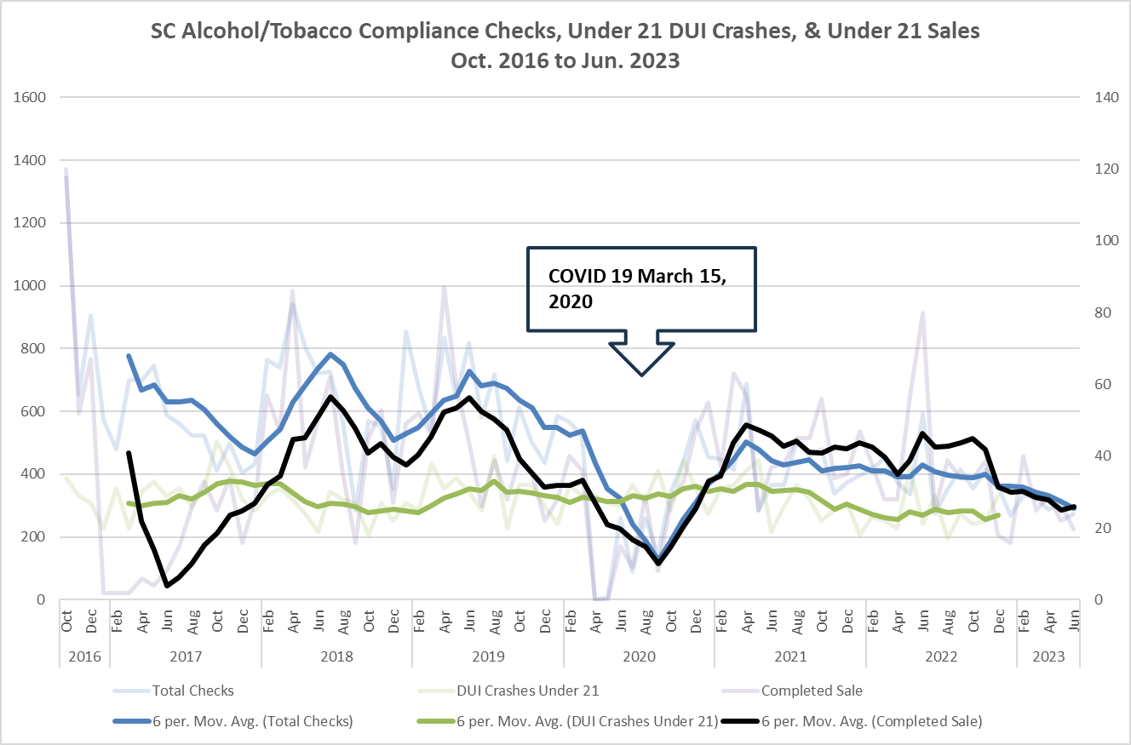
Under-21 impaired drivers remained somewhat constant, with a slight increase during and immediately after the pandemic when no or a small number of compliance checks occurred. The sales completed rate increased when compliance checks were restarted after the pandemic.

Slide 31
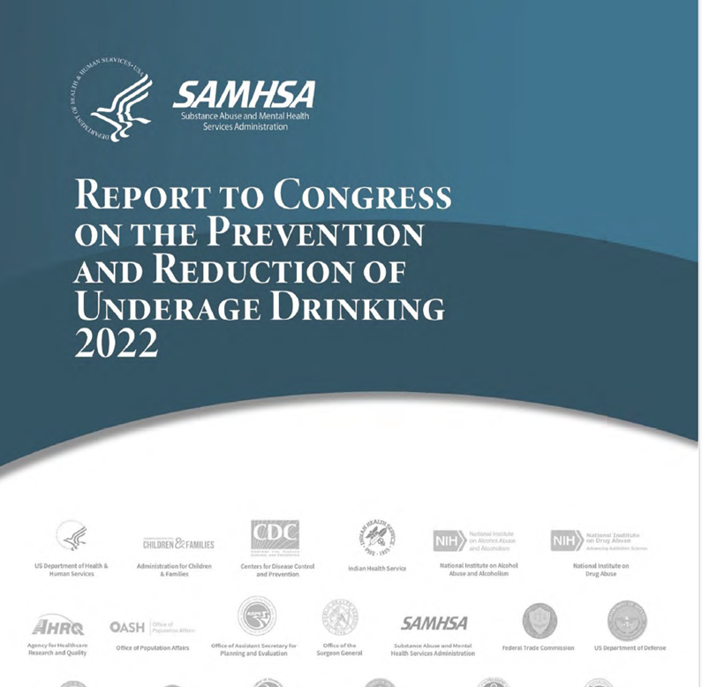
Data on following slides drawn from STOP Act Annual Report
Enacted by Congress in 2006
Reauthorized in 2022
Contains information on enforcement, media efforts, and other programs meant to address underage drinking throughout the United States
The 2022 report contains 2020 enforcement data

Slide 32
State | 2011 Compliance Checks |  | 2012 Compliance Checks |  | 2013 Compliance Checks |  | 2014 Compliance Checks |  | 2015 Compliance Checks |  | 2016 Compliance Checks
 | Total | Failed | Total | Failed | Total | Failed | Total | Failed | Total | Failed | Total | Failed
Alabama | 4,977 | 544 | 4,564 | 418 | 4,477 | 384 | 3,781 | 322 | 3,367 | 217 | 4,528 | 322
Florida | 10,788 | 1,159 | 10,655 | 1,057 | 5,865 | 832 | 3,009 | 419 | 2,479 | 359 | 5,394 | 755
Georgia | 4,349 | 711 | 4,337 | 753 | 5,343 | 617 | 3,832 | 298 | 3,686 | 235 | NR | NR
Kentucky | 3,616 | 226 | 1,854 | 119 | 1,482 | 127 | 1,477 | 161 | 2,207 | NR | 1,699 | 204
Mississippi | 5,493 | 266 | 37 | 31 | 78 | 78 | 78 | 78 | NR | NR | 145 | 59
North Carolina | 278 | 75 | 278 | 75 | 47 | 15 | 14 | 9 | 26 | 11 | 9 | 0
South Carolina | 6,889 | 1,384 | 6,559 | 1,205 | 7,873 | 1,527 | 13,280 | 1,681 | 15,583 | 1,987 | 18,325 | 2,062
Tennessee | 794 | 271 | 474 | 113 | NR | NR | 1,647 | 366 | 2,314 | 502 | 2,623 | 511
Region IV TOTAL | 37,184 | 4,636 | 28,758 | 3,771 | 25,165 | 3,580 | 27,118 | 3,334 | 29,662 | 3,311 | 32,723 | 3,913
Region IV Buy Rate | 12.5% |  | 13.1% |  | 14.2% |  | 12.3% |  | 11.0% |  | 12.9%

Slide 33
State | 2017 Compliance Checks |  | 2018 Compliance Checks |  | 2019 Compliance Checks |  | 2020 Compliance Checks
 | Total | Failed | Total | Failed | Total | Failed | Total | Failed
Alabama | 4,528 | 322 | 9,585 | 453 | 6,995 | 432 | 5,556 | 256
Florida | NR | NR | 4,311 | 478 | 5,757 | 662 | 1,993 | 213
Georgia | 3,360 | 263 | 3,273 | 198 | 3,150 | 174 | 3,812 | 405
Kentucky | NR | NR | 930 | 81 | 634 | 87 | 225 | 28
Mississippi | 111 | 88 | 1,700 | 240 | 9,800 | 2,629 | 412 | 0
North Carolina | NR | NR | NR | NR | NR | NR | NR | NR
South Carolina | 18,325 | 2,062 | 13,752 | 988 | 12,487 | 949 | 10,398 | 754
Tennessee | 2,465 | 413 | NR | NR | 2,997 | 523 | 1,944 | 400
Region IV TOTAL | 28,789 | 3,148 | 33,551 | 2,438 | 41,820 | 5,456 | 24,340 | 2,056
Region IV Buy Rate | 10.9% |  | 7.3% |  | 13.0% |  | 8.4%

Slide 34
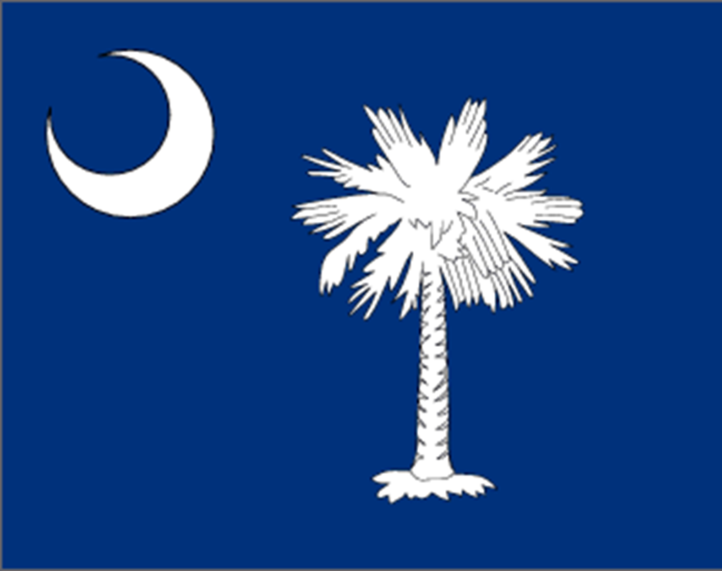
Processes & Outcomes in Reducing Underage Drinking in SC

Slide 35
FY’08 – FY’24 Enforcement Numbers
* July 1, 2007, through June 30, 2024
Activity | FY2008-2024 | Activity | FY2008-2024
Compliance Checks | 112,558 | Compliance Check Sales | 12,942 (11.5%)
Public Safety Checkpoints | 11.168 | Bar checks | 4,754
Saturation Patrols | 3,789 | # of Parties Prevented | 1,822 **
Party Dispersals | 2,033 | Merchant Education | 21,760
Media Contacts | 104,088 | Shoulder Taps | 363
* Enforcement & Education numbers are collected in delayed real-time, but FY’25 data are not included in this count. FY’24 numbers are preliminary.
** Data not updated for FY’24 yet

Slide 36
Outcomes for SC in Reducing
Underage Drinking
Survey Item (YRBS) | 2005 |  | % decrease
Rode with a driver who had been drinking | 30.0% | 14.0% (2021) | -53.3%
reported drinking alcohol before age 13 | 25.6% | 17.8% (2019) | -30.5%
reported drinking alcohol in past 30 days | 43.2% | 19.2% (2021) | -55.6%
= Decrease is significant @ 95% c.i.

Slide 37
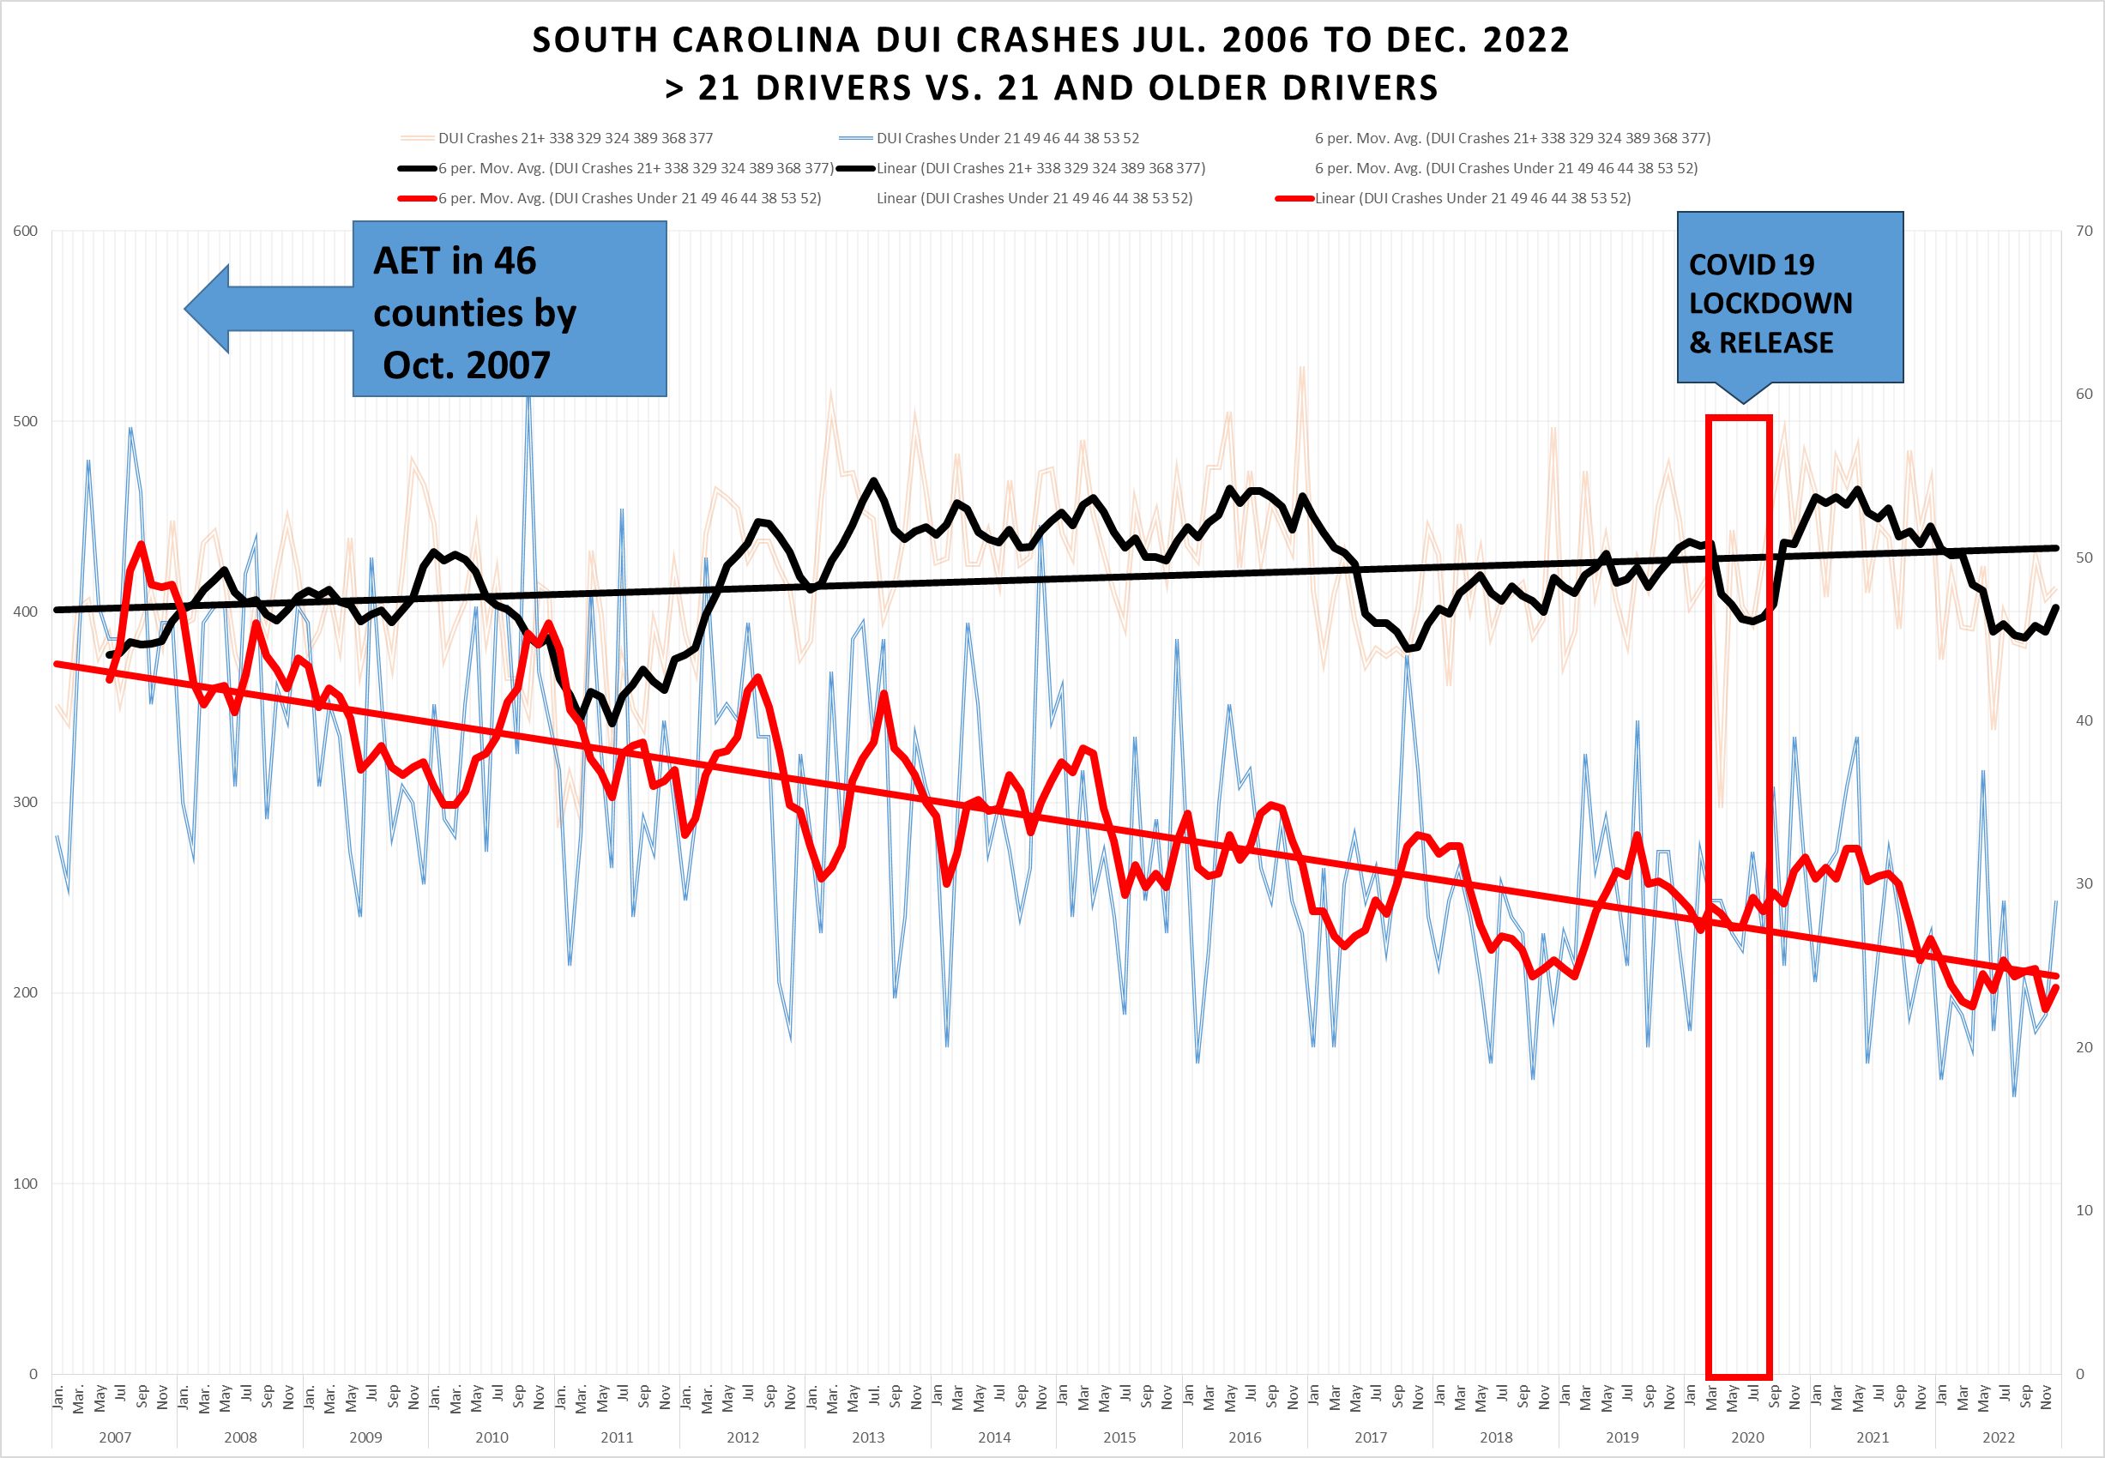

Slide 38
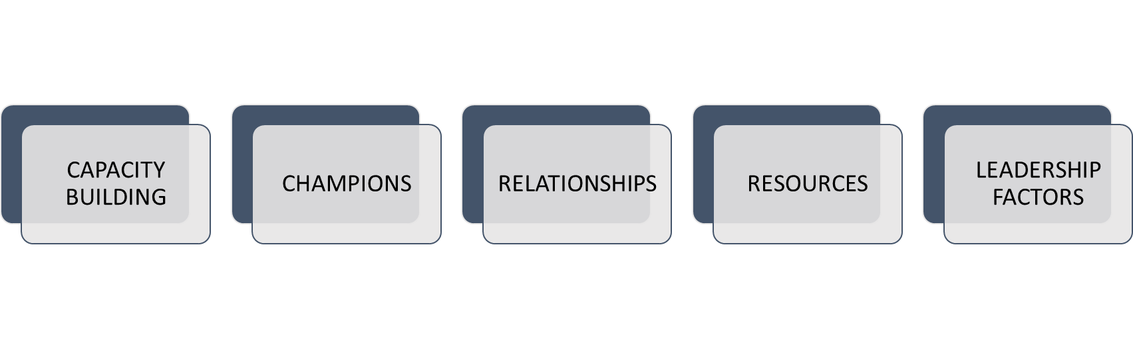
What facilitated South Carolina collaboration through COVID-19 pandemic?
George, M. D. (2016). A study of collaborative leadership in South Carolina Alcohol Enforcement Teams. (Ph.D. Doctoral Dissertation). Walden University, Ann Arbor. ProQuest Dissertations & Theses Global database. (1799913739)

Slide 39
Questions?
Michelle M. Nienhius mnienhius@daodas.sc.gov
Wehme A. Hutto whutto@ekcenter.org
Michael D. George mgeorge@pire.org
Notes:
Q&A Slide

