Slide 1
Equitable and innovative opioid overdose prevention and response in Chicago
National Prevention Network Conference
Phoenix, Arizona
Presented by:
Sarah Gabriella Hernandez, PhD
Chuck Klevgaard, CSPS
August 15, 2024
Notes:
SARAH

Slide 2
Learning Objectives
Learn about Chicago’s tapestry of innovative opioid overdose prevention programs and services
Understand how culturally responsive evaluation capacity building can support improved outcome measurement and program efficacy
Examine specific emergent community-centered strategies and promising practices to advancing opioid overdose prevention and response.
Notes:
SARAH

Slide 3
Notes:
CHUCK

Slide 4
Opioid Overdose Prevention and Response in Chicago
At-A-Glance
75,000
6,900
50
79%
Chicago residents receive services per year.
Narcan kits distributed between 1-22 and 3-23.
Partner organizations are funded by CDPH
Of those diverted start treatment.
Over 300
Between 2019 and 2022
Chicago converted data from their opioid overdose alert system into an actionable response plan, which has advanced outreach efforts in persistent overdose hotspots.
Connected to same or next-day medications to treat opioid use disorder since program launch in May 2022.
Notes:
CHUCK
75,000 receive services, 80 Million Dollar Budget
50 Organizations, 18 outreach, serving 25 communities, CDPH convenes monthly meetings with over 50 partner organizations to review data and maps of opioid-related overdose EMS responses in 5 West Side communities and coordinate efforts.
Every community area in the city is impacted by opioid overdose, but the West Side of Chicago is most disproportionately impacted: East and West Garfield Parks, Humboldt Park, Austin, and North Lawndale account for 35% of all opioid overdoses in the City. The majority of opioid-related overdose deaths in Chicago involve fentanyl, a highly potent opioid.
900 diverted , 79 % participate in treatment, 50 % still in treatment 30 days later
MAR Now an innovative treatment hotline called Medication Assisted Recovery Now (MAR NOW) that connects callers looking for opioid use disorder treatment directly to a provider for immediate care. CALL 833-234-6343, 24/7 to be connected to immediate treatment. This includes being able to start on the medication buprenorphine at home that same day - a safe and effective treatment for opioid use disorder that does not require daily clinic appointments
CDPH operates 5 Public Health Vending Machines that offer harm reduction supplies at no cost to anyone in Chicago. The machines launched as a pilot program in Fall 2023 and aim to help prevent overdose and support the health and wellbeing of people in Chicago.
Narcan, the FDA-approved nasal spray form of naloxone, is a crucial tool in the public health response to the opioid crisis. Narcan is available for free in all 81 Chicago Public Library locations, as well as many Aldermanic offices and other community locations
In 2022, there were more opioid-related overdose deaths in Chicago (1,397) than homicides and traffic crash fatalities combined. Sixty-five percent of those fatalities were among Non-Latinx Black individuals and 78 percent were men.
opioid-related overdose deaths are one of the primary drivers in the life-expectancy gap between Black and non-Black Chicagoans, along with deaths from chronic diseases (e.g. heart disease, diabetes, etc.) and gun-related homicide. That gap in life expectancy, which in 2017 was 8.8 years, widened to 10 years pre-pandemic and then, due largely to disparities in COVID-19 outcomes, to 12.7 years in 2021. Data from 2022 show it at 11.4 years.
For example, during one recent 24-hour period there were 50 suspected opioid-related overdoses in the city. While every Chicago community area has had an opioid-related overdose EMS response (fatal or non-fatal) in the last three years, in 2023, 34% of such responses occurred in five West Side community areas: Austin, Humboldt Park, North Lawndale, East Garfield Park and West Garfield Park. It is typical to see a surge in cases during summer months.
In Chicago, opioid overdose responses and deaths primarily affects…
African American Men
Ages 50-59
West and South side neighborhoods
Recent spike in the summer in 2024 – Chicago like many parts of the country are seeing spikes
This highlights racial inequities at the community level. These neighborhoods have experienced historical disinvestment that limits access to social determinants of health that support health and wellness.

Slide 5
Equitable and Innovative Opioid Overdose Prevention and Response in Chicago
Overdose Data to Action (OD2A)
OD2A in States and OD2A:Local
CDC launched the first multiyear OD2A cooperative agreement in 2019 with 66 recipients (referred to as jurisdictions) from state, territorial, county, and city health departments.
In August 2023, CDC awarded new five-year cooperative agreements to 90 jurisdictions under two distinct OD2A programs, one designed for states, and one designed specifically for localities and territories.
Notes:
CHUCK
CDC launched the first multiyear OD2A cooperative agreement in 2019 with 66 recipients (referred to as jurisdictions) from state, territorial, county, and city health departments. In August 2023, CDC awarded new five-year cooperative agreements to 90 jurisdictions under two distinct OD2A programs, one designed for states, and one designed specifically for localities and territories.
CDC created OD2A in States and OD2A: LOCAL to:
Address the evolving epidemiology of the drug overdose crisis.
Close identified gaps in prevention activities.
Apply lessons learned from the previous OD2A funding opportunity.
Leverage the differing roles and spheres of influence state and local health departments and their partners have.
OD2A: LOCAL
Required: Overdose surveillance infrastructure
Optional and competitive: Toxicologic testing of drug products and/or paraphernalia
Optional and competitive: Surveillance of linkage to and retention in care
Required in community, public safety, and healthcare settings: Linkage to and retention in care
Required in community, public safety, and healthcare settings: Harm reduction
Required in healthcare settings: Clinician and health systems best practices
Optional: Stigma reduction
Optional: Health IT enhancements
Chicago converted data from their opioid overdose alert system into an actionable response plan, which has advanced outreach efforts in persistent overdose hotspots. As a result, there are now teams and processes in place to respond to overdose spikes with naloxone, education, and linkages to additional resources via outreach events.

Slide 6
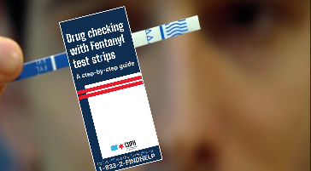
Chicago’s Strategies
Harm reduction resources and programs to Chicago’s most impacted communities
Hyperlocal Outreach
to distribute harm-reduction supplies including overdose reversal medication Narcan, and test strips to check for the presence of the powerful synthetic form of opioids, fentanyl. Visit bit.ly/find narcan for a list of locations with free harm reduction tools.
Community Education
on overdose prevention, including hyperlocal heat-mapping that reviews data and maps of opioid-related overdose EMS responses, and provider education.
Connection to Treatment
for opioid use disorder (OUD) including same-day access to medication treatment. Medication Assisted Recovery (MAR) consists of FDA-approved medications that reduce the risk of drug overdose and death, reduces withdrawal symptoms, and supports care engagement over time.
Notes:
CHUCK
CDPH’s response to the opioid overdose crisis includes a three-pronged strategy that is flooding resources to areas seeing overdose surges:
Hyperlocal outreach to distribute harm-reduction supplies including overdose reversal medication Narcan, and test strips to check for the presence of the powerful synthetic form of opioids, fentanyl. Visit bit.ly/findnarcan for a list of locations with free harm reduction tools.
Community education on overdose prevention, including hyperlocal heat-mapping that reviews data and maps of opioid-related overdose EMS responses, and provider education.
Connection to treatment for opioid use disorder (OUD) including same-day access to medication treatment— the Medication Assisted Recovery (MAR) NOW program which is a partnership with the Illinois Department of Human Services Division of Substance Use Prevention and Recovery (IDHS/SUPR) and Family Guidance Centers. MAR consists of FDA-approved medications that reduce the risk of drug overdose and death, reduces withdrawal symptoms, and supports care engagement over time.

Slide 7
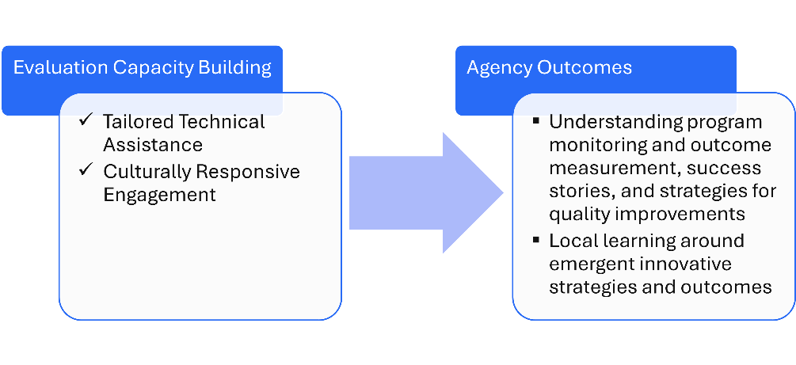
Evaluation Capacity Building Project
Tailored Technical Assistance
Agency Outcomes
Culturally Responsive Engagement
Evaluation Capacity Building
Understanding program monitoring and outcome measurement, success stories, and strategies for quality improvements
Local learning around emergent innovative strategies and outcomes
Notes:
SARAH
Overview of our partnership with CDPH
Through our approach of tailored technical assistance and culturally responsive engagement, we supported agencies in (1) understanding program monitoring and outcome measurement, success stories, and strategies for quality improvements, and (2) advancing local learning around emergent innovative strategies and outcomes.

Slide 8
Evaluation Capacity Building Project
Partner Agencies
Notes:
SARAH
Overview of our partnership with CDPH
Through our approach of tailored technical assistance and culturally responsive engagement, we supported agencies in (1) understanding program monitoring and outcome measurement, success stories, and strategies for quality improvements, and (2) advancing local learning around emergent innovative strategies and outcomes.

Slide 9
Chicago Overdose Data to Action (OD2A)
Building meaningful, data-informed, and community-centered solutions
Wednesday, June 21st, 2023
10:00am – 2:00pm CST
Loretto Hospital, Chicago
Notes:
SARAH
As part of our evaluation capacity building, we convened agencies for an evaluation roundtable session in which agencies first learned of CDPH’s efforts in opioid overdose prevention and response since 2020, and then engaged in structured peer sessions to co-develop ideas, innovations, and community centered solutions to opioid overdose response and prevention in Chicago.

Slide 10
Evaluation Roundtable
Goals and Objectives
Reflect on CDPH OD2A
Learn about progress, innovations, and lessons learned
Celebrate Delegate Work
Hear agency innovations and successes
Peer Engagement and Discussion
Identify strategies to advance this work in Chicago
Networking
Participate in Gallery Walk to build strategic connections
Notes:
SARAH

Slide 11
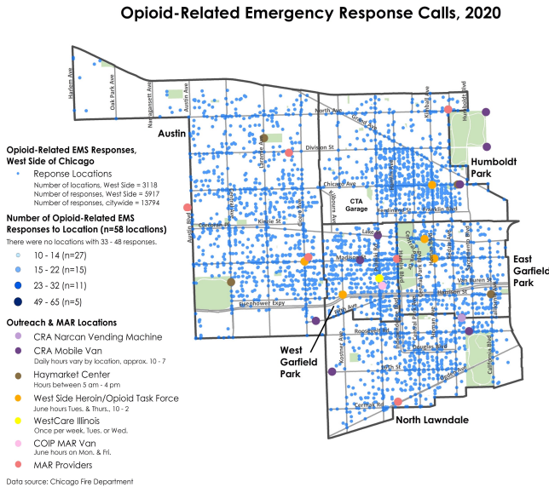
Progress We’ve Made Mapping Trends
In 2021, CDPH began hyperlocal mapping at the request of delegates and partners, in addition to publishing annual Opioid Surveillance Reports and Mid-Year Briefs.
Notes:
CHUCK
Delegate brick and mortar locations + outreach locations
West side community areas we work with in coordination meeting
Hot spots - 2022
Naloxone distribution?
Time series map?
MAR now map with DEA waivers?

Slide 12
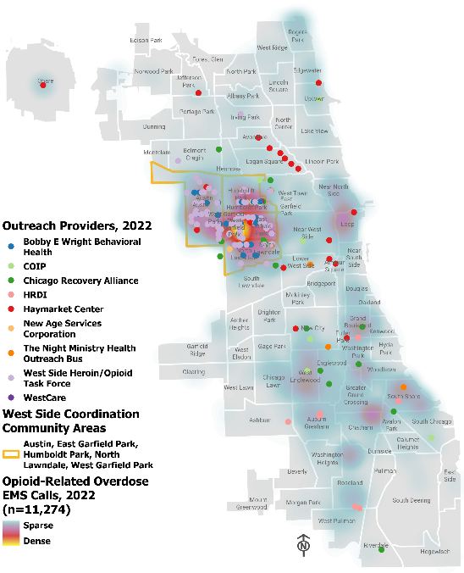
Progress We’ve Made Mapping Trends
CDPH holds monthly West Side meetings to cover EMS data and outreach and to provide a space for coordination.
Focus on 5 West Side community areas:
Austin, East Garfield Park, Humboldt park, North Lawndale, West Garfield Park
Usually account for about 35% of Chicago's opioid-related overdose EMS responses
Notes:
CHUCK
Delegate brick and mortar locations + outreach locations
West side community areas we work with in coordination meeting
Hot spots - 2022
Naloxone distribution?
Time series map?
MAR now map with DEA waivers?

Slide 13
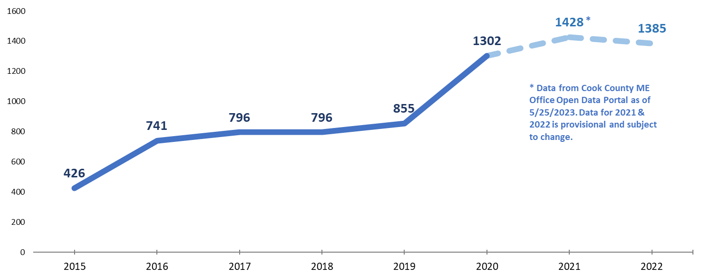
Progress We’ve Made Mapping Trends
Opioid-Related Overdose Fatalities in Chicago

Slide 14
Progress We’ve Made Mapping Trends
Opioid-Related Overdose EMS Responses in Chicago

Slide 15
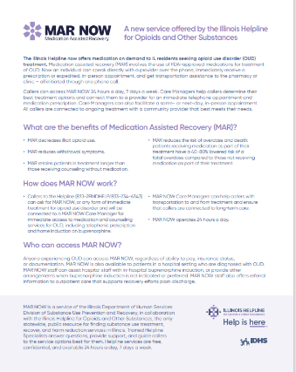
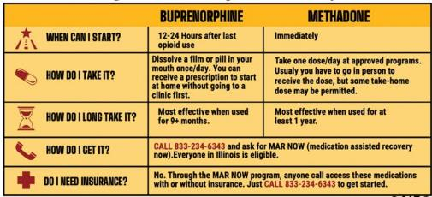
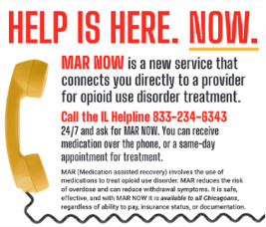
CDPH Innovations & Successes MAR NOW
OSU funds agencies to provide treatment and recovery services for people with substance use disorders and has worked closely with Family Guidance Center and Illinois Department of Human Services Division of Substance Use Prevention and Recovery (IDHS/SUPR) to launch a successful opioid treatment program that connects anyone across the entire state to immediate opioid treatment.
MAR NOW:
Medication Assisted Recovery NOW opioid treatment hotline launched May 2022.
Anyone can call the IL helpline regardless of insurance, documentation or ability to pay
Notes:
CHUCK
Narcan at CPL: Map of harm reduction box locations (Liv)
Vending machine rollout/xylazine distribution: Map of pending locations (Liv)
Fentanyl test kit distribution

Slide 16
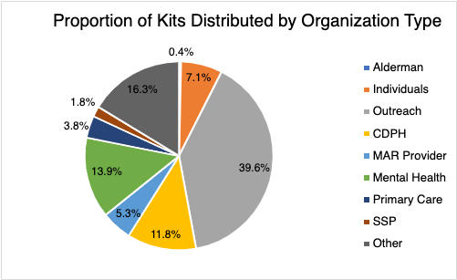
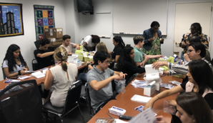
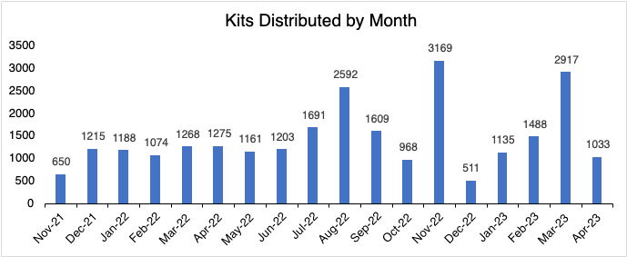
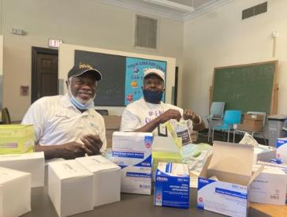
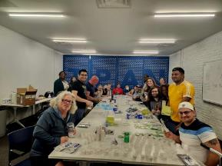
CDPH Innovations & Successes Fentanyl Test Kit Distribution
This project started October 2021
Average output: 1,447.5 Kits distributed per month
We have distributed over 28,000 Fentanyl test kits which is 115,000 test strips to various communities
Drug testing empowers individuals to make informed decisions
Notes:
CHUCK
Narcan at CPL: Map of harm reduction box locations (Liv)
Vending machine rollout/xylazine distribution: Map of pending locations (Liv)
Fentanyl test kit distribution

Slide 17
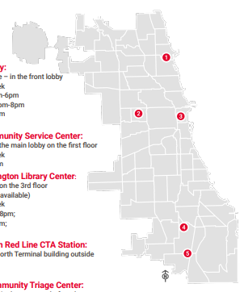
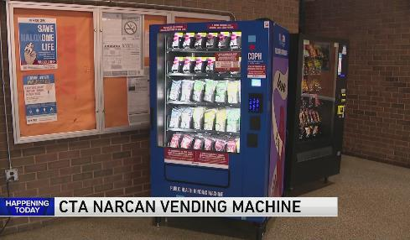
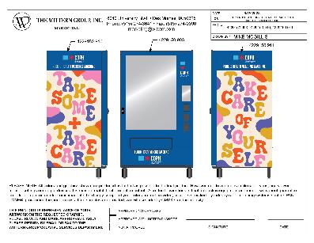
CDPH Innovations & Successes Vending Machines
Vending Machines are coming soon to a community area near you!
5 confirmed locations
Notes:
CHUCK
Narcan at CPL: Map of harm reduction box locations (Liv)
Vending machine rollout/xylazine distribution: Map of pending locations (Liv)
Fentanyl test kit distribution

Slide 18
Notes:
CHUCK

Slide 19
Roundtable Discussions
Chicago’s needs
Leveraging partnerships
Advancing our goals
Notes:
SARAH
agencies engaged in structured peer sessions to co-develop ideas, innovations, and community centered solutions to opioid overdose response and prevention in Chicago.
What do we need in Chicago to advance opioid overdose prevention and response? What could be meaningful, data informed, and community centered solutions?
How can we leverage this network of people and organizations to accomplish our goals?
How can the city of Chicago and CDPH help to advance these goals and support agencies?
After discussing data insights, innovations and successes, and lessons learned, we engaged agencies in roundtable small group discussions to learn about…

Slide 20
04 Medication Assisted Treatment
Expanding and Improving Services
05 Human Centered Services
Building trust and reducing stigma.
01 Immediate Resources ​Provision of safe housing and basic needs.
02 Systemic issues
Issues preventing individuals from accessing services.
06 Comprehensive Resource Hub
Coordination of data and services
RoundTable Event
Community centered solutions to opioid overdose response and prevention in Chicago
07 Hot Spot Corridors
Persistent Overdose in geographic areas of the city
03 Sector-wide Staffing
Retention and burnout challenges.

Slide 21
RoundTable Event
Community centered solutions to opioid overdose response and prevention in Chicago
04 Medication Assisted Treatment
Expanding and Improving Services
01 Immediate Resources ​Provision of safe housing and basic needs.
05 Human Centered Services
Building trust and reducing stigma.
02 Systemic issues
Issues preventing individuals from accessing services.
06 Comprehensive Resource Hub
Coordination of data and services
03 Sector-wide Staffing
Retention and burnout challenges.
07 Hot Spot Corridors
Persistent Overdose in geographic areas of the city

Slide 22
Safe Housing and Basic Needs Provision
Homelessness and unstable housing are associated with higher incidence of alcohol and drug use, sexual risk behaviors and HIV acquisition, and poorer health outcomes. ¹
Overdose survivors experiencing unsheltered homelessness describe a chaotic public drug scene and resort to residing in nearby encampments because the existing shelter, housing, and addiction treatment systems were unwelcoming, difficult to navigate, or unaffordable. ²
Pan, Y., Metsch, L. R., Wang, W., Philbin, M., Kyle, T. L., Gooden, L. K., & Feaster, D. J. (2020). The Relationship Between Housing Status and Substance Use and Sexual Risk Behaviors Among People Currently Seeking or Receiving Services in Substance Use Disorder Treatment Programs. The journal of primary prevention, 41, 363-382.
Paradise, R. K., Desmarais, J., O'Malley, S. E., Hoyos-Cespedes, A., Nurani, A., Walley, A. Y., ... & Kimmel, S. D. (2023). Perspectives and recommendations of opioid overdose survivors experiencing unsheltered homelessness on housing, overdose, and substance use treatment in Boston, MA. International Journal of Drug Policy, 119, 104127.
Increase awareness of readily accessible resources for organizations and their clients
Use 311 as a resource rather than barrier to treatment
Propose for closed hospitals and hotels to serve as safe housing or temporary shelters
Expand support for people experiencing homelessness in Chicago, including prioritizing research, program development, service provision, and additional funding
Notes:
Immediate resources include access to food, clothing, safe shelter, treatment, and additional services relevant to the individual’s complex needs like crisis support services, overdose prevention resources, and safe injection sites
311 operators can report an individual’s needs for services to appropriate organizations/agencies and check the status of previous service requests. Although the system is designed to address non-emergency situations, individuals in distress in addition to mental health professionals and healthcare workers dial 311 to obtain information regarding City pro
Approval from the government and federal funding is needed to use hotels as a safe shelter for vulnerable populations experiencing homelessness, which offers a strategy to increase housing resources. grams.
Create work groups to conduct research/collect and analyze data on complex needs of homeless populations including variables/factors impeding access to comprehensive treatment services. Qualitative data is needed/essential.
Recent studies have consistently shown that homelessness and unstable housing are
associated with higher incidence of alcohol and drug use, sexual risk behaviors and HIV
acquisition, and poorer health outcomes such as mental illness, psychiatric disorders,
tuberculosis, asthma, and bronchitis.¹
Overdose survivors experiencing unsheltered homelessness described a chaotic public drug scene but resorted to residing in nearby encampments because the existing shelter, housing, and addiction treatment systems were unwelcoming, difficult to navigate, or unaffordable. Despite efforts to provide low-threshold housing in Boston, additional low-barrier housing services (i.e., including harm reduction resources and without "sobriety" requirements) could promote the health and safety of people who use drugs and are experiencing homelessness.²
References for Recommendations for Housing
Pan, Y., Metsch, L. R., Wang, W., Philbin, M., Kyle, T. L., Gooden, L. K., & Feaster, D. J. (2020). The Relationship Between Housing Status and Substance Use and Sexual Risk Behaviors Among People Currently Seeking or Receiving Services in Substance Use Disorder Treatment Programs. The journal of primary prevention, 41, 363-382.
Paradise, R. K., Desmarais, J., O'Malley, S. E., Hoyos-Cespedes, A., Nurani, A., Walley, A. Y., ... & Kimmel, S. D. (2023). Perspectives and recommendations of opioid overdose survivors experiencing unsheltered homelessness on housing, overdose, and substance use treatment in Boston, MA. International Journal of Drug Policy, 119, 104127.

Slide 23
Systemic issues preventing individuals, particularly from marginalized/underserved groups, from accessing services
Disparities in overdose mortality rates are not fully explained by substance use patterns and result from unequal access to substance use treatment services, socioeconomic inequities, and social determinants of health” ³
A multisectoral approach that includes structural and policy-level changes and clinician- and health-system–based approaches, with an intentional focus on disparities and the long-standing inequities is essential to respond to this crisis.⁴
Kariisa, M., Davis, N. L., Kumar, S., Seth, P., Mattson, C. L., Chowdhury, F., & Jones, C. M. (2022). Vital signs: drug overdose deaths, by selected sociodemographic and social determinants of health characteristics—25 states and the District of Columbia, 2019–2020. Morbidity and Mortality Weekly Report, 71(29), 940.
Beals M. Drug overdose deaths reach record high. The Hill. February 16, 2022. Available at: https://thehill.com/policy/healthcare/594630-drugoverdose- deaths-reach-record-high. Accessed February 25, 2022.
Develop an efficient system to track referrals and care coordination across agencies
Collaborate with peer agencies to engage in mutual mental health services (i.e., warm handoffs, follow-up during and after referral process)
Identify a champion within ER Departments to ensure delivery of quality healthcare to patients, with a focus on warm handoffs
Notes:
Social determinants of health (SDOH) have been underutilized in addressing drug overdose crisis, and they are more important than ever now, given the 16% rise in drug overdose deaths with the emergence of the coronavirus disease 2019 pandemic.⁴
A multisectoral approach that includes structural and policy-level changes and clinician- and health-system–based approaches, with an intentional focus on racial and ethnic disparities and the long-standing inequities that contribute to increased risk for overdose, is essential to respond to this urgent public health crisis.” ⁵
Warm Handoffs, Sometimes referred to as warm handoffs, these interventions represent a collaborative effort among law enforcement, medical providers, social workers, and prevention professionals to engage individuals who have experienced a non-fatal overdose and their family members in the period immediately following the overdose event. ⁶
OD survivors engaged in emergency departments or other health care “touchpoints” are excellent candidates for OEND and other OD prevention interventions. For these initiatives to be effective, however, some health-care providers may require training interventions of their own, designed to reduce negative and stigmatizing views of PWUO, OD survivors, and substance use disorders in general.. To address attitudinal barriers among providers, programs are emerging to help reduce stigma toward PWUO among medical students and nurses in training, and a promising program delivering OEND curricula for medical students and grounded in harm reduction has recently been developed. ⁸
Establishing community and local partnerships, particularly in resource-limited areas, is crucial for the continuity of addiction care and rehabilitation outcomes. ⁹
Stigma has been called out by scholars as a major barrier to the success of mental health reform; this demonstrates the intersections between media narratives and institutional inequities, specifically law and regulation. (National Academies of Sciences, 2016) This is to say that stigma exists, not just as an interpersonal issue, but as a systemic structural issue that permeates through media narratives, institutions, laws and regulations. ⁹

Slide 24
Sector-wide staffing retention and burnout challenges
Explore strategies and solutions to addressing barriers to treatment that are commonly observed among many organizations. Agencies have reported staffing shortages, retention/burnout, language barriers and lack of DEI resources which have impacted client retention/satisfaction.
Recruitment and retention struggles that continue to challenge the SUD treatment and recovery services workforce. ⁵
This challenge of staffing acts as a barrier for health departments, not only in the administration of regular projects and programming, but also in obtaining new foundational programming that can address health inequity or insights that could improve upon current programming using some of the health equity actions previously mentioned.
Ryan, O., Murphy, D., Krom, L. (2012). Vital Signs: Taking the Pulse of the Addiction Treatment Workforce, A National Report, Version 1. Kansas City, MO: Addiction Technology Transfer Center National Office in residence at the University of Miss
Notes:
Recruitment and retention struggles that continue to challenge the SUD treatment and recovery services workforce. States are applying a variety of strategies to address the SUD treatment and recovery services workforce shortage, including offering free or low-cost training and education tools to help SUD professionals enhance their skills, often in collaboration with the ATTC Network. States are expanding their SUD workforce through telehealth and technology tools, such as video conferencing and mobile apps for recovery support. Training and certifying peer counselors and recovery coaches is also helping to build the workforce. ¹¹
The SU Corporate training series, Mark sanders event
Lack of staff & associated skills: The inability of some departments to acquire or retain trained staff was shared as a challenge in addition to the fact that some health departments are understaffed (e.g. some were reported as having as little as four people) and, thus, have limitations on the types and numbers of programs they can implement in their jurisdiction. This challenge of staffing acts as a barrier for health departments, not only in the administration of regular projects and programming, but also in obtaining new foundational programming that can address health inequity or insights that could improve upon current programming using some of the health equity actions previously mentioned.¹¹
Ryan, O., Murphy, D., Krom, L. (2012). Vital Signs: Taking the Pulse of the Addiction Treatment Workforce, A National Report, Version 1. Kansas City, MO: Addiction Technology Transfer Center National Office in residence at the University of Miss

Slide 25
Expanding and Improving Medication Assisted Recovery Programs
Despite the protective effect of MAT on mortality, barriers still exist in the access to and utilization of MAT. Better retention in MAT is associated with a decreased likelihood of overdose. ⁶
People seeking treatment with MOUD often experience long travel-times, insurance barriers, prohibitive out-of-pocket expenses, provider stigma and long waitlists; some of these problems worsened during COVID-19. Many people die waiting to receive treatment. ⁷
Au, V. Y., Rosic, T., Sanger, N., Hillmer, A., Chawar, C., Worster, A., ... & Samaan, Z. (2021). Factors associated with opioid overdose during medication-assisted treatment: How can we identify individuals at risk?. Harm Reduction Journal, 18(1), 1-10.
NACo Opioid solutions Strategy Brief, Medication-Assisted Treatment (“MAT”) For Opioid Use Disorder,
Publicize service area map and information
Increase awareness and education
Provide ongoing coordination of care and make multiple follow-up calls as intentional effort to ensure patient access to immediate life-saving treatment.
Notes:
Our findings indicate that a considerable proportion of patients enrolled in MAT are affected by past or recent overdose. Additionally, there are significant differences in sociodemographic, treatment, substance use, and mental/physical health characteristics among patients stratified by their overdose status. Our study’s findings also concur with previous literature that suggests better retention in MAT is associated with a decreased likelihood of overdose ¹²
Despite the protective effect of MAT on mortality, barriers still exist in the access to and utilization of MAT . Facing the situation of limited coverage of OST and other harm reduction
interventions in worldwide, increased coverage and expanding access to MAT are crucial components of the effort to reduce opioids-related deaths and alleviate disease burden. ¹⁴
People seeking treatment with MOUD often experience long travel-times, insurance barriers, prohibitive out-of-pocket expenses, provider stigma and long waitlists; some of these problems worsened during COVID-19. Many people die waiting to receive treatment^{.15}
Stigmatization and aspects of the healthcare systems as facilitators and related barriers 16
References
Au, V. Y., Rosic, T., Sanger, N., Hillmer, A., Chawar, C., Worster, A., ... & Samaan, Z. (2021). Factors associated with opioid overdose during medication-assisted treatment: How can we identify individuals at risk?. Harm Reduction Journal, 18(1), 1-10.
Ma, J., Bao, Y. P., Wang, R. J., Su, M. F., Liu, M. X., Li, J. Q., ... & Lu, L. (2019). Effects of medication-assisted treatment on mortality among opioids users: a systematic review and meta-analysis. Molecular psychiatry, 24(12), 1868-1883
NACo Opioid solutions Strategy Brief, Medication-Assisted Treatment (“MAT”) For Opioid Use Disorder, https://www.naco.org/sites/default/files/documents/OSC_MOUD_Brief_June2023.pdf
Cernasev A, Hohmeier KC, Frederick K, Jasmin H, Gatwood J. A systematic literature review of patient perspectives of barriers and facilitators to access, adherence, stigma, and persistence to treatment for substance use disorder. Explor Res Clin Soc Pharm. 2021;2:100029. Available here.

Slide 26
Supporting a Comprehensive Resource Hub for Service Provision and Data
Collaboration between public health, EMS, and academic partners, can inform targeted response efforts, guiding decision-makers to allocate the most needed public health and clinical resources to the neighbor-hoods that need them most. ⁷
Stopka, T. J., Jacque, E., Kelley, J., Emond, L., Vigroux, K., & Palacios, W. R. (2021). Examining the spatial risk environment tied to the opioid crisis through a unique public health, EMS, and academic research collaborative: Lowell, Massachusetts, 2008–2018. Preventive Medicine Reports, 24, 101591.
Support an organization to establish an online resource hub, and to coordinate across service providers to maintain and disseminate up to date information on services, current availability, resources, and data
Integrate online data dashboards and data archives of EMS opioid overdose responses
Notes:
Through an innovative collaboration between public health, EMS, and academic partners, we employed GIS, spatial and trend analyses of opioid-related outcome data enabling assessment of the risk landscape, identification of overlapping patterns, and provision of findings to inform local public health intervention efforts. Results produced through these analyses can inform targeted response efforts, guiding decision-makers to allocate the most needed public health and clinical resources to the neighborhoods that need them most.
Stopka, T. J., Jacque, E., Kelley, J., Emond, L., Vigroux, K., & Palacios, W. R. (2021). Examining the spatial risk environment tied to the opioid crisis through a unique public health, EMS, and academic research collaborative: Lowell, Massachusetts, 2008–2018. Preventive Medicine Reports, 24, 101591.

Slide 27
Supporting Human-centered Service Provision
Stigmatization and aspects of the healthcare systems as facilitators and related barriers ⁷
Cernasev A, Hohmeier KC, Frederick K, Jasmin H, Gatwood J. A systematic literature review of patient perspectives of barriers and facilitators to access, adherence, stigma, and persistence to treatment for substance use disorder. Explor Res Clin Soc Pharm. 2021;2:100029.
Continually build trust while seeking to reduce stigma of services
Provide comprehensive treatment services with love, empathy, and compassion

Slide 28
Persistence of “hot spots” of Fatal and Nonfatal Overdoses in Specific Geographic Corridors
Further explore why and how specific “hot spots” of fatal and nonfatal overdoses in specific geographic corridors remain consistent over time, and learn more about how social and structural determinants of health are contributing to this problem
Continue supporting west side coordination group to support the ongoing dissemination of realtime geospatial data on opioid overdoses and service provision
Consecutive hot spots often overlap with the most disadvantaged inner-city neighborhoods ⁹
The spatial discrepancy between the overdose hot spots and lack of medical facilities or hospitals in the disadvantaged neighborhoods points to the critical issue of health inequity.⁹
Hess, G. S., & Zhang, C. H. (2022). Clustering Patterns and Hot Spots of Opioid Overdoses in Louisville, Kentucky: A Spatial Analysis of the Opioid Epidemic. International Journal of Applied Geospatial Research (IJAGR), 13(1), 1-15.

Slide 29
Practice Informed Evidence & Evidence-based Practice
Evidence-Based Practices: Evidence-based practice is a decision-making process that integrates the best available research evidence.
Practice-Based Evidence: Evidence provides experiential information (i.e., evidence that a practice is supported by real world conditions and community context.
Evidence-based Practices
Practice-based Evidence
Notes:
Evidence-based practice is among the most influential and compelling reforms in contemporary education. Despite their potential to improve the outcomes of students with disabilities, adoption and implementation of evidence-based reforms have been disappointing, with the gap between research and practice remaining wide. Practice-based evidence provides an alternative perspective on evidence grounded in the realities of classroom teaching in authentic settings, which practitioners find compelling when making instructional decisions. We propose that practitioners and other special education stakeholders (e.g., researchers) can form partnerships around practice-based evidence to leverage the implementation of evidence-based practice, and provide examples of such partnerships.
It is important to recognize that practice-based evidence is not simply a less rigorous version of efficacy research. Rather, efficacy research and practice-based evidence serve two different purposes.
Whereas efficacy research establishes whether a practice can work for a population (under ideal conditions), practice-based evidence is concerned with examining whether and how a practice works in specific, authentic settings. As such, practice-based evidence is situationally bounded, examining “what is credible for these pupils in this classroom in this school in this city” (Simons et al., 2003, p. 356; see also Horn & Gassaway, 2007). Indeed, Kratochwill et al. (2012) suggested that the roles of efficacy research and practice-based evidence are independent of one another
In practice-based evidence, contextual and social validity are prioritized (which is not a goal in efficacy studies), with internal validity (the primary aim of efficacy studies) playing a subordinate role.
The facility is a partnership between the University of Illinois-Chicago’s Community Outreach Intervention Projects program and the West Side Heroin and Opioid Task Force. Their goal is curbing overdose deaths.

Slide 30
Questions and Discussion
How can we utilize what we're learning from practice-based evidence?
What strategies can we advance now?

Slide 31
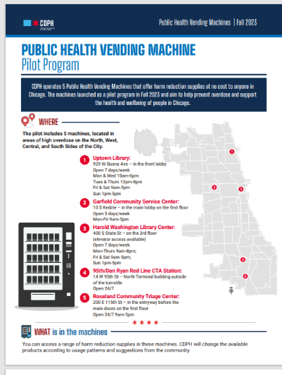
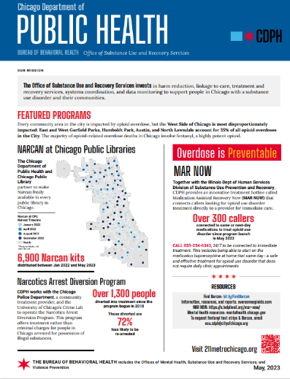
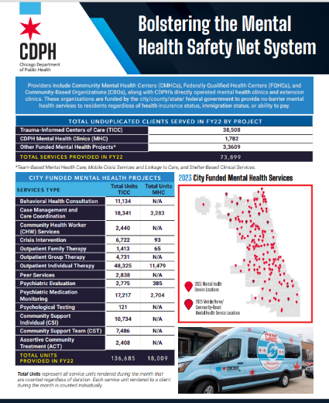
CDPH Flyers

Slide 32
Questions
Sarah Gabriella Hernandez, PhD
Chuck Klevgaard, CSPS
August 15, 2024
The Intersection of Social Determinants of Health and Substance Misuse | edc.org

Slide 33
References
Adair, T. (2023). Premature cardiovascular disease mortality with overweight and obesity as a risk factor: Estimating excess mortality in the United States during the COVID-19 pandemic. International Journal of Obesity, 47(4), 273-279.
Boardman, J. D., Finch, B. K., Ellison, C. G., Williams, D. R., & Jackson, J. S. (2001). Neighborhood disadvantage, stress, and drug use among adults. Journal of Health and Social Behavior, 151-165.
Carnevale Associates LLC (2021). Info brief: Addressing the social determinants of health in substance use prevention. https://www.carnevaleassociates.com/file_download/inline/c18c74f3-26a8-440a-ab9b-c5fb6949bb87
Cerda, M., Allen, B., & Knight, K. R. (2023). Addressing social determinants of health in overdose prevention. Report to National Academy of Medicine’s Action Collaborative on Countering the US Opioid Epidemic. Interdisciplinary Association of Population Health Sciences. https://iaphs.org/wp-content/uploads/2023/07/Addressing-Social-Determinants-of-Health-in-Overdose-Prevention.pdf
Dykstra, R. E., Beadnell, B., Rosengren, D. B., Schumacher, J. A., & Daugherty, R. (2023). A lifestyle risk reduction model for preventing high-risk substance use across the lifespan. Prevention Science, 1-13.
Eisenberg, M. E., Toumbourou, J. W., Catalano, R. F., & Hemphill, S. A. (2014). Social norms in the development of adolescent substance use: A longitudinal analysis of the International Youth Development Study. Journal of Youth and Adolescence, 43, 1486-1497
Farahmand, P., Arshed, A., & Bradley, M. V. (2020). Systemic racism and substance use disorders. Psychiatric Annals, 50(11), 494-498. https://www.marylandmacs.org/media/som/microsites/macs/documents/Systemic-Racism-and-SUDs.pdf
Fields, L. J., Roberts, W., Schwing, I., McCoy, M., Verplaetse, T. L., Peltier, M. R., ... & McKee, S. A. (2023). Examining the relationship of concurrent obesity and tobacco use disorder on the development of substance use disorders and psychiatric conditions: Findings from the NESARC-III. Drug and Alcohol Dependence Reports, 7, 100162.
Galea, S., Ahern, J., Tracy, M., Rudenstine, S., & Vlahov, D. (2007). Education inequality and use of cigarettes, alcohol, and marijuana. Drug and Alcohol Dependence, 90, S4-S15.
Gandelman, A., & Dolcini, M. M. (2012). The influence of social determinants on evidence-based behavioral interventions—considerations for implementation in community settings. Translational Behavioral Medicine, 2(2), 137-148.

Slide 34
References
The Intersection of Social Determinants of Health and Substance Misuse Brownbag
Gilbert, P. A., & Zemore, S. E. (2016). Discrimination and drinking: A systematic review of the evidence. Social Science & Medicine (1982), 161, 178–194. https://doi.org/10.1016/j.socscimed.2016.06.009
Goldstick, J. E., Stoddard, S. A., Carter, P. M., Zimmerman, M. A., Walton, M. A., & Cunningham, R. M. (2016). Characteristic substance misuse profiles among youth entering an urban emergency department: neighborhood correlates and behavioral comorbidities. The American Journal of Drug and Alcohol Abuse, 42(6), 671–681. https://doi.org/10.1080/00952990.2016.1174707
Guo, Y., Ward, R. M., & Speed, S. (2020). Alcohol-related social norms predict more than alcohol use: Examining the relation between social norms and substance use. Journal of Substance Use, 25(3), 258-263.
Healthy People 2030, U.S. Department of Health and Human Services, Office of Disease Prevention and Health Promotion. Retrieved March 27, 2024, from https://health.gov/healthypeople/objectives-and-data/social-determinants-health
Hill, T. D., & Angel, R. J. (2005). Neighborhood disorder, psychological distress, and heavy drinking. Social Science & Medicine, 61(5), 965-975.
Jansson-Fröjmark, M., & Lindblom, K. (2008). A bidirectional relationship between anxiety and depression, and insomnia? A prospective study in the general population. Journal of Psychosomatic Research, 64(4), 443-449.
Jernigan, D., Noel, J., Landon, J., Thornton, N., & Lobstein, T. (2017). Alcohol marketing and youth alcohol consumption: A systematic review of longitudinal studies published since 2008. Addiction, 112, 7-20.
Kress, C. B., & Schlesinger, S. (2023). The Prevalence of Comorbidities and Substance Use Disorder. Nursing Clinics, 58(2), 141-151.
Lê, F., Ahern, J., & Galea, S. (2010). Neighborhood education inequality and drinking behavior. Drug and Alcohol Dependence, 112(1-2), 18-26.
Matsuzaka, S., & Knapp, M. (2020). Anti-racism and substance use treatment: Addiction does not discriminate, but do we? Journal of Ethnicity in Substance Abuse, 19(4), 567-593.
Noel, J. K., Sammartino, C. J., & Rosenthal, S. R. (2020). Exposure to digital alcohol marketing and alcohol use: A systematic review. Journal of Studies on Alcohol and Drugs, Supplement, (s19), 57-67.
Noel, J. K., Rosenthal, S. R., & Sammartino, C. J. (2022). Exposure to alcohol marketing and alcohol-related consequences in young adults. Substance Use & Misuse, 57(7), 1156-1159.

Slide 35
References
Nolte-Troha, C., Roser, P., Henkel, D., Scherbaum, N., Koller, G., & Franke, A. G. (2023). Unemployment and substance use: An updated review of studies from North America and Europe. Healthcare (Basel, Switzerland), 11(8), 1182. https://doi.org/10.3390/healthcare11081182
Pan, Y., Metsch, L. R., Wang, W., Philbin, M., Kyle, T. L., Gooden, L. K., & Feaster, D. J. (2020). The relationship between housing status and substance use and sexual risk behaviors among people currently seeking or receiving services in substance use disorder treatment programs. The Journal of Primary Prevention, 41, 363-382.
Pinedo, M. (2019). A current re-examination of racial/ethnic disparities in the use of substance abuse treatment: Do disparities persist? Drug And Alcohol Dependence, 202, 162-167.
Powell, D. (2023). Educational attainment and US drug overdose deaths. JAMA Health Forum, 4(10), e233274-e233274.
Rosenthal, S. R., Gately, K. A., Archibald, N., Baker, A. B., Dawes, M. P., & Swanberg, J. E. (2023). Substance Misuse among Sexual and Gender Minorities: The Role of Everyday Discrimination and Identity. Substance Use & Misuse, 58(14), 1874-1882.
Settipani, C. A., Hawke, L. D., Virdo, G., Yorke, E., Mehra, K., & Henderson, J. (2018). Social determinants of health among youth seeking substance use and mental health treatment. Journal of the Canadian Academy of Child and Adolescent Psychiatry, 27(4), 213–221. https://www.ncbi.nlm.nih.gov/pmc/articles/PMC6254257/
Sistani, F., de Bittner, M. R., & Shaya, F. T. (2023). Social determinants of health, substance use, and drug overdose prevention. Journal of the American Pharmacists Association, 63(2), 628-632.
Strategic Prevention Technical Assistance Center. (2024). Incorporating the social determinants of health into substance use prevention. https://www.samhsa.gov/resource/sptac/incorporating-social-determinants-health-substance-use-prevention
Substance Abuse and Mental Health Services Administration (2023). Best practices for recovery housing. Publication No. PEP23-10-00-002. Rockville, MD: Office of Recovery, Substance Abuse and Mental Health Services Administration. https://store.samhsa.gov/sites/default/files/pep23-10-00-002.pdf
Thompson, R. G., Alonzo, D., Hu, M. C., & Hasin, D. S. (2017). Substance use disorders and poverty as prospective predictors of adult first-time suicide ideation or attempt in the United States. Community Mental Health Journal, 53, 324-333.

Slide 36
References
Wolfe, H. L., Biello, K. B., Reisner, S. L., Mimiaga, M. J., Cahill, S. R., & Hughto, J. M. (2021). Transgender-related discrimination and substance use, substance use disorder diagnosis and treatment history among transgender adults. Drug and Alcohol Dependence, 223, 108711.
Yen, I. H., & Kaplan, G. A. (1999). Poverty area residence and changes in depression and perceived health status: evidence from the Alameda County Study. International Journal of Epidemiology, 28(1), 90-94.

Slide 37
END

Slide 38
Community centered solutions to opioid overdose response and prevention in Chicago
$
Notes:
SARAH

Slide 39
Safe Housing and Basic Needs Provision
Increase awareness of readily accessible resources for organizations and their clients
Use 311 as a resource rather than barrier to treatment
Propose for closed hospitals and hotels to serve as safe housing or temporary shelters
Expand support for people experiencing homelessness in Chicago, including prioritizing research, program development, service provision, and additional funding
Notes:
Immediate resources include access to food, clothing, safe shelter, treatment, and additional services relevant to the individual’s complex needs like crisis support services, overdose prevention resources, and safe injection sites
311 operators can report an individual’s needs for services to appropriate organizations/agencies and check the status of previous service requests. Although the system is designed to address non-emergency situations, individuals in distress in addition to mental health professionals and healthcare workers dial 311 to obtain information regarding City pro
Approval from the government and federal funding is needed to use hotels as a safe shelter for vulnerable populations experiencing homelessness, which offers a strategy to increase housing resources. grams.
Create work groups to conduct research/collect and analyze data on complex needs of homeless populations including variables/factors impeding access to comprehensive treatment services. Qualitative data is needed/essential.

Slide 40
Systemic issues preventing individuals, particularly from marginalized/underserved groups, from accessing services
Develop an efficient system to track referrals and care coordination across agencies
Collaborate with peer agencies to engage in mutual mental health services (i.e., warm handoffs, follow-up during and after referral process)
Identify a champion within ER Departments to ensure delivery of quality healthcare to patients, with a focus on warm handoffs
Notes:
Consider using a bi-directional referral system that includes information released from the referring system to the receiving provider and the information returned from the provider to the referring system.
Successful linkage is crucial for individuals who have been identified as needing treatment for SUD.
Champions in healthcare serve as key facilitators for change.

Slide 41
Sector-wide staffing retention and burnout challenges
Explore strategies and solutions to addressing barriers to treatment that are commonly observed among many organizations. Agencies have reported staffing shortages, retention/burnout, language barriers and lack of DEI resources which have impacted client retention/satisfaction.

Slide 42
Expanding and Improving Medication Assisted Recovery Programs
Publicize service area map and information
Increase awareness and education
Provide ongoing coordination of care and make multiple follow-up calls as intentional effort to ensure patient access to immediate life-saving treatment.
Notes:
Increase educational efforts for MAR Now program, particularly with materials that specify details that span beyond the phone number (e.g., program information, insurance requirements, transportation logistics, etc.)
Care coordination involves intentional efforts of providers (i.e., mental health professionals, case managers, mental health court support manager) across agencies to coordinate care activities/services which involves sharing pertinent information to ensure the patient’s receipt of quality service care/delivery over a given period.

Slide 43
Supporting Human-centered Service Provision
Continually build trust while seeking to reduce stigma of services
Provide comprehensive treatment services with love, empathy, and compassion
Notes:
Comprehensive treatment services include the provision of care from a multidisciplinary team of professionals involved in assessing/addressing an individual’s emotional, psychological, and social needs and strengths. Prevention and management of health issues affecting one’s physical and emotional health is crucial to immediate and long-term wellness.

Slide 44
Supporting a Comprehensive Resource Hub for Service Provision and Data
Support an organization to establish an online resource hub, and to coordinate across service providers to maintain and disseminate up to date information on services, current availability, resources, and data
Integrate online data dashboards and data archives of EMS opioid overdose responses
Notes:
Include resource repository and map of MAT/MAR serving organizations
Develop and maintain monthly service directory, which includes information on organizations that have available appointments, or those that are at capacity
Consider integrating the work of the west side coordination network (e.g., monthly data maps). Consider developing dashboard templates for delegate organizations to publish publicly available data on a routine basis (e.g., prevention partnership specific data, CRA data from drug checking program)

Slide 45
Persistence of “hot spots” of Fatal and Nonfatal Overdoses in Specific Geographic Corridors
Further explore why and how specific “hot spots” of fatal and nonfatal overdoses in specific geographic corridors remain consistent over time, and learn more about how social and structural determinants of health are contributing to this problem
Continue supporting west side coordination group to support the ongoing dissemination of realtime geospatial data on opioid overdoses and service provision
Notes:
Utilize specific evaluation, monitoring, and CQI strategies and tools to test changes
Consider cross-sector funding opportunities that can address multiple social determinants. For example, affordable housing, healthcare, and substance use and recovery supports, or education, youth development, and mental health initiatives.

