Slide 1
Prevention Nirvana
Coleen Smith, CPS
Nicole Hackley, CPS

Slide 2
Outline
Where we were
New model
Requirements and vision
Onboarding Process
Workforce development
Effectiveness

Slide 3
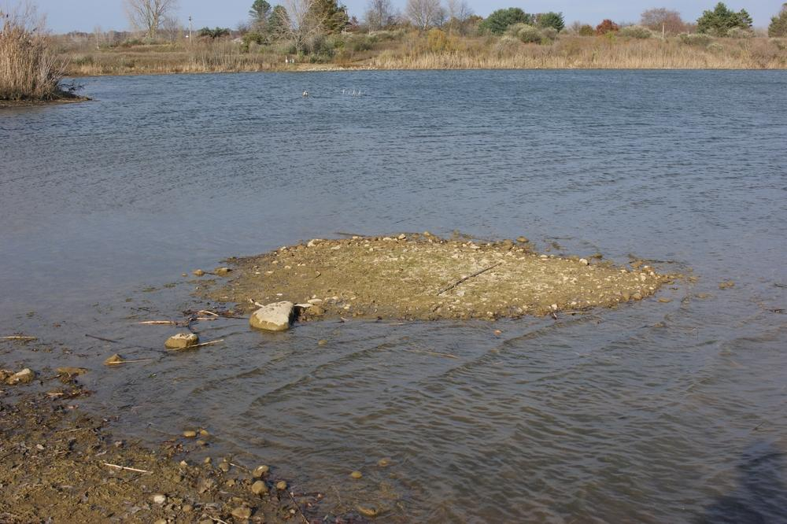
WHERE WE WERE
Notes:
(CS) Prevention efforts were inch deep mile wide; no bridge. 56 counties all got money, even if there was no readiness. Prevention specialists weren’t connected. No movement of the needle on youth substance use.

Slide 4
https://tinyurl.com/pwc86ah6
Notes:
To give you an idea of our geography. You can fit these 8 states into MT. Population - 1 million. We’re frontier.

Slide 6
Prevention dollars all went through treatment facilities
Notes:
Anyone else have prevention dollars housed in Tx?
On paper it might make sense. There’s little/no commitment/understanding about primary prevention.

Slide 7
Prevention dollars all went through treatment facilities
Notes:
Couple of PS housed in closet. No access to budget. One PS covered MULTIPLE counties. Treatment and Public Health don’t always understand prevention - they require employees to be at their desk from 8-5. That’s not where prevention happens.
Prevention is relationships - how does that work?

Slide 8
THERE WAS NO:
COORDINATION
COLLABORATION
COMMITMENT
CONSISTENT TRAINING
Notes:
We were alone, working on whatever we thought was a good idea at the time.

Slide 9
HOW WE DID PREVENTION
Notes:
No access to budgets; little to no money

Slide 10
Outline
Where we were
New model
Requirements and vision
Onboarding Process
Workforce development
Effectiveness

Slide 11
Visionaries at State Level
Used the 5 public health regions to RFP (limited contracts)
RFP for Training/Technical Assistance - TA for each region
Eventually a
Tribal TA
Notes:
Explain what RFP (request for proposal) is for people who may not know
We need to move the needle on prevention. The status quo is not working
TA - hadn’t been done before

Slide 12
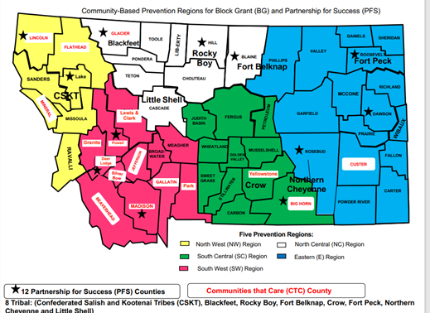
Notes:
TAs for each region. 1.5 in SW and EA, Tribal, WF, SP
One TA can handle 8-9 prevention specialists
The goal with this model was a trained workforce

Slide 13
Outline
Where we were
New model
Requirements and vision
Onboarding Process
Workforce development
Effectiveness

Slide 14
TA DELIVERABLES
Logic models/action plans
Engage Prevention Specialists (PS) in Community Health Assessment and Health Improvement Plan
Media plans (state guidelines)
Budgets/fiscal monitoring
Use SPF and PH Model
Build community relationships
ID evidence-based programs
Review grant-required data
Train in WITS
Provide regional trainings
Provide SAPST
Conduct needs assessment
Develop training schedule
Provide info on training opportunities
Provide one-on-one TA
Evaluate TA services
Monitor progress of measures
Monitor WITS entries
Help develop certification
Short answer: teach someone to be a prevention specialist using prevention science
Notes:
Used SHIP and the state’s indicators to determine what to put on the LM. The problems were required, as were a couple of RF/PF that they wanted everyone working on.
Focus on science and best practice.

Slide 15
Notes:
Goal: work towards same goal. Arriving at the same place at the same time.

Slide 16
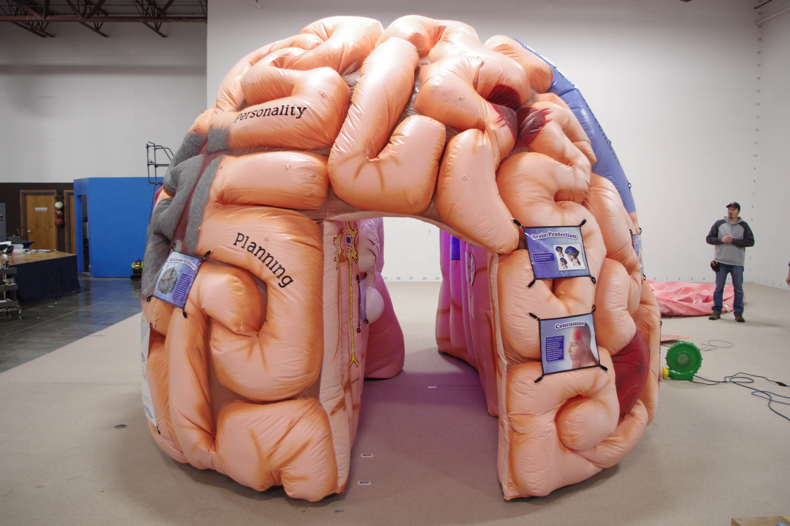
Benefits of a Regional System
Collaboration among prevention specialists
Evidence-Based Programs
Media Campaigns
Prevention materials
Sharing ideas
Multiple levels of support
Notes:
Media Detective was purchased and used by multiple counties; sharing costs for training, prevention escape room - way more bang for buck, accomplish together that they couldn’t on their own
Sharing ideas - newsletter to highlight accomplishments; Roundtables.
Support - employer, each other, TA. Peer Power Hour, certification study groups

Slide 17
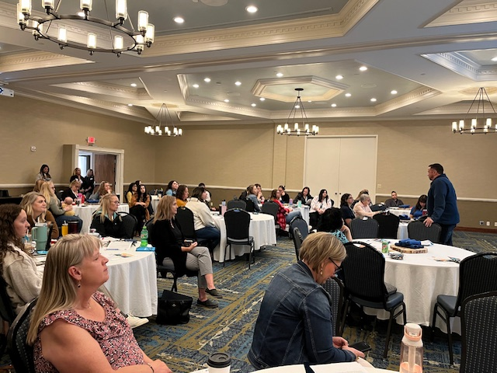
Benefits of a Regional System Within Statewide Infrastructure
Coordination among prevention specialists
Statewide media campaigns
CADCA Forum - Montana
Regional and statewide trainings
Prevention Connection
Notes:
PMT - see it across the state - everyone pushing it out = way more coverage; beneficial to the State - way more coverage
Forum - bring in big ticket speaker, who else wants to partner. Ben Cort. 10 locations. Who’s tried this EBP?
Trngs - see each other, connect, collaborate
PC - include DFC, tobacco, PFS, MAP, state - so everyone knows what’s going on

Slide 18
Montana Evidence-Based Workgroup
Using the same tools
Save time
No guessing - all evidence-based
Search by RF/PF, domain, population, etc.
Working toward same goal
Guide to Evidence-Based
Substance Prevention
Program Dashboard
Policy Dashboard
Notes:
Assist Montana communities in selecting best fit evidence-based substance misuse and abuse prevention strategies for their unique community to address identified needs.
All had different names for levels of effectiveness. Goals: Effective 70%; Promising 20%, Innovative 10%.
Group meets quarterly and reviews new programs.
Evidence-Based Work Group: The Evidence-Based Work group’s purpose is to assist prevention specialists and coalitions with identifying research and evidence-based practices that are grounded in prevention science and, if implemented with fidelity and culturally relevant, can achieve measurable outcomes and move the needle on curbing and addressing substance misuse and abuse. The work group is currently working on setting criteria and guidelines for local prevention specialists and coalitions to help them develop a prevention strategy that meets evidence-based standards.

Slide 19
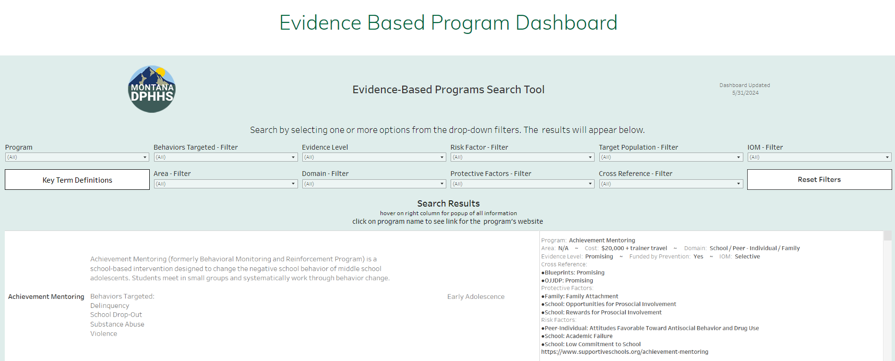
Notes:
Filter by need. Programs, policies and procedures. Looking to expand to more than SUD - suicide, public health, early childhood.
Evidence-Based Work Group: The Evidence-Based Work group’s purpose is to assist prevention specialists and coalitions with identifying research and evidence-based practices that are grounded in prevention science and, if implemented with fidelity and culturally relevant, can achieve measurable outcomes and move the needle on curbing and addressing substance misuse and abuse. The work group is currently working on setting criteria and guidelines for local prevention specialists and coalitions to help them develop a prevention strategy that meets evidence-based standards.

Slide 20
Benefits of a Training/TA Within Statewide Infrastructure
All prevention specialists receive the same training
Onboarding
Regional trainings
Other trainings
Increase workforce retention = saves money
Surveys consistently show TA/support is one of the main reasons they stay in the job
Frees up contractors and the state
State receives accurate data needed for reporting
Notes:
Firing on all cylinders. Success for communities, prevention, families, the state…

Slide 21
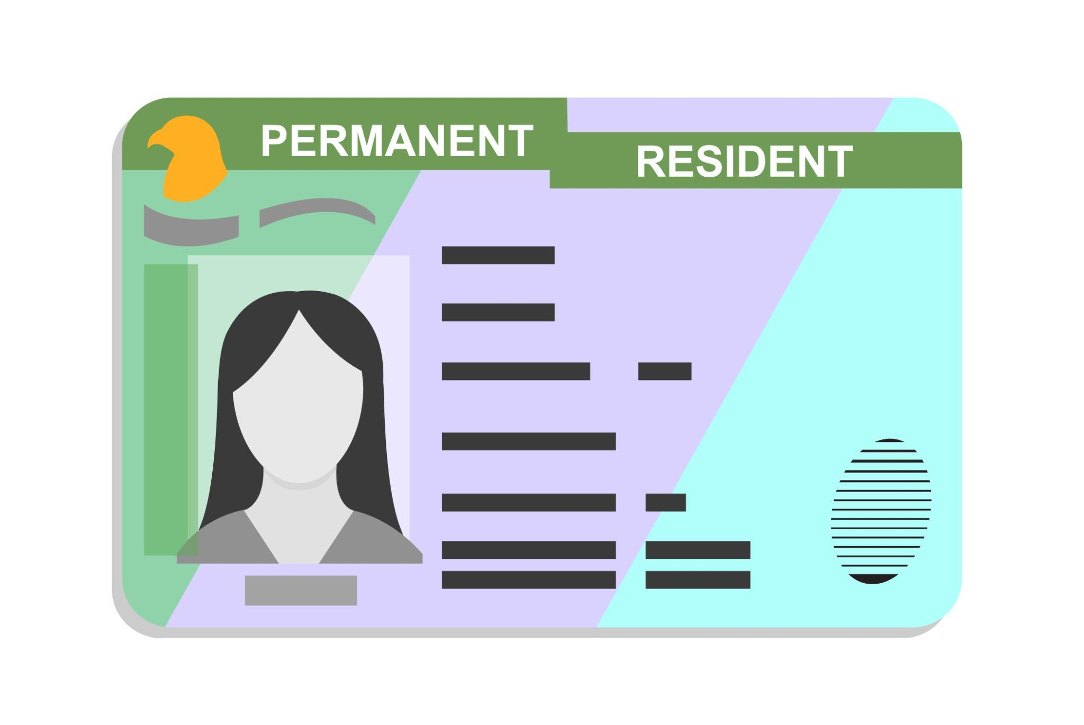
Benefits of Training/TA
Without training,
you get what you get
Train them and they may leave vs. not training and them stay
Notes:
Untrained workforce can cause harm - scare tactics, mock crashes, showing use, bad data, etc.

Slide 22
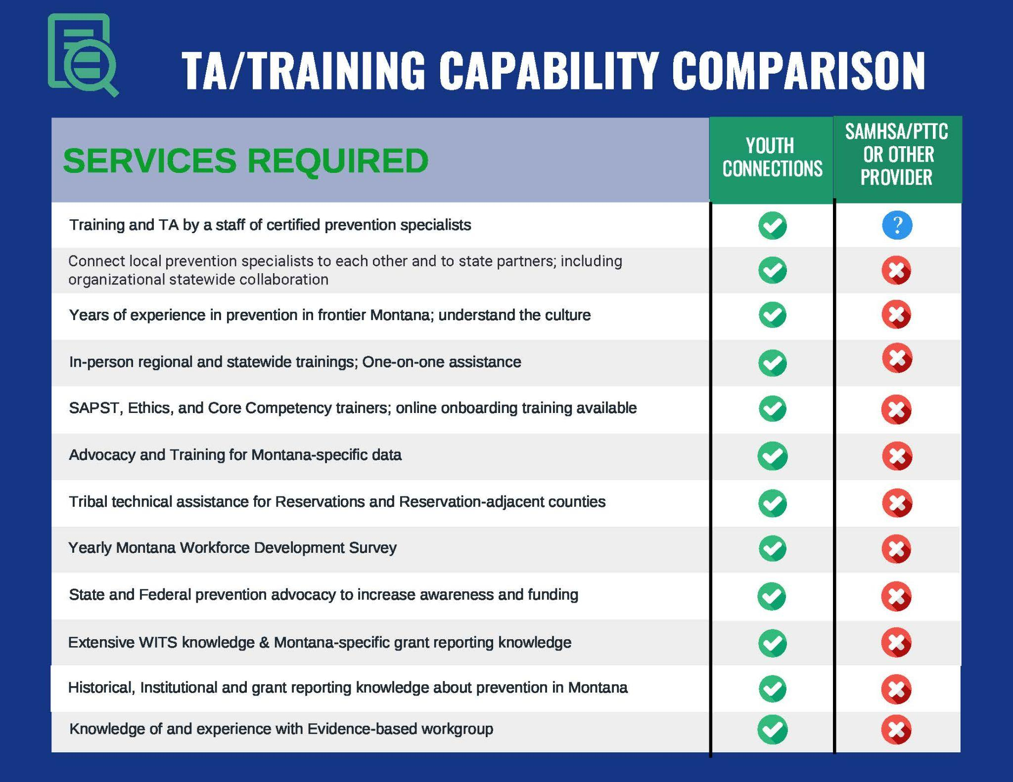
Benefits of Staying Local
Notes:
We know MT. We’ve done prevention in rural MT - WAS DC does not know rural. Advocacy at state and fed level (testify, letter to congressman), connect to statewide resources. Understanding the culture.

Slide 23
Outline
Where we were
New model
Requirements and vision
Onboarding Process
Workforce development
Effectiveness
Notes:
What we’re calling our onboarding process was not one of the grant deliverables required.
Need came from 2 places:
Those of us who were PSs under to old system wished we had received training or some sort of process to learn about prevention. What we all received was different.
Realized with multiple TAs we needed to have a system where no matter who the TA was, all of the PSs were learning the same things.

Slide 24
https://tinyurl.com/pwc86ah6
Notes:
How were we going to accomplish this, knowing how big our state was, and how few TAs we had to cover each health planning region?
We knew we had to do something virtually, but would also reach people with different learning styles in the most effective way. Get a variety of people from all educational backgrounds and experiences
-Had to create a system that would work for all
Obviously we knew we couldn’t do all of this in person, given how large the state is, so virtual was our best option. Mind you, this was pre-COVID when remote learning was much less popular than it is now!

Slide 25
Onboarding Process - Vision
Notes:
We use a learning management system, or LMS. Each TA on our staff has an account, and each learner has their own account. When working together, the TA can assign courses as needed throughout onboarding.
What’s unique about this process we’ve created that we haven’t found anywhere else, is the ability to provide the mentoring and coaching to the PSs as they are learning.
Anyone can take a webinar or online course, but what those lack is the ability to apply the skill learned, then come back and meet with a subject matter expert that can help teach, overcome barriers, provide feedback, and guide you to the next step of what needs to happen, all based on prevention science and best practice
3. The basis of the leveled system we’ve created is to accomplish 3 things:
Introduce new hires to their role and prevention
Provide them with an introductory level of knowledge
Develop their skills and abilities to conduct prevention within their communities
4. We start with 100 level courses, then move onto 200-level courses, much like college curriculum.
100 = Knowledge
200 = Skills
Have other courses, but those are topic-specific

Slide 26
Onboarding Process - Components
New Hire
Onboarding
100 Level
Onboarding
200 Level
Ongoing Support
Image Source
Image Source
Image Source
Image Source
Notes:
We have four different steps that make up the Onboarding Process. The beginning when a new person gets hired, there’s work to do beforehand. Then when they start their learning on our LMS, they begin with the 100-level. Once they’ve completed all courses within that module, they move up to the 200-level. Once they have completed that, they will receive ongoing support from their TA, and training from YC and other external partners.
We’ll look more closely at what each of these steps looks like.

Slide 27
Onboarding Process - Components
Onboarding
100 Level
Onboarding
200 Level
New Hire
Ongoing Support
Onboarding Guide
Agency onboarding
Welcome folder
Meet with TA
Image Source
Image Source
Image Source
Image Source
Notes:
New Hire:
All of these things happen within a couple of days or a week. They may differ by region, depending on the agency who hires them. Some agencies prefer to do their onboarding first and then hand them over for the onboarding process, while others want us to meet with them immediately, and they can do both onboarding processes at the same time.
Either way, the TA for that region will create the Onboarding Guide for that person.
Sometimes they notify the TA in advance that they’ll be hiring someone and the TA can get started on the onboarding guide for that PS. Other times we get just a day’s notice. But we have made this process so seamless, flexible, and sustainable, that we can do this last-minute.
Also part of this is a “Welcome Folder”. The agency who hires the PS has a folder that YC provided to them, which contains a welcome to prevention letter from our agency, and a picture of their TA and that TA’s short bio. They also get a one-page flyer on the LMS explaining what it is and that it will be used for onboarding. There’s also a one-page sheet sharing all of the emails/invitations they’ll be receiving as part of the onboarding setup. They’ll get calendar invitations for regional meetings, upcoming training, etc. and the monthly YC newsletter. Lastly, they receive a prevention glossary of terms that shares common words, phrases, and acronyms. In the beginning they get a lot of paperwork and information thrown at them, so we wanted a space for them to have the most pertinent information available to them within reach if they needed it.
The last step of this “new hire” step is for the TA and the PS to meet virtually. This first meeting allows for introductions and become familiar with one another. They will exchange contact information if they don’t already have it, and the TA reviews the Welcome folder with them. The TA also asks about background, experience, and why they are interested in prevention.

Slide 28
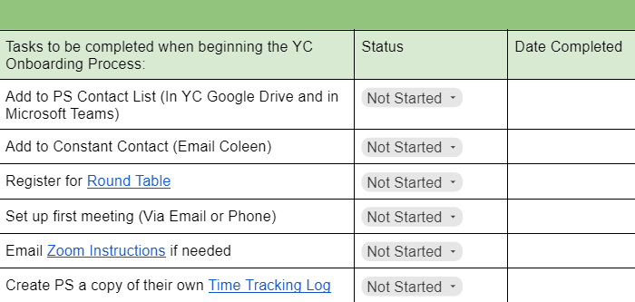
Onboarding Guide
Notes:
This pic give an idea of what the Onboarding Guide looks like.
When a person gets hired the TA will create an onboarding guide for this person. There’s a whole checklist of items that need to be accomplished as soon as a person is hired.
They’re sent invitations for any regional meetings, recurring trainings, etc.
This is not a document share with them,but for the TA to keep track of what they’ve done so far.
The green section are the tasks the TA needs to do before the person is hired, or within 1-2 days of them being hired.

Slide 29
Onboarding Process - Components
Onboarding
100 Level
Onboarding
200 Level
New Hire
Ongoing Support
Onboarding Guide
Agency onboarding
Welcome folder
Meet with TA
LMS
Montana prevention
Prevention science
Strategic Prevention Framework
Basic
Core Competencies
Prevention science
In-depth SPF
Intermediate
Image Source
Image Source
Image Source
Image Source
Notes:
Onboarding 100
-MT prevention: Explain the system, much like we’re doing now
-Px science: Public Health Model, science of addiction,
Onboarding 200
-We have them take courses on each of the core competencies, and even more about prevention science and theory.
-For each step of the SPF we go fairly in-depth. Remember, the goal of 200 level courses is to increase their skill.
What does this actually look like:
-TA and PS meet several times week in the beginning. Each session has a set of objectives they want to accomplish. When they are done the TA will assign them courses (which is done in he LMS), and sometimes there are activities for the PS to complete before they meet next.
-As they get further along in their onboarding they start meeting less and less with their TA, because they’ve been able to connect with others in their community and get started on some work.
-Sometimes this depends on if the person is from the community or is new. If they’re from there, they usually already know people they need to connect with. If they are new to the community, this might take a little longer to get out on their own. No matter the circumstance, the TA provides the level of support needed for that person.

Slide 30
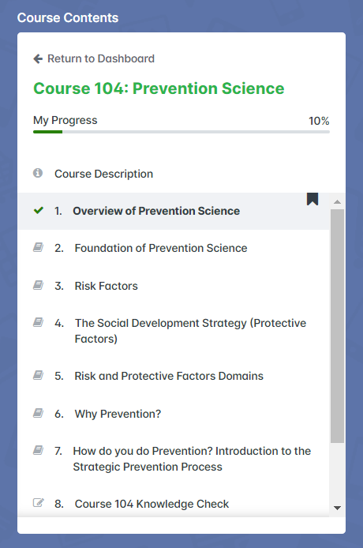
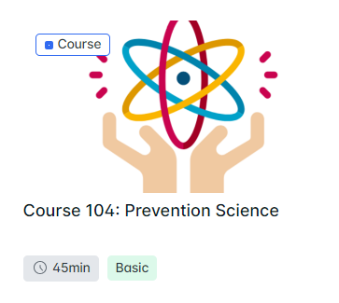
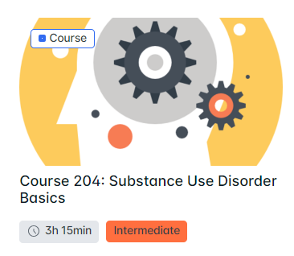
Courses
Notes:
Examples of courses.
Vary in length. Each course has a description, objectives, is made up of modules, and most have a knowledge check at the end containing true/false, matching, or multiple choice questions.

Slide 31
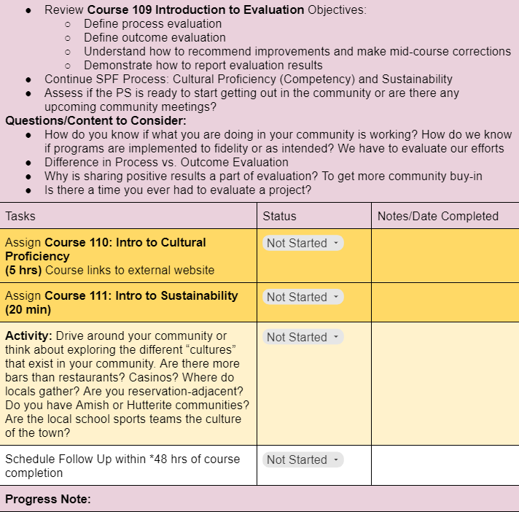
Onboarding Guide
Notes:
As mentioned previously, each onboarding session has objectives. These align with the objectives of the online course they just finished. The session also has predetermined questions to ask the PS, which gets them critically thinking about the content they learned. (Pink section)
Once that is reviewed, the TA will explain the next courses and the activity if there is one.
The last step is to schedule their next session.

Slide 32
Onboarding Process - Components
Onboarding
100 Level
Onboarding
200 Level
New Hire
Ongoing Support
Onboarding Guide
Agency onboarding
Welcome folder
Meet with TA
LMS
Montana prevention
Prevention science
Strategic Prevention Framework
Core Competencies
Prevention science
In-depth SPF
Technical Assistance
1 x 1
Support groups
Training
Needs-based
Emerging trends
Image Source
Image Source
Image Source
Image Source
Notes:
Ongoing Support
TA
-After the onboarding process, the TA continues to support and meet with the PS on a regular basis, all depending on that individual’s needs. The TA also meets with their region as a group, once a week to check in and provide any updates needed.
-Support groups: can do onboarding in groups, which helps them feel not alone in their communities.
Training
-In addition to our onboarding courses, we have additional courses created and are creating more all the time, that align with needs of our workforce.

Slide 33
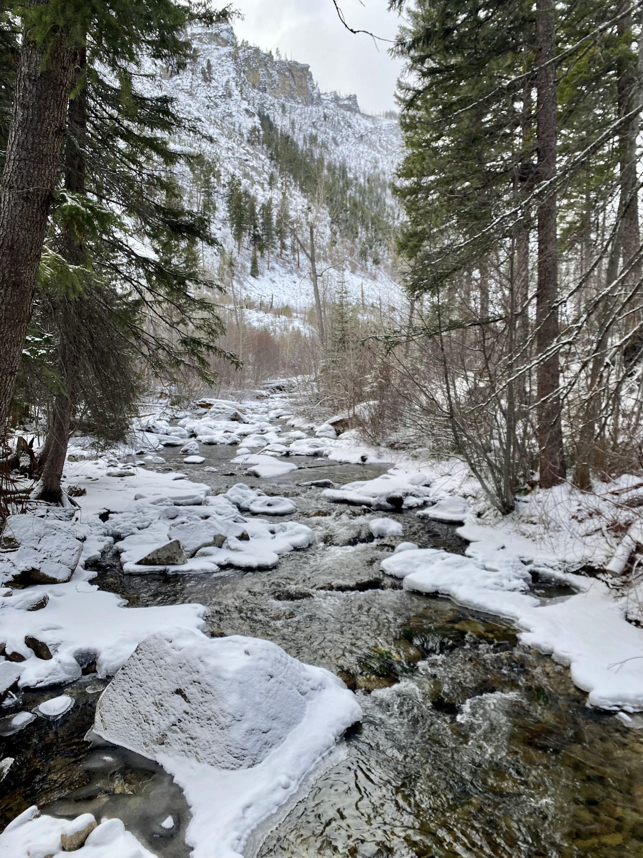
FAQs
What if they don’t complete a course or task you assign them?
How long does this process take?
What if they don’t show up for their meetings?

Slide 34
Outline
Where we were
New model
Requirements and vision
Onboarding Process
Workforce development
Effectiveness
Notes:
The onboarding process is only one piece of the puzzle when we look at workforce development as a whole system in our state. I’m going to share all of the other pieces so you can begin to see what the entire picture looks like in Montana for workforce development.
This is an ongoing process for us, and happens throughout the year with a lot of assessment and evaluation.

Slide 35
Workforce Development
Notes:
What exactly is my role as the Workforce Development Coordinator?
It’s my job to take all of the pieces of the prevention puzzle, to make sure we’re fitting them into the work we provide as TAs.
Every product, training, or service we provide has a specific need and purpose behind it.

Slide 36
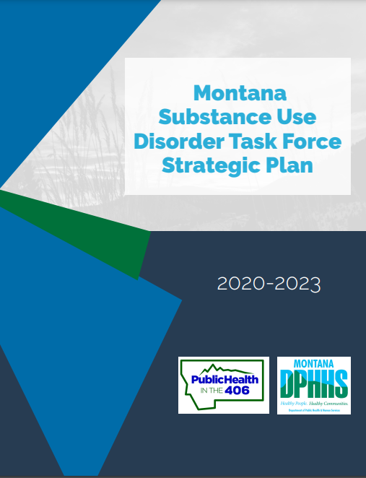
Ongoing Assessments and Evaluations
IC&RC Prevention Performance Domains
SAMHSA Prevention Core Competencies
Workforce Development Assessment
Advisory Group
Training Evaluations
Regional Trainings, Round Tables, 6-Month Reviews, other training
Notes:
We are pulling from international, national, state, community, tribal, and individual needs
Master Training Needs document:
Start gathering information about 6 months BEFORE the next fiscal year, to start preparing.
Do ongoing evaluation of our training and services we offer. Some of these are done through surveys, but others we do through focus groups or 1x1 interviews to provide both quantitative and qualitative information.
We do an annual workforce assessment, which I’ll talk about in a minute.
We also want to make sure what we do fits in with Montana’s health needs, so we pull from the Montana State Health Improvement Plan, and the Montana SUD Task Force Strategic Plan. Our agency serves as a conduit between the local prevention work and state-level work. We educate PSs on what’s going on at the state level, and educate people on the state level and these Task Forces on what is being done at a local level. With that comes more partnerships, successes, and less duplication of services or efforts.
Everything we offer is intentionally created and designed to fit the specific needs of our Montana workforce.

Slide 37
Workforce Assessment
WHEN: Late summer/early fall
WHAT:
Demographics
Education & Background
Core Competency Needs/Wants
Training Information
Communication
Workforce Sustainability
WHO: Prevention Specialists
HOW: Survey Monkey
Notes:
WHEN: Give them a month to fill it out
WHAT: These are sections on the survey
WHO: PSs who we provide training and TA to. Currently around 50
HOW: Survey Monkey.
Anonymous. Almost 100% completion rate. Required participation as part of their grant requirements.

Slide 38
Evaluate Results
Lowest Skills
Highest Skills
1. Utilize strategies and resources to promote environmental change
(Domain 5)
2. Utilize marketing techniques for prevention programs
(Domain 3)
3. Demonstrate advocacy skills in public health promotion and prevention
(Domain 5)
1. Coordinate prevention activities
(Domain 2)
2. Implement prevention education and skill development activities
(Domain 2)
3. Adhere to legal, professional, and ethical principles
(Domain 6)
Notes:
After it’s finished I rank the domains from highest need to lowest skills. That informs us which general area we need to focus on. Lowest-ranked the past 5 years overall has been Public Policy and Environmental Change
I also take each individual task from all of the domains and rank them from highest need to lowest need.

Slide 39
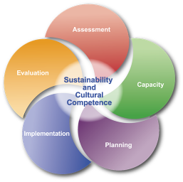
Training Plan
Required Trainings:
SAPST
Ethics
Public Health 101
Evaluation Results:
Needs
Wants
Notes:
Looking at the trainings required by the grant, and adding the results from all of the evaluations and assessments we’ve conducted throughout the year, we come up with a training plan.
Some of the needs and wants are covered in SAPST, but maybe not as in-depth. Also need to remember that SAPST only gets taken by new PSs. So those in the workforce here longer than a year will not be taking SAPST. We conduct in-person SAPST at least twice a year. PH 101 is Montana-specific and included in the onboarding process.
We infuse these needs and wants into recurring trainings, such as 3x/year regional training, Round Tables. Others we bring in outside trainers to focus on these areas. Example: Carlton Hall for 2-part sustainability training. Native American Development Council for Cultural Relevancy training.
Everything we do, down to which days of the week and times of the day we offer training, comes from PS feedback and our assessment results.

Slide 40
Outline
Where we were
New model
Requirements and vision
Onboarding Process
Workforce development
Effectiveness

Slide 41
Effectiveness
86%
391%
Notes:
86% of PSs said they felt very supported by their TA.
Since this regional system began, there has been a 391% increase in EB programs implemented across MT

Slide 42
Notes:
When we have this regional system, it is MUCH easier to implement EB programs, because more people are talking to one another, there is more coordination, and we can share successes and ways to overcome barriers.
Implementing CTC was also one of the deliverables for the RFP when this regional system started. There were a few pilot communities the state chose that would implement this. Most worked, a few didn’t. But it was successful enough that the state expanded the CTC funding and now there are additional CTC communities and coordinators across the state.
We have regions, or multiple regions collaborating to bring in train-the-trainer for EB programs-makes money go further when costs are shared.

Slide 43
Summary
Notes:
We’ve seen the benefits of having this coaching/mentoring system and how well it works, for all the reasons we’ve explained.
We would encourage others to use this type of system.

Slide 44
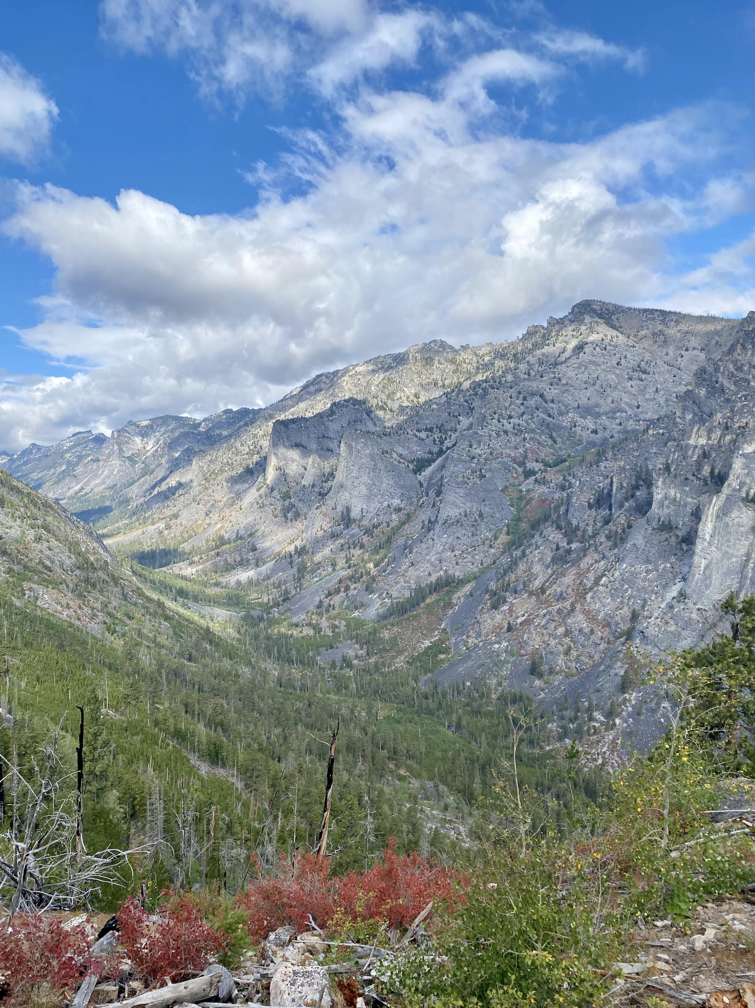
Questions?
Coleen Smith
coleen@youthconnectionscoalition.org
Nicole Hackley
Nicole@youthconnectionscoalition.org

