Slide 1


Harmonizing Horizons: Innovative Resources for Prevention and Harm Reduction
National Prevention Network
August 15, 2024

Slide 2

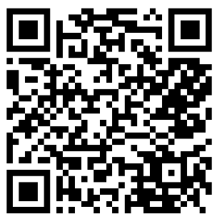

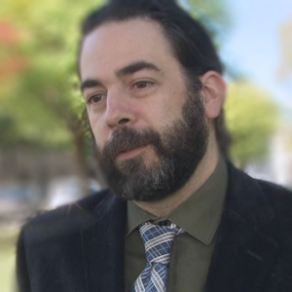
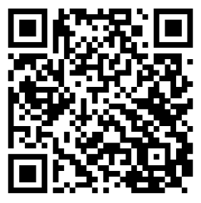

Samantha Bone, MS – Senior Consultant at PCG
sbone@pcgus.com
Scott Gagnon, MPP, PS-C – Former Director of New England PTTC, Regional Director (Region 1), SAMHSA
scott.gagnon@samhsa.hhs.gov

Slide 3
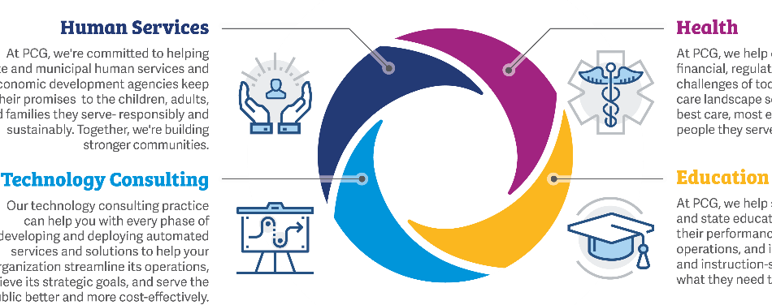
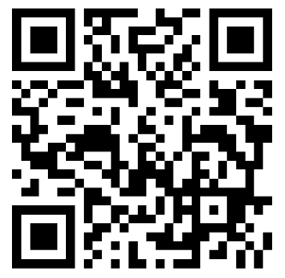
Getting to know Public Consulting Group (PCG)
National management consulting and evaluation firm that delivers solutions that matter and has served the public sector for more than 30 years.

Slide 4
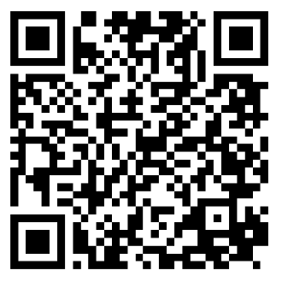
New England Prevention Technology Transfer Center
Provides training and technical assistance services to the professional and volunteer prevention workforce within the New England states and is administered by AdCare Educational Institute of Maine, Inc. The New England PTTC program is funded by SAMHSA of the U.S. Department of Health and Human Services (HHS).

Slide 5

Our Partnership
Partnered in 2023 to study and recommend ways to advance harm reduction within Rhode Island’s substance use disorder continuum of care. Together, we aim to empower people who use substances to reach their goals through positive, incremental change.

Slide 6
Funding Acknowledgment
The New England Prevention Technology Transfer Center (New England PTTC) is supported by Substance Abuse and Mental Health Services Administration (SAMHSA) of the U.S. Department of Health and Human Services (HHS) as part of a financial assistance award with 100 percent funded by SAMHSA/HHS. The contents are those of the author(s) and do not necessarily represent the official views of, nor an endorsement, by SAMHSA/HHS, or the U.S. Government. The New England PTTC was the funder of this project.
Cooperative Agreement # 6H79SP081020-05M005

Slide 7
Disclosure
Samantha Bone works for Public Consulting Group, a for profit company.

Slide 8
Audience poll
Public sector, private sector, or academia?
Prevention, harm reduction, treatment and recovery?
Less than a year, one to five years, over five years?

Slide 9

Learning Objectives
Name everyday examples of harm reduction
Explain how harm reduction practices and services improve equity within the substance use disorder continuum of care
Learn practices for engaging people who use substances
Understand key features of both the Harm Reduction Guide for Prevention Professionals and Stack the Deck Rhode Island as a blueprint for your state
Learn next steps on state distribution of these resources

Slide 10
Agenda
What is harm reduction?
Harm reduction and equity
Community empowerment
Anti-Stigma Educational Materials
What’s next for Rhode Island
1
2
3
4
5

Slide 11
Harm Reduction
What is it?

Slide 12
Harm reduction is a practical and transformative approach that incorporates community-driven public health strategies — including prevention, risk reduction, and health promotion — to empower people who use drugs (and their families) with the choice to live healthy, self-directed, and purpose-filled lives.
-Substance Abuse and Mental Health Services Administration (SAMHSA)

Slide 13
What are some everyday examples of harm reduction?

Slide 14
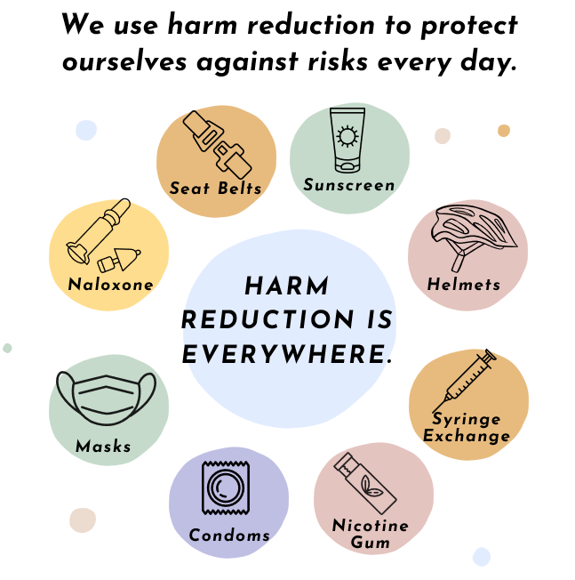

Slide 15






Substance Use Disorder Continuum of Care
How can we incorporate harm reduction?
HARM REDUCTION
Promotion
Prevention
Treatment
Recovery

Slide 16
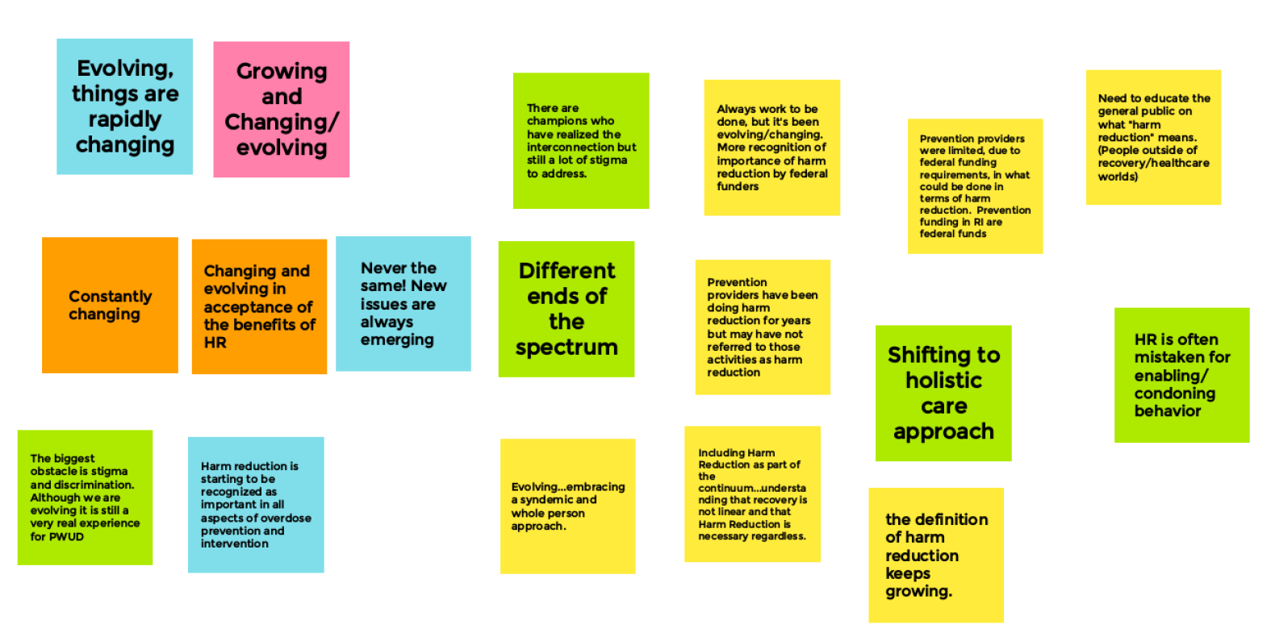
The evolution of harm reduction and prevention

Slide 17
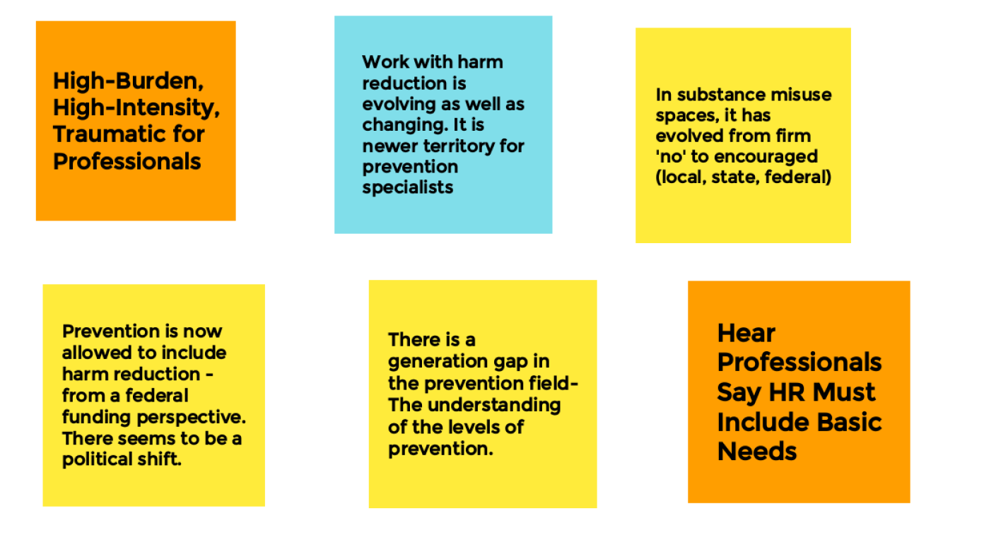
The evolution of harm reduction and prevention

Slide 18
What evolution have you seen in harm reduction and prevention?

Slide 19
SAMHSA and CDC Support Harm Reduction
A federal policy and funding priority
The Biden-Harris Administration has identified harm reduction as a federal drug policy priority and is one of the four strategic priorities of the U.S. Department of Health and Human Services (HHS) Overdose Prevention Strategy
SAMHSA released the Harm Reduction Framework in 2023 as an outcome of its first-ever federal Harm Reduction Summit in 2021, held in partnership with the CDC.
SAMHSA and CDC partnered on funding the National Harm Reduction Technical Assistance Center (NHRTAC) to provide free help to anyone in the country providing (or planning to provide) harm reduction services to their community and also fund the Harm Reduction Grant Program.

Slide 20
Of the 31 states publicly reporting their state share of Opioid Settlement Funding, all 31 report spending on harm reduction activities.
Source: www.opioidsettlementtracker.com

Slide 21
Project Overview
Anti-stigma educational materials completed in 2023
Harm Reduction Guide for Prevention Professionals
A guide to help illustrate how harm reduction and prevention professionals can collaborate, best practices, and resources to continue to learn about harm reduction.
Goal: Continue to integrate harm reduction into Rhode Island’s SUD continuum of care.
Stack the Deck Initiative
A deck of cards to help stack success in favor of the reader that includes statewide harm reduction tools and resources.
Goal: Empower readers to live the life they want, with or without substances.

Slide 22
Methods
Our process
Explore
Conduct literature review
Interview subject matter experts
Talk with people with lived and living experience
Design
Create anti-stigma educational materials for both professionals who work within the SUD continuum and people who use substances
Innovate
Work together to pilot materials that promote professional collaboration and community empowerment

Slide 23

Qualitative Sources
Local, state, and national experts
Literature Review
SAMHSA, National Institute of Health, NASTAD, NIDA, NCSACW, European Monitoring Centre for Drugs and Drug Addiction, PTTC, National Harm Reduction Coalition, RIPRC, RIDOH, among others
Subject Matter Experts
Regional Prevention Task Force, Prevention Work Group, Harm Reduction Work Group, RI Student Assistance Counselors, BHDDH, EOHHS, RIDOH, NYC Dept of Health and Mental Hygiene, Boston AHOPE, National Alliance for State & Territorial AIDS Directors (NASTAD), Opioid Response Network (ORN), UMKC Collaborative to Advance Health Services, Kansas City CARE Health Center, Prevention Technology Transfer Center, Addiction Technology Transfer Center
Lived and Living Experience Experts
Participants from Project Weber /RENEW, in Pawtucket, RI, and from Parent Support Network in Westerly, RI

Slide 24
Harm Reduction and Equity
Expanding care options for everyone.

Slide 25
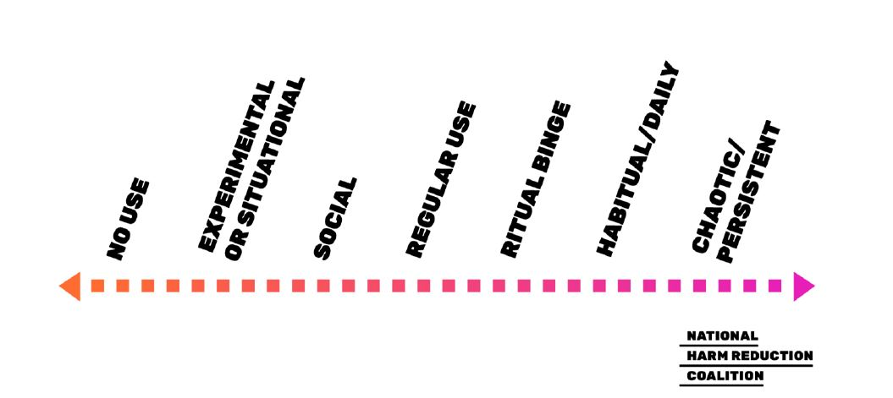
Continuum of Use
Harm reduction meets folks where they are in their use

Slide 26
The harm reduction approach emphasizes engaging directly with people who use substances to prevent overdose and infectious disease transmission; improve physical, mental, and social wellbeing; and offer low barrier options for accessing health care services, including substance use and mental health disorder treatment.

Slide 27

Harm reduction approaches to care improves equity within the SUD continuum of care by providing care for those who continue to use substances.

Slide 28
Community Empowerment
What do people who use substances want?

Slide 30
What are some examples of person-first or affirming language you’ve used or heard in your work?

Slide 31


Pawtucket, RI
September 2023
7 participants
Westerly, RI
August 2023
7 participants

Slide 32

Engagement Practices
Planning and preparation
Solicited suggestions from harm reduction community regarding participation
Reached out to organizational leadership to introduce the initiative
Iterated questions together with community organizations
Avoided jargon, used person-first, affirming language

Slide 33
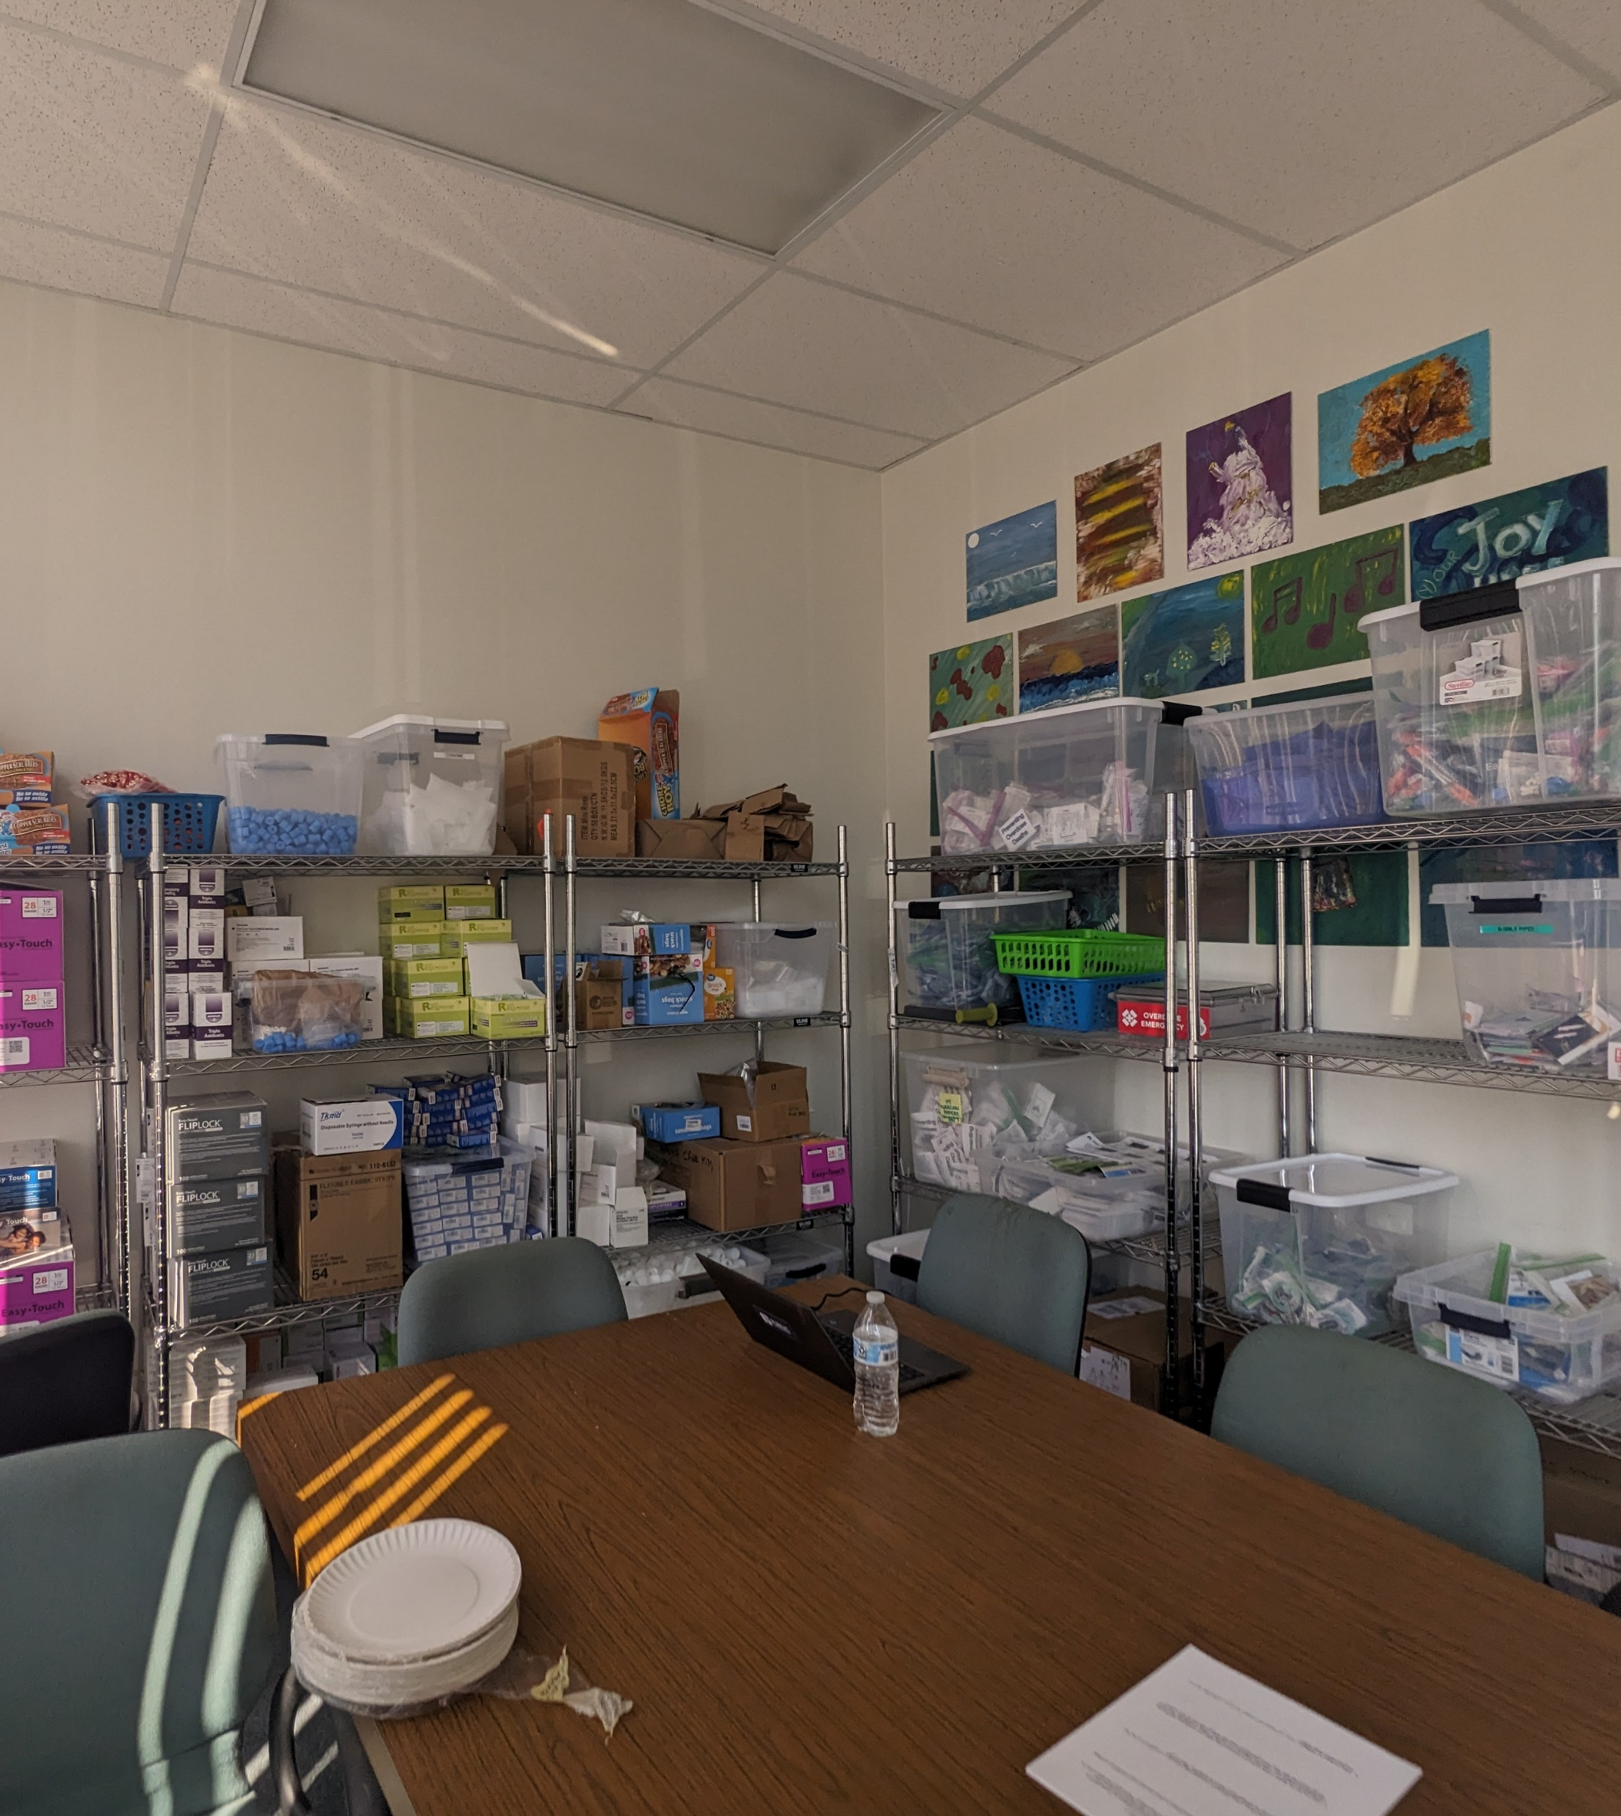
Engagement Practices
Listening sessions
Held listening sessions in person where people would normally go in their community
Recruited participants through on-site manager
Asked for one or two more participants than needed
Arrived one to two hours early to set up
Budgeted 90 minutes for a 60-minute session

Slide 34
Engagement Practices
Listening sessions, continued
Reserved first 30 minutes for arrival, introductions, informed consent, and conversation
Read informed consent form out loud before all participants signed
Emphasized anonymity and ability to leave
Were flexible with how people participated
Asked to record session and were prepared in case permission was not granted

Slide 35

Engagement Practices
Support and feedback
Provided opportunity for onsite counseling Left optional paper feedback surveys
Provided lunch from a neighborhood vendor
Provided a $25 gift card for each person’s time and expertise
Shared results and products with participants through their organizations once materials were completed

Slide 36
What are other practices you’ve used that we haven’t mentioned here?

Slide 37
Anti-Stigma Educational Materials
Harm reduction is everywhere.

Slide 38
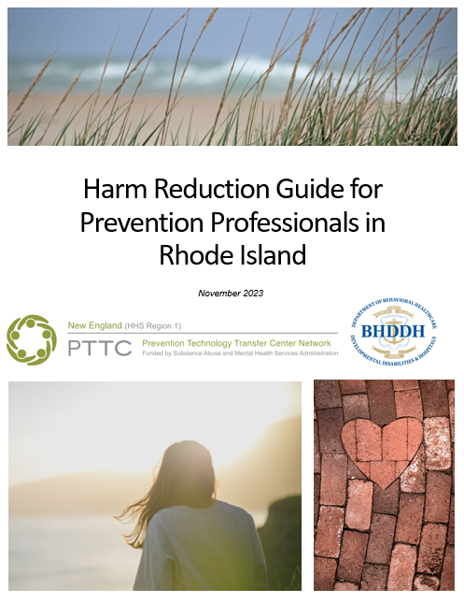


Slide 39
Highlights from Stack the Deck Rhode Island

Slide 40


Slide 41
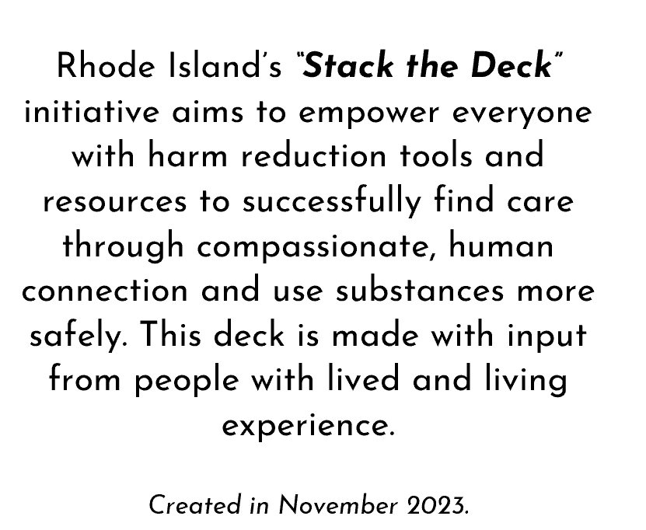

Slide 43
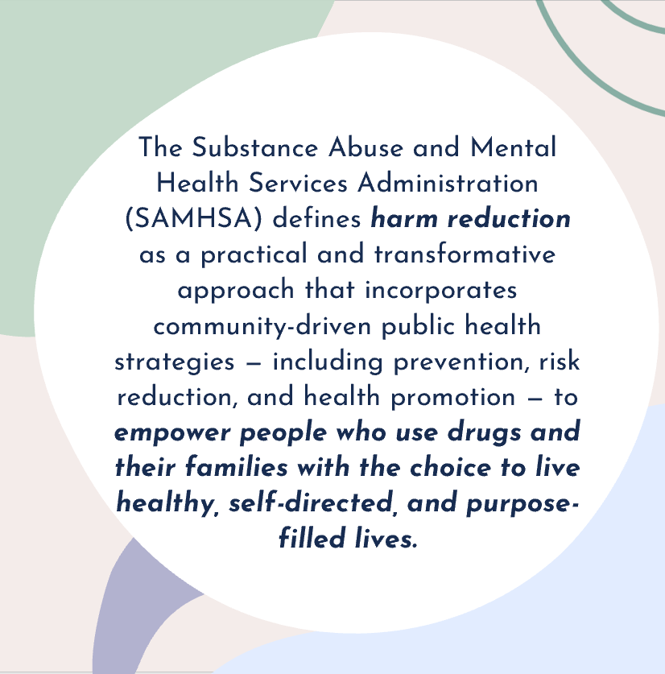

Slide 44
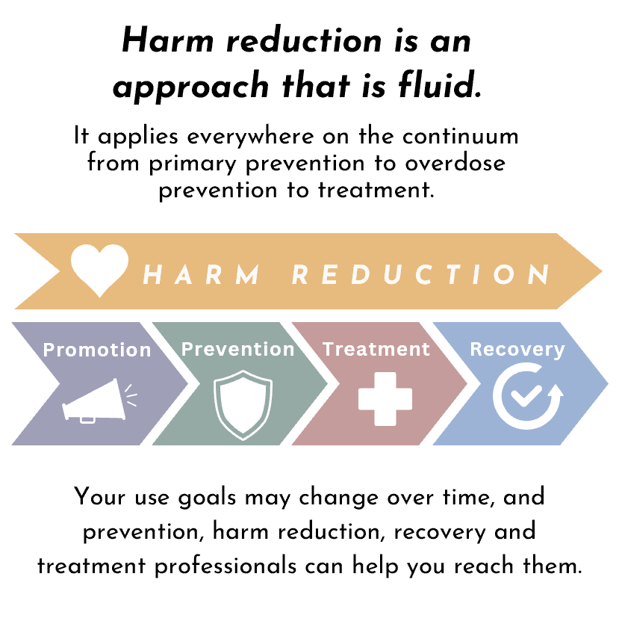

Slide 45
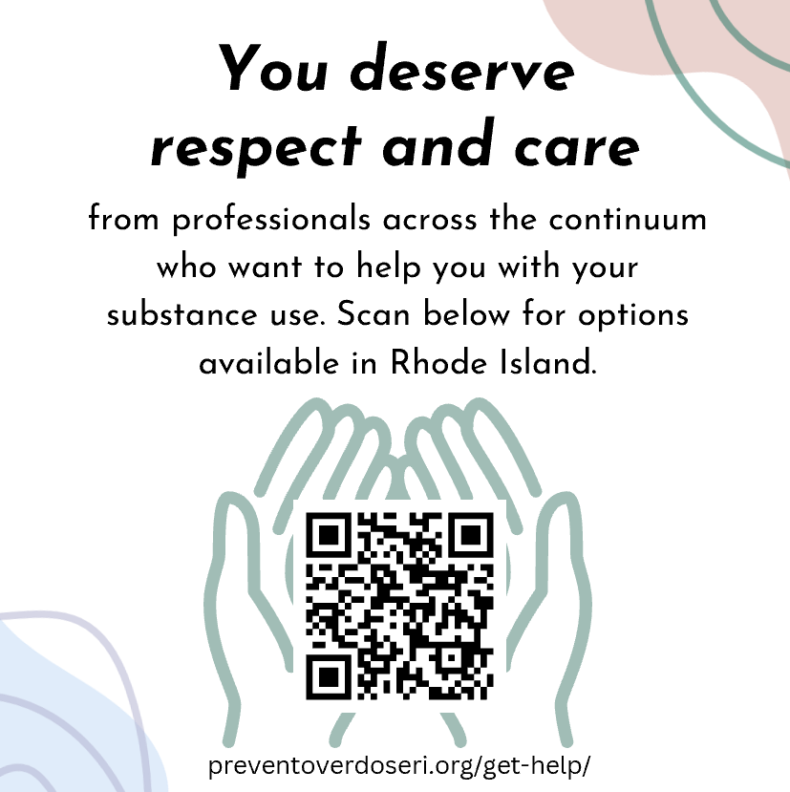

Slide 46
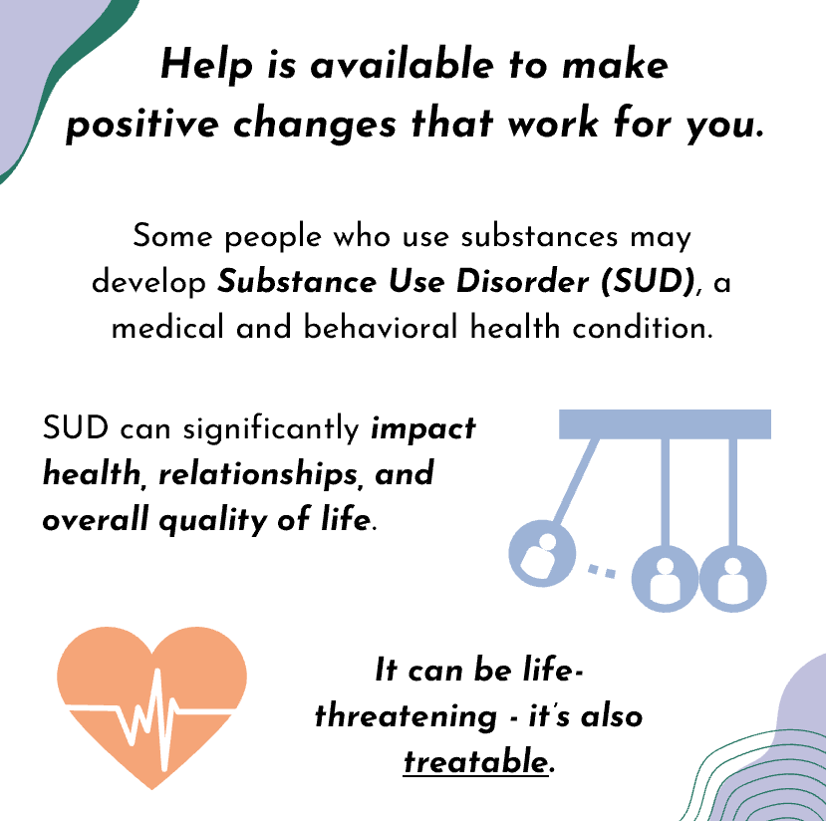

Slide 47


Slide 48
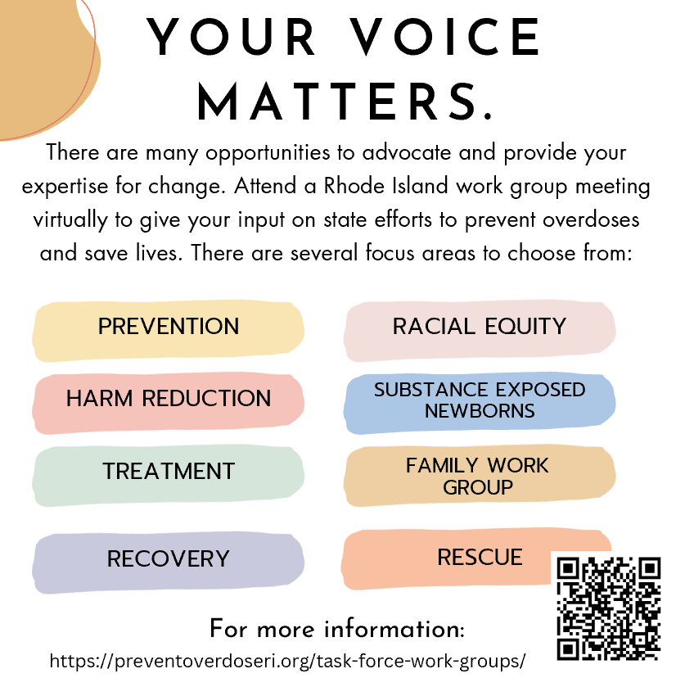

Slide 49
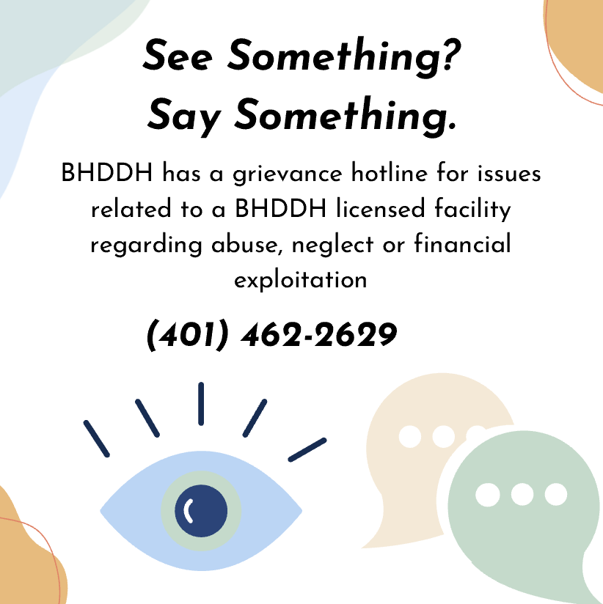

Slide 50
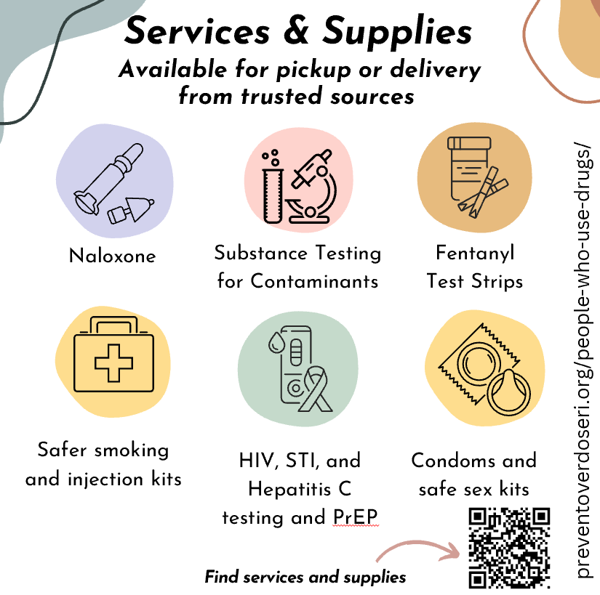

Slide 51
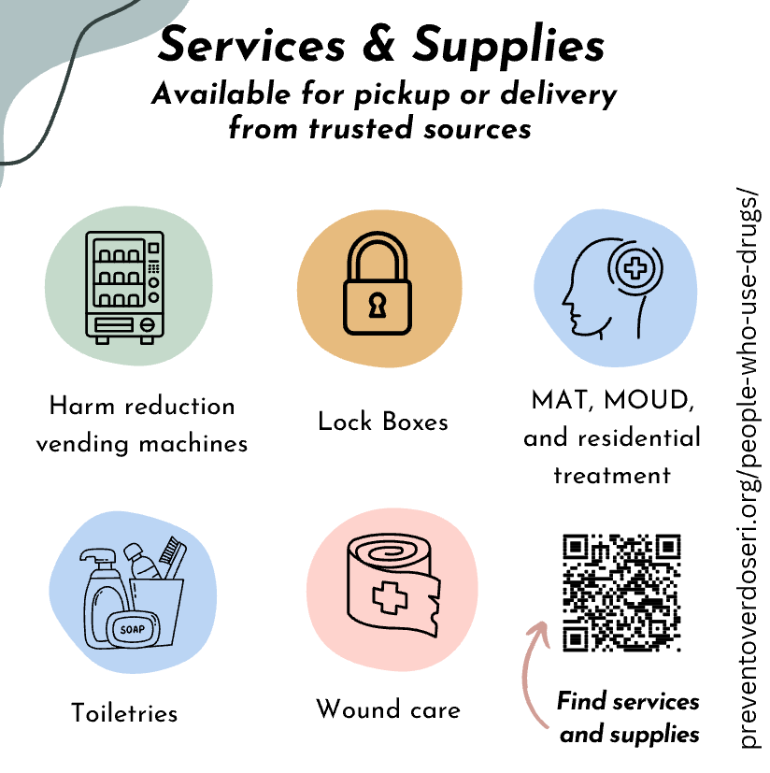

Slide 52
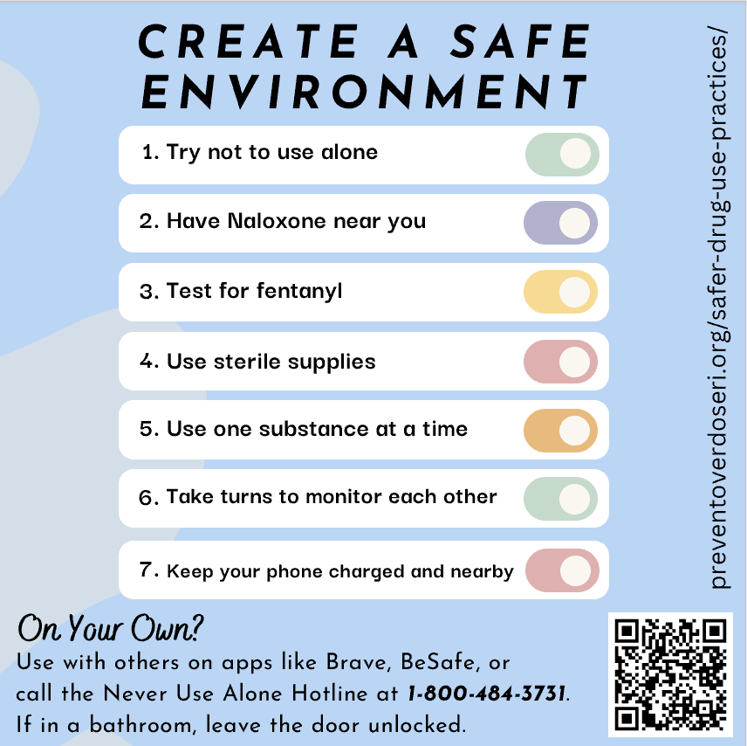

Slide 53
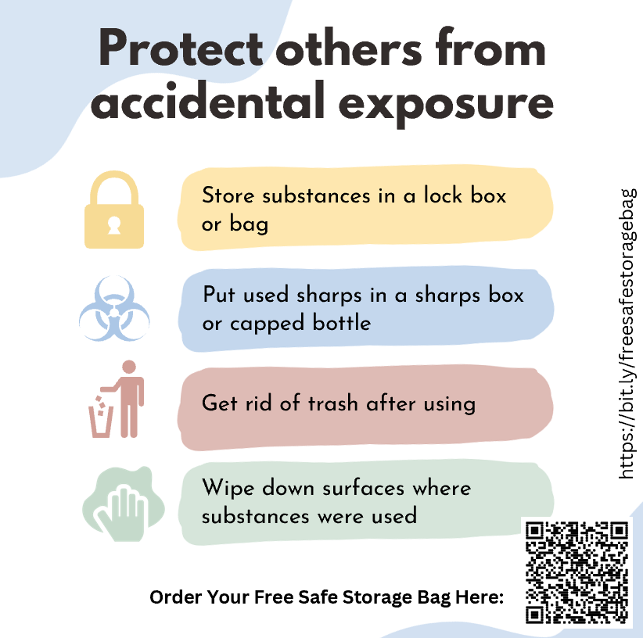

Slide 54
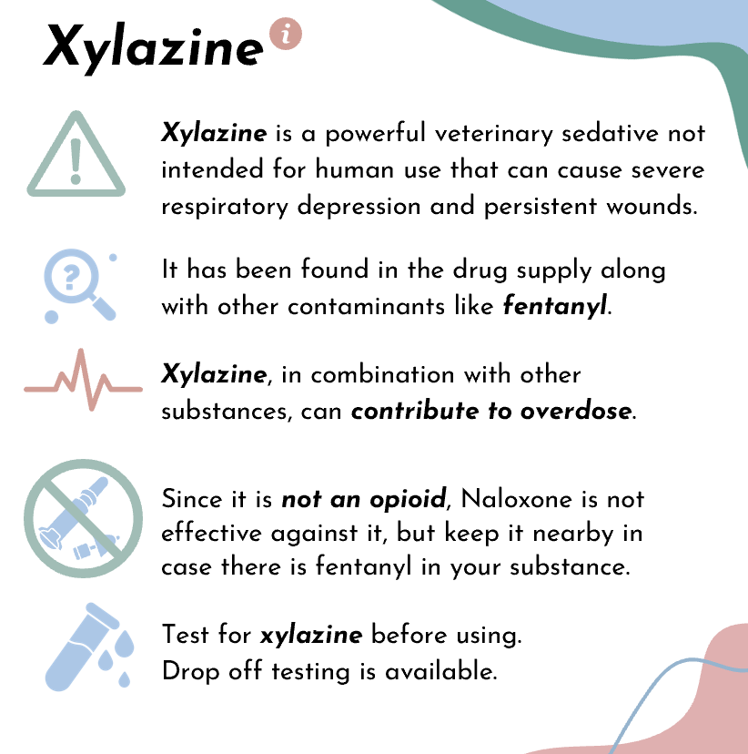

Slide 55
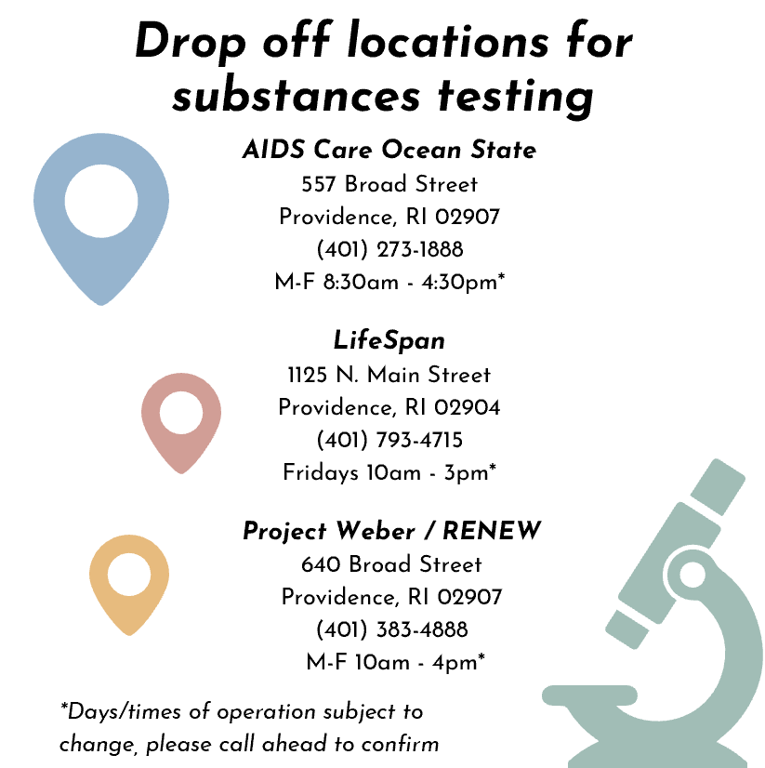

Slide 56
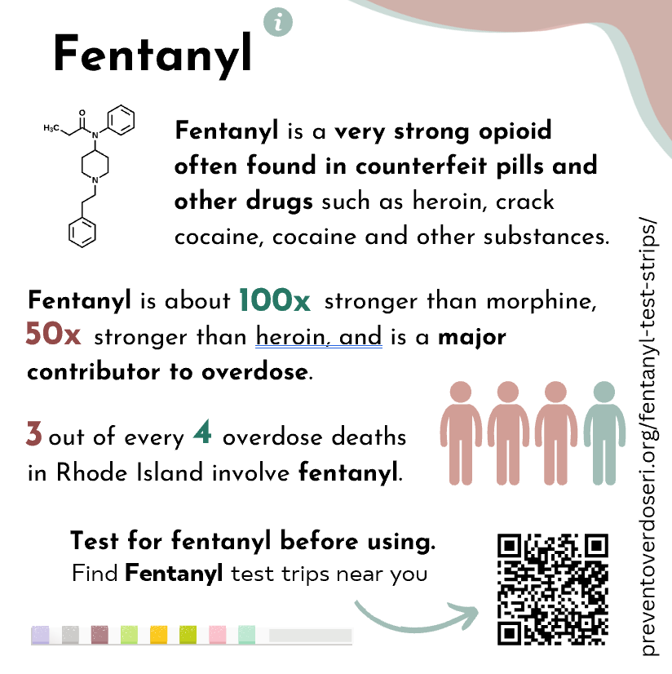

Slide 57
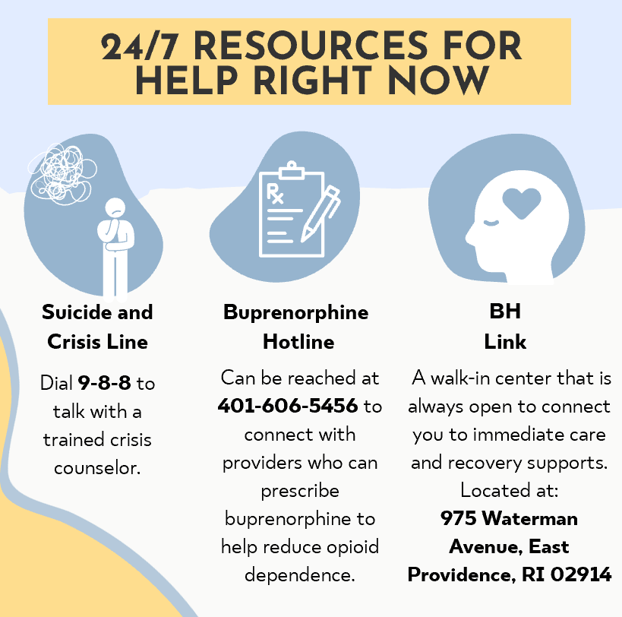

Slide 58
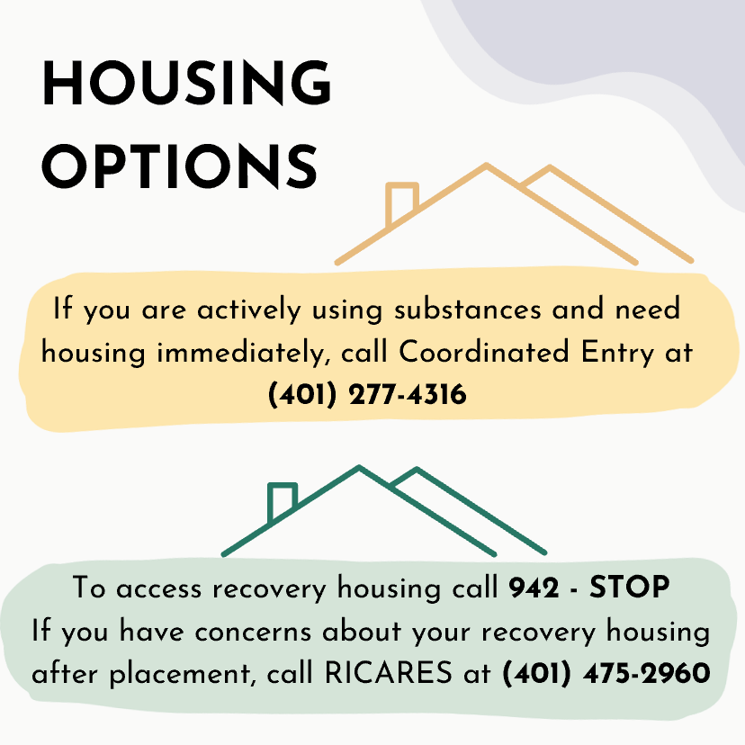

Slide 59
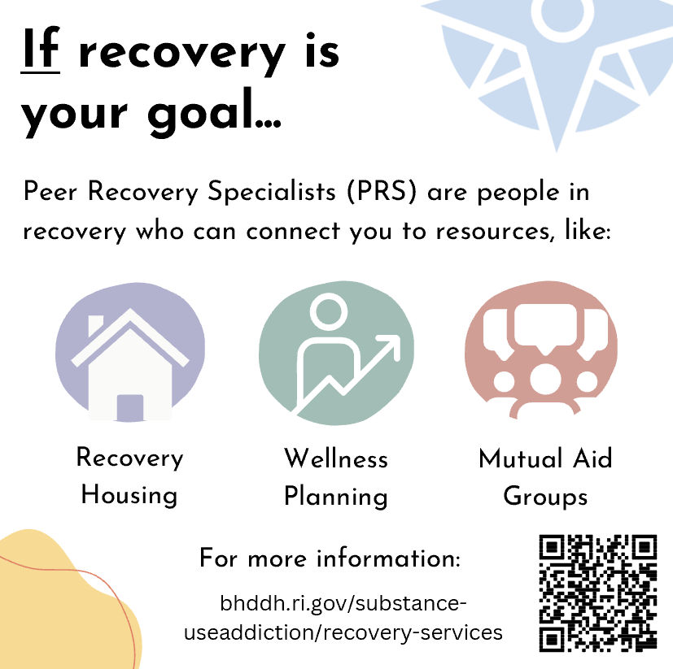

Slide 60
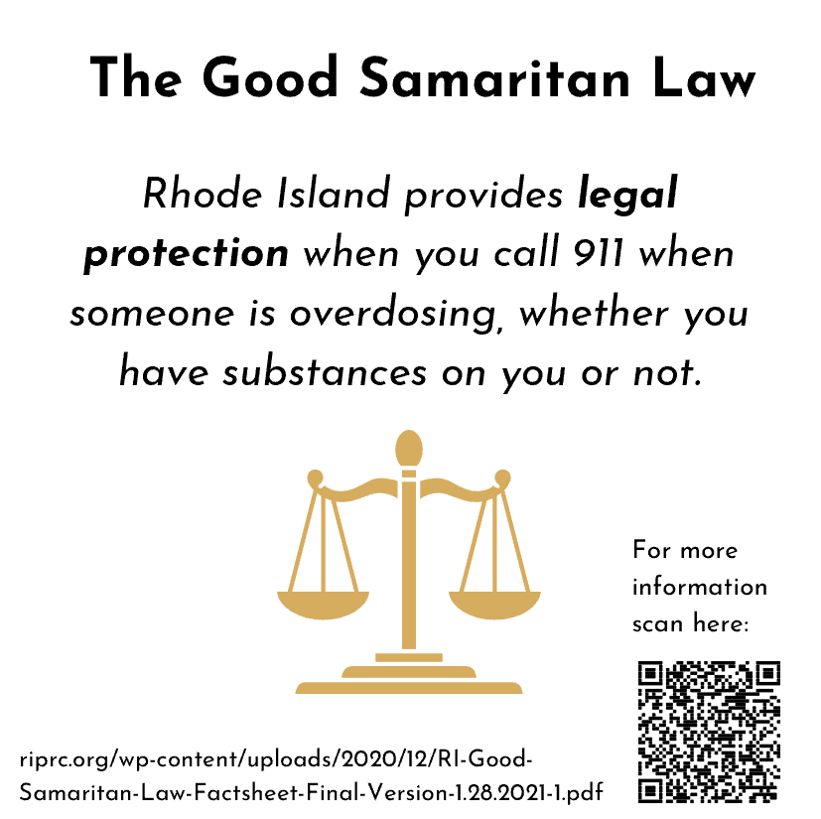

Slide 61
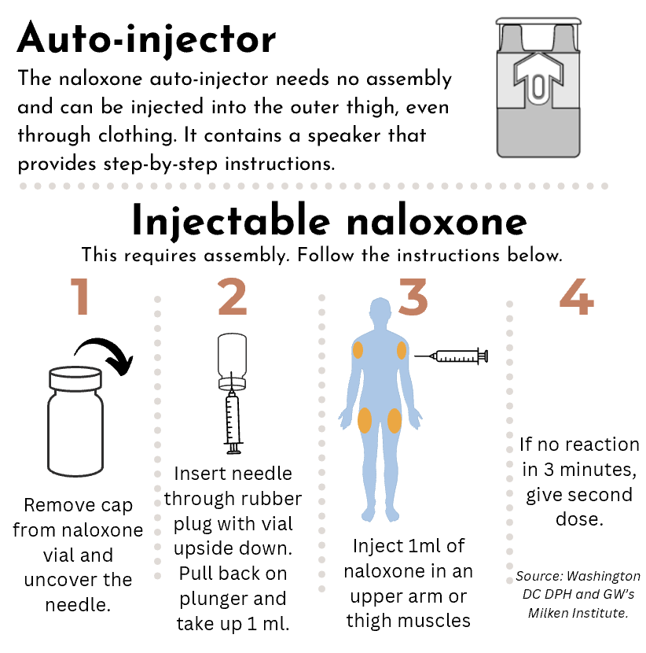

Slide 62
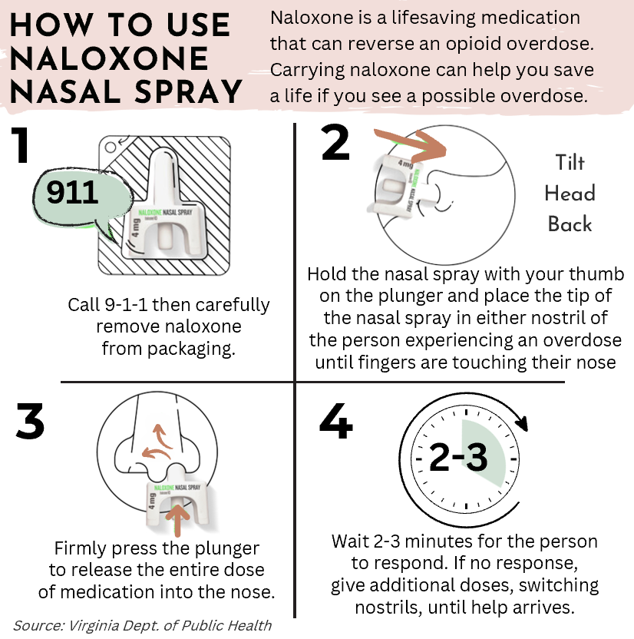

Slide 63
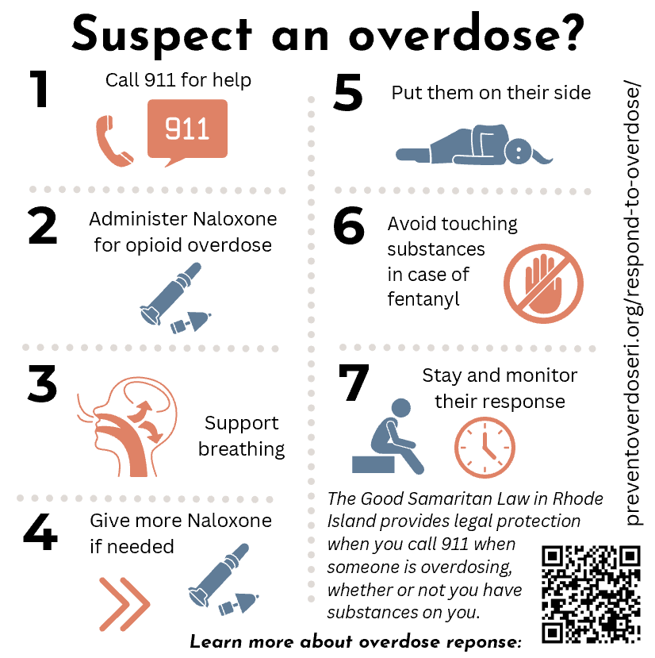

Slide 64
Do you think that people who use substances, their families, and/or the general public would find this deck helpful? What might be different in your state?

Slide 65
Highlights from the Harm Reduction Guide for Prevention Professionals

Slide 66



Harm Reduction Guide for Prevention Professionals in Rhode Island
November 2023

Slide 67










Harm Reduction
1
What do the following tools have in common?
Seat Belts
Sunscreen
HARM REDUCTION IS EVERYWHERE.
Naloxone
Helmets
Syringe Exchange
Masks
Condoms
Nicotine Gum
They are ALL implemented to reduce harm to people in our communities.
SAMHSA defines harm reduction as a practical and transformative approach that incorporates community-driven public health strategies — including prevention, risk reduction, and health promotion — to empower people who use drugs and their families with the choice to live healthy, self-directed, and purpose-filled lives.

Slide 68

Shared Goals and Priorities
2
HARM REDUCTION
Promotion
Prevention
Treatment
Recovery
Harm reduction spans across the continuum of care
Shared Goals
  Healthy and happy people
  Safe communities
  Meeting people’s basic needs such as housing, food
Shared Strategies
  Sharing information about substances and the science and disease of addiction
  Providing education on positive alternatives to substance use
  Mental health support, coping and regulation skills, referral to treatment or recovery services
  Leading and supporting drug take-back events
  Referrals to treatment and/or recovery services
  Encouraging healthy lifestyles
  Making safe storage an easy option
  Supporting the Good Samaritan Law
  Distribution of and training on Naloxone
  Motivational Interviewing to identify levers for change
  Co-creating a strengths-based plan for action

Slide 69
Collaboration Across the Continuum
3
When prevention, treatment, harm reduction, and recovery work together, there can be a greater reach and more positive impact on the community.
Professionals across the continuum can better collaborate by…
Encouraging professionals to openly share their perspectives
and experience
Learning more about each other’s work (e.g., attending prevention, treatment, recovery, harm reduction workgroup meetings or a state summit)
Making referrals to services across the continuum of care
Developing and updating shared definitions and language
Incorporating people with lived experience in decision making, planning, evaluation, and implementation across the substance use continuum

Slide 70


Best Practices
4
Harm reduction IS | Harm reduction IS NOT
Encouraging safer use by those who will use drugs and always welcoming them back to care | Encouraging substance use
Compassionate, person-centered | Judgmental, stigmatizing
A journey with multiple stops along the way | Straight line from point A to point B
Infectious disease prevention, overdose prevention, wound care, safe and sterile supplies | Just overdose prevention
Meeting people where they’re at and encouraging achievable, positive change | Telling people what you think they need
Supported by state and federal funding | Prohibited by state and federal funding

Slide 71

Language Matters
5

Slide 72
Best Practices for
Messaging and Communication
6
“People-first” language should be used when speaking to and about people with a substance use condition to ensure the person remains at the center of the conversation, not the condition (e.g., “people with a substance use condition” instead of “substance user.”)
Be thoughtful about the language you use that may label someone, avoiding words such as “addict”, “clean” or “dirty”, and “substance abuser.”
“Nothing about us without us.” People with a substance use condition must be meaningfully included in setting goals for positive change in their substance use, and any planning, implementation, and evaluation of statewide harm reduction efforts.
People with a substance use condition in Rhode Island report being most likely to find out about resources and supports through word of mouth, which makes peers with shared experiences invaluable messengers to reach this community.
Making it clear that all are welcome for care, without conditions such as needing to promise sobriety or exhibiting a serious medical or mental health condition.

Slide 73




Well-supported SAMHSA-approved* harm reduction practices
7
Integrated reproductive health education, services and supplies, and sexually transmitted infection screening and treatment
Fentanyl test strips
Overdose Education and Naloxone Distribution
Supplies to promote sterile injection and reduce infectious disease transmission through injection drug use (excluding sterile needles, syringes, and other drug paraphernalia)
*No federal funding is used directly or through subsequent reimbursement of SAMHSA grantees to purchase pipes in safer smoking kits. Grants include explicit prohibitions of federal funds to be used to purchase drug paraphernalia.
Safer smoking kits to reduce infectious disease transmission (excluding pipes/pipettes and other drug paraphernalia)
For more information:
https://www.samhsa.gov/find-help/harm-reduction

Slide 74

Innovative Harm Reduction Practices 2 of 2
8
Pharmacy Interventions (e.g., pharmacists distributing naloxone)
Safe spaces for oversedation (i.e., location where people who are over sedated can be monitored)
Bathroom safety (e.g., bathroom monitoring, posters advocating for safer use, sharps boxes, easy access to naloxone)
Injectable opioid agonist treatment (diacetylmorphine, hydromorphone) for patients with a severe opioid use disorder who inject opioids
Fourier-transform infrared spectrometers (FTIR) to test substances for all known contaminants

Slide 75
Innovative Harm Reduction Practices 2 of 2
9
(continued)
On-call certified peer recovery specialists
Knock and Talk outreach, similar to the Hope Initiative in RI, (i.e., public health and public safety partners reach out to overdose survivors and link them to services)
At-home delivery of harm-reduction supplies
Harm Reduction vending machines
Public health-public safety surveillance and rapid response
Never use alone technology (Brave App, BeSafe App, Never Use Alone Hotline)

Slide 76
Do you think that prevention professionals would find this deck helpful? What might be different in your state?

Slide 77
What’s next in Rhode Island?
Vision to reality.

Slide 78





Next Steps
2024-2025
Distribute anti-stigma educational materials statewide.
Monitor utilization of resources and solicit feedback.
Continue to promote materials statewide and nationally.
Make updates to materials as new resources, tools, and/or research becomes available.

Slide 79
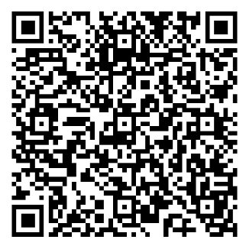
Access the Deck and Guide from the New England PTTC

Slide 80
Comments and questions?
Let’s talk.

Slide 81
Learning Objectives
Name everyday examples of harm reduction
Explain how harm reduction practices and services improve equity within the substance use disorder continuum of care
Learn practices for engaging people who use substances
Understand key features of both the Harm Reduction Guide for Prevention Professionals and Stack the Deck Rhode Island as a blueprint for your state
Learn next steps on state distribution of these resources

Slide 82
Samantha Bone, MS – Senior Consultant at PCG
sbone@pcgus.com
Scott Gagnon, MPP, PS-C – Former Director of New England PTTC, Regional Director (Region 1), SAMHSA
scott.gagnon@samhsa.hhs.gov

Slide 83
Thank you!
Please contact us with questions: Samantha Bone at sbone@pcgus.com and Scott Gagnon at scott.gagnon@samhsa.hhs.gov

